Slide 1
A Java-Based Versatile Micro Architectural Simulator
Website : www.cse.iitd.ac.in/tejas/
Supported by
Ministry of Information Technology,
Government of India

Slide 2
Session 1: Motivation and High Level Architecture | 08:30 to 09:00
Session 2: Simulating Different Architectural Components | 09:00 to 10:30
Session 3: Sample Use Cases and Hands-on Demo | 10:00 -- 11:30
Coffee break: 10:30 to 11:00
Session 4: Sister Projects of Tejas | 11:30 to 12:00

Slide 3
Session 1: Motivation and High Level Architecture | 08:30 to 09:00
Need for Architectural Simulators Need for Tejas High Level Architecture of Tejas
Session 2: Simulating Different Architectural Components | 09:00 to 10:30
Session 3: Sample Use Cases and Hands-on Demo | 10:00 -- 11:30
Coffee break: 10:30 to 11:00
Session 4: Sister Projects of Tejas | 11:30 to 12:00

Slide 4
Need for Architectural Simulators
Study the impact of different
components of a chip on the
application performance
Education
Research
Industry
Image Source: http://www.123rf.com/processor-scan.html

Slide 5
Session 1: Motivation and High Level Architecture | 08:30 to 09:00
Need for Architectural Simulators Need for Tejas High Level Architecture of Tejas
Session 2: Simulating Different Architectural Components | 09:00 to 10:30
Session 3: Sample Use Cases and Hands-on Demo | 10:00 -- 11:30
Coffee break: 10:30 to 11:00
Session 4: Sister Projects of Tejas | 11:30 to 12:00

Slide 6
Existing Architectural Simulators
Simics
GEM5
Sniper
Multi2Sim
Graphite
SESC
MARS
FastMP
C/C++: Platform Specific !!
Library
Build environment
Problems exacerbated when moving the simulation to a cloud !!

Slide 7
Existing Architectural Simulators
Simics
GEM5
Sniper
Multi2Sim
Graphite
SESC
MARS
FastMP
Implement both in the same package
Correctly Execute Program
Simulation Engine
Emulator
Simulator
ISA inflexibility
Bulky code

Slide 8
Why Tejas ?
WANTED
Simple
Flexible
Easy to use
Cloud compliant simulator
Platform Independence as a Design Goal
TEJAS: The Java-based Architectural Simulator
First architectural simulator written entirely in Java

Slide 9
Tejas: Family
Tejas
ParTejas
GPUTejas
TejasJava
Parallel Version of Tejas
Tejas for GPU’s
Tejas for Java
Used in 15 universities of India to teach computer architecture
Around 1000 users world wide

Slide 10
License
Apache license, version 2
Free to use
Free to modify
Free to re-distribute
You are more than welcome to contribute to Tejas ☺

Slide 11
Comparison with other simulators
Functionality
Out of Order pipeline, NOC, NUCA, GPU, DRAM, Full system simulation
Speed
Speedup of 25% over Multi2sim
Validation
Validated against actual hardware
Speedup of 220% over GEM5
Comparable with other simulators

Slide 12
Small Code Base
Others vs Tejas
Code base (Lines of code)
Tejas (32 K)
Sniper (76 K)
Multi2Sim (108 K)
GEM5 (170 K)
Almost similar functionalities
Image Source: www.picturespider.com

Slide 13
Why Java?
Programming Constructs
Generics, interfaces
Type Safety
Strongly Typed
Ease of Debugging
Rich debug information
Library Support
Efficient data structures
XML parsing
Intuitive IDEs
Control over casting
No pointer manipulations
String manipulations
Defects per line is 15-50% more in C++!
Debugging time can be six times more!! [Phipps 1999]

Slide 14
Speed: Java Vs C++
Dynamic Compilation: Associated with slow performance
Data-structures
Memory System: set associative cache
Event Queue: priority event queue
ROB: circular queue
C++ : g++(4.7.2), O3 optimization, STL
Java : JDK 7
Memory System
Event Queue
ROB

Slide 15
Session 1: Motivation and High Level Architecture | 08:30 to 09:00
Need for Architectural Simulators Need for Tejas High Level Architecture of Tejas
Session 2: Simulating Different Architectural Components | 09:00 to 10:30
Session 3: Sample Use Cases and Hands-on Demo | 10:00 -- 11:30
Coffee break: 10:30 to 11:00
Session 4: Sister Projects of Tejas | 11:30 to 12:00

Slide 16
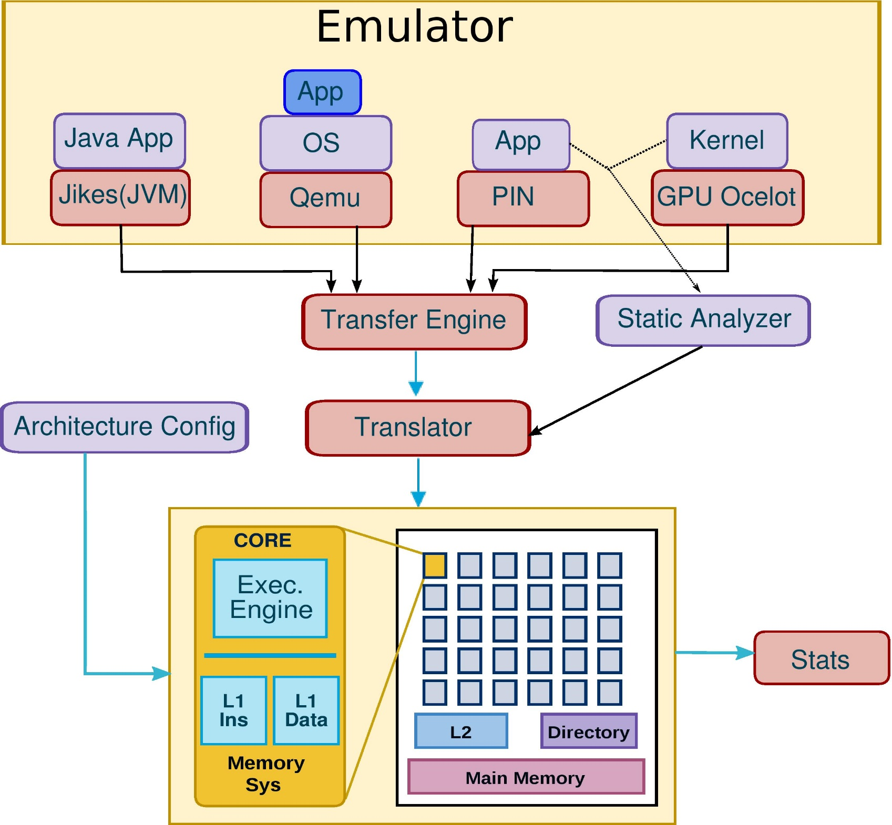
1. Emulator
2. Transfer Engine
3. Translator
(VISA)
X86, ARM, Byte code
VISA
4. Simulation Engine

Slide 17
Emulator (Black Box)
Emulator
Benchmark
Execution traces
Program counter
Memory (load, store)
Branch (taken, not-taken)
Synchronization
Thread create, destroy
Locks, barriers
X-86 application
Full system
GPU kernel
RISC-V application
Java bytecode
Correctly execute the benchmark

Slide 18
Emulators (Feeders for Tejas)
X86 App
App
Intel Pin
OS
Normal x86 applications
Qemu
Full system simulation
Kernel
GPU Ocelot
Java App
GPU workloads
Jikes RVM
Java applications
RISC V App
Spike
RISC V applications (work in progress)

Slide 19
Intel PIN Tool
Intel PIN is essentially an instrumentation engine for X86 programs. Uses DBT to add special hooks.
Load/store operation
Branch
Thread create/destroy
Understands executable formats and hence can be used to identify special functions in the executable
App
Intel PIN
Operating System
Hardware (x86/x86-64)
Software Stack

Slide 20
Intel PIN Tool
App
Intel PIN
Gives execution traces for x86 applications
Suitable for application-mostly suites such as SPEC, PARSEC, and Splash
Operating System
Hardware (x86/x86-64)
Software Stack

Slide 21
Intel PIN Tool
Pipeline (VISA)
X86 application
Execution
Traces
(X86 program)
Intel PIN
Tejas
Software Stack

Slide 22
Translation Engine
X86
ARM
MIPS
RISC V
Translator
VISA
Tejas’s ISA

Slide 23
Virtual Instruction Set Architecture
Classify all the operations of any assembly language into simple basic operations.
Instruction Class
Data Flow | Move | Load | Store
Integer Arithmetic | Integer ALU | Integer Multiplication | Integer Division
Float Arithmetic | Float ALU | Float Multiplication | Float Division
Control Flow | Unconditional Jump | Branch
Other | Exchange | NOP

Slide 24
Intel PIN
(x86 to VISA translation)
X86 instruction
Input Application (X86)
add %rax, (%rbx)
Translator
Input Application: X86
Simulation Engine: VISA
App
VISA instruction (static)
Emulator
VISA static
load <(%reg1), ?>, %tmpreg1
int-alu %reg0, %tmpreg1, %tmpreg1
store %tmpreg1, <(%reg1), ?>
Operating System
Runtime information
Fuse
Packet <IP,value,target>
(0x10, memread, 0x1234)
VISA instruction (dynamic)
VISA dynamic
load <(%reg1), 0x1234>, %tmpreg1
int-alu %reg0, %tmpreg1, %tmpreg1
store %tmpreg1, <(%reg1), 0x1234>

Slide 25
Coverage of the Translator
Static Coverage
Dynamic Coverage
Translator
Rating
Dynamic Coverage

Slide 26
Coverage of the Translator

Slide 27
Qemu (Full System Mode)
App1
App2
App1
App2
Guest
OS1
Guest
OS2
Guest OS
VMM
Guest H/W
Guest H/W
Qemu
Qemu
Native OS
Native OS
Native H/W
Native H/W
Important for studying the execution of different workloads in native as well as virtualized environments

Slide 28
Qemu Emulation
(Full System Mode)
Translation
App1
App2
Guest OS
Guest H/W
Qemu
ip, assembly, add rax, [rbx], rcx
ip, memread, addr X
Mapping Available ?
Yes
load [r1 (addr X)], tmp
int-alu r0, tmp, r2
Translate
And cache
Fuse
No

Slide 29
Qemu (Framework)
Traces contain:
Regular (memory, and branch)
Assembly text of each instruction
OS Events
System call ID
Interrupt ID
Privilege level switches in x86
Research specific (OS instrumentation)
App1
App2
Guest OS
Guest H/W
Qemu

Slide 30
Communication Channel
Benchmark
Communication channel
Emulator
Tejas Simulator
Written in C/C++/Java
Execution trace
Written in Java
Any communication channel only needs to follow rules in terms of the order in which the information is passed
Options: Shared memory, Network, and Files

Slide 31
Execution trace
Communication channel (Sequence of packets)
p3
p2
p1
…
Emulator
Simulator
Individual Packet
Program counter (64 bits) | Type of packet (64 bits) | Packet value (64 bits)
Assembly packet can have variable size
Single instruction can have multiple packets

Slide 32
Shared Memory
Benchmark
Synchronization: Peterson lock
Java interaction with shared memory: JNI
Emulator
Tejas (Simulator)
Producer
Consumer
control
used to transfer data
Shared memory segment (circular queue)

Slide 33
Network
Benchmark
Emulator
Tejas Simulator
Remote machine
Native machine
Network
(TCP Sockets)
Can be useful if the Emulator can run only on a particular machine.

Slide 34
File
Benchmark
Emulator
Trace file
Tejas Simulator
Machine X
Machine Y
Machine X and Machine Y can have completely different platform (hardware, software): Driver for clouds
Deterministic simulations: boon for debugging parallel programs
Implementation: GZip compressed (10X reduction in trace size)

Slide 35
Speed

Slide 36
Session 1: Motivation and High Level Architecture | 08:30 to 09:00
Session 2: Simulating Different Architectural Components | 09:00 to 10:30
Session 3: Sample Use Cases and Hands-on Demo | 10:00 -- 11:30
Coffee break: 10:30 to 11:00
Session 4: Sister Projects of Tejas | 11:30 to 12:00

Slide 37
Session 1: Motivation and High Level Architecture | 08:30 to 09:00
Session 2: Simulating Different Architectural Components | 09:00 to 10:30
Semi-Event Driven Model Simulating the Pipeline Simulating the Memory System Simulating the On-chip Interconnect Simulating the Off-Chip DRAM Simulation Tricks Validation and Performance Hacker’s Guide
Session 3: Sample Use Cases and Hands-on Demo | 10:00 -- 11:30
Coffee break: 10:30 to 11:00
Session 4: Sister Projects of Tejas | 11:30 to 12:00

Slide 38
Simulation Engine
Finite State Machines
Any chip can be viewed as a set of components
Whose functioning are defined by FSMs
Capable of communicating with each other
A
B
C
E
D
A
B
C
D
C1
cache
C2
directory
A
B
C
A
B
C
E
D
C4
core
C3
NOC

Slide 39
Simulation Engine
Iterative Model of Simulation
Expensive if each component is not accessed in each cycle !!
cycle : n
cycle : n+1
A
B
C
E
D
A
B
C
D
C1
C2
A
B
C
A
B
C
E
D
C4
C3

Slide 40
Simulation Engine
Event Driven Model of Simulation
cycle : 100
Event Queue
C1 : 105
C2 : 102
C1 : 100
A
B
C
E
D
C1
C2
C4
C3

Slide 41
Simulation Engine
Event Driven Model of Simulation
Expensive to modify the event queue !!
cycle : 100
cycle : 101
cycle : 102
Event Queue
C1 : 105
C2 : 102
A
B
C
E
D
A
B
C
D
C1
C2
C1 : 104
C4
C3

Slide 42
Simulation Engine
Iterative Model
Expensive when component is not active every cycle
Event Driven Model
Expensive when components are highly active
TEJAS : Semi – Event Driven Model
Iterative when simulating highly active components
Ex. Pipeline stages
Event-driven when simulating less active components
Ex. Caches, directories

Slide 43
Session 1: Motivation and High Level Architecture | 08:30 to 09:00
Session 2: Simulating Different Architectural Components | 09:00 to 10:30
Semi-Event Driven Model Simulating the Pipeline Simulating the Memory System Simulating the On-chip Interconnect Simulating the Off-Chip DRAM Simulation Tricks Validation and Performance Hacker’s Guide
Session 3: Sample Use Cases and Hands-on Demo | 10:00 -- 11:30
Coffee break: 10:30 to 11:00
Session 4: Sister Projects of Tejas | 11:30 to 12:00

Slide 44
On-chip Components
Core
Pipeline
Instruction Cache
Data Cache
Interconnect
Shared Cache
Memory Controller
Coherence

Slide 45
Pipeline
Core
Pipeline
Instruction Cache
Data Cache
Interconnect
Shared Cache
Memory Controller
Coherence

Slide 46
Branch Predictor
Execution model: (Emulator Simulator) ensures correct order of instructions
if (instruction-type=branch)
Pipeline flush is simulated by stalling the pipeline by a fixed number of cycles
State
Program counter
Predictor
Decision (taken/not-taken)
based on the state before
this insn
Taken/not taken

Slide 47
Branch Predictor Options
Simple: Perfect Predictor, No Predictor, Always taken, Always not-taken
Tournament
Bimodal
GAg, GAp, PAg, PAp
Gshare
Modern: TAGE
Takes 3-4 days to code a branch predictor in Tejas
State
Program counter
Predictor
Decision (taken/not-taken)
based on the state before
this insn
Taken/not taken

Slide 48
Multi-Issue Inorder Pipeline
Intel Pentium [Alpert ‘1993]
Fetch
Decode
Execute
Memory
Write-Back
Issue in-order as long as
No branch
No producer
No write to same destination
in this cycle

Slide 49
Out-of-Order Pipeline (9 stages + wakeup select logic)
Fetch
Decode
Rename
IW Push
Select
Execute
Wake-Up
Write-Back
Commit
Register Files
ROB
LSQ
IW

Slide 50
Wakeup-Select
Issue those instructions in IW with operands ready and FU available
Higher priority for older instructions
Wake up those instructions in IW waiting for this result
Fetch
Decode
Rename
IW Push
Select
Execute
Wake-Up
Write-Back
Commit
Register Files
ROB
LSQ
IW

Slide 51
Load-Store Forwarding
Load address ready : 0x10
LD ? | LD 0x30 | ST 0x20 | ST 0x10
LSQ
Tail
LSQ
Head

Slide 52
Load-Store Forwarding
Use this value to complete load
Search for store
LD 0x10 | LD 0x30 | ST 0x20 | ST 0x10
LSQ
Tail
LSQ
Head

Slide 53
Load-Store Forwarding
Store address ready : 0x10
LD 0x10 | LD 0x30 | ST 0x20 | ST ?
LSQ
Tail
LSQ
Head

Slide 54
Load-Store Forwarding
Use value to complete this load
Search for loads
LD 0x10 | LD 0x30 | ST 0x20 | ST 0x10
LSQ
Tail
LSQ
Head

Slide 55
Session 1: Motivation and High Level Architecture | 08:30 to 09:00
Session 2: Simulating Different Architectural Components | 09:00 to 10:30
Semi-Event Driven Model Simulating the Pipeline Simulating the Memory System Simulating the On-chip Interconnect Simulating the Off-Chip DRAM Simulation Tricks Validation and Performance Hacker’s Guide
Session 3: Sample Use Cases and Hands-on Demo | 10:00 -- 11:30
Coffee break: 10:30 to 11:00
Session 4: Sister Projects of Tejas | 11:30 to 12:00

Slide 56
Memory hierarchy
Core
Pipeline
Instruction Cache
Data Cache
Interconnect
Shared Cache
Memory Controller
Coherence

Slide 57
Memory System
Highly configurable caches
Thorough Miss Status Holding Register (MSHR) design
Flexibility to create a graph of caches to form the memory system

Slide 58
Specifying Memory Hierarchy
L1 (private caches)
L2
L3
Root: Main memory
Inverted Tree

Slide 59
Example Configurations
Core 0
I D
L2
Core 1
I D
L2
Core 2
I D
L2
Core 3
I D
L2
Core 0
I D
L2
Core 1
I D
L2
Core 2
I D
L2
Core 3
I D
L2
L3 cache
L3 (0)
L3 (1)
L3 (2)
L3 (3)
ConfigurationA (Private L2)
Core 0
I D
L2
Core 1
I D
L2
Core 2
I D
L2
Core 3
I D
L2
Core 0 Core1
I D I D
L2
Core 2 Core3
I D I D
L2
L3 (4)
L3 (5)
L3 (6)
L3 (7)
L3 cache
ConfigurationB
(L2 shared between 2 cores)
ConfigurationC
(L3 is broken down (NUCA))

Slide 60
Non Uniform Cache Access (NUCA)
L1
Placement, Migration and Replacement
UCA
Sets
L2
NUCA
L2
L2
L2
L2
- SNUCA: Find memory element based on the bits in the address field
- DNUCA: Allow caches to migrate data based on usage patterns
L2
L2
L2
L2
Lower Level Memory

Slide 61
Coherence
Core
Pipeline
Instruction Cache
Data Cache
Interconnect
Shared L2 Cache
Memory Controller
Coherence

Slide 62
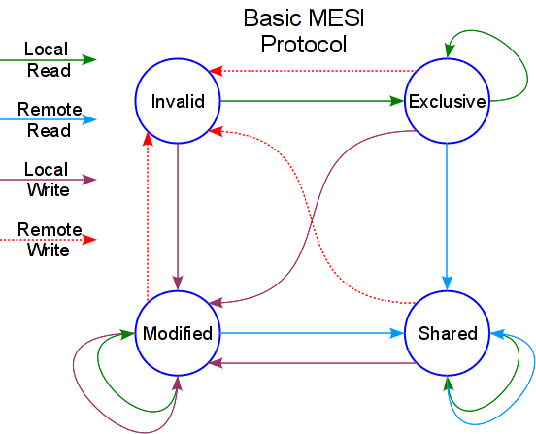
Coherence Protocol (MESI: Directory)
Simple 4-state textbook protocol does not capture the complexity of a real world system with complexities such as NUCA and NOC
H/W approach: 100’s of states
Simulating so many states would make the code bulky and difficult to maintain. Idea is to use code simple textbook protocol and use a ‘corrective’ operation when an inconsistency is found
Corrective operations form 0.001% of the total coherence operations
Image Reference: http://sc.tamu.edu/systems/eos/hardware.php

Slide 63
Session 1: Motivation and High Level Architecture | 08:30 to 09:00
Session 2: Simulating Different Architectural Components | 09:00 to 10:30
Semi-Event Driven Model Simulating the Pipeline Simulating the Memory System Simulating the On-chip Interconnect Simulating the Off-Chip DRAM Simulation Tricks Validation and Performance Hacker’s Guide
Session 3: Sample Use Cases and Hands-on Demo | 10:00 -- 11:30
Coffee break: 10:30 to 11:00
Session 4: Sister Projects of Tejas | 11:30 to 12:00

Slide 64
Interconnect
Core
Pipeline
Instruction Cache
Data Cache
Interconnect
Shared L2 Cache
Memory Controller
Coherence

Slide 65
Inter-connect: BUS and NOC
Core 1
Core 2
Core 3
Core 4
Core 5
Core 6
Core 7
Core 8
BUS
Shared L2 Cache
Core 1
Core 2
Core 3
Core 4
L2 1
L2 2
L2 3
L2 4
Core 1
Core 2
Core 3
Core 4
L2 1
L2 2
L2 3
L2 4
NOC

Slide 66
Network On Chip
R.port.put(msg)
Same Network
Interface
Different Network
Interface
Sender ‘S’
Receiver ‘R’
Interconnect

Slide 67
Network On Chip
Interconnect
Bus
Network
Medium
Electrical
Optical
Routing Algorithm
Simple West first
North last Negative first
Topology
Mesh Torus Ring Bus
Fat Tree Butterfly Omega
Route Selection
Static
Adaptive (based on congestion)

Slide 68
Network On Chip
Bandwidth governed by
Flit width
Flow control provided by
Router buffer size
Number of router ports
Any SimulationElement can communicate with another through the NOC
Deadlock Avoidance
Prioritizing messages

Slide 69
Session 1: Motivation and High Level Architecture | 08:30 to 09:00
Session 2: Simulating Different Architectural Components | 09:00 to 10:30
Semi-Event Driven Model Simulating the Pipeline Simulating the Memory System Simulating the On-chip Interconnect Simulating the Off-Chip DRAM Simulation Tricks Validation and Performance Hacker’s Guide
Session 3: Sample Use Cases and Hands-on Demo | 10:00 -- 11:30
Coffee break: 10:30 to 11:00
Session 4: Sister Projects of Tejas | 11:30 to 12:00

Slide 70
Tejas DRAM Implementation
Salient features:
Modelled all DRAM timing parameters
Cycle accurate (verified against DRAMSim 2)
Multiple physical channels supported
Support for Open page, Close page policies
DDR2/DDR3 can be modelled by supplying appropriate timing parameters
Semi-event driven model

Slide 71
Block diagram showing the flow of events
MainMemoryDRAMController
Request (read/write)
Address Mapping
pending queue
L2 Cache
At RAM Clock
MemoryResponse
MainMemoryBusPacket
CommandQueue
RamBus (address)
Rank_Response
Ranks

Slide 72
Block diagram
Package: dram
Pipeline
Main Memory Controller
Ranks
Cache miss event
Address
Mapping
Bank States
Rank k
Caches
Rank 1
Rank 0
Response
event
REF
PRE
CAS
RAS
DATA
Directory
Refresh
Generate
Command
Scheduling
Bank States
NoC
CMD
Command Queue
Basic block diagram for Tejas-DRAM

Slide 73
Session 1: Motivation and High Level Architecture | 08:30 to 09:00
Session 2: Simulating Different Architectural Components | 09:00 to 10:30
Semi-Event Driven Model Simulating the Pipeline Simulating the Memory System Simulating the On-chip Interconnect Simulating the Off-Chip DRAM Simulation Tricks Validation and Performance Hacker’s Guide
Session 3: Sample Use Cases and Hands-on Demo | 10:00 -- 11:30
Coffee break: 10:30 to 11:00
Session 4: Sister Projects of Tejas | 11:30 to 12:00

Slide 74
Cache Locality: Block of Instructions
Instruction
Emulation
Data transfer
Translation
Simulation
Large piece of code: i-cache and d-cache miss
Approach: Operate at a granularity of 50 instructions
Block of Instruction
Emulation
Data transfer
Translation
Simulation

Slide 75
GC Overhead
Automated way of allocating and de-allocating objects
Heap Memory
Translation
VISA
Java
Fetch
Malloc’ed objects
……..
Commit
No de-allocate routine !!

Slide 76
GC Overhead
Automated way of allocating and de-allocating objects
Heap Memory
Translation
Java
Fetch
……..
Malloc’ed objects
Commit
Garbage Collector
Image source: www.sjbparish.com

Slide 77
Approach1: Pooling of Objects
Pre-allocate a pool of objects
Borrow from pool
Translation
VISA
VISA
Fetch
VISA
VISA
……..
Commit
Return to pool
Data footprint remains bounded

Slide 78
Approach2: Event Re-use
Modify and re-use the same object
A
Router 1
Message (A, B) : <A, Router1>
Router 2
Message (A, B) : <Router1, Router2>
NOC
Router 3
Message (A, B) : <Router2, Router3>
Router 4
Message (A, B) : <Router3, Router4>
B

Slide 79
Session 1: Motivation and High Level Architecture | 08:30 to 09:00
Session 2: Simulating Different Architectural Components | 09:00 to 10:30
Semi-Event Driven Model Simulating the Pipeline Simulating the Memory System Simulating the On-chip Interconnect Simulating the Off-Chip DRAM Simulation Tricks Validation and Performance Hacker’s Guide
Session 3: Sample Use Cases and Hands-on Demo | 10:00 -- 11:30
Coffee break: 10:30 to 11:00
Session 4: Sister Projects of Tejas | 11:30 to 12:00

Slide 80
Validation (Dell PowerEdge R620 server)
Machine
Intel XEON 2620 (2GHz)
µ-arch
Sandybridge
# cores
24
LLC
15 MB
RAM
Multi-threading / DVFS
31 GB
No
JRE
Java 7

Slide 81
Validation : Serial Workloads (SPEC CPU2006)
27%
11.45%

Slide 82
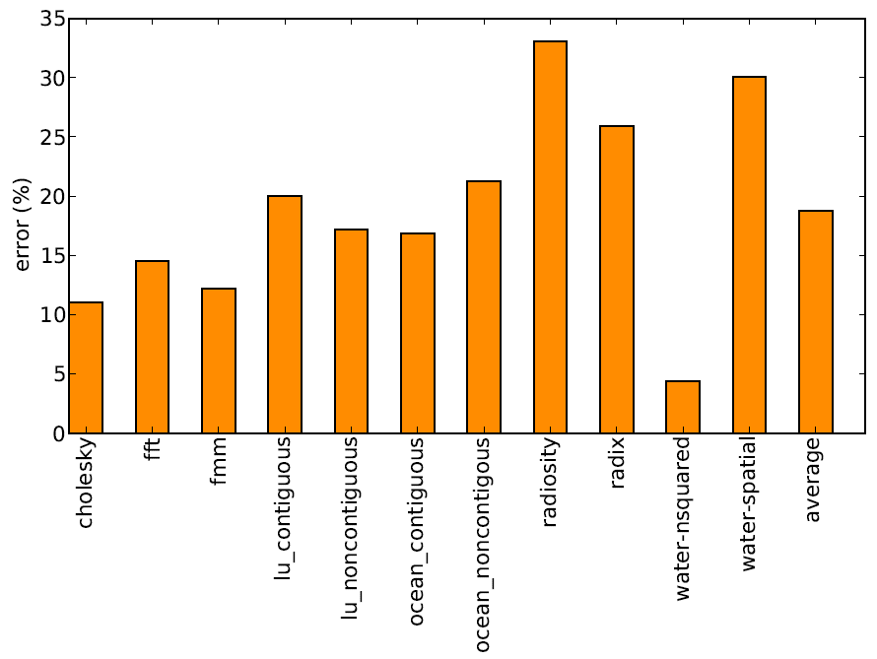
Validation : Parallel Workloads (SPLASH 2)
33%
18.77%

Slide 83
Comparison with other simulators
Simulator | Benchmark Suite | Average Absolute Error % | Max. Absolute Error%
MARSS | SPEC 2006 | 23.46 % | 59.2 %
FastMP | SPEC 2006 | 9.56 % | 40 %
Tejas | SPEC 2006 | 11.45 % | 27 %
Sniper | SPLASH-2 | 25 % | 59.3 %
Tejas | SPLASH-2 | 18.77 % | 33 %

Slide 84
Performance : Serial Workloads (SPEC CPU2006)
220 % faster than GEM5
25 % faster than Multi2Sim

Slide 85
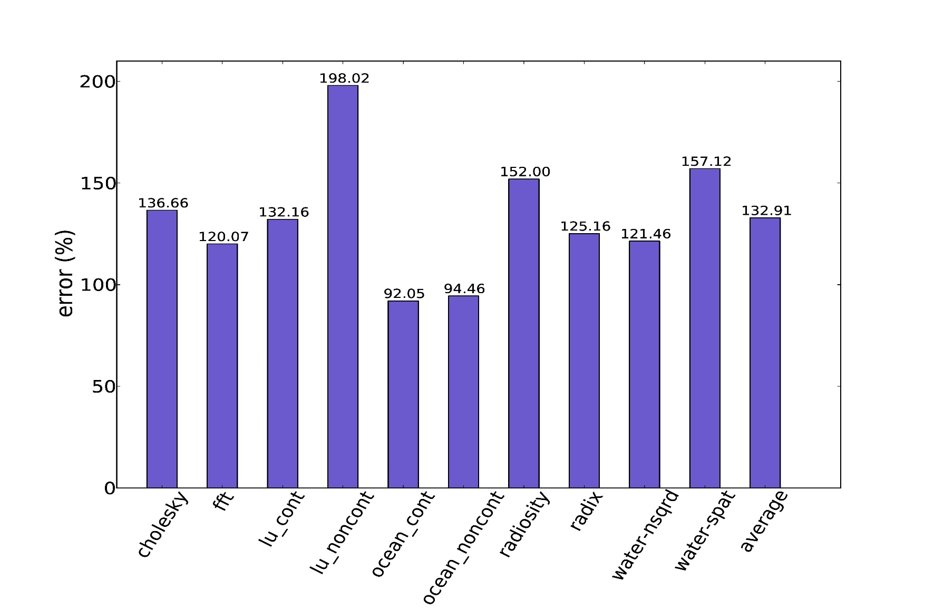
Performance : Parallel Workloads (SPLASH 2)
132 KIPS

Slide 86
Full system simulations

Slide 87
Overall Picture of the Infrastructure

Slide 88
The Kernels
Linux FreeBSD OpenBSD
3.13.0 9.2.0 5.5

Slide 89
Workloads
Network:
ISCP: Secure copy file from remote machine to local machine (SCP)
OSCP: Secure copy file from local machine to remote machine (SCP)
Database:
OLTP: Online Transaction Processing (Sysbench benchmark suite)
File system
Find: File system browsing (Utility application Find)
File IO: Random reads and writes to file (Sysbench benchmark suite)
Memory intensive
MemorySB: Multiple threads perform random read/write to memory (Sysbench benchmark suite)

Slide 90
CPU Spec
Intel® Xeon® Processor X5650 (2 CPUs: 6 cores each)
Nehalem Micro architecture
Frequency: 2.66 GHz
L1 – 32KB, ICache – 32KB
L2 – 256KB
L3 – 12MB (Shared)

Slide 91
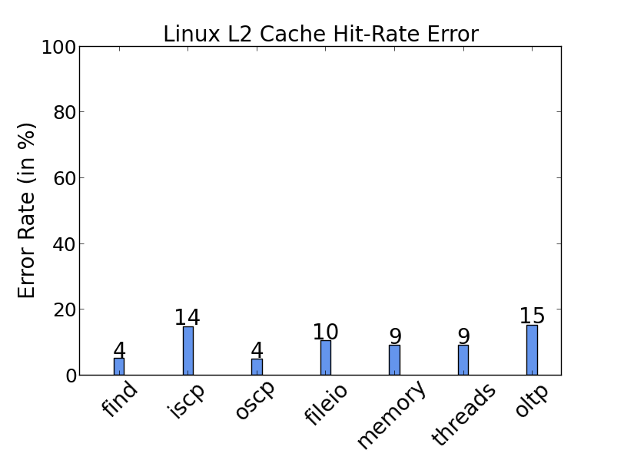
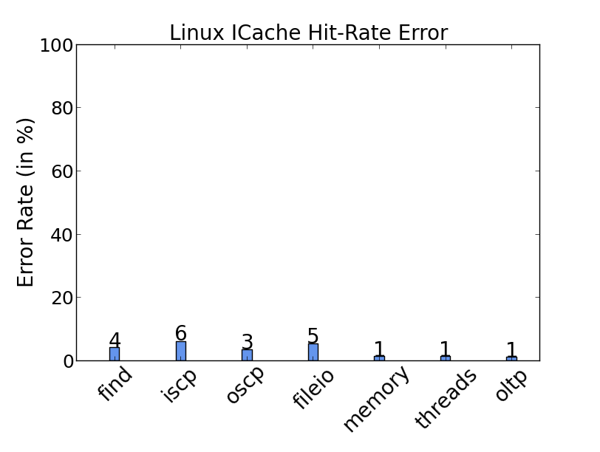
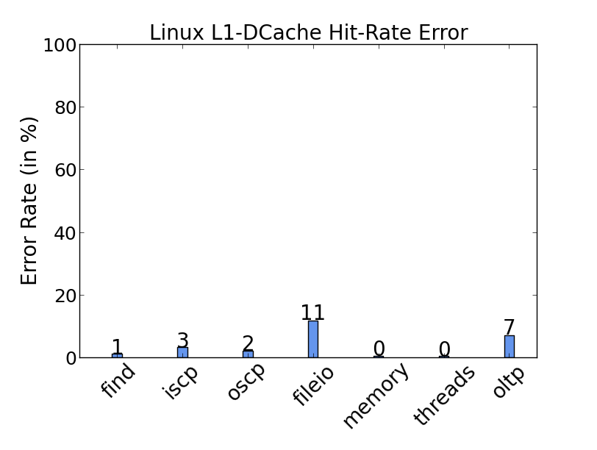
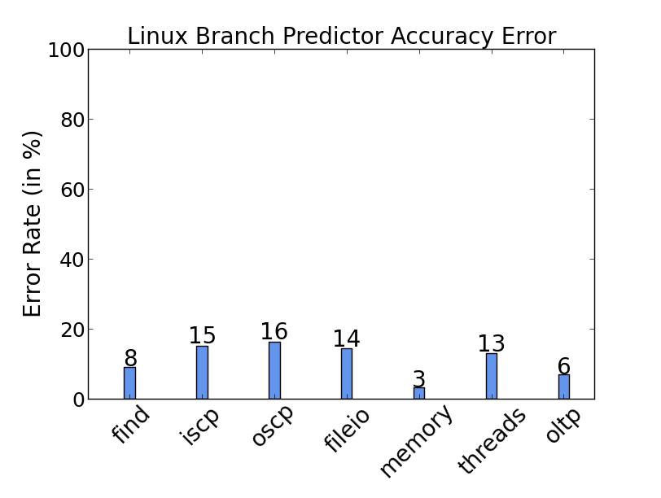
Linux Statistics Validation
Average Error = 15%
Average Error = 9.3%
Average Error = 3%
Average Error = 3.5%
Average Error = 10.7%

Slide 92
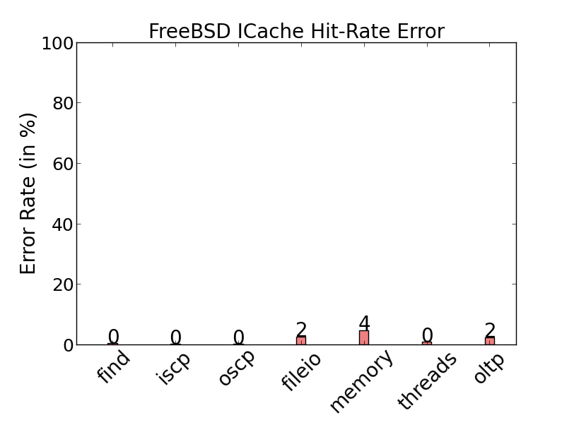
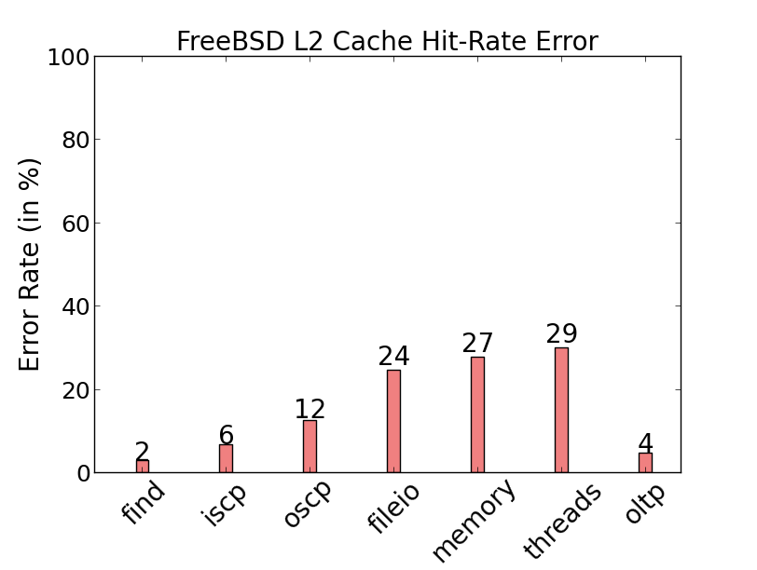
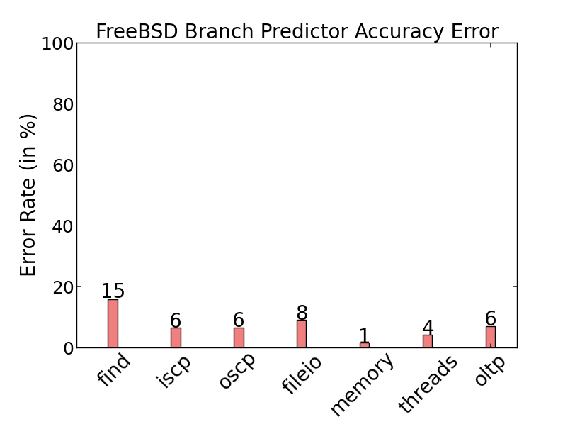
FreeBSD Statistics Validation
Average Error = 14.1%
Average Error = 0.9%
Average Error = 14.9%
Average Error = 6.6%

Slide 93
OpenBSD Statistics Validation
Time command to measure CPU time
Average Error = 12.7%

Slide 94
Session 1: Motivation and High Level Architecture | 08:30 to 09:00
Session 2: Simulating Different Architectural Components | 09:00 to 10:30
Semi-Event Driven Model Simulating the Pipeline Simulating the Memory System Simulating the On-chip Interconnect Simulating the Off-Chip DRAM Simulation Tricks Validation and Performance Hacker’s Guide
Session 3: Sample Use Cases and Hands-on Demo | 10:00 -- 11:30
Coffee break: 10:30 to 11:00
Session 4: Sister Projects of Tejas | 11:30 to 12:00

Slide 95
At the Highest Level
main.ArchitecturalComponent.createChip();
while (simulation is not complete) {
for each benchmark thread {
get trace from emulator
translate to VISA
}
while more VISA instructions to simulate{
for each benchmark thread {
simulate corresponding core
}
clock++
}
}
Notes:
Talk about how each benchmark thread is simulated on a separate core

Slide 96
At the Highest Level
main.ArchitecturalComponent.createChip();
while (simulation is not complete) {
for each benchmark thread {
get trace from emulator
translate to VISA
}
while more VISA instructions to simulate{
for each benchmark thread {
simulate corresponding core for 1 cycle
}
clock++
}
}
Create components and establish links between them

Slide 97
At the Highest Level
main.ArchitecturalComponent.createChip();
while (simulation is not complete) {
for each benchmark thread {
get trace from emulator
translate to VISA
}
while more VISA instructions to simulate{
for each benchmark thread {
simulate corresponding core
}
clock++
}
}
Get data from the emulator and translate instructions to VISA format
Notes:
Talk about how each benchmark thread is simulated on a separate core

Slide 98
At the Highest Level
main.ArchitecturalComponent.createChip();
while (simulation is not complete) {
for each benchmark thread {
get trace from emulator
translate to VISA
}
while more VISA instructions to simulate{
for each benchmark thread {
simulate corresponding core
}
clock++
}
}
Feed VISA instructions to pipeline and increment simulation clock
Notes:
Talk about how each benchmark thread is simulated on a separate core

Slide 99
At the Highest Level
main.ArchitecturalComponent.createChip();
while (simulation is not complete) {
for each benchmark thread {
get trace from emulator
translate to VISA
}
while more VISA instructions to simulate{
for each benchmark thread {
simulate corresponding core for 1 cycle
}
clock++
}
}
Create components and establish links between them

Slide 100
main.ArchitecturalComponent.createChip()
Cores
Private caches
Shared caches
Coherence elements
Memory controllers
Interconnect
DRAM
Connect the elements

Slide 101
main.ArchitecturalComponent.createChip()
Cores
Private caches
Shared caches
Coherence elements
Memory controllers
Interconnect
DRAM
Create the Memory Hierarchy

Slide 102
At the Highest Level
main.ArchitecturalComponent.createChip();
while (simulation is not complete) {
for each benchmark thread {
get trace from emulator
translate to VISA
}
while more VISA instructions to simulate{
for each benchmark thread {
simulate corresponding core for 1 cycle
}
clock++
}
}

Slide 103
emulatorinterface.RunnableThread
for each thread {
ipcBase.fetchManyPackets()
for each packet {
ObjParser.fuseInstruction()
}
}

Slide 104
emulatorinterface.RunnableThread
for each thread {
ipcBase.fetchManyPackets()
for each packet {
ObjParser.fuseInstruction()
}
}
IpcBase
FilePacket
SharedMem
Network
Pipe

Slide 105
emulatorinterface.RunnableThread
for each thread {
ipcBase.fetchManyPackets()
for each packet {
ObjParser.fuseInstruction()
}
}
VISA static
VISA instruction (static)
load <(%reg1), ?>, %tmpreg1
int-alu %reg0, %tmpreg1, %tmpreg1
store %tmpreg1, <(%reg1), ?>
Runtime information
Fuse
Packet <IP,value,target>
(0x10, memread, 0x1234)
VISA instruction (dynamic)
VISA dynamic
load <(%reg1), 0x1234>, %tmpreg1
int-alu %reg0, %tmpreg1, %tmpreg1
store %tmpreg1, <(%reg1), 0x1234>

Slide 106
At the Highest Level
main.ArchitecturalComponent.createChip();
while (simulation is not complete) {
for each benchmark thread {
get trace from emulator
translate to VISA
}
while more VISA instructions to simulate{
for each benchmark thread {
simulate corresponding core for 1 cycle
}
clock++
}
}

Slide 107
emulatorinterface.RunnableThread
void runPipelines() {
while more VISA instructions to simulate{
for each benchmark thread t {
pipelineInterfaces[t].oneCycleOperation()
}
clock++
}
}

Slide 108
pipeline.outoforder.OutOfOrderPipeline.java
void oneCycleOperation() {
performCommits();
performWriteBack();
performSelect();
processEvents();
performIWPush();
performRename();
performDecode();
performFetch();
}

Slide 109
pipeline.outoforder.OutOfOrderPipeline.java
void oneCycleOperation() {
performCommits();
performWriteBack();
performSelect();
processEvents();
performIWPush();
performRename();
performDecode();
performFetch();
}
Iterative Model: done every cycle

Slide 110
pipeline.outoforder.OutOfOrderPipeline.java
void oneCycleOperation() {
performCommits();
performWriteBack();
performSelect();
processEvents();
performIWPush();
performRename();
performDecode();
performFetch();
}
Discrete Event Simulator Model
Notes:
Talk about per core event queue. It offers scalability.

Slide 111
Discrete Event Simulator Model: Example (pipeline.outoforder.IWEntry.java)
eventQ.addEvent( //at time of issue
new ExecCompleteEvent(
curTime+FU_latency, //event time
IW, //requester
executer, //processor
RequestType.EXEC_COMPLETE,//event type
associatedROBEntry)); //payload
Event
Address Carrying
ExecComplete
NOC
Notes:
Different instructions take different times to execute

Slide 112
SimulationElement
class generic.SimulationElement {
public abstract void handleEvent(event);
generic.Port port;
generic.CommunicationInterface comInterface;
public void sendEvent(event);
}

Slide 113
Global Event Queue
void addEvent (Event e) {
timedQueue.add(e.getTime())
}
void processCyclesForCycle(long c) {
while (true) {
events = getEventsForCycle(c)
if (events==NULL) {
break
} else {
for (event e: events) {
e.getProcessingElement.handleEvent(e)
}
}
}
}

Slide 114
Discrete Event Simulator Model: Example
void handleEvent(event) {//called by processEvents
if event type is RequestType.EXEC_COMPLETE {
handleExecutionCompletion(event);
}
}
void handleExecutionCompletion(event) {
event.associatedROBEntry.setExecuted(true);
}
File: pipeline.outoforder.ExecutionLogic.java
Notes:
handleEvent is invoked at curTime+FU_lat by processEvents()

Slide 115
SimulationElement
class generic.SimulationElement {
public abstract void handleEvent(event);
generic.Port port;
generic.CommunicationInterface comInterface;
public void sendEvent(event);
}

Slide 116
Ports of SimulationElements
class generic.Port {
PortType portType; //Unlimited or FCFS
int noOfPorts;
long latencyOfConnectedElement;
long occupancy;
long[] portBusyUntil;
public void put() {
find earliest time T that a port is free
set event time to T
add event to event queue
}

Slide 117
SimulationElement: ComInterface
class generic.SimulationElement {
public abstract void handleEvent(event);
generic.Port port;
generic.CommunicationInterface comInterface;
public void sendEvent(event) {
dest = event.getProcessingElement
if dest.getComInterface == this.getComInterface {
dest.getPort.put(event);
} else {
this.getComInterface.sendMessage(event);
}
}

Slide 118
SimulationElement: ComInterface
class generic.SimulationElement {
public abstract void handleEvent(event);
generic.Port port;
generic.CommunicationInterface comInterface;
public void sendEvent(event) {
dest = event.getProcessingElement
if dest.getComInterface == this.getComInterface {
dest.getPort.put(event);
} else {
this.getComInterface.sendMessage(event);
}
}
If they use the same interface to connect to the chip interconnect, we can access this component directly

Slide 119
SimulationElement: ComInterface
class generic.SimulationElement {
public abstract void handleEvent(event);
generic.Port port;
generic.CommunicationInterface comInterface;
public void sendEvent(event) {
dest = event.getProcessingElement
if dest.getComInterface == this.getComInterface {
dest.getPort.put(event);
} else {
this.getComInterface.sendMessage(event);
}
}
Let the interconnect handle delivering the message to the destination element

Slide 120
Example: Cache Access
void handleAccess(addr, request_type, event) {
CacheLine cl = accessAndMark(addr);
if (cl != null)
cacheHit(addr, requestType, cl, event);
else {
if (this.mycoherence != null) {
if (request_type == Cache_Write)
mycoherence.writeMiss(addr, this);
else if (request_type == Cache_Read)
mycoherence.readMiss(addr, this);
} else
sendRequestToNextLevel(addr, Cache_Read);
mshr.addToMSHR(event);
}
}

Slide 121
Example: Cache Access
void handleAccess(addr, request_type, event) {
CacheLine cl = accessAndMark(addr);
if (cl != null)
cacheHit(addr, requestType, cl, event);
else {
if (this.mycoherence != null) {
if (request_type == Cache_Write)
mycoherence.writeMiss(addr, this);
else if (request_type == Cache_Read)
mycoherence.readMiss(addr, this);
} else
sendRequestToNextLevel(addr, Cache_Read);
mshr.addToMSHR(event);
}
}
Send response to requester through this.sendEvent()
If coherent cache, and if it is a write request, inform coherence of write hit. Again through this.sendEvent()

Slide 122
Example: Cache Access
Request coherence for line through this.sendEvent()
void handleAccess(addr, request_type, event) {
CacheLine cl = accessAndMark(addr);
if (cl != null)
cacheHit(addr, requestType, cl, event);
else {
if (this.mycoherence != null) {
if (request_type == Cache_Write)
mycoherence.writeMiss(addr, this);
else if (request_type == Cache_Read)
mycoherence.readMiss(addr, this);
} else
sendRequestToNextLevel(addr, Cache_Read);
mshr.addToMSHR(event);
}
}

Slide 123
Example: Cache Access
Request next level cache or main memory through this.sendEvent()
void handleAccess(addr, request_type, event) {
CacheLine cl = accessAndMark(addr);
if (cl != null)
cacheHit(addr, requestType, cl, event);
else {
if (this.mycoherence != null) {
if (request_type == Cache_Write)
mycoherence.writeMiss(addr, this);
else if (request_type == Cache_Read)
mycoherence.readMiss(addr, this);
} else
sendRequestToNextLevel(addr, Cache_Read);
mshr.addToMSHR(event);
}
}

Slide 124
Example: Cache Access
void handleAccess(addr, request_type, event) {
CacheLine cl = accessAndMark(addr);
if (cl != null)
cacheHit(addr, requestType, cl, event);
else {
if (this.mycoherence != null) {
if (request_type == Cache_Write)
mycoherence.writeMiss(addr, this);
else if (request_type == Cache_Read)
mycoherence.readMiss(addr, this);
} else
sendRequestToNextLevel(addr, Cache_Read);
mshr.addToMSHR(event);
}
}

Slide 125
Session 1: Motivation and High Level Architecture | 08:30 to 09:00
Session 2: Simulating Different Architectural Components | 09:00 to 10:30
Session 3: Sample Use Cases and Hands-on Demo | 10:00 -- 11:30
Coffee break: 10:30 to 11:00
Session 4: Sister Projects of Tejas | 11:30 to 12:00

Slide 126
Session 1: Motivation and High Level Architecture | 08:30 to 09:00
Session 2: Simulating Different Architectural Components | 09:00 to 10:30
Session 3: Sample Use Cases and Hands-on Demo | 10:00 -- 11:30
Practical Experiences of using Tejas for Research Practical Experiences of using Tejas for Teaching Hands-on Demo
Coffee break: 10:30 to 11:00
Session 4: Sister Projects of Tejas | 11:30 to 12:00

Slide 127
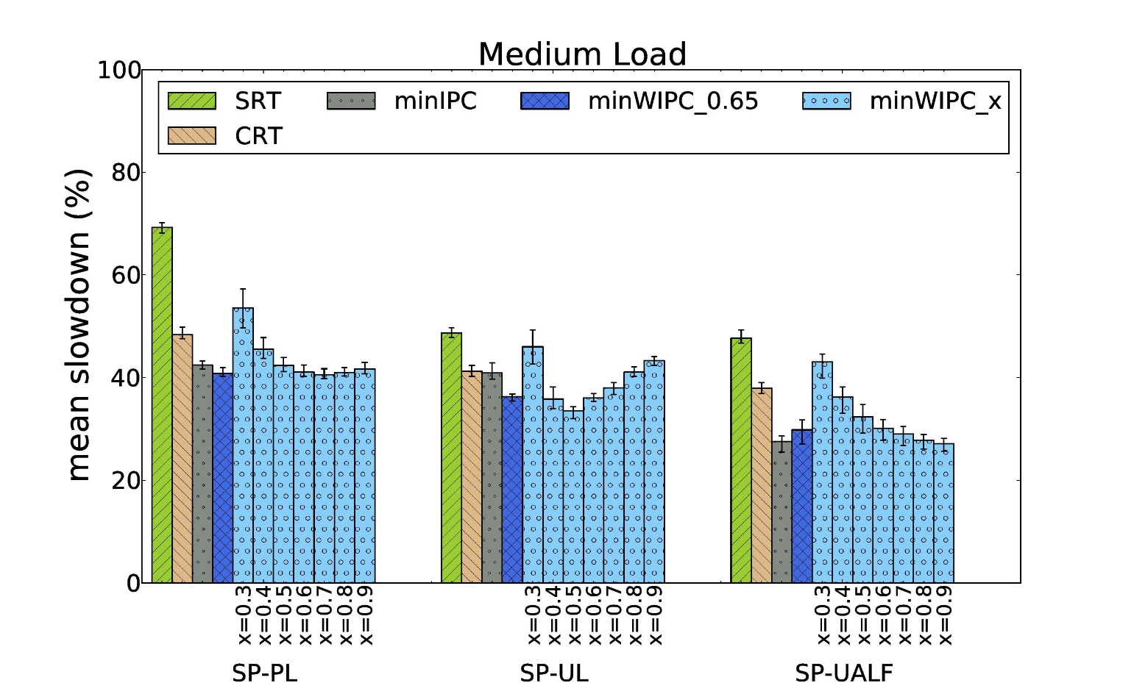
Efficient Detection of Soft Errors in Manycore Processors
“FluidCheck: A Redundant Threading based Approach for Reliable Execution in Manycore Processors”, Kalayappan et al, TACO 2016.

Slide 128
Instruction Prefetching Scheme for OS Intensive Applications (MICRO 2016)
Non-privileged: Application
Privileged: OS
OS Events
Execution block of 125 functions
HyperTask
1) System call
2) Interrupt (top-half)
3) Interrupt (bottom-half)
4) Schedule routine
Time

Slide 129
Optical Overlay NUCA: A High Speed Substrate for Shared L2 Caches
Published in HiPC 2014
Excerises NUCA
32 cores and 32 L2 cache banks connected through optical interconnects
Optical NUCA protocols at L2 level
NUCA messages are passed through optical interconnects
Dynamic creation of bank sets
Based on benchmark characteristics to improve cache utilization and hit rate

Slide 130
ColdBus - A Near-Optimal Power Efficient Optical Bus
Published in HiPC 2015
Uses optical NOC
On chip electrical interconnects are replaced by optical interconnects
Fast but not energy efficient
This work proposes to use optical network reconfiguration
At regular intervals
Based on network usage prediction
Predictor uses load/store memory address
Reduce optical output power during low activity period

Slide 131
BigBus : A scalable optical interconnect
Published in DATE 2016
Optical NOC
768 cores and 256 L2 cache banks
Energy efficient, scalable optical interconnect
Multi level interconnect to save energy
Network activity prediction
Intelligent placements of cores and cache banks

Slide 132
Session 1: Motivation and High Level Architecture | 08:30 to 09:00
Session 2: Simulating Different Architectural Components | 09:00 to 10:30
Session 3: Sample Use Cases and Hands-on Demo | 10:00 -- 11:30
Practical Experiences of using Tejas for Research Practical Experiences of using Tejas for Teaching Hands-on Demo
Coffee break: 10:30 to 11:00
Session 4: Sister Projects of Tejas | 11:30 to 12:00

Slide 133
Course Aid for CSL718: Architecture of High Performance Computers at IIT Delhi

Slide 134
Understanding the Working of a Cache
To design micro-benchmarks and simulate them on Tejas. The benchmarks must have the following properties:
100% misses, with most capacity misses
Increasing the L1 d-cache block size improves hit rate
Increasing the L1 d-cache block size degrades hit rate
Increasing the L1 d-cache associativity improves hit rate
Write through better than write back, in terms of L1-L2 traffic
Write back better than write through, in terms of L1-L2 traffic

Slide 135
Load Store Predictors
Implement and evaluate
anyStore: “Memory Dependence Prediction Using Store Sets”, Chrysos et al., ISCA 98.
pairLS: “Dynamic Speculation and Synchronization of Data Dependences”, Moshovos et al., ISCA 97.
Load address ready : 0x10
LD ? | LD 0x30 | ST 0x20 | ST 0x10
LSQ
Tail
LSQ
Head

Slide 136
Odd-Even Routing
“The odd-even turn model for adaptive routing”, Chiu, TPDS 2000.

Slide 137
Reactive NUCA
“Reactive NUCA: near-optimal block placement and replication in distributed caches”, Hardavellas et al., ISCA 2009.

Slide 138
Session 1: Motivation and High Level Architecture | 08:30 to 09:00
Session 2: Simulating Different Architectural Components | 09:00 to 10:30
Session 3: Sample Use Cases and Hands-on Demo | 10:00 -- 11:30
Practical Experiences of using Tejas for Research Practical Experiences of using Tejas for Teaching Hands-on Demo
Coffee break: 10:30 to 11:00
Session 4: Sister Projects of Tejas | 11:30 to 12:00

Slide 139
Installing Tejas

Slide 140
Performing ROI Simulations

Slide 141
Region-of-interest Simulations
Number of instructions
Special functions

Slide 142
ROI Simulations
<Configuration>
…
<Simulation>
…
<subsetSim>false</subsetSim>
<numInsToIgnore>0</numInsToIgnore>
<subsetSimSize>0</subsetSimSize>
<markerFunctions>false<markerFunctions>
<startSimMarker></startSimMarker>
<endSimMarker></endSimMarker>
<Simulation>
…
</Configuration>

Slide 143
ROI Simulations
Set subsetSim to true to simulate execution block specified in terms of number of instructions
<Configuration>
…
<Simulation>
…
<subsetSim>false</subsetSim>
<numInsToIgnore>0</numInsToIgnore>
<subsetSimSize>0</subsetSimSize>
<markerFunctions>false<markerFunctions>
<startSimMarker></startSimMarker>
<endSimMarker></endSimMarker>
<Simulation>
…
</Configuration>
Number of instructions
Benchmark start
Ignore
Simulate

Slide 144
ROI Simulations
Set markerFunctions to true to simulate execution block whose start and end are special functions
<Configuration>
…
<Simulation>
…
<subsetSim>false</subsetSim>
<numInsToIgnore>0</numInsToIgnore>
<subsetSimSize>0</subsetSimSize>
<markerFunctions>false<markerFunctions>
<startSimMarker>f_start</startSimMarker>
<endSimMarker>f_end</endSimMarker>
<Simulation>
…
</Configuration>

Slide 145
Deterministic Simulations Using Files
Execute benchmark and collect traces
Run simulations using trace files

Slide 146
Storing Execution Traces in a File
$ java –jar tejas.jar config.xml statfile ./benchmark.o

Slide 147
Storing Execution Traces in a File
$ java –jar tejas.jar config.xml statfile ./benchmark.o
<Configuration>
<Emulator>
…
<EmulatorType>pin</EmulatorType>
<CommunicationType>file</CommunicationType>
<StoreExecutionTracesInAFile>true</StoreExecutionTracesInAFile>
<BasenameForTraceFiles>/home/guest/bm<BasenameForTraceFiles>
…
</Emulator>
…
</Configuration>

Slide 148
Storing Execution Traces in a File
$ java –jar tejas.jar config.xml statfile ./benchmark.o
<Configuration>
<Emulator>
…
<EmulatorType>pin</EmulatorType>
<CommunicationType>file</CommunicationType>
<StoreExecutionTracesInAFile>true</StoreExecutionTracesInAFile>
<BasenameForTraceFiles>/home/guest/bm<BasenameForTraceFiles>
…
</Emulator>
…
</Configuration>
Traces: /home/guest/bm_*.gz
Number of files: Number of threads
Trace file for thread #x: /home/guest/bm_x.gz

Slide 149
Simulation Using Trace Files
$ java –jar tejas.jar config.xml statfile /home/guest/bm
<Configuration>
<Emulator>
…
<EmulatorType>pin</EmulatorType>
<CommunicationType>file</CommunicationType>
<StoreExecutionTracesInAFile>false</StoreExecutionTraceInAFile>
<BasenameForTraceFiles><BasenameForTraceFiles>
…
</Emulator>
…
</Configuration>

Slide 150
Performing Full-system Simulations

Slide 151
Qemu (Full System Mode)
App1
App2
App1
App2
Guest
OS1
Guest
OS2
Guest OS
VMM
Guest H/W
Guest H/W
QemuTrace
QemuTrace
Important for studying the execution of different workloads in native as well as virtualized environments

Slide 152
Procedure for Performing Full System Simulations
Download and build Qemu Trace
Prepare a Full system disk image using any emulator/VMM
Collect traces of benchmarks inside your disk QemuTrace
Execution
Traces
Tejas

Slide 153
Collecting Traces Using QemuTrace
T
I
M
E
Boot and login into your disk image
Execute the benchmark
Initialization
Region of interest
Cleanup
De-initialize and poweroff your disk image

Slide 154
Region-of-interest Simulations
Adding Special Instructions
Manual Intervention Using Qemu Terminal

Slide 155
Adding Special Instructions
int main(void) {
... //initialization
asm int(“int $100”) // start trace collection
ROI() //region of interest
asm int(“int $101”) // stop trace collection
... //cleanup
}
asm int (“int $100”) | asm int (“int $101”)
Ignore the instruction Start trace collection | Ignore the instruction Stop trace collection
Does not affect benchmark’s execution
Deterministic
Notes:
Different instructions take different times to execute

Slide 156
Manual Intervention
Cases when the special instruction approach will not work:
Proprietary benchmark which you cannot change
Special benchmark whose region of interest can only be verified through external help (GUI)
Give commands to QemuTrace to start and stop the trace collection at run time
$ <qemu-command>
$ qqq_start_trace
$ qqq_stop_trace

Slide 157
Realizing Different Memory Hierarchies

Slide 158
Hierarchy 1
Core 0
Core 1
Core 2
Core 3
Pipeline
Pipeline
Pipeline
Pipeline
i-cache
d-cache
i-cache
d-cache
i-cache
d-cache
i-cache
d-cache
BUS
Directory
L2 cache (LLC)

Slide 159
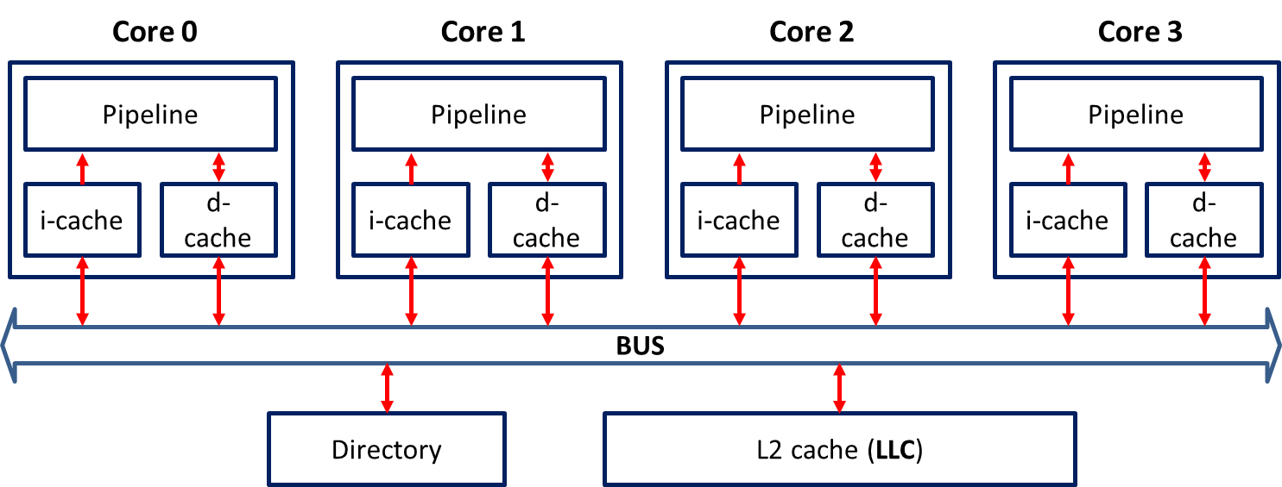
Memory Hierarchy
Private Caches
<Core>
...
<Cache firstLevel=“true” name=“L1_I” nextLevel=“L2” type=“icache”/>
<Cache firstLevel=“true” name=“L1_D” nextLevel=“L2” type=“dcache”/>
</Core>
<SharedCaches>
<Cache name=“L2” type=“L2Cache”/>
<Cache name=“D1” type=“Directory1”/>
</SharedCaches>
Shared Caches

Slide 160
Memory Hierarchy
<Core>
...
<Cache firstLevel=“true” name=“L1_I” nextLevel=“L2” type=“icache”/>
<Cache firstLevel=“true” name=“L1_D” nextLevel=“L2” type=“dcache”/>
</Core>
<SharedCaches>
<Cache name=“L2” type=“L2Cache”/>
<Cache name=“D1” type=“Directory1”/>
</SharedCaches>

Slide 161
Memory Hierarchy
<Core>
...
<Cache firstLevel=“true” name=“L1_I” nextLevel=“L2” type=“icache”/>
<Cache firstLevel=“true” name=“L1_D” nextLevel=“L2” type=“dcache”/>
</Core>
<SharedCaches>
<Cache name=“L2” type=“L2Cache”/>
<Cache name=“D1” type=“Directory1”/>
</SharedCaches>
Used to specify a Cache element

Slide 162
Memory Hierarchy
<Core>
...
<Cache firstLevel=“true” name=“L1_I” nextLevel=“L2” type=“icache”/>
<Cache firstLevel=“true” name=“L1_D” nextLevel=“L2” type=“dcache”/>
</Core>
<SharedCaches>
<Cache name=“L2” type=“L2Cache”/>
<Cache name=“D1” type=“Directory1”/>
</SharedCaches>
Identify which cache is level 1
Useful when a core has more than one level of private caches

Slide 163
Memory Hierarchy
<Core>
...
<Cache firstLevel=“true” name=“L1_I” nextLevel=“L2” type=“icache”/>
<Cache firstLevel=“true” name=“L1_D” nextLevel=“L2” type=“dcache”/>
</Core>
<SharedCaches>
<Cache name=“L2” type=“L2Cache”/>
<Cache name=“D1” type=“Directory1”/>
</SharedCaches>
Used for creating links between caches using names

Slide 164
Memory Hierarchy
<Core>
...
<Cache firstLevel=“true” name=“L1_I” nextLevel=“L2” type=“icache”/>
<Cache firstLevel=“true” name=“L1_D” nextLevel=“L2” type=“dcache”/>
</Core>
<SharedCaches>
<Cache name=“L2” type=“L2Cache”/>
<Cache name=“D1” type=“Directory1”/>
</SharedCaches>
Creates a link to a cache named “L2”
Search nextLevel cache if a line was not found in this cache
If next level is not specified, it implies that this cache is the last level cache

Slide 165
Memory Hierarchy
<Core>
...
<Cache firstLevel=“true” name=“L1_I” nextLevel=“L2” type=“icache”/>
<Cache firstLevel=“true” name=“L1_D” nextLevel=“L2” type=“dcache”/>
</Core>
<SharedCaches>
<Cache name=“L2” type=“L2Cache”/>
<Cache name=“D1” type=“Directory1”/>
</SharedCaches>
Name of this element’s detailed configuration in the configuration library

Slide 166
Cache: Detailed Configuration
<dcache>
<WriteMode>WB</WriteMode>
<BlockSize>64</BlockSize>
<Associativity>8</Associativity>
<Size>32768</Size>
<Latency>3</Latency>
<PortType>FCFS</PortType>
<AccessPorts>4</AccessPorts>
<PortOccupancy>1</PortOccupancy>
<Coherence>D1</Coherence>
<NumBuses>1</NumBuses>
<MSHRSize>16</MSHRSize>
<BusOccupancy>0</BusOccupancy>
<Nuca>NONE</Nuca>
<NucaMapping>S</NucaMapping>
<LeakageEnergy>0.1092</LeakageEnergy>
<ReadDynamicEnergy>0.33964264705</ReadDynamicEnergy>
<WriteDynamicEnergy>0.33964264705</WriteDynamicEnergy>
<CacheType>Data</CacheType>
</dcache>

Slide 167
Cache: Detailed Configuration
<dcache>
<WriteMode>WB</WriteMode>
<BlockSize>64</BlockSize>
<Associativity>8</Associativity>
<Size>32768</Size>
<Latency>3</Latency>
<PortType>FCFS</PortType>
<AccessPorts>4</AccessPorts>
<PortOccupancy>1</PortOccupancy>
<Coherence>D1</Coherence>
<NumBuses>1</NumBuses>
<MSHRSize>16</MSHRSize>
<BusOccupancy>0</BusOccupancy>
<Nuca>NONE</Nuca>
<NucaMapping>S</NucaMapping>
<LeakageEnergy>0.1092</LeakageEnergy>
<ReadDynamicEnergy>0.33964264705</ReadDynamicEnergy>
<WriteDynamicEnergy>0.33964264705</WriteDynamicEnergy>
<CacheType>Data</CacheType>
</dcache>
Size parameters

Slide 168
Cache: Detailed Configuration
<dcache>
<WriteMode>WB</WriteMode>
<BlockSize>64</BlockSize>
<Associativity>8</Associativity>
<Size>32768</Size>
<Latency>3</Latency>
<PortType>FCFS</PortType>
<AccessPorts>4</AccessPorts>
<PortOccupancy>1</PortOccupancy>
<Coherence>D1</Coherence>
<NumBuses>1</NumBuses>
<MSHRSize>16</MSHRSize>
<BusOccupancy>0</BusOccupancy>
<Nuca>NONE</Nuca>
<NucaMapping>S</NucaMapping>
<LeakageEnergy>0.1092</LeakageEnergy>
<ReadDynamicEnergy>0.33964264705</ReadDynamicEnergy>
<WriteDynamicEnergy>0.33964264705</WriteDynamicEnergy>
<CacheType>Data</CacheType>
</dcache>
Cache Ports

Slide 169
Cache: Detailed Configuration
<dcache>
<WriteMode>WB</WriteMode>
<BlockSize>64</BlockSize>
<Associativity>8</Associativity>
<Size>32768</Size>
<Latency>3</Latency>
<PortType>FCFS</PortType>
<AccessPorts>4</AccessPorts>
<PortOccupancy>1</PortOccupancy>
<Coherence>D1</Coherence>
<NumBuses>1</NumBuses>
<MSHRSize>16</MSHRSize>
<BusOccupancy>0</BusOccupancy>
<Nuca>NONE</Nuca>
<NucaMapping>S</NucaMapping>
<LeakageEnergy>0.1092</LeakageEnergy>
<ReadDynamicEnergy>0.33964264705</ReadDynamicEnergy>
<WriteDynamicEnergy>0.33964264705</WriteDynamicEnergy>
<CacheType>Data</CacheType>
</dcache>
Name of the cache coherence scheme
Specify as None if the cache is not coherent

Slide 170
Cache: Detailed Configuration
<dcache>
<WriteMode>WB</WriteMode>
<BlockSize>64</BlockSize>
<Associativity>8</Associativity>
<Size>32768</Size>
<Latency>3</Latency>
<PortType>FCFS</PortType>
<AccessPorts>4</AccessPorts>
<PortOccupancy>1</PortOccupancy>
<Coherence>D1</Coherence>
<NumBuses>1</NumBuses>
<MSHRSize>16</MSHRSize>
<BusOccupancy>0</BusOccupancy>
<Nuca>NONE</Nuca>
<NucaMapping>S</NucaMapping>
<LeakageEnergy>0.1092</LeakageEnergy>
<ReadDynamicEnergy>0.33964264705</ReadDynamicEnergy>
<WriteDynamicEnergy>0.33964264705</WriteDynamicEnergy>
<CacheType>Data</CacheType>
</dcache>
Energy Parameters
1) Dynamic Energy: Joules/access
2) LeakageEnergy: Joules/second

Slide 171
Hierarchy 2 (L2 Cache is now private)
Core 0
Core 1
Core 2
Core 3
Pipeline
Pipeline
Pipeline
Pipeline
i-cache
d-cache
i-cache
d-cache
i-cache
d-cache
i-cache
d-cache
L2 cache
L2 cache
L2 cache
L2 cache
BUS
Directory
L3 cache (LLC)

Slide 172
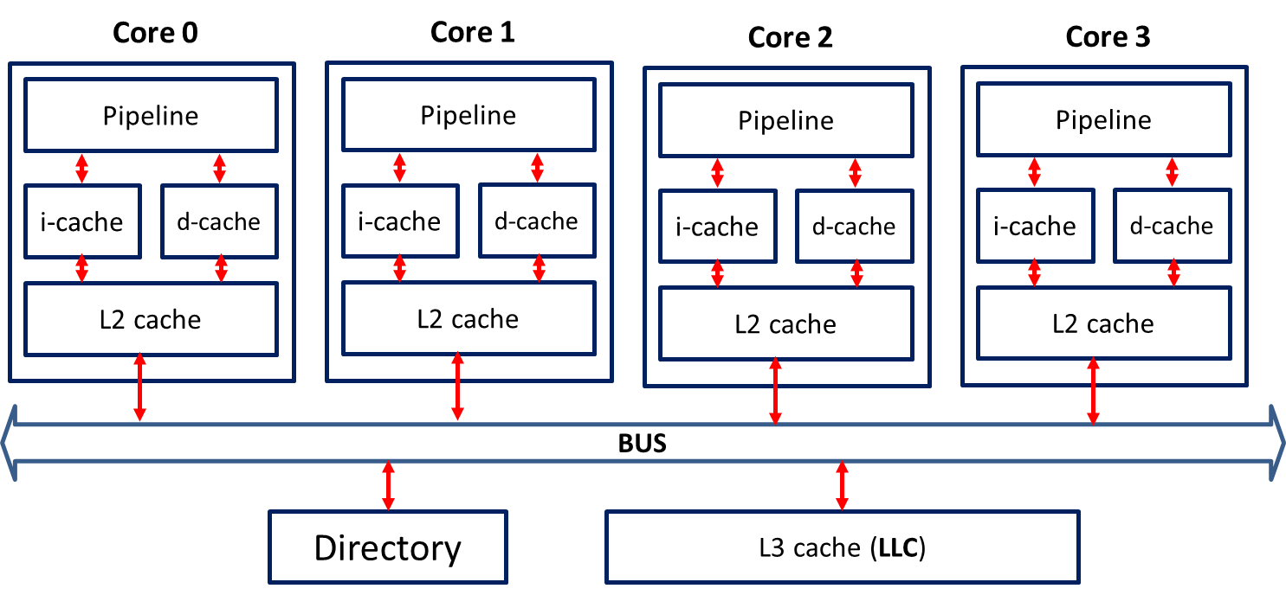
Memory Hierarchy
<Core>
...
<Cache firstLevel=“true” name=“L1_I” nextLevel=“L2” type=“icache”/>
<Cache firstLevel=“true” name=“L1_D” nextLevel=“L2” type=“dcache”/>
<Cache name=“L2” nextLevel=“L3” type=“L2Cache”/>
</Core>
<SharedCaches>
<Cache name=“L3” type=“L3Cache”/>
<Cache name=“D1” type=“Directory1”/>
</SharedCaches>

Slide 173
Memory Hierarchy
<Core>
...
<Cache firstLevel=“true” name=“L1_I” nextLevel=“L2” type=“icache”/>
<Cache firstLevel=“true” name=“L1_D” nextLevel=“L2” type=“dcache”/>
<Cache name=“L2” nextLevel=“L3” type=“L2Cache”/>
</Core>
<SharedCaches>
<Cache name=“L3” type=“L3Cache”/>
<Cache name=“D1” type=“Directory1”/>
</SharedCaches>
High level modifications:
L2Cache is private, its nextLevel is L3
L3 replaces L2 as the LLC

Slide 174
Memory Hierarchy
<Core>
...
<Cache firstLevel=“true” name=“L1_I” nextLevel=“L2” type=“icache”/>
<Cache firstLevel=“true” name=“L1_D” nextLevel=“L2” type=“dcache”/>
<Cache name=“L2” nextLevel=“L3” type=“L2Cache”/>
</Core>
<SharedCaches>
<Cache name=“L3” type=“L3Cache”/>
<Cache name=“D1” type=“Directory1”/>
</SharedCaches>
Changes to the detailed configuration of caches:
dcache:
WriteThrough instead of WriteBack
No coherence
L2 cache becomes coherent cache

Slide 175
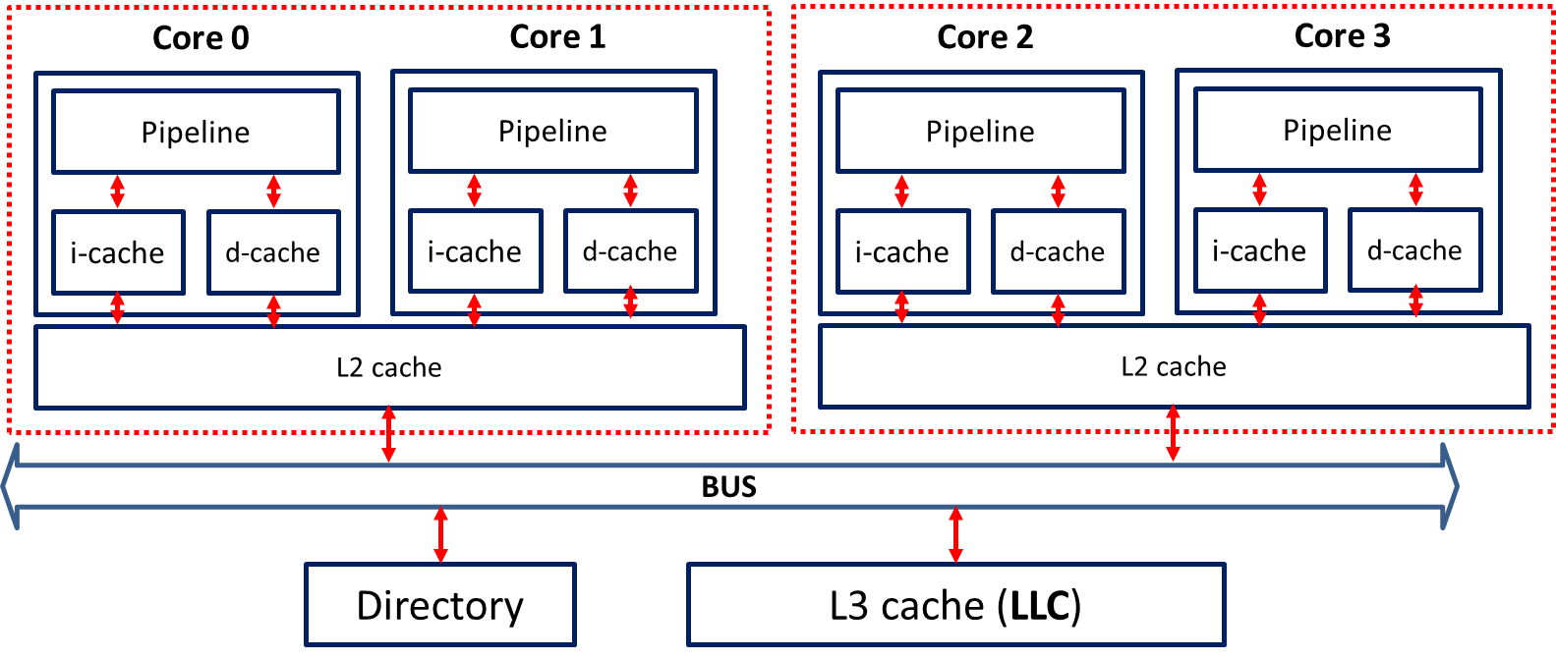
Hierarchy 3 (L2 Cache is now shared between two cores)

Slide 176
Memory Hierarchy
<Core>
...
<Cache firstLevel=“true” name=“L1_I” nextLevel=“L2” nextLevelID=“$i/2” type=“icache”/>
<Cache firstLevel=“true” name=“L1_D” nextLevel=“L2” nextLevelID=“$i/2” type=“dcache”/>
</Core>
<SharedCaches>
<Cache name=“L2” numComponents=“2” nextLevel=“L3” type=“L2Cache”/>
<Cache name=“L3” type=“L3Cache”/>
<Cache name=“D1” type=“Directory1”/>
</SharedCaches>

Slide 177
Memory Hierarchy
<Core>
...
<Cache firstLevel=“true” name=“L1_I” nextLevel=“L2” nextLevelID=“$i/2” type=“icache”/>
<Cache firstLevel=“true” name=“L1_D” nextLevel=“L2” nextLevelID=“$i/2” type=“dcache”/>
</Core>
<SharedCaches>
<Cache name=“L2” numComponents=“2” nextLevel=“L3” type=“L2Cache”/>
<Cache name=“L3” type=“L3Cache”/>
<Cache name=“D1” type=“Directory1”/>
</SharedCaches>

Slide 178
Memory Hierarchy
<Core>
...
<Cache firstLevel=“true” name=“L1_I” nextLevel=“L2” nextLevelID=“$i/2” type=“icache”/>
<Cache firstLevel=“true” name=“L1_D” nextLevel=“L2” nextLevelID=“$i/2” type=“dcache”/>
</Core>
<SharedCaches>
<Cache name=“L2” numComponents=“2” nextLevel=“L3” type=“L2Cache”/>
<Cache name=“L3” type=“L3Cache”/>
<Cache name=“D1” type=“Directory1”/>
</SharedCaches>
Specify nextLevelID in terms of ID of this cache
ID of private caches = ID of the core
icache[0],icache[1],dcache[0], dcache[1]-> L2[0]
icache[2],icache[3],dcache[2], dcache[3]-> L2[1]

Slide 179
Specifying the Chip Layout and Configuring the NoC

Slide 180
Core 0 | Core 1 | Core 2 | Core 3
Core 4 | Core 5 | Core 6 | Core 7
Core 8 | Core 9 | Core 10 | Core 11
Core 12 | Memory Controller | Directory | L2 (LLC)
Chip 1:
NocConfig.txt
4 4
C C C C
C C C C
C C C C
C M D L2

Slide 181
Core 0 | Core 1 | Core 2 | Core 3
Core 4 | Core 5 | Core 6 | Core 7
Core 8 | Core 9 | Core 10 | Core 11
Core 12 | Memory Controller | Directory | L2 (LLC)
Chip 1:
NocConfig.txt
4 4
C C C C
C C C C
C C C C
C M D L2
#rows #columns

Slide 182
Core 0 | Core 1 | Core 2 | Core 3
Core 4 | Core 5 | Core 6 | Core 7
Core 8 | Core 9 | Core 10 | Core 11
Core 12 | Memory Controller | Directory | L2 (LLC)
Chip 1:
NocConfig.txt
4 4
C C C C
C C C C
C C C C
C M D L2
Cores in the first row
Core 0, Core 1, Core 2, Core 3

Slide 183
Core 0 | Core 1 | Core 2 | Core 3
Core 4 | Core 5 | Core 6 | Core 7
Core 8 | Core 9 | Core 10 | Core 11
Core 12 | Memory Controller | Directory | L2 (LLC)
Chip 1:
NocConfig.txt
4 4
C C C C
C C C C
C C C C
C M D L2
M -> Memory Controller
D -> Directory
L2 -> L2 (LLC)

Slide 184
NOC: Extra parameters in config.xml
<NOC> <NocConfigFile>NocConfig.txt</NocConfigFile> <NocSelScheme>STATIC</NocSelScheme> <NocNumberOfBuffers>4</NocNumberOfBuffers> <NocPortType>FCFS</NocPortType> <NocAccessPorts>4</NocAccessPorts> <NocPortOccupancy>1</NocPortOccupancy> <NocLatency>1</NocLatency> <NocOperatingFreq>2000</NocOperatingFreq> <NocTopology>TORUS</NocTopology> <NocRoutingAlgorithm>SIMPLE</NocRoutingAlgorithm> <NocLatencyBetweenNOCElements>4</NocLatencyBetweenNOCElements> <NocRouterArbiter>RR_ARBITER</NocRouterArbiter> <TechPoint>90</TechPoint> <NocConnection>ELECTRICAL</NocConnection> <LeakageEnergy>0.1877</LeakageEnergy> <DynamicEnergy>2.1164</DynamicEnergy> </NOC>

Slide 185
NOC: Extra parameters in config.xml
<NOC> <NocConfigFile>NocConfig.txt</NocConfigFile> <NocSelScheme>STATIC</NocSelScheme> <NocNumberOfBuffers>4</NocNumberOfBuffers> <NocPortType>FCFS</NocPortType> <NocAccessPorts>4</NocAccessPorts> <NocPortOccupancy>1</NocPortOccupancy> <NocLatency>1</NocLatency> <NocOperatingFreq>2000</NocOperatingFreq> <NocTopology>TORUS</NocTopology> <NocRoutingAlgorithm>SIMPLE</NocRoutingAlgorithm> <NocLatencyBetweenNOCElements>4</NocLatencyBetweenNOCElements> <NocRouterArbiter>RR_ARBITER</NocRouterArbiter> <TechPoint>90</TechPoint> <NocConnection>ELECTRICAL</NocConnection> <LeakageEnergy>0.1877</LeakageEnergy> <DynamicEnergy>2.1164</DynamicEnergy> </NOC>
Mesh Torus Ring Bus
Fat Tree Butterfly Omega

Slide 186
Memory Controller 0 |  |  | Memory Controller1
Core 0 | Core 1 | Core 2 | Core 3
L2 0 | L2 1 | L2 2 | L2 3
Core 4 | Core 5 | Core 6 | Core 7
L2 4 | L2 5 | L2 6 | L2 7
Core 8 | Core 9 | Core 10 | Core 11
L2 8 | L2 9 | L2 10 | L2 11
Memory Controller 2 |  | Directory | Memory Controller3
Chip 1:

Slide 187
NocConfig.txt
8 4
M - - M
C C C C
L2 L2 L2 L2
C C C C
L2 L2 L2 L2
C C C C
L2 L2 L2 L2
M – C M

Slide 188
NocConfig.txt
8 4
M - - M
C C C C
L2 L2 L2 L2
C C C C
L2 L2 L2 L2
C C C C
L2 L2 L2 L2
M – C M
Specify this cache as NUCA in its detailed cache configuration

Slide 189
NocConfig.txt
8 4
M - - M
C C C C
L2 L2 L2 L2
C C C C
L2 L2 L2 L2
C C C C
L2 L2 L2 L2
M – C M
No element in these locations

Slide 190
NocConfig.txt
8 4
M - - M
C C C C
L2 L2 L2 L2
C C C C
L2 L2 L2 L2
C C C C
L2 L2 L2 L2
M – C M
If there is cache miss at L2 level, the request will be sent to the nearest memory controller

Slide 191
Energy Simulations
Branch Predictor
Private caches
Shared caches
Coherence elements
Memory controllers
Interconnect
DRAM
TLBs
Pipeline Units
Leakage Energy: Energy consumed in one second of execution
Dynamic Energy: Energy consumed in one access of the element
Type of access: element specific
Differentiated accesses: Need to be added. Example: Cache
Read dynamic energy
Write dynamic energy

Slide 192
Session 1: Motivation and High Level Architecture | 08:30 to 09:00
Session 2: Simulating Different Architectural Components | 09:00 to 10:30
Session 3: Sample Use Cases and Hands-on Demo | 10:00 -- 11:30
Coffee break: 10:30 to 11:00
Session 4: Sister Projects of Tejas | 11:30 to 12:00

Slide 193
Session 1: Motivation and High Level Architecture | 08:30 to 09:00
Session 2: Simulating Different Architectural Components | 09:00 to 10:30
Session 3: Sample Use Cases and Hands-on Demo | 10:00 -- 11:30
Coffee break: 10:30 to 11:00
Session 4: Sister Projects of Tejas | 11:30 to 12:00
ParTejas GPUTejas Tejas-Java

Slide 194
AIM: To Parallelize a given sequential architectural simulator
Contributions
Separate clock domains
Special barriers (Phasers)
Lock free datastructures for shared caches
Core partitioning

Slide 195
PARTEJAS
Parallelizing Simulation

Slide 196
System Overview
Simulator thread
Simulator thread
EMULATOR
Simulator thread
SHARED MEMORY
No. of Partitions = No. of Simulator Threads
Simulator thread

Slide 197
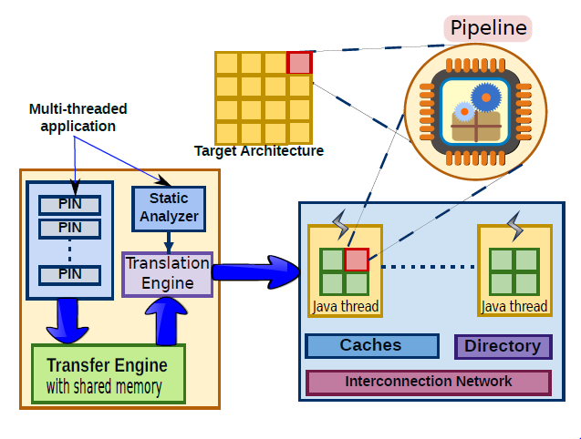

Slide 198
Challenges
Common Instruction Pools
Separate instruction pool for each simulator thread
Global clock
Different clock domains
Synchronization issues
Shared instances
Parallel port
Synchronization issues

Slide 199
Evaluation
Architecture
Four 8 core 2.20 Ghz Intel Xeon GHz processors
OS
Ubuntu Linux 12.10
RAM
64 GB
Threads
64
Platform
Sun’s Java SE Runtime 1.6.0

Slide 200
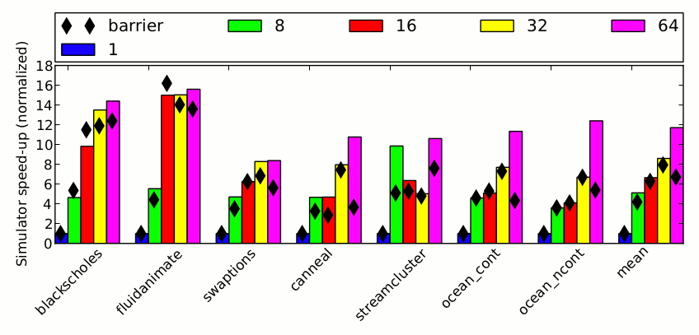
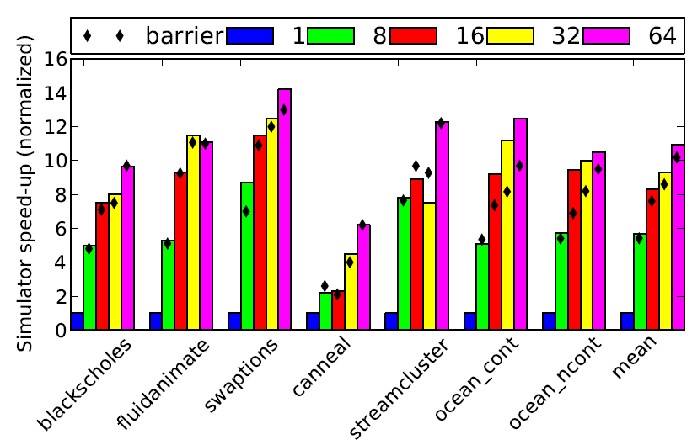
Performance
Multi-Issue Inorder : ~4.6 MIPS
Out-of-Order : ~2.34 MIPS

Slide 201
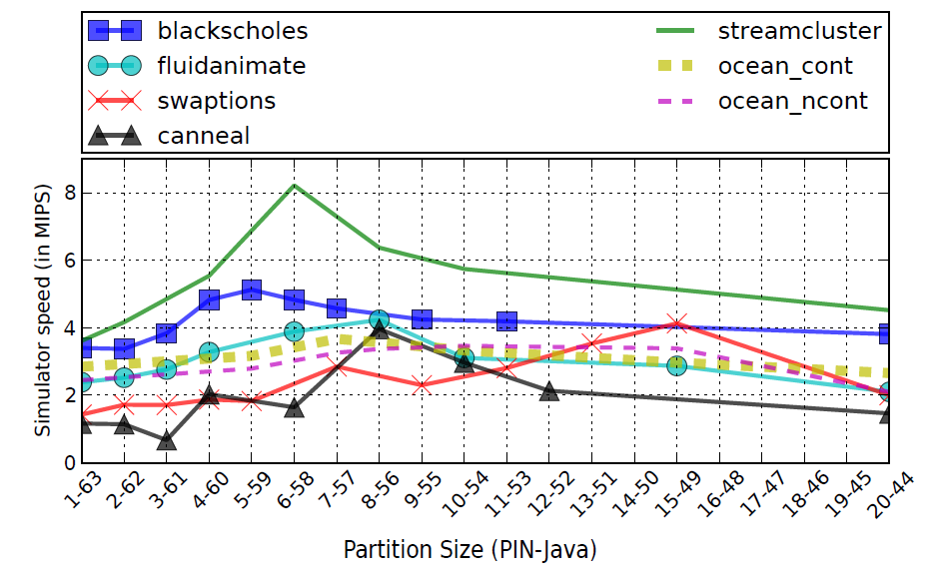
Performance
Input Size:
simsmall
Synchronization:
Phaser
#Cores:
64
Transfer Engine:
Shared Memory
Pipeline:
Multi-Issue Inorder

Slide 202
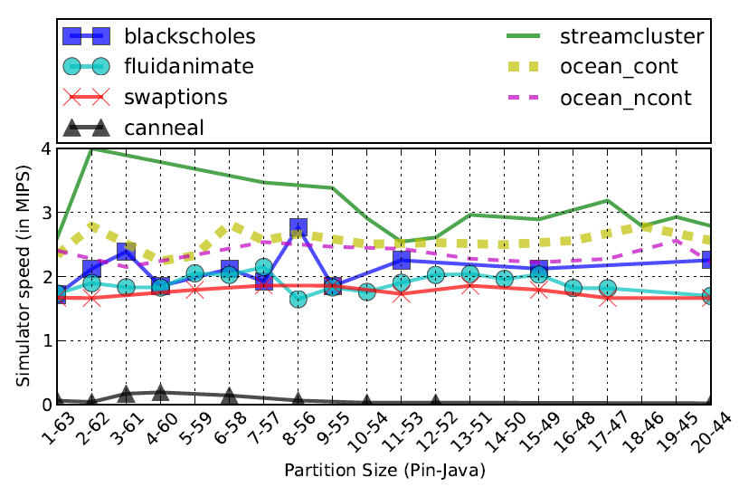
Performance
Input Size:
simsmall
Synchronization:
Phaser
#Cores:
64
Transfer Engine:
Shared Memory
Pipeline:
Out of Order

Slide 203
GPU-TEJAS
Simulating GPU’s

Slide 204
Why we need GPUTejas ?
A Simulator is needed to study and design new architectures.
Modern GPUs
have 1000+
processing
elements.
GPUTejas
GPUs have gone general purpose.
Sequential simulators suffer from performance issues.
Very little prior work in parallel GPU simulation

Slide 205
Other GPU Simulators
Attila
Detailed cycle accurate GPU simulator.
GPGPU-Sim
Supports cycle accurate timing simulation for NVDIA GPUs.
Others
Gem5-GPU , Multi2Sim , FusionSim, Ocelot
Highly configurable.
Does not support CUDA and GPGPU framework.
Requires access to source code.
Barra-Sim
A parallel functional GPGPU emulator for the NVIDIA Tesla architecture.
Does not perform timing simulation
Ro et.al.
Parallelized GPGPU-Sim.
Demonstrate a speedup of 4.15x over the sequential GPGPU-Sim on a 8-core system.
GpuTejas is 429.89x faster than GPGPU-Sim

Slide 206
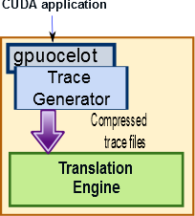
System Architecture

Slide 207
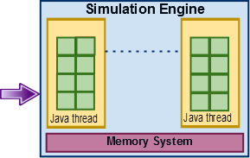
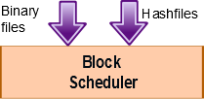
System Architecture

Slide 208
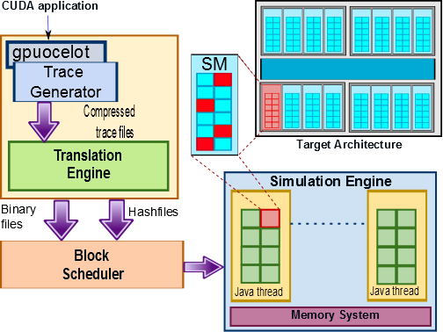
System Architecture

Slide 209
Evaluation
Architecture
Four 8 core 2.20 Ghz Intel Xeon GHz processors, 64 threads
OS
Ubuntu Linux 12.10
RAM
64 GB
Platform
Sun’s Java SE Runtime 1.6.0
GPU
NVIDIA TESLA

Slide 210
Simulation Speed
25.44
23.38
22.21
21.04
17.33
16.42
11.52
1.48

Slide 211
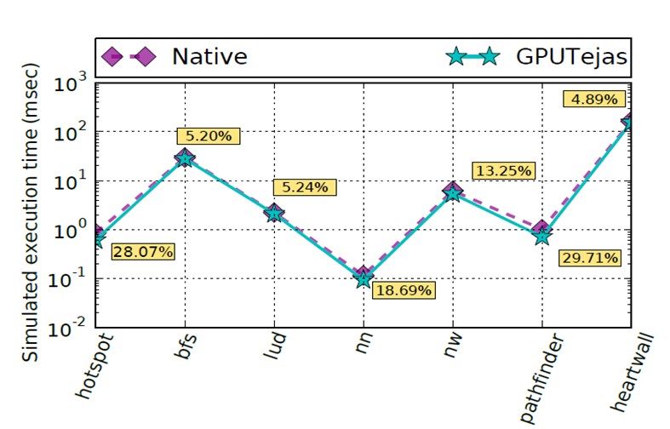
Validation

Slide 212
Performance
Benchmarks | Execution Time
 | Native Execution (ms) | GPGPU-sim (s) | GpuTejas (s)
hotspot | 0.85 | 200 | 4.54
bfs | 29.48 | 4517 | 5.36
lud | 2.22 | 168 | 16.31
nn | 0.12 | 3 | 0.86
nw | 6.21 | 1673 | 27.76
pathfinder | 1.02 | 280 | 23.51
heartwall | 162.77 | 91861 | 151.24
mean | 28.95 ms | 14100.29 s | 32.80 s

Slide 213
Session 1: Motivation and High Level Architecture | 08:30 to 09:00
Session 2: Simulating Different Architectural Components | 09:00 to 10:30
Session 3: Sample Use Cases and Hands-on Demo | 10:00 -- 11:30
Coffee break: 10:30 to 11:00
Session 4: Sister Projects of Tejas | 11:30 to 12:00
ParTejas GPUTejas Tejas-Java

Slide 214
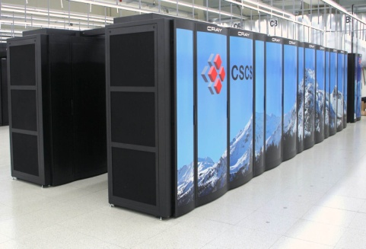
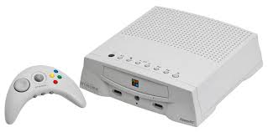
Java Applications
Java is Everywhere, there are billions of Java applications.
Laptops
Supercomputers
Cell phones
Gaming Consoles
Softwares
Mobile applications

Slide 215
Challenges
Traces enable architecture performance analysis
Challenges to get the execution traces
Java code is dynamically compiled
PIN, a binary instrumentation tool crashes
Java program and virtual machine are represented by a single process to external process
No publically available tool

Slide 216
Scope of TejasJava
Performance analysis of Java applications on a particular hardware
Evaluation of different hardware garbage collectors
Other research work that requires execution traces of Java programs

Slide 217
Running Traces on Tejas
TejasJava System Architecture

Slide 218
Thank You

