Slide 1
Computer Architecture: Past, Present, and Future
Prof. Smruti R. Sarangi
IIT Delhi

Slide 2

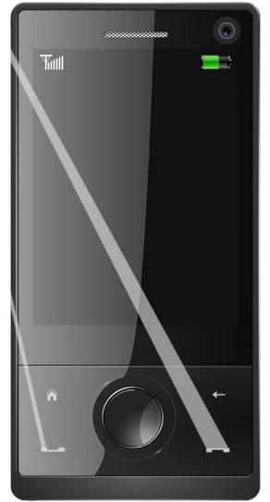

What is computer architecture?
The study of computer processors and computer systems

Slide 3
What does a computer do?
Almost everything:
  Financial calculations
  Games
  Weather forecasting
  Connect to friends on the other side of the world
  Astrology
  ...

Slide 4
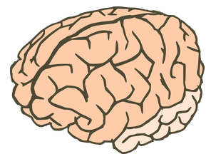
How does it do it?
USB
Monitor
Mouse
Processor (CPU)
Printer
Keyboard
Network
Network
Brain of the computer system

Slide 5

Past
Present
Future

Slide 6
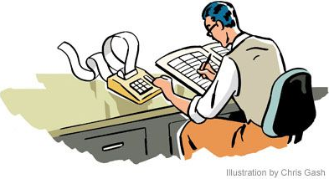
What does a program look like?
Historical Perspective
Ever since mathematics was discovered
  Man always felt the need for a little bit more of help
Almost all early civilizations had accountants and book keepers
  They wrote simple programs (in their mind) to tally accounts, compute expenditures, and forecast future demands

Slide 7
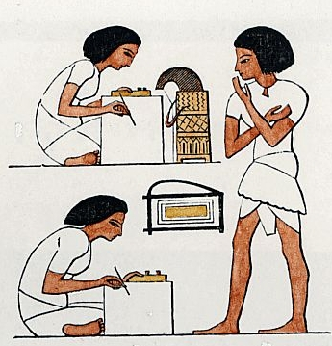
Ancient Accountants

Slide 8
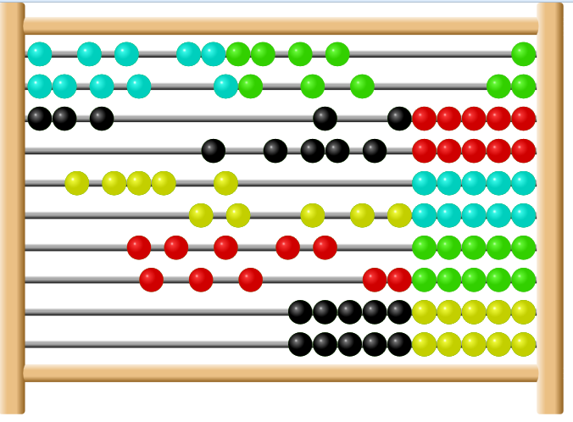
The first real computing machine – Abacus (simple and fast mathematics)

Slide 9
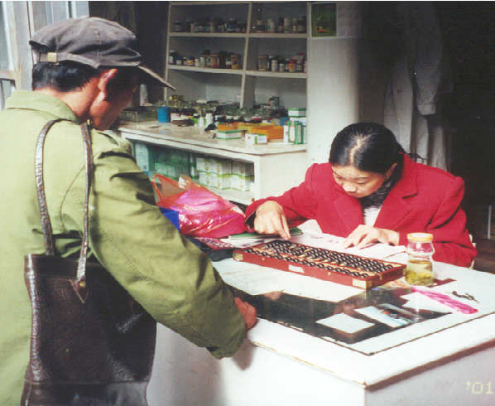
It is still being used!
(circa 1997)

Slide 10
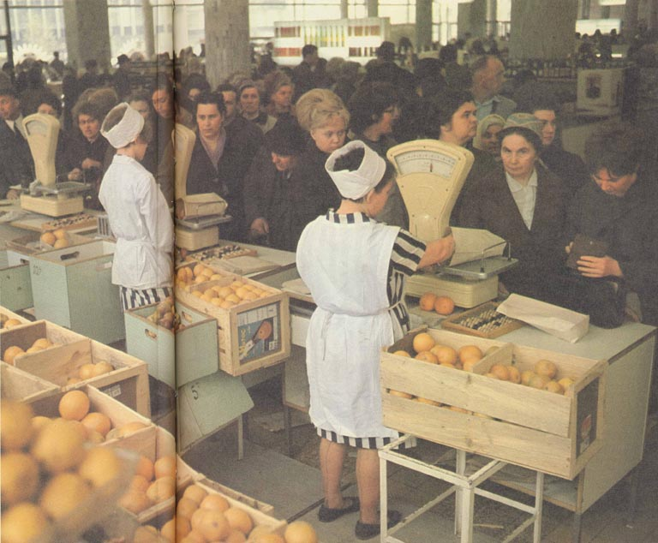
Abacus in Russia

Slide 11
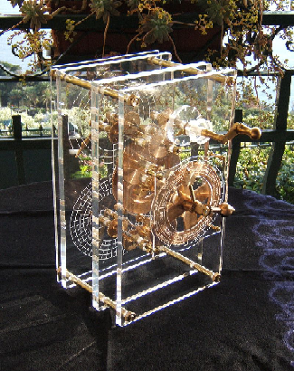
Analog Computers
2007 recreation of ancient
Greek computer

Slide 12
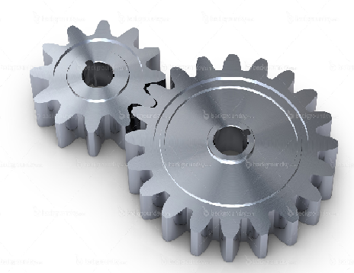
Basic operation
Radius r1
Can be used to compute the ratio r1/r2
Turn 1 gear r1 times, the other will turn r2 times
Radius r2

Slide 13
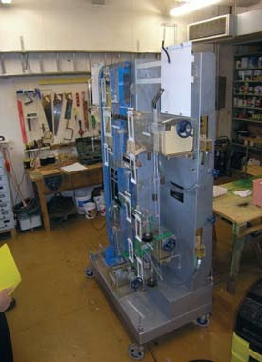
Water computers: Used in the Soviet Union till the early 80s
This computer can solve differential equations ...

Slide 14
Basic Methods of Operation
Program
Computer
a = 100
b = 500
result = b / a
Output
Spend energy: move gears, move water, move electrons, move ... → get the result

Slide 15
What was known about computing till 1900 AD
Task (program)
a = 100
b = 500
result = b / a
state
logic
a b result
+ - * / exp sin cos

Slide 16
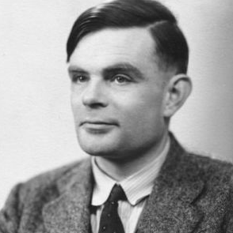
Then came Alan Turing and asked ...
What basic operations do we need to implement any kind of a program?

Slide 17
Church Turing Thesis
A function is computable by a human being using an algorithm if and only if it is computable by a Turing machine
Infinite Tape
Tape head
State Table
1
read the
symbol
access the
state table
write a new
symbol
2
4
move the
tape head
left or right
3

Slide 18
Led to the design of the modern computer – Von Neumann, Eckert Mauchly, and others
Memory
CPU
I/O Devices

Slide 19

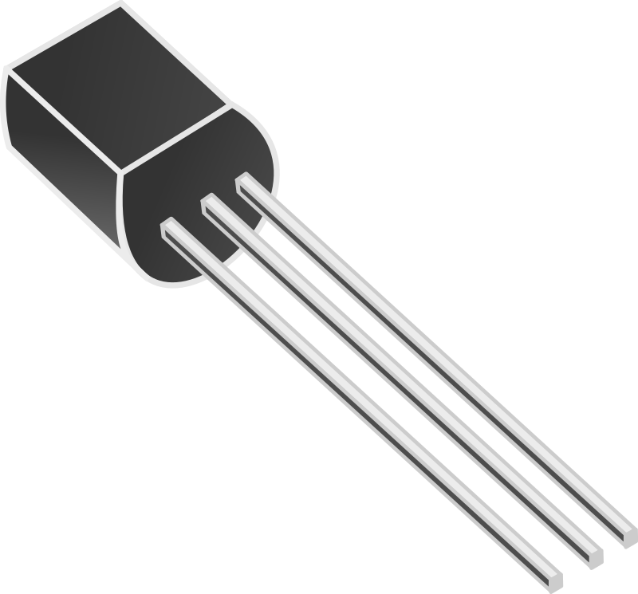
We have the theoretical tools → How do we build a computer
Then came the transistor (1947, Bardeen and Brattain)
Simple 3 pin device.
Acts like a simple
electrically
controlled switch

Slide 20



By the 50s and 60s
Theoretical
Advancements
Technological
Advancements
Era of Computers

Slide 21

Era of Big Computer Corporations
Gordon Moore (co-founder) of Intel proposed the Moore’s Law
The number of transistors per chip will double roughly every year
  Has held true for the last 55 years
  One year has increased to roughly 2 years

Slide 22

Why does Moore’s law hold?
Transistors get smaller with every new generation
  1 micron in 1980 to 14nm in 2016
High Speed
Smaller Transistors
Lower Area
Lower Power

Slide 23
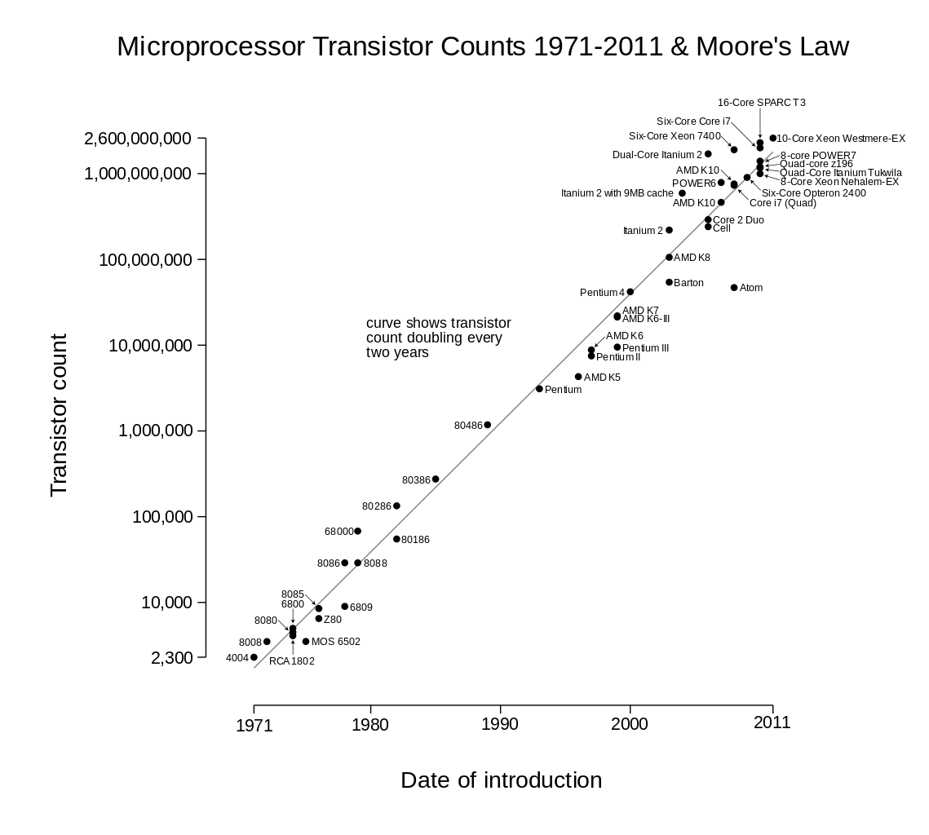

Slide 24



From 2000 to 2,000,000,000 transistors
What have we gained?
Performance
Equation
Performance $=\frac{IPC ∗frequency}{\#instructions}$
Clock Frequency → increased from 0.5 Mhz to 3 GHz (6000 times)
#instructions in a program → better compiler technology, reduced by at least 2-3X in the last 30 years
IPC → Instructions per cycle

Slide 25
IPC (Basis of Modern Computer Architecture)
Program
n
Processor
n
In the steady state, the processor will take in n instructions every cycle (average), execute them, and complete them
The IPC is equal to n

Slide 26
What determines the IPC?
Processor
Pipeline
Increase the #instructions
it can process per cycle
(average)
100s of techniques
On-Chip Memory System
Increase the hit rate (probability of finding data)
Decrease the access time and power
Off-Chip Memory System
Increase the hit rate (probability of finding data)
Decrease the access time and power

Slide 27

Crux of the techniques: Out of Order
Execution
4
3
2
1
Processor

Slide 28
Crux of the techniques: Speculation
Predict a value
Move ahead
If prediction is correct, GREAT
Direction of a branch
Value of a variable
If prediction is wrong
Rollback and Recover
Dependence between instructions
Time it takes to access Memory

Slide 29
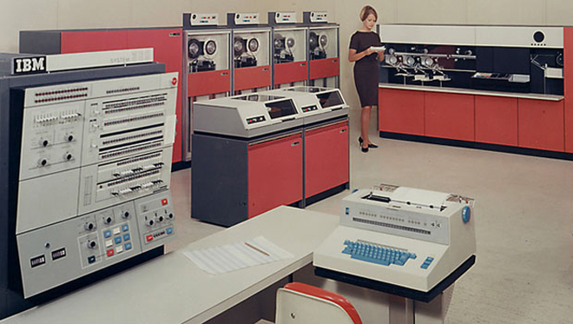
Where did we reach with all these tricks ...
IBM 360
Early 60s

Slide 30

Modern Cellphone

Slide 31


Which computer is faster, and by how many times ...
10,000 times
Samsung S5
IBM 360

Slide 32
Past
Present
Future

Slide 33
Processor Performance Scaling has reached its Limits
6000
5
000
4000
Clock frequency (MHz)
3000
2000
1000
0
29/10/99
12/03/01
25/07/02
07/12/03
20/04/05
02/09/06
15/01/08
29/05/09
11/10/10
23/02/12
Date
Clock frequency has remained constant for the last 10 years

Slide 34
Processor Performance
35
30
25
20
Speclnt 2006 Score
15
40
10
5
0
29/10/99
12/03/01
25/07/02
07/12/03
20/04/05
02/09/06
15/01/08
29/05/09
11/10/10
23/02/12
Date
Performance is also saturating

Slide 35
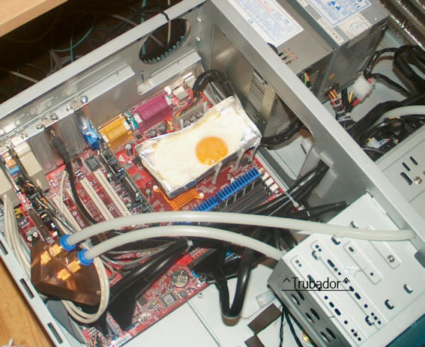


What stopped gains in processor performance?
Power and Temperature
  Power $∝$ freq³
  We cannot increase frequency any more

Slide 36

What else?
IPC
  Diminishing returns ...
  Hard to handle localized temperature hot spots
Compiler Optimizations
  Again diminishing returns ...
Single core computer architecture is dead

Slide 37
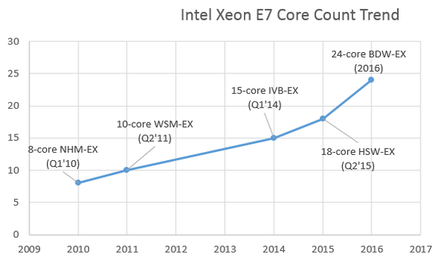
What do we do now? Moore’s law still holds ...
Solution → Add more processors (cores) per chip

Slide 38
New Mantra: Think parallel
Typical design of a multicore CPU
Cores
Cache banks
Memory
controller
Other
circuitry

Slide 39
What are the new problems to be solved ...
Designing a parallel system
  Writing a parallel program
  Convert existing algorithms into parallel algos. or write new ones
  Design of parallel architectures
  Ease of programmability
  Sending messages between cores and cache banks effectively in such a system

Slide 40
What about old friend power?
Tradeoff
  Performance per core
  Number of cores
  Frequency of each core
We can afford to have many low frequency cores
  As a result frequencies have come down in the past decade

Slide 41
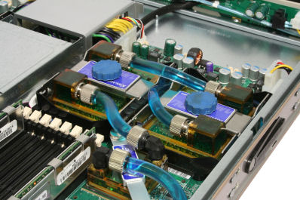
Novel methods of cooling → Water cooled server

Slide 42
Process Variation
Can you do fine grained calligraphy with a blunt knife → NO
Then, how can you design 14nm transistors with 193nm (wavelength) light?

Slide 43
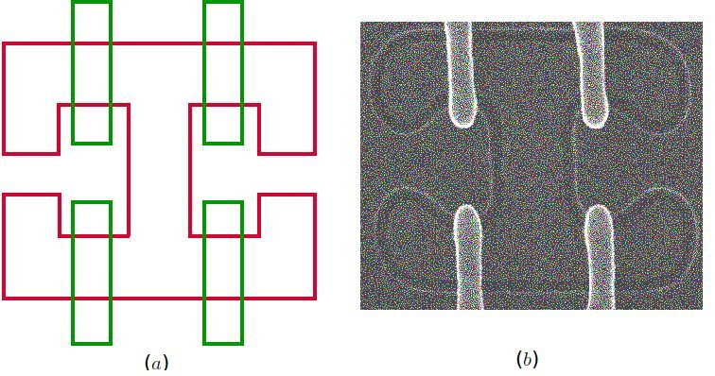
This is what you get ...
bent, deformed shapes in silicon
(courtesy: IBM Microelectronics)

Slide 44
Process Variation Effects
Cannot accurately fabricate transistors anymore
Their power, and performance vary from specifications
Need to have a lot of error tolerance and timing margins
Create new variation tolerant architectures

Slide 45

Reliability: Soft Errors and Hard Errors
Let us ask some questions:
We all know that it takes a lot of money to cool a super-computer. Why not place it on top of the Himalayas? No cooling required.
If I run a processor continuously for 10 years. What happens?

Slide 46
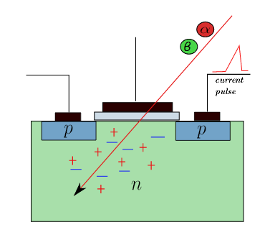
You cannot place a supercomputer on mount Everest.
The processor will be bombed by cosmic rays
The resultant current pulse can flip bits

Slide 47
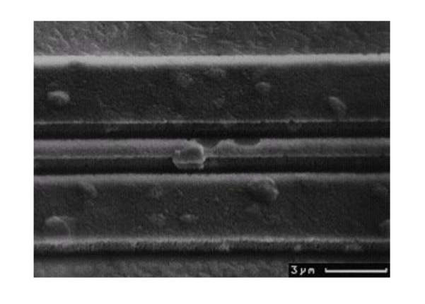
What happens after 10 years of continuous operation ...
This is what happens to a wire after that many years → Electromigration
Designs should be tolerant to such ageing mechanisms

Slide 48
Security: The kill switch (HW Trojan)
September 2007: Israeli jets bombed a Syrian nuclear facility.
The Syrian radar had mysteriously stopped, but why?
  Scoop: Israelis sent a wireless message to the processor in the radar.
  It shut itself off.
  Research problem: How do you make a design tolerant to hardware Trojans.

Slide 49
Past
Present
Future

Slide 50

Transistor Size Roadmap
Year | Transistor Size
2016 | 14 nm
2018 | 10 nm
2020 | 7 nm
2022 | ???
It is not possible (?) to design such small transistors with
current technologies.
7 nm = 70 atoms wide

Slide 51
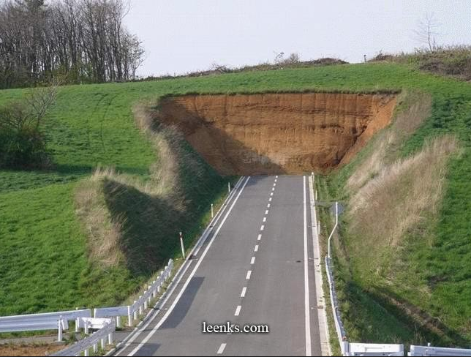
What next?
No Silicon

Slide 52
Future of Computer Architecture
Graphene – Sheet of carbon (1 atom wide)
Spintronics – Based on the spin of the electron
Quantum Computing – Store information as qubits → multiple bits at once
Instead of electrons use photons (light)

Slide 53

Discussion on Teaching Computer Architecture

Slide 54
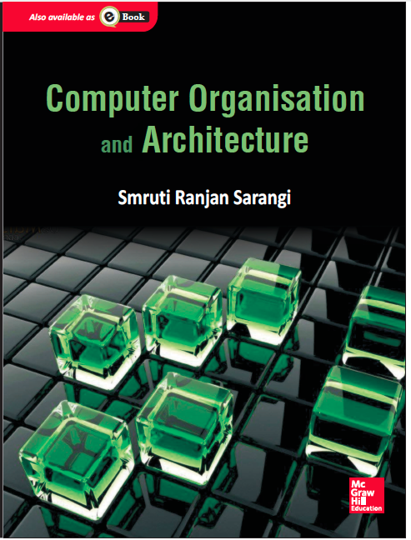
Based on my book
Computer Organisation and Architecture, Smruti Ranjan Sarangi, McGrawHill 2015
Visit: http://www.cse.iitd.ernet.in/~srsarangi/archbooksoft.html

Slide 55


Two paradigms of teaching
Analysis
Synthesis

Slide 56
Time to follow a more synthesis oriented approach
Elements of a computer architecture course
Boolean Algebra
Assembly Languages
Digital Logic
Representation of Numbers, Strings
ARM
Computer Arithmetic
x86
Basic Course 1

Slide 57
Synthesis Perspective
Give a man a fish, and you feed him for a day. Teach a man to fish, and you feed him for a lifetime.
Chinese Proverb
Assembly Language
Digital Logic
Should write at least 500 lines
of assembly code
Should at least design fully:
3 circuits in LogiSim (or similar)
Examples: basic adder,
divider, multiplier
Targets
One program should at least
be 100 lines

Slide 58
Time to follow a more synthesis oriented approach
Elements of a computer architecture course
Processor Design
Memory Systems
Multiprocessors
Pipelining
ARM
I/O Systems
x86
Basic Course 2

Slide 59
Synthesis Perspective
Give a man a fish, and you feed him for a day. Teach a man to fish, and you feed him for a lifetime.
Chinese Proverb
Processor Design
Memory System and Parallel Processing
Design one full processor
Logisim
C, C++, Java model
VHDL
Implement a cache simulator
Design replacement algorithms
Write at least 1000 lines of parallel code
(pthreads of OpenMP)
Targets

Slide 60
Software Support
ARM emulator – emuARM
x86 assembler – nasm (http://www.nasm.us/)
Logisim – logic simulator (http://www.cburch.com/logisim/)
Tejas – Architectural Simulator (www.cse.iitd.ac.in/tejas) More useful for research and for teaching an advanced course.

Slide 61
Thank you

