Slide 1
PredStereo: An Accurate Real-time Stereo Vision System
Diksha Moolchandani, Nivedita Shrivastava,
Anshul Kumar, and Smruti R. Sarangi
Indian Institute of Technology Delhi, India

Slide 2
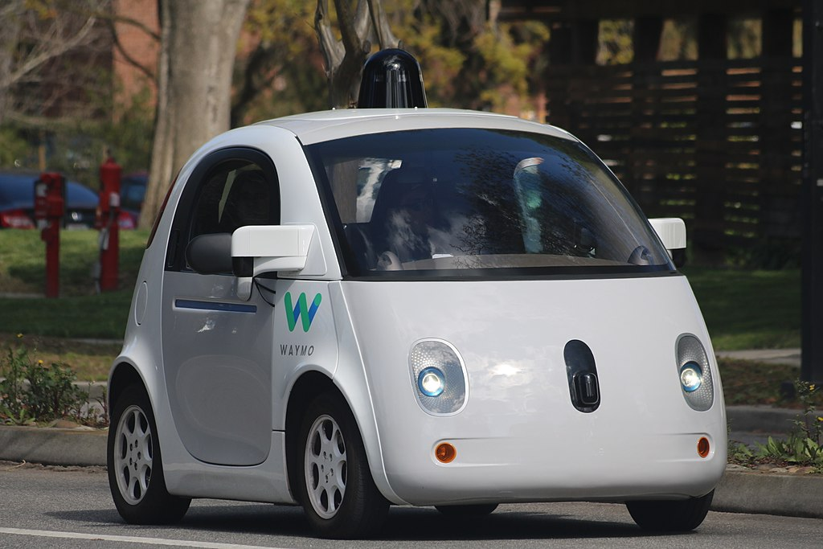
Motivation
Ideal scenario
Inclement weather
Driving in inclement weather poses challenges
1-pixel error for a 50 m away object 6.4 m error in depth 320 ms to cover with a car at 70km/hr
Need highly accurate stereo vision system for self-driving to avoid accidents
Safety buffer time according to half speedometer rule for a car at 70km/hr 1.8 s
Reduced safety buffer time 1.48 s
This Photo by Unknown Author is licensed under CC BY-SA

Slide 3
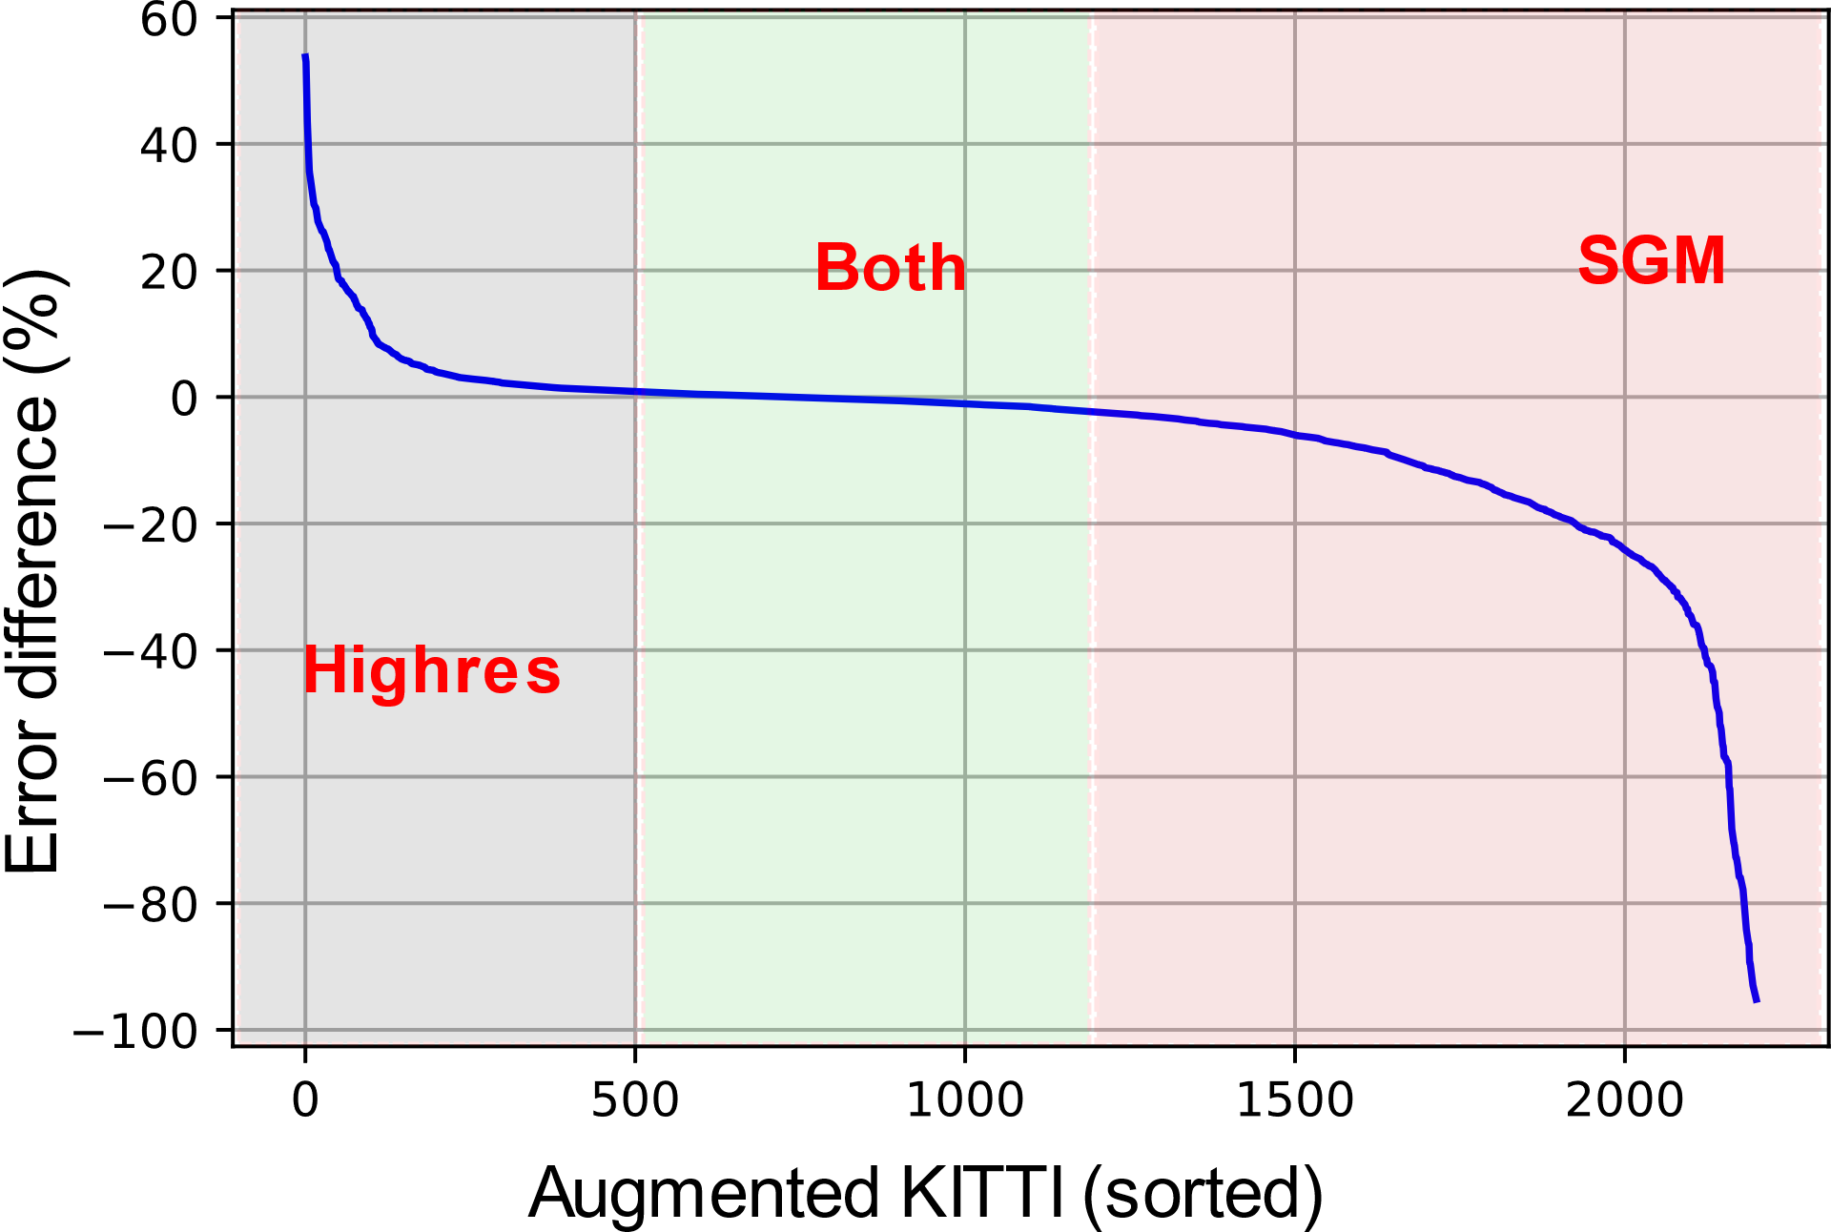
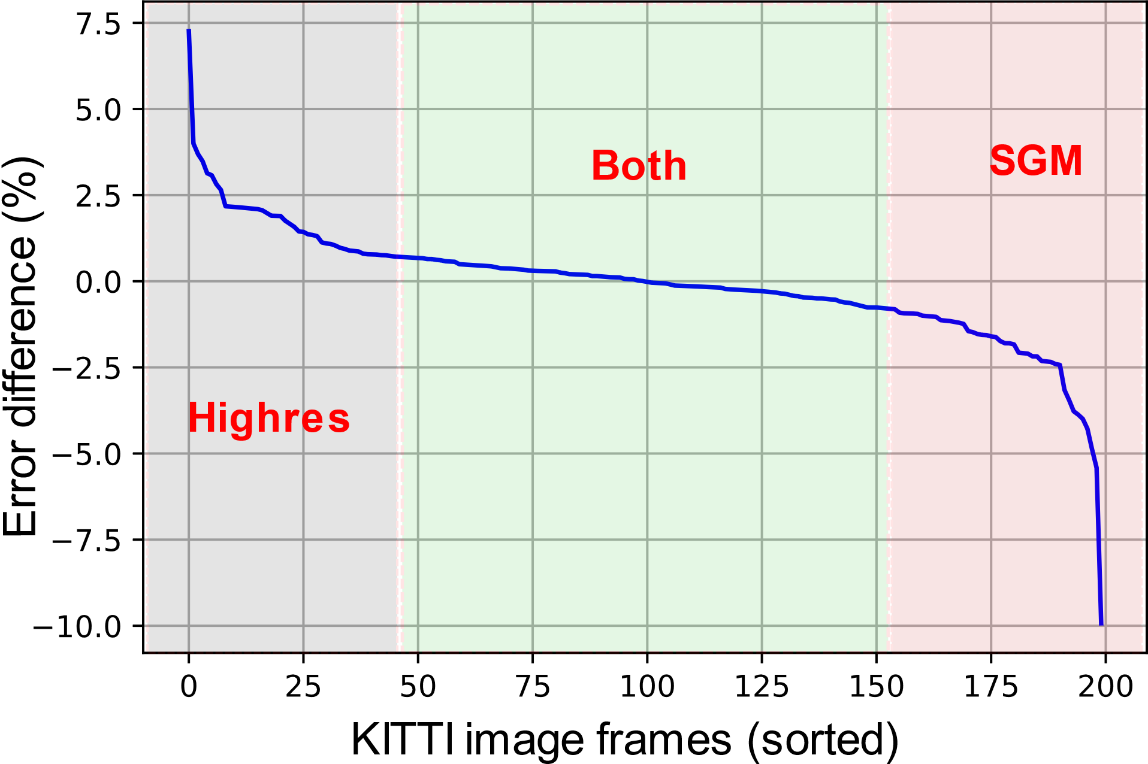
High Accuracy Self-driving: CNN or Traditional Stereo?
Original Kitti
Augmented Kitti
Highres
SGM
Trad.
SGM
SGM
CNN
Highres
SGM
SGM
Highres
50% SGM, 50% Highres
66% SGM, 33% Highres
Highres
Highres

Slide 4
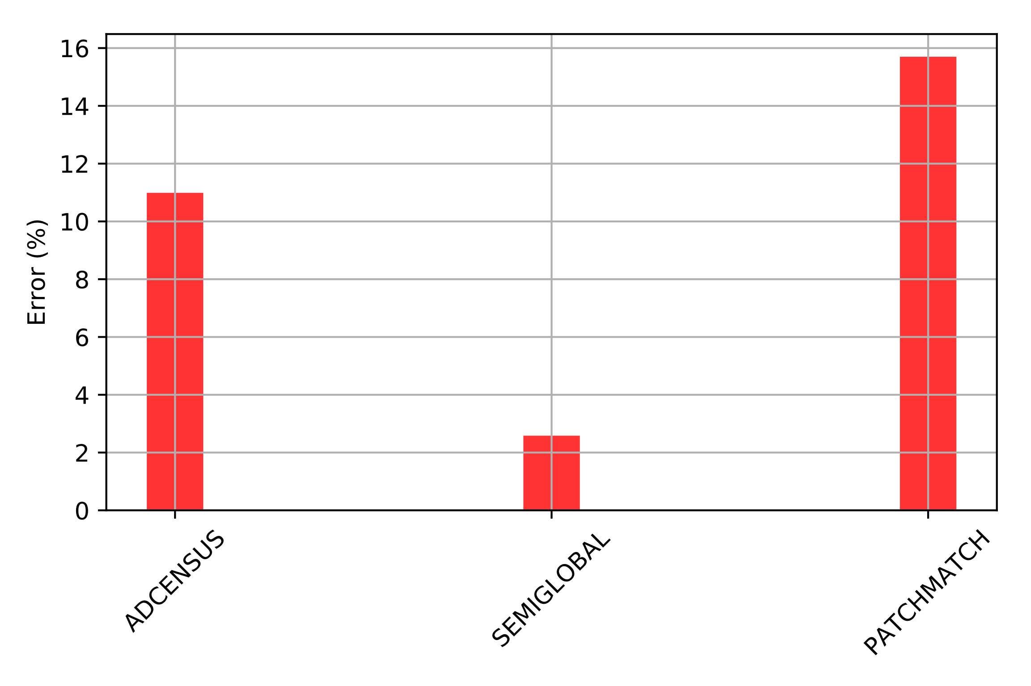
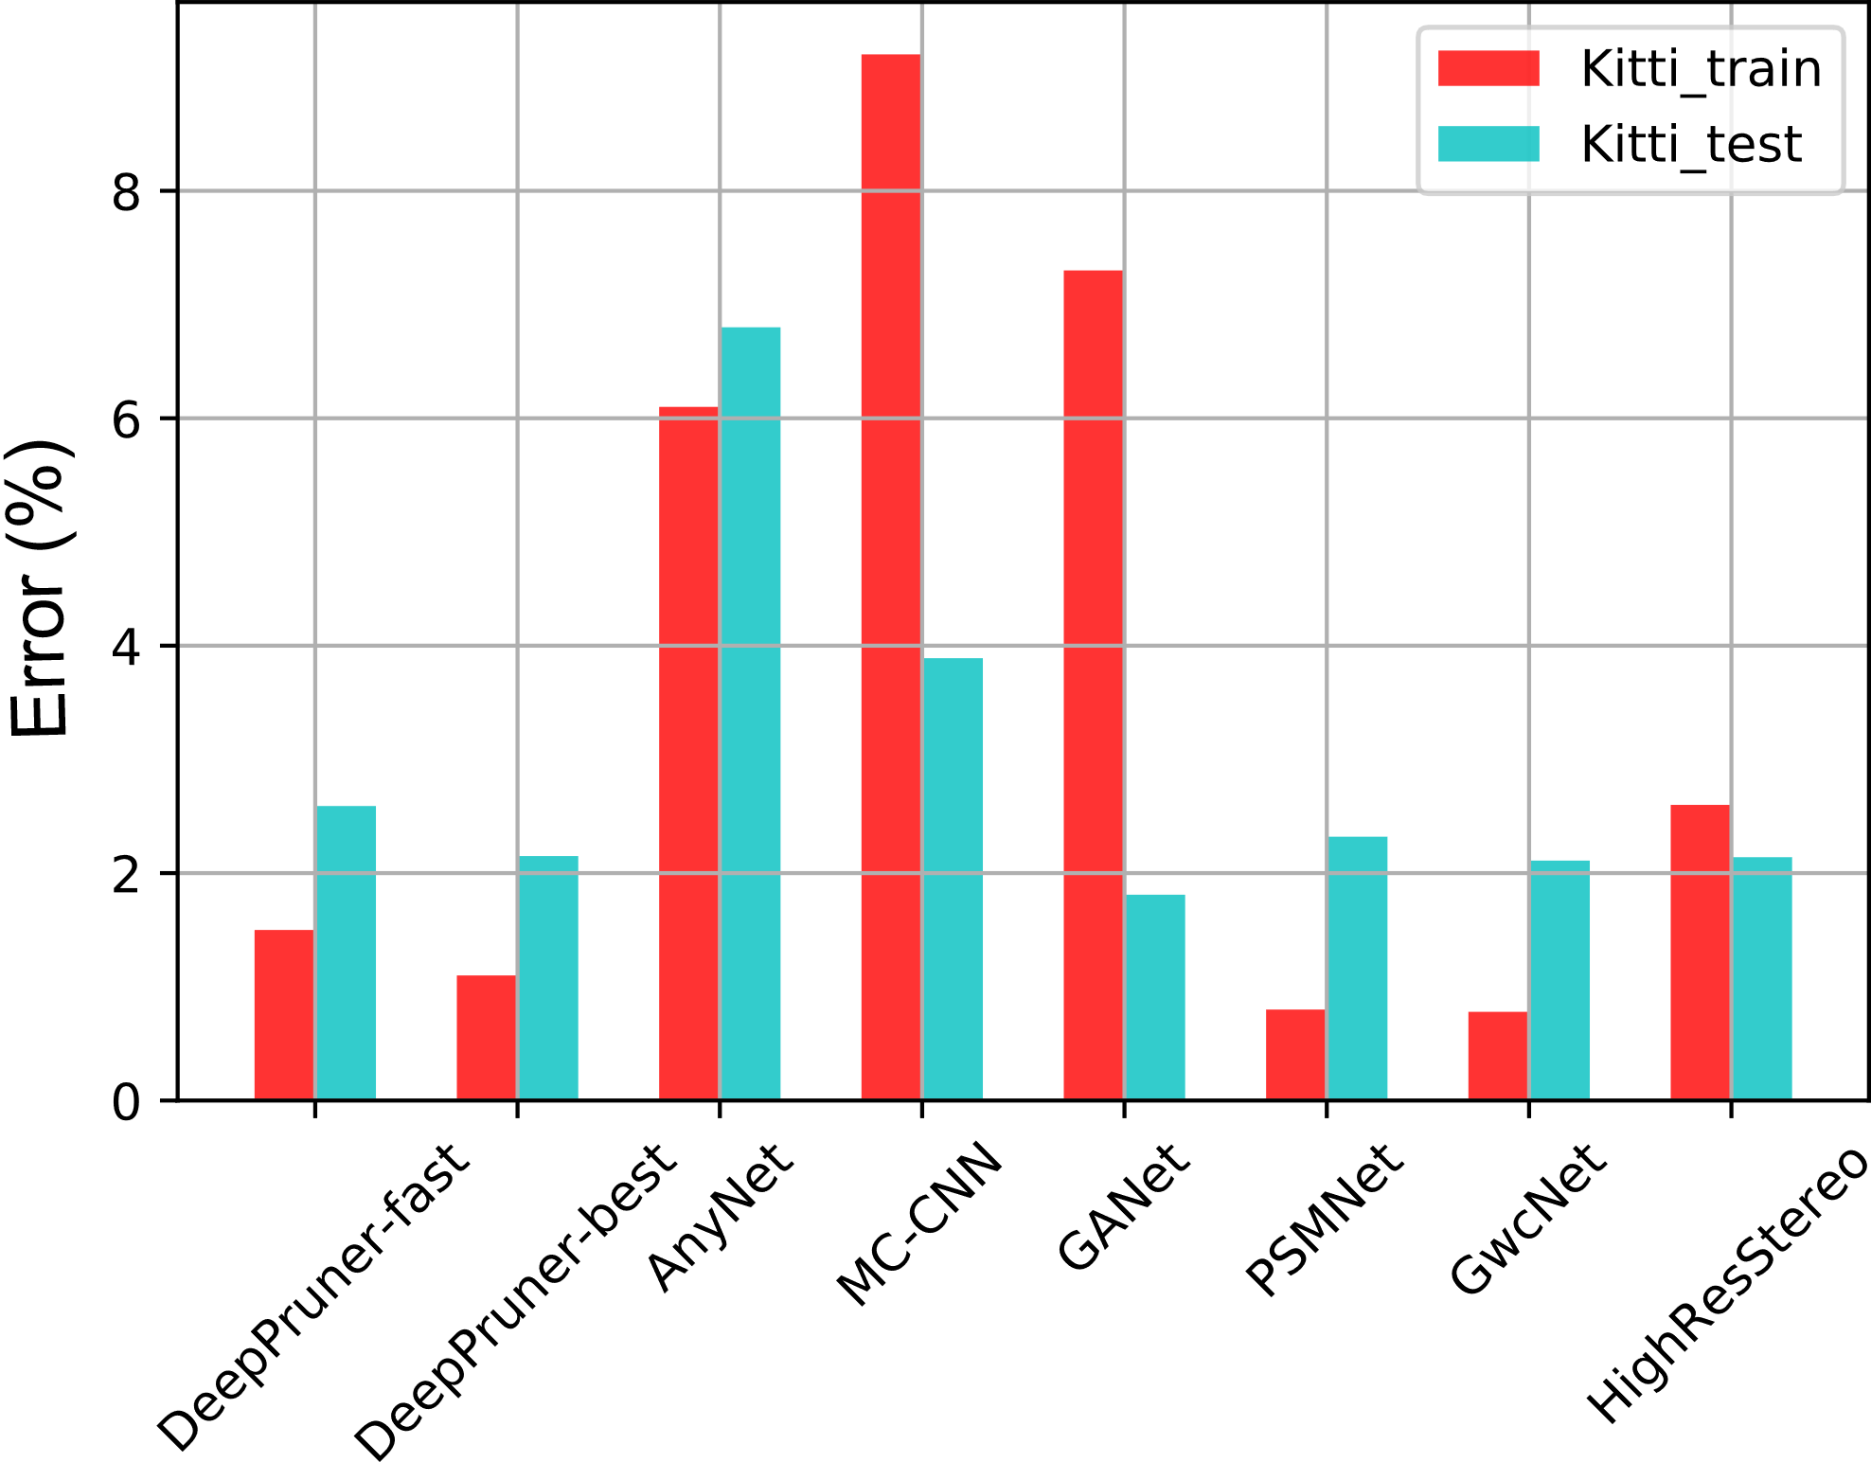
Characterization: Accuracy
CNN-based stereo
Traditional stereo
DeepPruner, PSMNet, GwcNet, HighRes
Only Semiglobal comparable

Slide 5
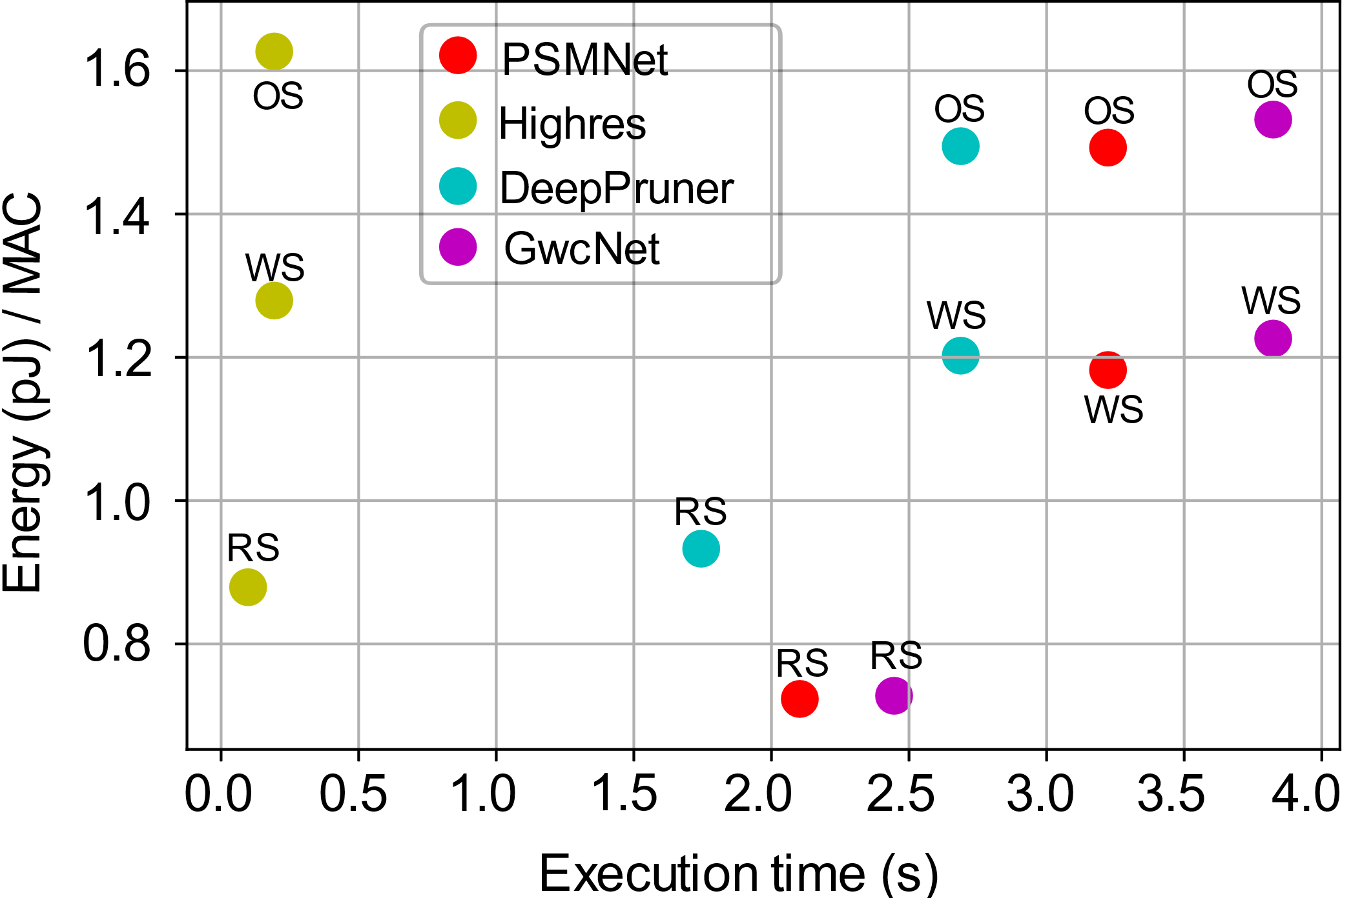
Characterization: Performance and Energy
Using Timeloop
CNN-based stereo algorithms contain a mix of 2D and 3D CNNs
Characterization needed to check if the same architecture works for both
Choose the point at the bottom-left corner: Highres algorithm – RS dataflow

Slide 6
Key Insight
Ensemble-based System
SGM
Highres
Use a predictor to choose one
Selection predictor: choose between Highres and SGM
Confidence predictor: get estimate of confidence on the chosen algorithm’s accuracy

Slide 7
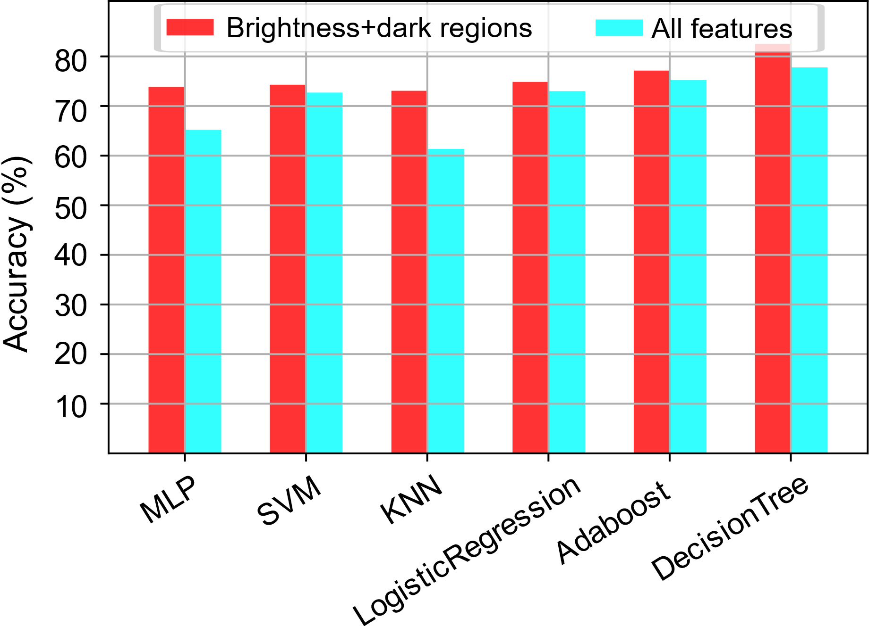
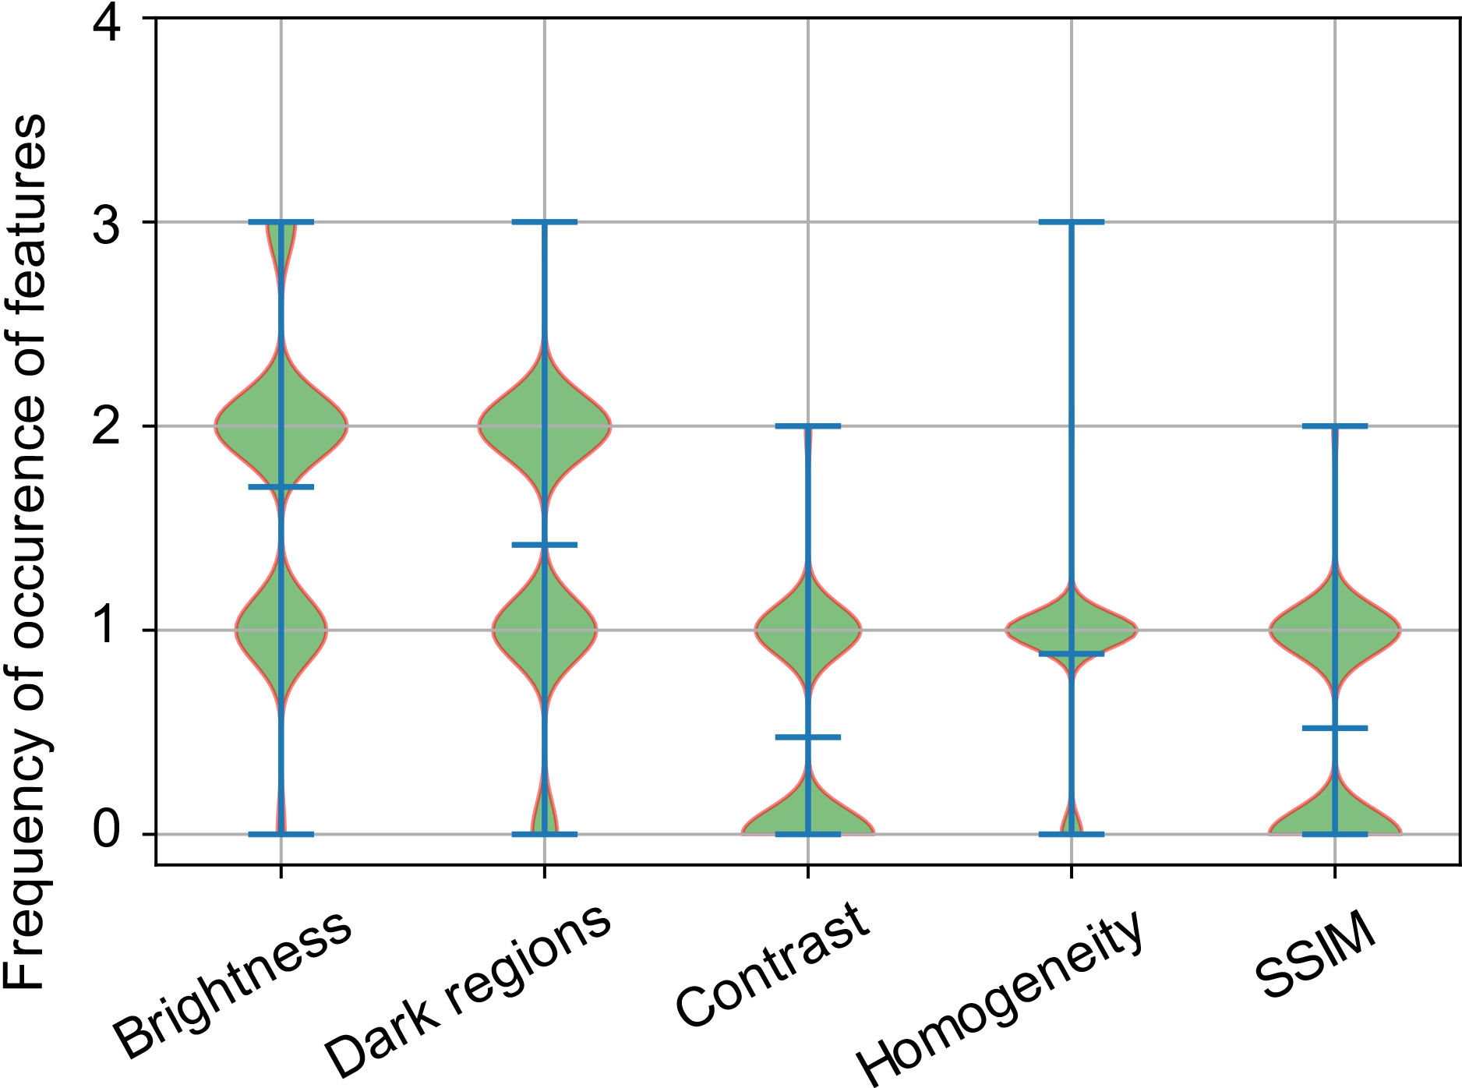
Predictor
Wider more number of frames
Brightness and Dark regions have the highest contribution in decision making
Choose a decision tree

Slide 8
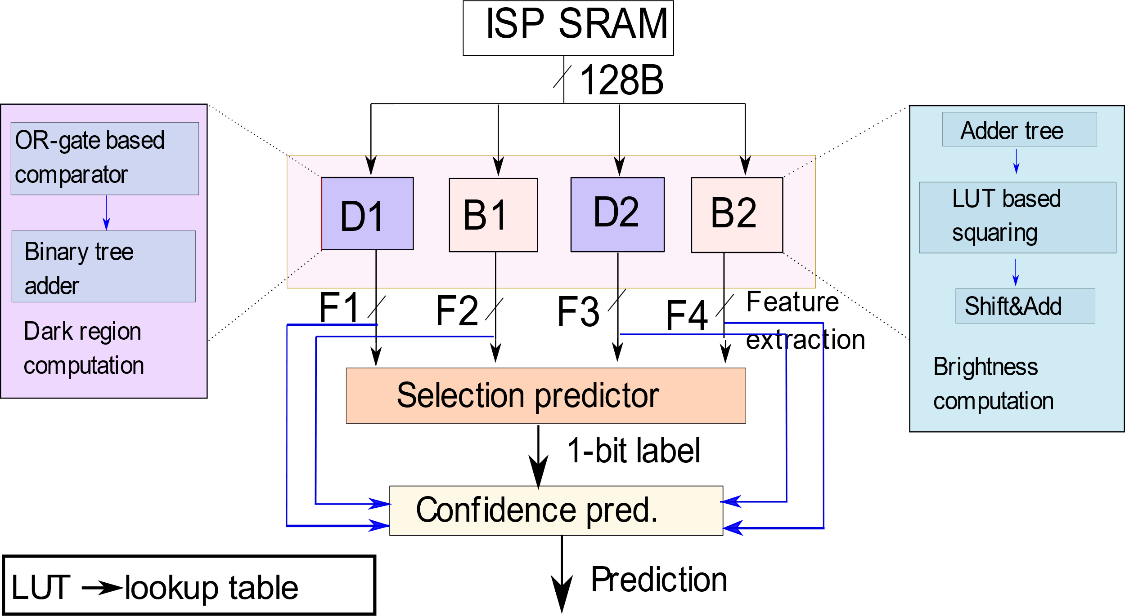
Hardware Design of Predictor
$$Brightness= \sqrt{0.241∗r^{2}+0.691∗g^{2}+0.068 ∗b^{2}}$$
r, g, b are mean pixel intensities for 3 channels resp.
Squaring
Mean
Floating point multiplication
Count the 1s
OR the MSBs
Dark regions = count all the pixels for which r, g, b values are less than a threshold (=15)

Slide 9
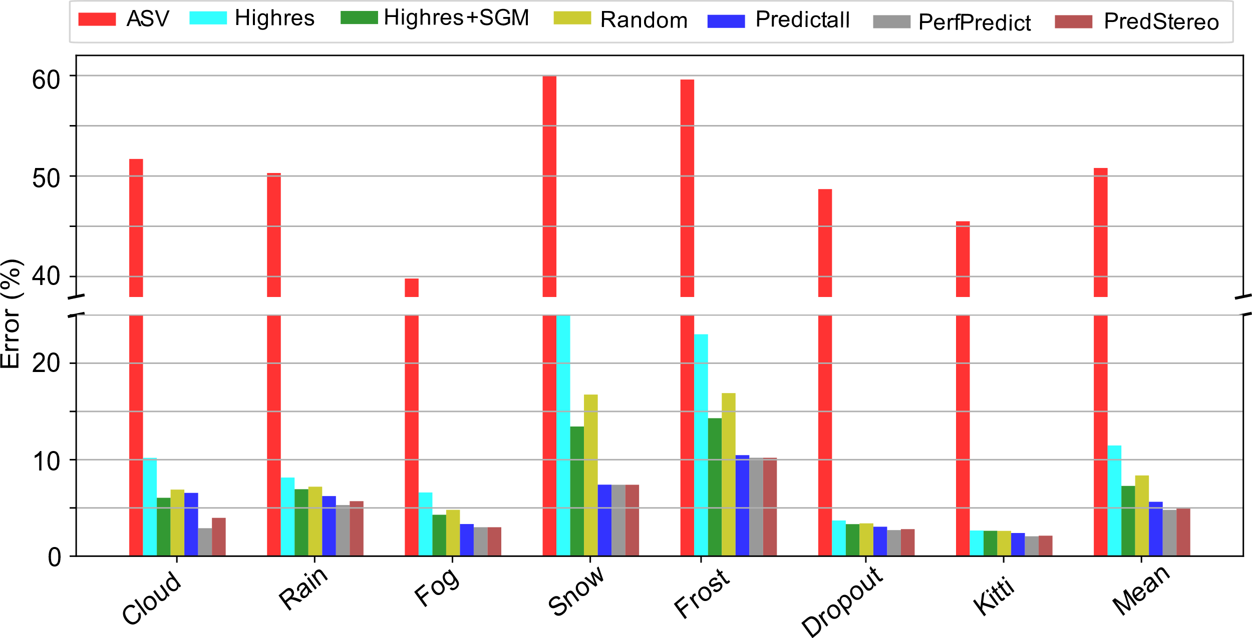
Evaluation: Accuracy Comparison
13%
5%
Our ensemble-based algorithm is 8% more accurate than monolithic CNN-based algorithm

Slide 10
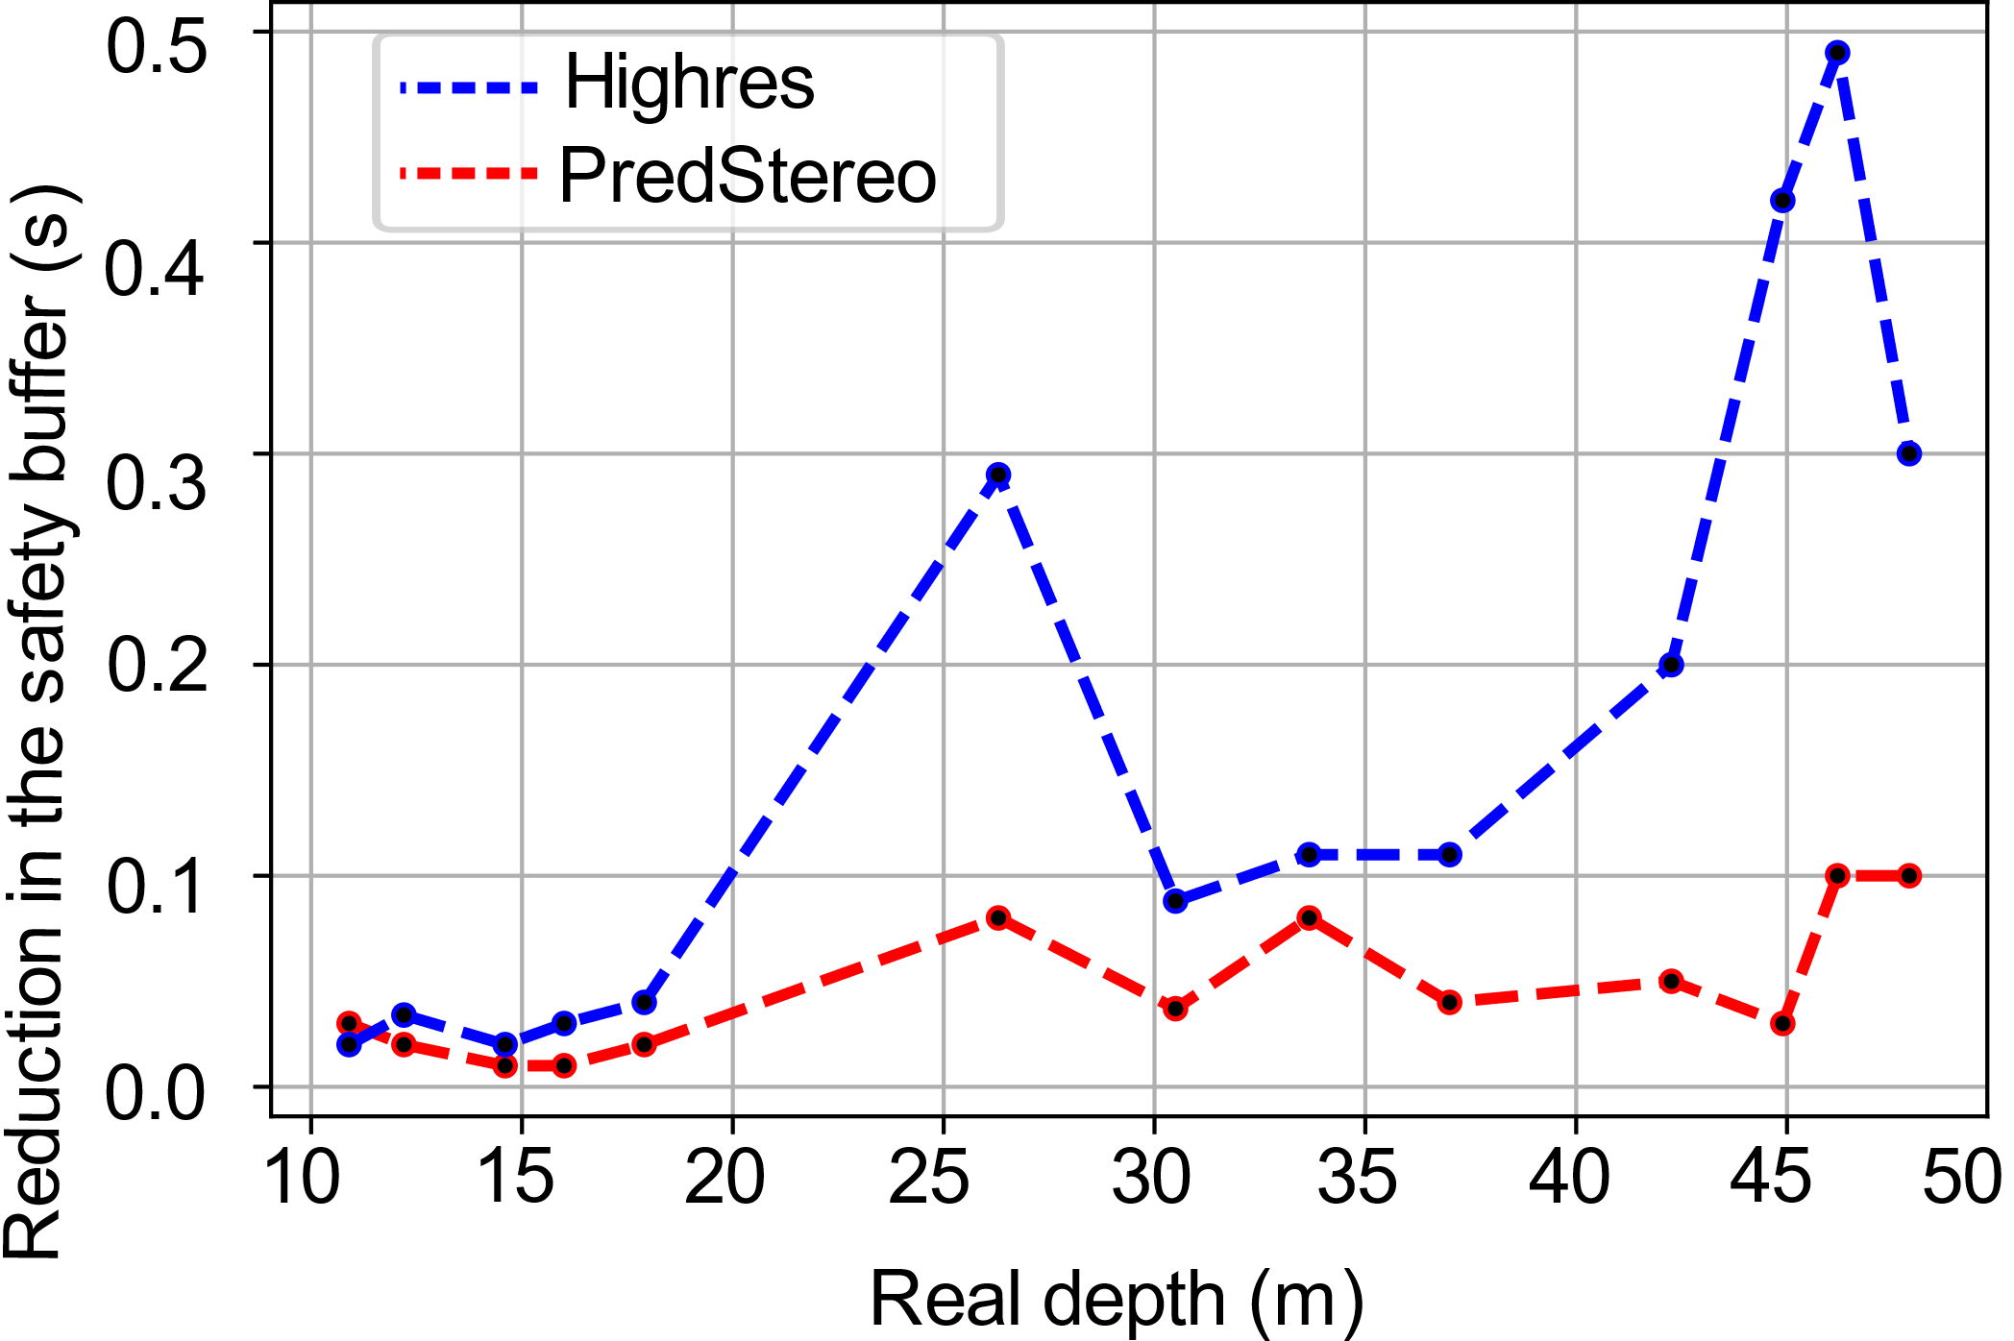
Evaluation: Reduction in Safety Buffer Time
Reduction in safety buffer with CNN-based system: 500 ms
Better safety buffer time with PredStereo as compared to CNN-based system
Reduction in safety buffer with PredStereo: 100 ms
Typical time taken to react and apply brakes 1.2-1.5 s

Slide 11
Conclusion
CNNs are not always highly accurate
Traditional algorithms outperform CNNs for inclement unseen weather scenes
Minimal image features can predict a suitable algorithm in real-time
Ensemble-based stereo vision is the right choice for safety-critical systems

Slide 12
Email: diksha.Moolchandani@cse.iitd.ac.in
Website: https://www.cse.iitd.ac.in/~diksha/

Slide 13
Disparity and Depth
P (x,y,z)
depth
$$Depth=\frac{B∗f}{disparity}$$
P1(x_{l}, y)
P2(x_{r}, y)
f
disparity
O_{l}
O_{r}
B
O_{l}, O_{r} : Optical center of camera
P1, P2 : 2D projections of 3D point P
f : focal length of the camera
B : distance between the two cameras

Slide 14
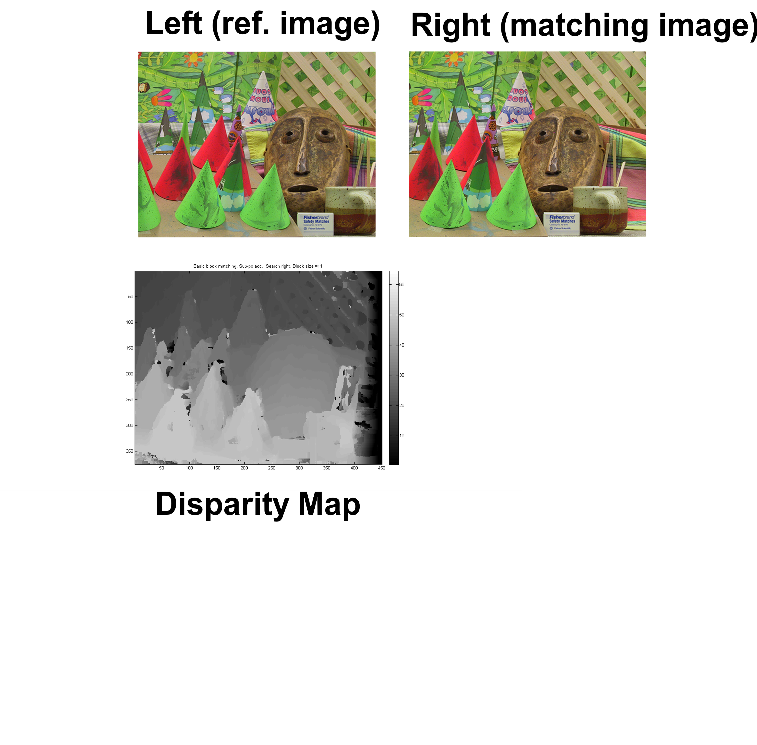
Stereo Vision: Disparity and Depth
(xl,yl)
(xr,yr)
$$Depth=\frac{B∗f}{disparity}$$
f : focal length of the camera
B : distance between the two cameras
(xl,yl)
xr = xl + D(xl,yl)
yr = yl
D(xl,yl) denotes the pixel
value of (xl,yl) in the disparity map

