Slide 1
FlexiCheck: an Adaptive Checkpointing Architecture for Energy Harvesting Devices
Priyanka Singla, Shubhankar S. Singh and Smruti R. Sarangi
School of Information Technology
Indian Institute of Technology Delhi, India
This work has been partially supported by the Semiconductor Research Corporation (SRC)

Slide 2
Outline
Introduction
Existing Work
Mathematical Modelling
Proposed Model – FlexiCheck
Evaluation
Conclusion
Introduction

Slide 3
Difficult to replace
Large form factor
Use ambient energy, which otherwise goes wasted

Slide 4
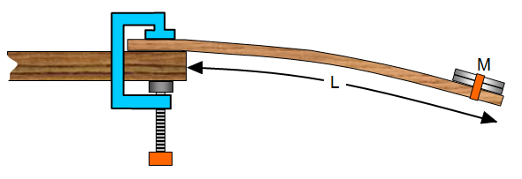
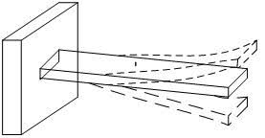
Energy Harvesting Devices (EHDs)
Convert ambient energy into electrical energy and store in a small storage unit (capacitor)
ISSUES!!
small
Solar Energy
Uncertain ambient energy
Rate of charging is much less than the rate of discharging
Different sources have different characteristics
Power
Time
Vibrational Energy
1.
Vibrational
Solar
1. Image Source: http://www.schoolphysics.co.uk

Slide 5
Normal Execution vs EHD Execution
Normal Execution: Battery based device.
EHD Execution: Capacitor based device.

Slide 6
Normal Execution

Slide 7
Program Finishes Successfully
Program Begins
Normal Execution
EHD Execution

Slide 8
Program Finishes Successfully
Program Begins
Normal Execution
EHD Execution
Energy Store
Program Failure
Program Begins
Storage Drained Out

Slide 9
Program Finishes Successfully
Program Begins
Normal Execution
The cycle continues
EHD Execution
Energy Store
Program Failure
Program Begins
Storage Drained Out

Slide 10
Program Finishes Successfully
Program Begins
Normal Execution
EHD Execution
Energy Store
Checkpoint
Program Begins

Slide 11
11
Wait and Recharge
Energy Store
Program Finishes Successfully
Restore

Slide 12
Device’s Execution Cycle
Compute
Checkpoint
Wait/
Recharge
Restore

Slide 13
Outline
Introduction
Existing Work
Mathematical Modelling
Proposed Model – FlexiCheck
Evaluation
Conclusion
Existing Work

Slide 14
Checkpointing Techniques
STATIC: Programmer or compiler intervention.
Conservative: Oblivious to ambient energy
E.g., Dino[1], Ratchet[2], Chain[3]
FLEXICHECK: ADAPTIVE (Dynamic + Learning)
No inputs from programmer
Architecture predicts the profile, dynamically adapts the checkpointing strategy
DYNAMIC: Use energy monitoring by hardware
Runtime decisions: Checkpoint when energy is about to exhaust
E.g., Hibernus[4], Mementos[5]
LEARNING: Learn ambient profile offline, ambient energy not monitored
at runtime
E.g., MDP[6]
1. B. Lucia and B. Ransford, “A simpler, safer programming and execution model for intermittent systems,” PLDI 2015.
2. J. Van et al., “Intermittent computation without hardware support or programmer intervention.” in OSDI, 2016.
3. A. Colin and B. Lucia, “Chain: tasks and channels for reliable intermittent programs,” OOPSLA 2016.
4. D. Balsamo et al., “Hibernus: Sustaining computation during intermittent supply for energy-harvesting systems,” IEEE ESL, 2015.
5. B. Ransford et al. , “Mementos: System support for long-running computation on rﬁd-scale devices,” ASPLOS 2011
6. Z. Ghodsi et al., “Optimal checkpointing for secure intermittently-powered iot devices,” in ICCAD, 2017.

Slide 15
Checkpointing Techniques
STATIC: Programmer or compiler intervention.
Conservative: Oblivious to ambient energy
E.g., Dino[’15], Ratchet[’16], Chain[’16]
DYNAMIC: Use energy monitoring by hardware
Runtime decisions: Checkpoint when energy is about to exhaust
E.g., Hibernus['15], Mementos[’11]
LEARNING: Learn ambient profile offline, ambient energy not monitored
at runtime
E.g., MDP [’17]
FLEXICHECK: ADAPTIVE (Dynamic + Learning)
No inputs from programmer
Architecture predicts the profile, dynamically adapts the checkpointing strategy

Slide 16
Outline
Introduction
Existing Work
Mathematical Modelling
Proposed Model – FlexiCheck
Evaluation
Conclusion
Mathematical Modelling

Slide 17
Mathematical Model of the Problem
Model
Optimization Formulation
Modified Formulation:
Quadratically Constrained Linear Program (QCLP)

Slide 18
Ambient Energy
$$Instantaneous Power:𝒫(t)$$
$$Energy \left[t_{0}{, t}_{0}+Δt\right]: \int_{t_{0}}^{t_{0}+Δt}{𝒫\left(t\right)dt}$$
Power (mW)
Term | Notation
Instantaneous Power | $$𝒫(t)$$
Solar Energy
Vibrational Energy
Time (ms)

Slide 19
Ambient Energy
Program
Subset Creation
Create Disjoint Subsets
Example | Subset creation | Checkpoint creation
Dino, Ratchet | Static | All (static)
Hibernus | Dynamic creation when energy about to exhaust.
Mementos | Static | Dynamic
MDP | Implicit (equal sized) | Dynamic
Term | Notation
Instantaneous Power | $$𝒫(t)$$
Subset execution Energy | $$𝓔(Si)$$
Subset execution Time | $$𝓣\left(Si\right)$$
Term | Notation
Instantaneous Power | $$𝒫(t)$$
S₁
S₂
S_{m}
$$𝒯\left(Si\right),ℰ(Si)$$
$ℰ(Si)$should not be more than the device can provide
Feasible Points
Checkpoints can be taken only at boundaries, not within a subset

Slide 20
Ambient Energy
Subset Creation
S₁
S₂
S_{m}
Checkpointing Cost
Recharging Time
W_{i}
Term | Notation
Instantaneous Power | $$𝒫(t)$$
Subset execution Energy | $$ℰ(Si)$$
Subset execution Time | $$𝒯\left(Si\right)$$
Checkpointing Energy | E_{c}
Checkpointing Time | T_{c}
Boolean (checkpoint taken at boundary) | X_{i}=1
Wait time (per subset) | W_{i}
Term | Notation
Instantaneous Power | $$𝒫(t)$$
Subset execution Energy | $$ℰ(Si)$$
Subset execution Time | $$𝒯\left(Si\right)$$
Checkpointing Energy | E_{c}
Checkpointing Time | T_{c}
Boolean (checkpoint taken at boundary) | X_{i}=1
Term | Notation
Instantaneous Power | $$𝒫(t)$$
Subset execution Energy | $$ℰ(Si)$$
Subset execution Time | $$𝒯\left(Si\right)$$
X_{i}=1
Entire Volatile memory (SRAM and registers)
Energy (E_{c}) and Time (T_{c})
Wait (W_{i}) is always preceded by a checkpoint (X_{i})
Wait and recharge anytime, not only at end.

Slide 21
Mathematical Model of the Problem
Model
Optimization Formulation
Modified Formulation:
Quadratically Constrained Linear Program (QCLP)

Slide 22
Optimization Formulation
Term | Notation
Instantaneous Power | $$𝒫(t)$$
Subset execution Energy | $$ℰ(Si)$$
Subset execution Time | $$𝒯\left(Si\right)$$
Checkpointing Energy | E_{c}
Checkpointing Time | T_{c}
Boolean (checkpoint taken at boundary) | X_{i}=1
Wait time (per subset) | W_{i}
Term | Notation
Instantaneous Power | $$𝒫(t)$$
Subset execution Energy | $$ℰ(Si)$$
Subset execution Time | $$𝓣\left(Si\right)$$
Checkpointing Energy | E_{c}
Checkpointing Time | T_{c}
Boolean (checkpoint taken at boundary) | X_{i}=1
Wait time (per subset) | W_{i}
Term | Notation
Instantaneous Power | $$𝒫(t)$$
Subset execution Energy | $$ℰ(Si)$$
Subset execution Time | $$𝒯\left(Si\right)$$
Checkpointing Energy | E_{c}
Checkpointing Time | T_{c}
Boolean (checkpoint taken at boundary) | X_{i}=1
Wait time (per subset) | W_{i}
$$Minimize: T$$
Subset exec
Subset exec
Checkpointing
$$\sum_{i=1}^{m}{𝒯\left(S_{i}\right)}$$
$$+ \sum_{i=1}^{m}{T_{c}∗X_{i}}$$
X_{i}=0
22
X_{i}=1
X_{i}=1
X_{i}=1

Slide 23
Optimization Formulation
Term | Notation
Instantaneous Power | $$𝒫(t)$$
Subset execution Energy | $$ℰ(Si)$$
Subset execution Time | $$𝒯\left(Si\right)$$
Checkpointing Energy | E_{c}
Checkpointing Time | T_{c}
Boolean (checkpoint taken at boundary) | X_{i}=1
Wait time (per subset) | W_{i}
Term | Notation
Instantaneous Power | $$𝒫(t)$$
Subset execution Energy | $$ℰ(Si)$$
Subset execution Time | $$𝓣\left(Si\right)$$
Checkpointing Energy | E_{c}
Checkpointing Time | T_{c}
Boolean (checkpoint taken at boundary) | X_{i}=1
Wait time (per subset) | W_{i}
Term | Notation
Instantaneous Power | $$𝒫(t)$$
Subset execution Energy | $$ℰ(Si)$$
Subset execution Time | $$𝒯\left(Si\right)$$
Checkpointing Energy | E_{c}
Checkpointing Time | T_{c}
Boolean (checkpoint taken at boundary) | X_{i}=1
Wait time (per subset) | W_{i}
Term | Notation
Instantaneous Power | $$𝒫(t)$$
Subset execution Energy | $$ℰ(Si)$$
Subset execution Time | $$𝒯\left(Si\right)$$
Checkpointing Energy | E_{c}
Checkpointing Time | T_{c}
Boolean (checkpoint taken at boundary) | X_{i}=1
Wait time (per subset) | W_{i}
$$Minimize: T$$
Subset exec
Wait Time
Subset exec
Checkpointing
Waiting
Checkpointing
$$\sum_{i=1}^{m}{𝒯\left(S_{i}\right)}$$
$$+ \sum_{i=1}^{m}{T_{c}∗X_{i}}$$
$$+ \sum_{i=1}^{m}{W_{i}∗X_{i}}$$
X_{i}=0
23
X_{i}=1
X_{i}=1
X_{i}=1

Slide 24
Optimization Formulation
Term | Notation
Instantaneous Power | $$𝒫(t)$$
Subset execution Energy | $$ℰ(Si)$$
Subset execution Time | $$𝒯\left(Si\right)$$
Checkpointing Energy | E_{c}
Checkpointing Time | T_{c}
Boolean (checkpoint taken at boundary) | X_{i}=1
Wait time (per subset) | W_{i}
Term | Notation
Instantaneous Power | $$𝒫(t)$$
Subset execution Energy | $$𝓔(Si)$$
Subset execution Time | $$𝒯\left(Si\right)$$
Checkpointing Energy | E_{c}
Checkpointing Time | T_{c}
Boolean (checkpoint taken at boundary) | X_{i}=1
Wait time (per subset) | W_{i}
Device energy (beginning of each subset) | $$B_{i}$$
Term | Notation
Instantaneous Power | $$𝒫(t)$$
Subset execution Energy | $$𝓔(Si)$$
Subset execution Time | $$𝒯\left(Si\right)$$
Checkpointing Energy | E_{c}
Checkpointing Time | T_{c}
Boolean (checkpoint taken at boundary) | X_{i}=1
Wait time (per subset) | W_{i}
Device energy (beginning of each subset) | $$B_{i}$$
Term | Notation
Instantaneous Power | $$𝓟(t)$$
Subset execution Energy | $$𝓔(Si)$$
Subset execution Time | $$𝒯\left(Si\right)$$
Checkpointing Energy | E_{c}
Checkpointing Time | T_{c}
Boolean (checkpoint taken at boundary) | X_{i}=1
Wait time (per subset) | W_{i}
Device energy (beginning of each subset) | $$B_{i}$$
Term | Notation
Instantaneous Power | $$𝒫(t)$$
Subset execution Energy | $$ℰ(Si)$$
Subset execution Time | $$𝒯\left(Si\right)$$
Checkpointing Energy | E_{c}
Checkpointing Time | T_{c}
Boolean (checkpoint taken at boundary) | X_{i}=1
Wait time (per subset) | W_{i}
Device energy (beginning of each subset) | $$B_{i}$$
Term | Notation
Instantaneous Power | $$𝒫(t)$$
Subset execution Energy | $$ℰ(Si)$$
Subset execution Time | $$𝒯\left(Si\right)$$
Checkpointing Energy | E_{c}
Checkpointing Time | T_{c}
Boolean (checkpoint taken at boundary) | X_{i}=1
Wait time (per subset) | W_{i}
Device energy (beginning of each subset) | $$B_{i}$$
$$Minimize: T$$
$$\sum_{i=1}^{m}{𝒯\left(S_{i}\right)+ \sum_{i=1}^{m}{T_{c}∗X_{i}}+ \sum_{i=1}^{m}{W_{i}∗X_{i}}}$$
Subject to:
Variables
$$+\int_{t=t_{i}}^{t_{i}+W_{i}}{X_{i}∗𝒫\left(t\right)dt}$$
${∀i:B}_{i+1}$=
$$B_{i}$$
$$−{ℰ(S}_{i})$$
$${−E}_{c}∗X_{i}$$
$$𝒫\left(t\right)dt$$
Both objective function and constraints highly non linear
Computationally intractable
Reduce complexity
$${∀i:B}_{min} ≤ B_{i} ≤ B_{max}$$
subset execution energy
Energy spent in checkpointing
Energy gained while waiting
$$S_{i}$$
$$W_{i}$$
24
Initial stored energy

Slide 25
Mathematical Model of the Problem
Model
Optimization Formulation
Modified Formulation:
Quadratically Constrained Linear Program (QCLP)

Slide 26
Approximations to reduce the complexity
Assumed same sized subsets: intervals
2
Experimental Observation:
3
Constrained W to span multiple intervals
1
Relatively very low checkpointing energy and time, so considered statically
Wait time and execution time can be computed in the same way: only keeping the track of the interval
S₁
S₂
S_{m}
Rate of discharge is much more than rate of charging.
Fixed number of instructions, similar time and energy for all the intervals, choose max
$${∀i:B}_{i+1}=B_{i}−{ℰ(S}_{i}){−E}_{c}∗X_{i}+\int_{t=t_{i}}^{t_{i}+W_{i}}{X_{i}∗ℰ𝒫\left(t\right)dt}$$
$$Minimize: T= \sum_{i=1}^{m}{𝒯\left(S_{i}\right)+ \sum_{i=1}^{m}{T_{c}∗X_{i}}+ \sum_{i=1}^{m}{W_{i}∗X_{i}}}$$
No need to keep a track of per interval energy or time
W

Slide 27
Modified Optimization Formulation
Modified Optimization Formulation: QCLP
$ℱ$= 0
$$E$$
$$E$$
$$Q$$
$$Q$$
$$Q$$
$$E$$
$$Q$$
$$E$$
$$Q$$
$$E$$
$$E$$
$$E$$
1
2
3
4
5
6
𝒩-2
𝒩-1
𝒩
$$Minimize: T=\sum_{i=1}^{\text{𝒩} }{{\overline{ℱ}}_{i}}$$
Linear Program
$ℱ$= 1
Subject to:
$${∀i:B}_{i+1}=B_{i}−{\left({\overline{ℱ}}_{i}∗{\overline{Q}}_{i}∗ℰ\right)+({\overline{ℱ}}_{i}∗Q_{i}∗En}_{i})$$
$${\text{ℱ}}_{0}\text{=} \text{0}$$
$∀i$:${ ℱ}_{i}=1⇒ ℱ_{i+1}=1$
Quadratic Constraints
$$∀i:\sum_{i=1}^{\text{𝒩}}{{\overline{ℱ}}_{i}∗{\overline{Q}}_{i}=U}$$
27

Slide 28
Outline
Introduction
Existing Work
Mathematical Modelling
Proposed Model – FlexiCheck
Evaluation
Conclusion
Introduction

Slide 29
FlexiCheck
QCLP
FlexiCheck
Optimal solution for a particular ambient profile.
Does not deal with variations in the profile
Why FlexiCheck?
Implement an energy predictor in hardware
Learn some parameters from QCLP
Based on the prediction, take actions in software
Idea and its relation to QCLP

Slide 30
Ambient Energy Source
Vibrational source, vary sinusoidally at ms granularity
Define a threshold S_{t} (QCLP), S >S_{t} good to recharge
S_{t}
S (Power mW)
Time (ms)

Slide 31
Decision Logic
Decision
Logic
Ambient Energy (S)
Action
(S_{t}, B_{t})
Action A is a tuple (E_{x}, Ck)
E_{x}=1: Execute, else wait
Ck=1: Checkpoint
$\left(S≤ S_{t} \&\& { B}_{t}<B<B_{max}\right) \left| \right| B=B_{max}$ => $E_{x}=1$
$$\left(B<B_{t}\right)⇒Ck=1$$
B_{max}
S_{t}
S (Power mW)
B_{t}
Using
QCLP
B_{min}
Time (ms)

Slide 32
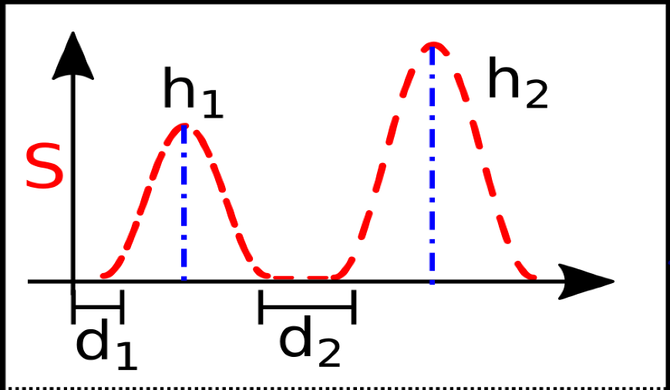
Implementation
Characterize S using periods, denoted as (h,d) pairs
Space efficiency:
Few bits for (h,d).
Need not store values for all the points in a period.
S (Power mW)
Energy efficiency:
No need to compare S with S_{t}, in every clock cycle, only if new (h,d).
Since periodic, so (h,d) will be maintained, and hence the frequency of computing actions decrease.
Time (ms)

Slide 33
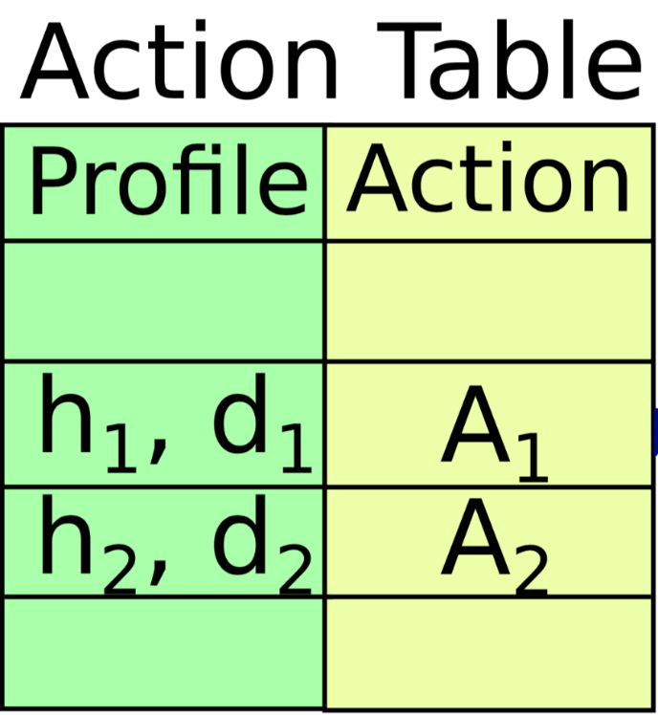
_{Implementing in Hardware}
Train
Find (h,d) of the period
Decision
Logic
Prediction

Slide 34
Read (h,d)
_{Implementing in Hardware}
Train
Prediction
Find action

Slide 35
Learning Thresholds (S_{t}, B_{t})
Computed using QCLP
S_{t}
𝒩-1
𝒩
From QCLP: For each interval, $i$, we have a tuple (($S_{i}$, $B_{i}$), ${Ck}_{i}$)
B_{t}
Apply linear regression on all the points, get the intercepts

Slide 36
Outline
Introduction
Existing Work
Mathematical Modelling
Proposed Model - FlexiCheck
Evaluation
Conclusion
Evaluation

Slide 37
Synthesis Results: Area, Time and Energy
Designed in Verilog, used Cadence Genus Tool, 130nm Technology
Area | Time | Energy
6346 $μm^{2}$ | 62.5 $ns$ | 11.25 $nJ$

Slide 38
Activity Recognition
LED Blinker
Cuckoo Filter
RSA Encryption
ColdChain Equipment Monitoring
AR
RSA
Benchmarks
CEM
LED
CF

Slide 39
Tejas
Open source, cycle accurate architectural simulator
TI’s MSP430FR5969
16-bit 5 staged inorder, 16MHz
32 byte set associative cache, 2KB SRAM, 64KB FRAM
SRAM: R - 0.12 nJ, W - 0.27 nJ, 1 cycle
3.6 V, 10$μ$F, B_{min}=16,200 nJ, B_{max}= 64,800 nJ, S_{t}=700 $μ$W
3.6 V, 10 𝜇F, B_{min}=16,200 nJ, B_{max}= 64,800 nJ, S_{t}=700 𝜇W
Checkpoint: 2443 nJ, 1771 cycles
FRAM: 2.7 nJ, 2 cycles
Platform
Experimental Setup
Processor
System Parameters
39

Slide 40
Experiments Performed
Time and energy comparison with variable energy
Number of checkpoints

Slide 41
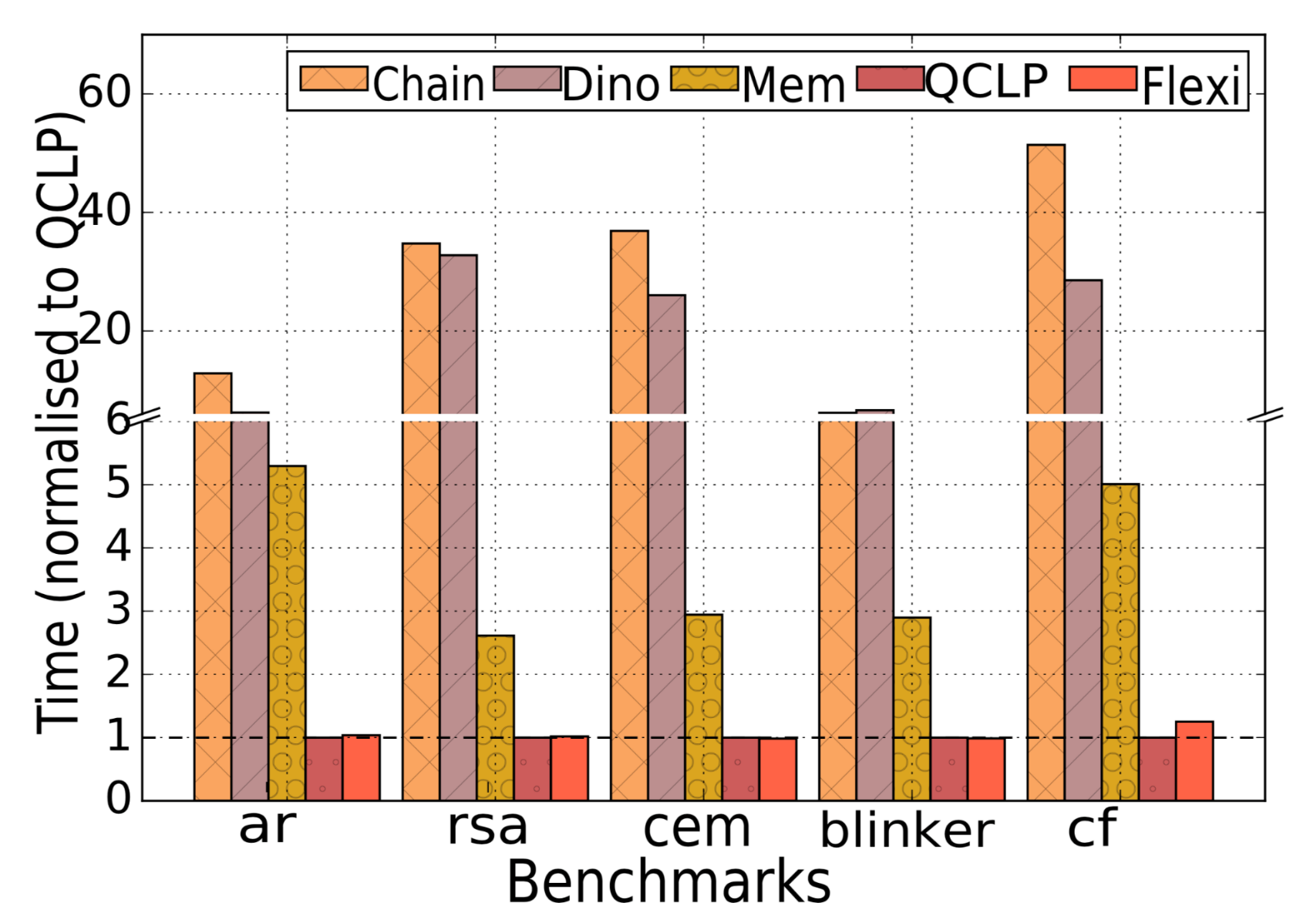
Performance
FlexiCheck is within 3-8% of QCLP
Chain: 6-50 X slower
Dino: 6-36X slower
Mementos: 2-5X slower
A. Colin and B. Lucia, “Chain: tasks and channels for reliable intermittent programs,” OOPSLA 2016.
B. Lucia and B. Ransford, “Dino: A simpler, safer programming and execution model for intermittent systems,” PLDI 2015.
B. Ransford et al. , “Mementos: System support for long-running computation on rﬁd-scale devices,” ASPLOS 2011.

Slide 42
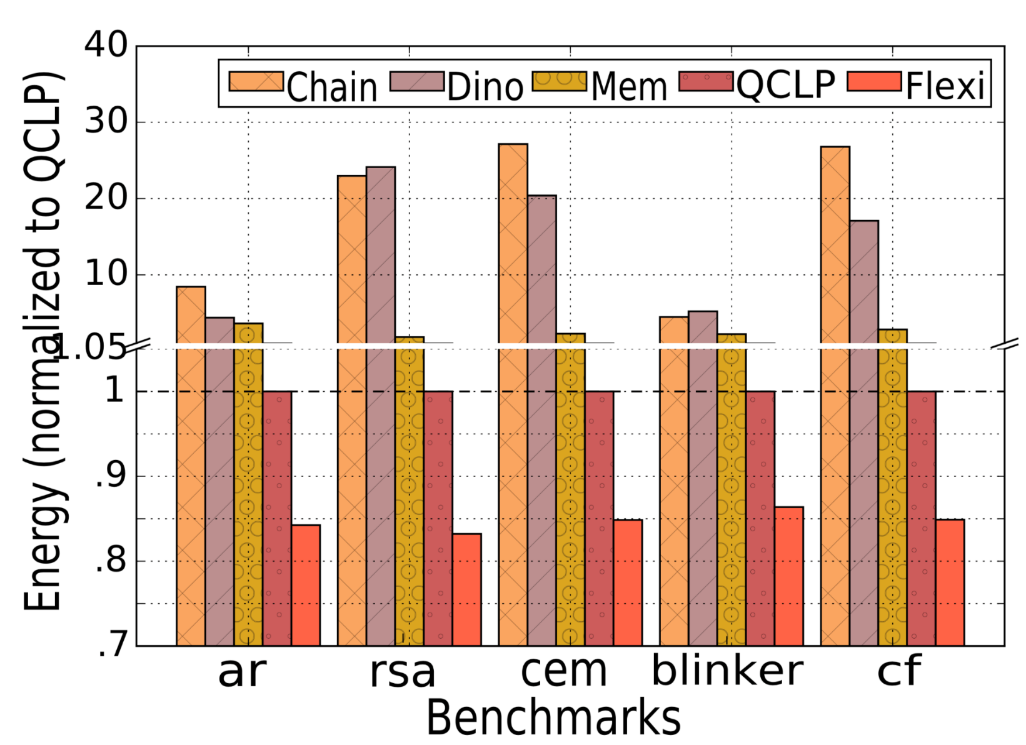
Energy
FlexiCheck ~20% less energy than QCLP
Chain: 10-30X more
Dino: 6-25X more
Mementos: 2-5X more
A. Colin and B. Lucia, “Chain: tasks and channels for reliable intermittent programs,” OOPSLA 2016.
B. Lucia and B. Ransford, “Dino: A simpler, safer programming and execution model for intermittent systems,” PLDI 2015.
B. Ransford et al. , “Mementos: System support for long-running computation on rﬁd-scale devices,” ASPLOS 2011.

Slide 43
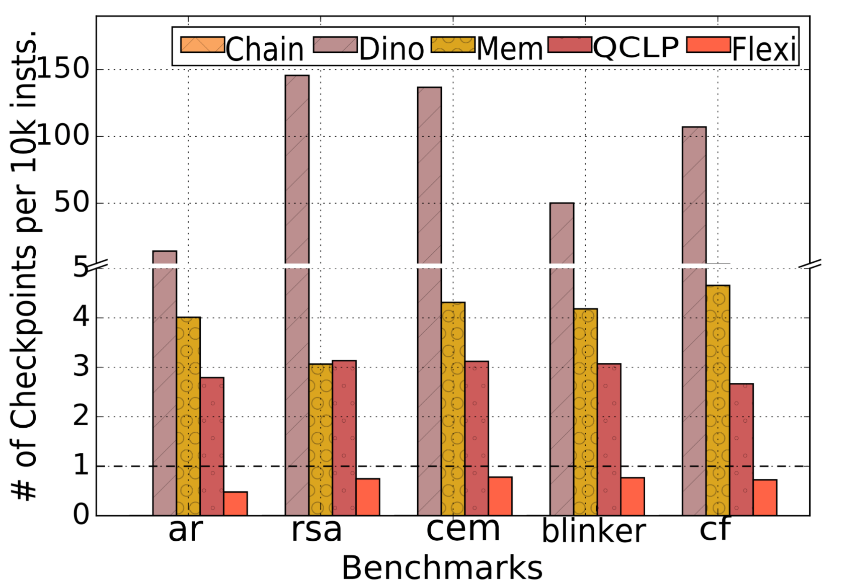
# Checkpoints
FlexiCheck has least number of checkpoints
A. Colin and B. Lucia, “Chain: tasks and channels for reliable intermittent programs,” OOPSLA 2016.
B. Lucia and B. Ransford, “Dino: A simpler, safer programming and execution model for intermittent systems,” PLDI 2015.
B. Ransford et al. , “Mementos: System support for long-running computation on rﬁd-scale devices,” ASPLOS 2011.

Slide 44
Outline
Introduction
Existing Work
Mathematical Modelling
Proposed Model - FlexiCheck
Evaluation
Conclusion
Conclusion

Slide 45
Conclusion
Places checkpoints optimally
Predicts ambient energy
Checkpointing is codesigned with predictor
2-5X Mementos
Performance against QCLP
Energy: 20% better
10-30X Chain
6-20X Dino
Performance gain against existing work
Time: Within 3-8%

Slide 46
46

Slide 47
FlexiCheck: an Adaptive Checkpointing Architecture for Energy Harvesting Devices
Priyanka Singla, Shubhankar S. Singh and Smruti R. Sarangi
School of Information Technology
Indian Institute of Technology Delhi, India
This work has been partially supported by the Semiconductor Research Corporation (SRC)

