Slide 1
CmpctArch: A Generic Low Power Architecture for Compact Data Structures in Energy Harvesting Devices
Priyanka Singla and Smruti R. Sarangi
School of Information Technology
Indian Institute of Technology Delhi, India

Slide 2
Introduction

Slide 3
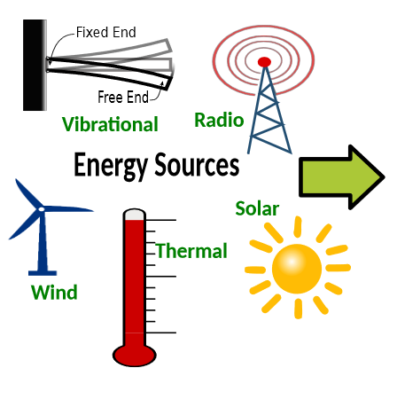
Energy Harvesting Devices
3
Limited power budget (500-750) μW
Limited memory
Expensive NVM accounts for > 50% of the device’s price (15-20 USD)
Typically
2-8KB SRAM
64-128KB FRAM
Aim: Minimize the memory footprint while staying within the power constraints and not significantly increasing the processing time
Convert ambient energy into electrical energy and store in a small storage unit (capacitor)
Proposal: Use compact data structures (CDSs)
No application specific implementations: Generic Architecture

Slide 4
Background-CDS Examples
Introduction

Slide 5
1. Hash Tables (HT)
$$\{$$
$$1, ifAk\left[i\right]≠NULL ∀i∈[0,n−1]$$
$$\text{B}\left[i\right]=$$
$$0, otherwise$$
Regular
n entries
Rank₁(B,i)
A_{k}
k₂
Returns the number of 1 bits in B[0:i]
k₁
k_{m}
k₃
k₄
A_{v}
v₂
v₁
v_{m}
v₃
v₄
$$rank1\left(\text{B},i\right)=\sum_{j=0}^{i}{\text{B}[j]} ∀i∈\left[0,n−1\right]$$
Compressed
B
1
1
0
1
0
1
1
0
n > m
A’_{k}
k₁
k_{m}
k₂
$$\{$$
k₃
k₄
$$NULL, if \text{B}\left[i\right]=0$$
A’_{v}
$$Ak\left[i\right]=$$
Entries wasted: 2*(n-m)
v₂
v₁
v_{m}
v₃
v₄
$A′k\left[rank\left(\text{B}\left[i\right]\right)−1\right]$, otherwise

Slide 6
Efficient Rank Computation
Expensive sequential scanning
Precompute and store
k bits
k=16
Store for superblocks
B
1100 1001 1101 0101 1111 1001 1100 0110 1
R
0
9
19
$$rank1\left(\text{B},i\right)=\sum_{j=0}^{i}{\text{B}[j]} ∀i∈\left[0,n−1\right]$$
$rank1\left(\text{B},i\right)=\text{R}\left[⌊i/k⌋\right]$ + $cntOnes\left(\text{B},i,k\right)$

Slide 7
Efficient Rank Computation
Expensive Sequential Scanning
Precompute and Store
k bits
k=16
Store for Superblocks
B
1100 1001 1101 0101 1111 1001 1100 0110 1
Sub-blocks
p bits
R’
0
2
4
7
0
4
6
8
0
R
0
9
19
$$rank1\left(\text{B},i\right)=\sum_{j=0}^{i}{\text{B}[j]} ∀i∈\left[0,n−1\right]$$
$rank1\left(\text{B},i\right)=\text{R}\left[⌊i/k⌋\right]$ + $cntOnes\left(\text{B},i,k\right)$
$$cntOnes\left(\text{B},i,k\right)=\text{R}′\left[⌊i/p⌋\right]+cntOnes\left(\text{B},i,p\right)$$

Slide 8
$$Notation$$ | $$Meaning$$
$$i$$ | $$Data item$$
$$h()$$ | $$Hash function$$
$$n$$ | $$No of entries in array A$$
$$rank1()$$ | $$Rank functionality$$
$$A^{′}k$$ | $$Compressed key array$$
$$Notation$$ | $$Meaning$$
$$i$$ | $$Data item$$
$$h()$$ | $$Hash function$$
$$n$$ | $$No of entries in array A$$
$$rank1()$$ | $$Rank functionality$$
$$A^{′}k$$ | $$Compressed key array$$
$$A^{′}v$$ | $$Compressed value array$$
$$Notation$$ | $$Meaning$$
$$i$$ | $$Data item$$
$$h()$$ | $$Hash function$$
$$n$$ | $$No of entries in array A$$
Update and Query Operations
$$Notation$$ | $$Meaning$$
$$i$$ | $$Data item$$
$$h()$$ | $$Hash function$$
$$n$$ | $$No of entries in array A$$
$$rank1()$$ | $$Rank functionality$$
$$rank1\left(\text{B},h\left(i\right)\%n\right)$$
$$A^{′}k[rank1\left(\text{B},h\left(i\right)\%n\right)−1]$$
$$\left(h\left(i\right)\%n\right)$$
Match key and update/query
$$A^{′}v[rank1\left(\text{B},h\left(i\right)\%n\right)−1]$$
Find Index
Compute Rank
Regular Expression
Access Array
((Index)(Rank)(Access Array)(Match))⁺
Match key

Slide 9
2. Lists
n samples
Data
10
17
10
25
17
25
Huffman codes
B
0100 0111 0100 101110 0100 101110
0100 0111 0100 101110 0100 101110
L
4
4
4
6
6
6
Lengths
$$codei=\text{B}\left[j:j+\text{L}\left[i\right]−1\right], where j=\sum_{k=0}^{i−1}{\text{L}[k]}$$
Digit -> Codeword
Mapping
1
0
1
B
0100 0111 0100 101110 0100 101110
1
0
k values
1
0
1
0
P
0
18
7
5
2
0
$j=\text{P}\left[⌊i/k⌋\right]$ + $\sum_{w=\left\lfloor \frac{i}{k}\right\rfloor ∗k}^{i−1}{\text{L}[w]}$
Expensive sequential scanning
Precompute and store for blocks

Slide 10
Query Operation
$$codei=\text{B}\left[j:j+\text{L}\left[i\right]−1\right], where j=\text{P}\left[⌊i/k⌋\right] \text{+} \sum_{w=\left\lfloor \frac{i}{k}\right\rfloor ∗k}^{i−1}{\text{L}[w]}$$
Compute Rank
$$get_code$$
$$Query\left(i\right):v=get_code(codei)$$
Array Traversal
Tree|CAM Traversal
Traverse Hufmman Tree
Codeword | Digit
0 | 1
100 | 0
101 | 2
110 | 5
111 | 7
Match
Codeword->Digit mapping
1
0
1
1
0
Regular Expression
1
0
1
0
(Rank)(Array Traversal)((Tree|CAM Traversal)(Match))⁺
7
5
2
0

Slide 11
3. Tries
C
11011010101100001010110110000
W
0
B
E
wb
ih
k
i
pm
l
o
go
sg
Edge Labels
I
1
5
H
L
er
mberg
L
edia
atsapp
pot
edia
WIKIPEDIA
WIKIMEDIA
WHATSAPP
BLOGSPOT
BLOGGER
BLOOMBERG
2
A
T
S
A
P
P
6
K
O
M
011110111101111110111011011111
3
7
I
G
O
4
8
M
B
E
R
G
Preorder Traversal
P
M
S
G
Description
E
D
I
A
E
D
I
A
P
O
T
E
R
Sizes of the leaf labels
Leaf Labels

Slide 12
W
0
B
Query()
I
1
5
H
C
11011010101100001010110110000
L
2
A
T
S
A
P
P
6
E
wb
ih
k
i
pm
l
o
go
sg
K
Given a node’s description starts at index u in C
O
L
edia
edia
atsapp
pot
er
mberg
3
7
Find index of j^{th} child’s description, child(u,j)?
I
G
O
M
011110111101111110111011011111
4
child(u,1) = u+c+1, c: No. of children of the node
P
M
8
M
B
E
R
G
S
G
E
D
I
A
child(u,2): sum of the sizes of the descriptions of the sub-tree at child(u,1)
E
D
I
A
P
O
T
E
R
Similarly, compute child(u,j)

Slide 13
W
0
B
Query(P)
: Checks the existence of a pattern P in the trie
I
1
5
H
L
Start at the root; check if P’s first character (P[0]) is an outgoing edge label
2
A
T
S
A
P
P
6
K
O
3
7
I
G
O
4
8
M
B
E
R
G
Iterate over the children to match the next character
P
M
S
G
E
D
I
A
E
D
I
A
P
O
T
E
R
Continue the process till a leaf node is reached
C
11011010101100001010110110000
E
wb
ih
k
i
pm
l
o
go
sg
L
edia
edia
atsapp
pot
er
mberg
M
011110111101111110111011011111

Slide 14
Related Work
Background-CDS Examples
Introduction

Slide 15
Related Work
1
2
Sampling Based
CompressionBased
Lossy/lossless compression
Based on the correlation between the samples
Not generic; requires ~100mW power
Our proposal consumes <1mW (existing works:10-100X)
Incomplete information
Need to maintain uncompressed versions in memory for handling the query operation.
Agnostic to data, is lossless, allows efficient querying
Hard to find and leverage temporal relations in data

Slide 16
Generic Architecture
Related Work
Background-CDS Examples
Introduction

Slide 17
Generic Regular Expression
Generic Architecture
((Index*)(Rank)(Array Traversal)((Tree|CAM|Array Traversal)(Match) )⁺)⁺
Input Request
2 Rank Stage
3 Evaluate Stage
k
Local Indexer*
1
2
3
1 Index Stage
Array Accessor
Indexer*
4
5
Buff0
h(k)%n
6
Sum Computer

Slide 18
Generic Architecture
Input Request
2 Rank Stage
3 Evaluate Stage
Local Indexer*
Structure Accessor*
1
2
3
8
9
1 Index Stage
Array Accessor
Property Matcher*
Indexer*
4
5
10
Buff0
Buff1
6
7
Sum Computer

Slide 19
Generic Architecture
HT | Tries
89% | 82%
HT | Lists | Tries
71% | 37% | 66%
Shared Area
Input Request
2 Rank Stage
3 Evaluate Stage
Local Indexer*
Structure Accessor*
1
2
3
8
9
1 Index Stage
Array Accessor
Property Matcher*
Indexer*
4
5
10
12
Value Updater*
Buff0
Buff1
6
12’
7
Sum Computer
Query Result
11

Slide 20
Implementing the ‘Property Matcher’
A comparator checks if the fetched data matches the key
HT
A content addressable memory (CAM) structure checks if the codeword (retrieved from the bit-vector) matches the codes stored in the reverse dictionary
Lists
Require two properties to be satisfied
1.Used to find the matching edge labels; realized via a comparator
Tries
2. Used in child(u,j), cnt₀ = cnt₁+1

Slide 21
Genericity of the Architecture
Considered a set of popular data structures used in sensor devices
Data structure | Regular expression
Tree | ((Index*)(Rank)(Array Traversal)(Match))⁺
Key-value store | (Index)((Index*)(Rank)(Array Traversal) ((Tree|CAM|Array Traversal*) (Match))⁺)⁺
Queue | ((Array Traversal)(Match))⁺
Positional index | (Index)((Array Traversal)(Match))*

Slide 22
Evaluation
Generic Architecture
Related Work
Background-CDS Examples
Introduction

Slide 23
-16 bit, 5-stage, in-order processor, 16MHz
- 32 byte set associative cache, 2KB SRAM, 64KB FRAM (TI’s MSP430FR5969)
- 28nm Technology, designed in VHDL, used Cadence Genus Tool
- All signals are 16 bits wide
- Intel Lab Dataset[1]
- Samples of different ambient parameters
System Configuration
Hardware Configuration
Experimental Setup
Datasets
Considered
1. Samuel Madden, “Intel Lab Data,” http://db.csail.mit.edu/labdata/labdata.html, MIT Comp. Sc. and Artificial Intelligence Lab, 2004.

Slide 24
Memory Savings
Compaction Ratio ($\frac{MFR}{MFC}$)
Ratio of the memory footprints (MF) of the regular and compact representations.
 | HT | Lists | Tries
Compaction Ratio ($\frac{MFR}{MFC}$) | 1.31 | 1.36 | 3.44

Slide 25
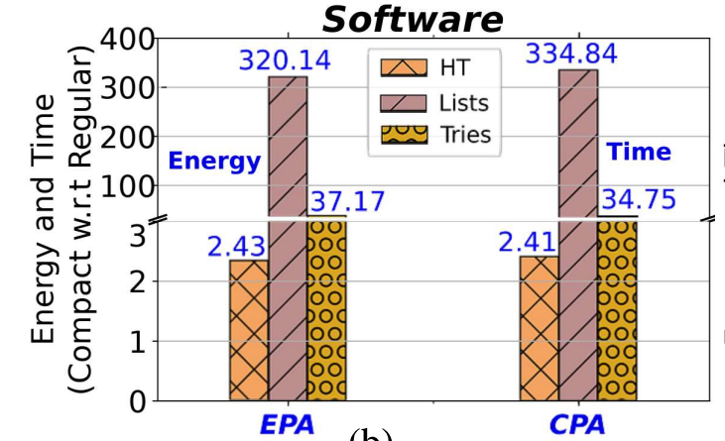
Energy Consumed and Time Taken (in Software)
25
EPA: Energy Per Access
CPA: Cycles Per Access
Compact HT and tries consume 2.43-37.17X more energy.
They take 2.41-34.75X more time.
Operations such as cntOnes and child (in tries) involve linear scanning of the bit vectors => Large overheads

Slide 26
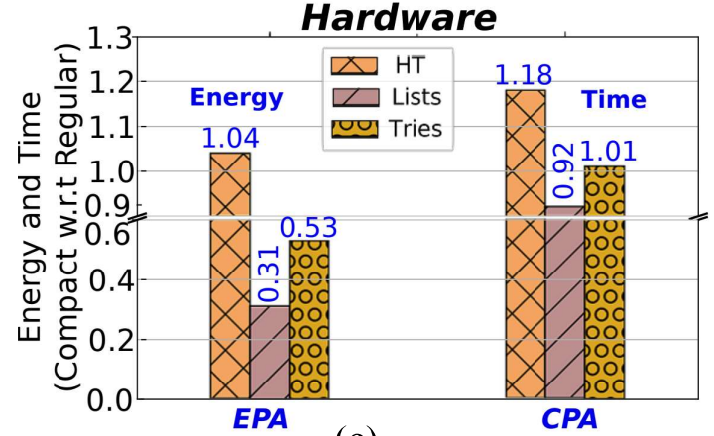
Energy Consumed and Time Taken (in Hardware)
26
Due to parallelism and
reduced memory usage.
HT:
Similar energy (1.04X),
Time (1.18X)
Tries:
More energy efficient (0.53X), similar time (1.01X)

Slide 27
Energy Consumed and Time Taken (Lists)
27
Energy and time overheads in software are extremely high.
Multiple memory accesses involved while performing the linear scanning in the get_code function.
Avoid linear scanning by implementing the dictionary as a CAM structure in hardware.

Slide 28
Preferable Ambient Source
Hardware implementations of the considered data structures consume around 180μW-700μW
Observation regarding the power consumption
Much lower than the power provided by various ambient sources
Commercially available solar harvesters (e.g., MAX20361) and piezo transducers (e.g., S118-J1SS-1808YB) can harvest the required power
Preferable sources
Thus, the solar and vibrational sources are preferable

Slide 29
Conclusion
Evaluation
Generic Architecture
Related Work
Background-CDS Examples
Introduction

Slide 30
CONCLUSION
30
Considerably reduced the memory footprint while staying within the power constraints (700 μW), and not significantly increasing the processing time
Proposed to use compact data structures, and created a generic architecture
Experimentally evaluated our synthesized hardware
- 3.5X memory footprint reduction, with minimal energy & time overheads
- Instantiated three structures – HT, lists, and tries

Slide 31
31
Questions
Contact:
priyanka@cse.iitd.ac.in
http://www.cse.iitd.ac.in/~priyankas/

Slide 32
CmpctArch: A Generic Low Power Architecture for Compact Data Structures in Energy Harvesting Devices
Priyanka Singla and Smruti R. Sarangi
School of Information Technology
Indian Institute of Technology Delhi, India

