Slide 1
Processor Design
The Language of Bits
Basic Computer Architecture
Prof. Smruti Ranjan Sarangi IIT Delhi
Chapter 6: RISC-V Assembly Language

Slide 2
2nd version
www.basiccomparch.com
Download the pdf of the book
videos
Slides, software, solution manual
The pdf version of the book and all the learning resources can be freely downloaded from the website: www.basiccomparch.com
Print version
(Publisher: WhiteFalcon, 2021)
Available on e-commerce sites.

Slide 3
Outline
RISC-V Machine Model
Integer Instructions
Control Transfer and Memory Instructions
Floating Point Instructions
Instruction Encoding
Code snippets beautified with carbon.app (https://carbon.now.sh)

Slide 4
Requirements of a Modern ISA
Compatible with all kinds of devices: 32, 64, 128 bits
No licensing requirement
Large software developer community
Extensibility: Possible to add all kinds of novel extensions: vector, crypto, AI/ML, etc.
Why did the need for RISC-V arise?
2010
2015
Project begins in Berkeley
Creative Commons License
Maintained by the RISC-V Foundation

Slide 5
RISC-V Machine Model
Name | Description
RV32 | 32-bit ISA
RV32E | 32-bit ISA (embedded version)
RV64 | 64-bit ISA
RV64E | 64-bit ISA (embedded version)
RV128 | 128-bit ISA
Extensions
Mnemonic | Meaning
E | Embedded version
I | Base integer ISA
M | Integer multiplication/division instructions
A | Atomic instructions
F | Single-precision floating point
D | Double-precision floating point
V | Vector Instructions
Different variants of the instruction set

Slide 6
More about Extensions
Integer variants of the ISA
RV32I is a regular 32-bit ISA with integer instructions
RV64I, RV128I
RV32IMA → integer, mul/div, atomic instructions
RV32I1p3
Major version number: 1
Minor version number: 3
G → base integer ISA, additional integer insts, FP instructions, basic synch. instructions
Popular format: RV32G

Slide 7
Embedded and Compressed Instructions
We quickly run out of letters !!!
The `Z’ series was introduced
Zfa → Additional floating-point instructions
Embedded version
Does not reduce the instruction width (still 32 bits)
Reduces the number of registers by 50%
Compressed version
Width = 16 bits
Access only 8 registers
Limited opcode support, smaller immediate values
Even in 64 and 128-bit formats, instructions are 32 bits.
48 and 64-bit instructions are getting ratified

Slide 8
RISC-V Integer Registers
Register | Mnemonic | Description
x0 | zero | Hardwired to zero
x1 | ra | Return address
x2 | sp | Stack pointer
x3 | gp | Global pointer
x4 | tp | Thread pointer (thread-local storage
x5-7 | t0-2 | Temporary registers
x8 | s0/fp | Saved register/frame pointer
Register | Mnemonic | Description
x9 | s1 | Saved register
x10-11 | a0-1 | Function args/ return values
x12-17 | a2-7 | Function args
x18-27 | s2-11 | Saved registers
x28-31 | t3-6 | Temporary registers
x0 is hardwired to 0
There is a dedicated pc register
Bi-endian

Slide 9
RV128
RV64
RV32
x0/zero
x1
x2
x3
View of Registers
x4
x5
x6
x7
x8
x9
x31
127
64
32
0
PC
127
64
32
0

Slide 10
Outline
RISC-V Machine Model
Integer Instructions
Control Transfer and Memory Instructions
Floating Point Instructions
Instruction Encoding

Slide 11
Moving values to registers
Semantics | Example | Explanation
addi rd, rs1, imm | addi x1, x0, 5 | x1 ← 0 + 5
add rd, rs1, rs2 | add x1, x0, x3 | x1 ← 0 + x3
Register x0/ zero is hardwired to 0
Moving a value to a register is accomplished by adding it to zero
Immediates are normally 12 bits in RISC-V
The addi instruction adds an immediate to a register (could be zero)
The regular add instruction can be used
If the first source register is set to zero → Moving a value from one register to another
There is no subi instruction because the immediate is signed

Slide 12
Loading Immediates Directly
Semantics | Example | Explanation
lui rd, imm (20-bit) | lui x1, 5 | x1 ← 5 << 12
li rd, imm (32-bit) | li t0, 0xABCD1234 | t0 ← 0xABCD1234
The lui instruction can load a 20-bit immediate directly into the upper 20 bits.
Note that other instructions only load the lower 12 bits
The li assembler directive can load a 32-bit value directly
Translated to two instructions (internally)
We can either use the x-series registers or the mnemonics
The mnemonics are normally preferred because it is possible to honor the register-usage semantics.

Slide 13
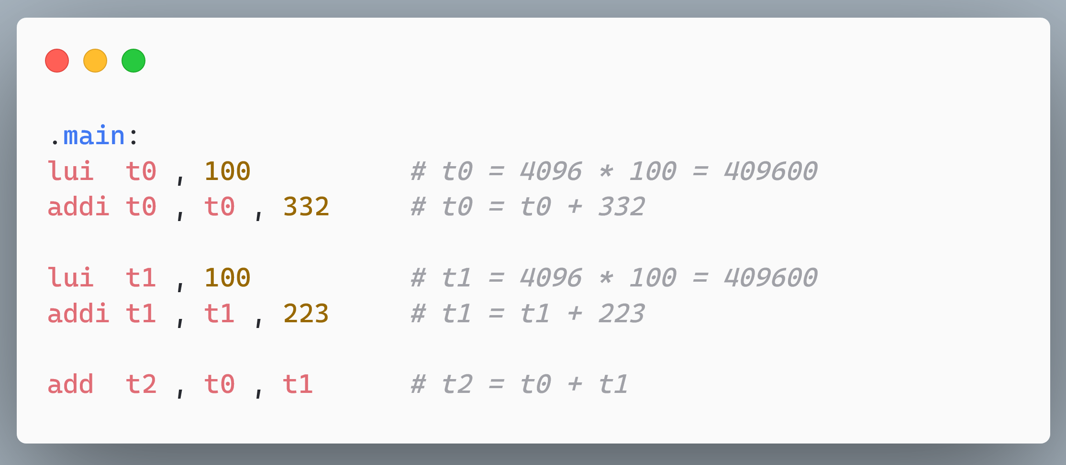
Add 409932 + 409823.

Slide 14
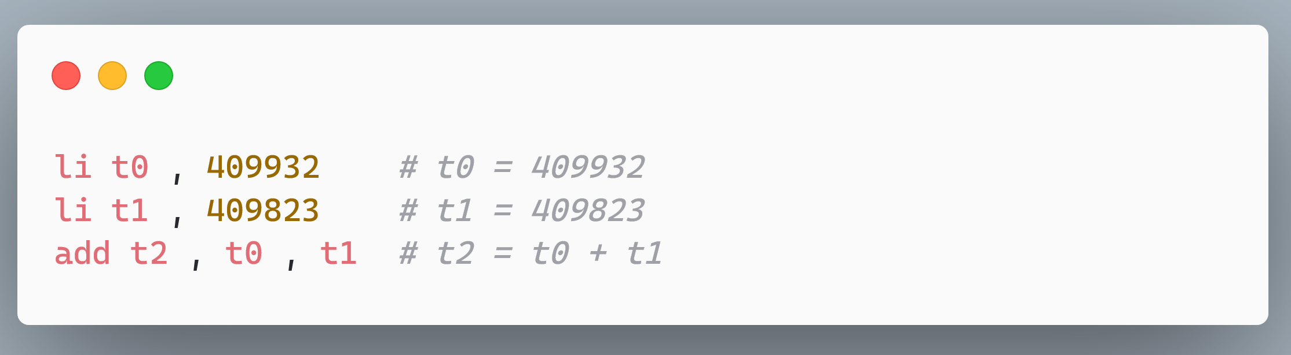
Add 409932 + 409823.
Using assembler directives like li makes writing assembly code easier

Slide 15
Add/Sub Instructions
Semantics | Example | Explanation
add rd, rs1, rs2 | add x1, x2, x3 | x1 ← x2 + x3
addi rd, rs1, imm | addi x1, x2, 5 | x1 ← x2 + 5
sub rd, rs1, rs2 | sub x1, x2, x3 | x1 ← x2 - x3

Slide 16
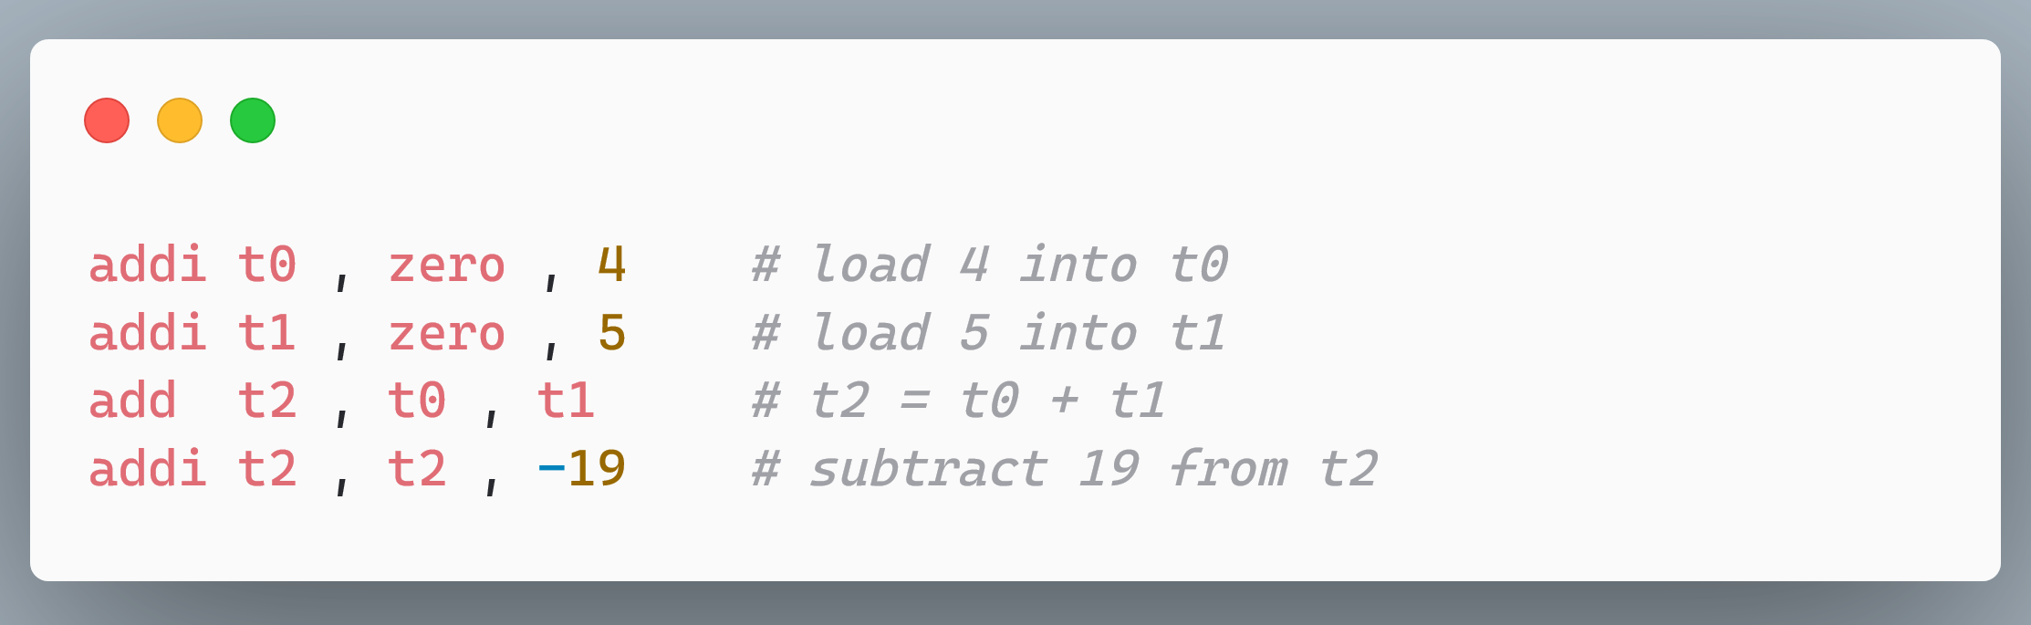
Compute 4 + 5 - 19.

Slide 17
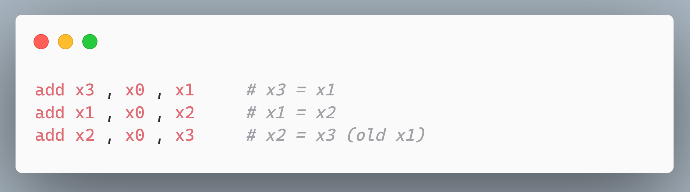
Swap two numbers stored in x1 and x2 (resp.).

Slide 18
Multiplication and Division
Semantics | Example | Explanation
mul rd, rs1, rs2 | mul x1, x2, x3 | x1 ← x2 * x3
div rd, rs1, rs2 | div x1, x2, x3 | x1 ← x2 / x3
rem rd, rs1, rs2 | rem x1, x2, x3 | x1 ← rem (x2 / x3)
Part of the ‘M’ extension
The default mul instruction computes the lower 32 bits
The product ideally requires 64 bits
The mulh and mulhu instructions can be used to compute the upper 32 bits
The HW dynamically recognizes a consecutive mul-mulh instruction pair, and replaces it with a single multiplication

Slide 19
Division Rules
Division Operation | Quotient | Remainder
4 ÷ 3 | 1 | 1
4 ÷ (-3) | -1 | 1
(-4) ÷ 3 | -1 | -1
(-4) ÷ (-3) | 1 | -1
Round towards 0
Sign of the remainder is the same as the sign of the dividend
Consecutive division and remainder instructions (with the same operands) can be fused.

Slide 20
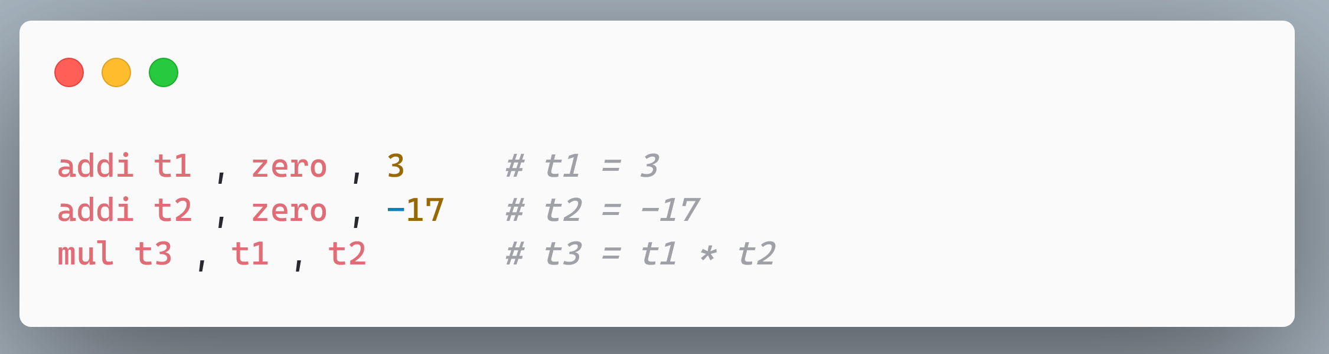
Multiply 3 with (-17).

Slide 21
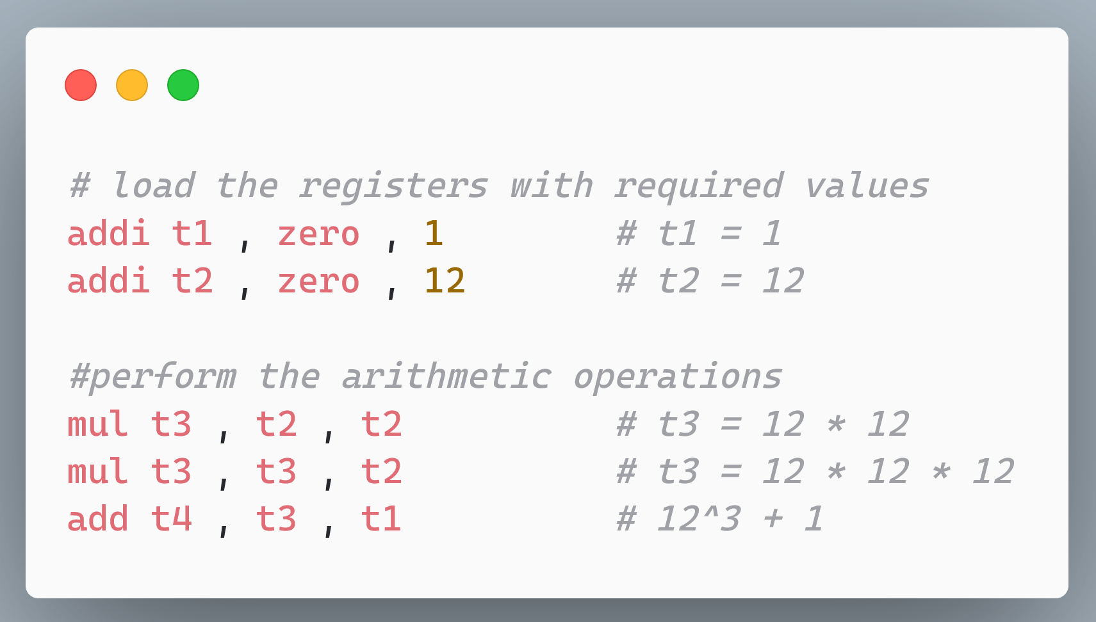
Compute 12³ + 1.

Slide 22
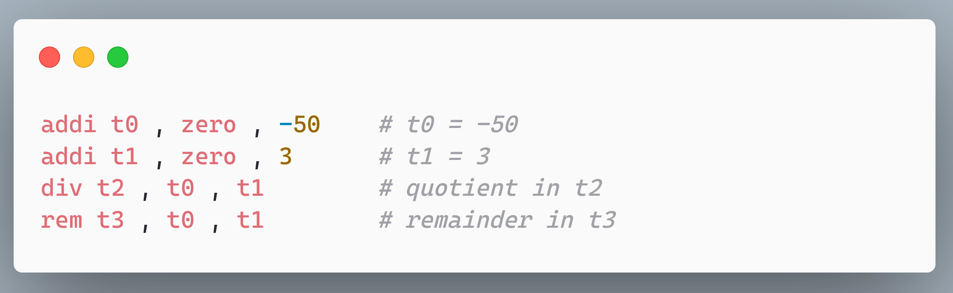
Divide -50 / 3.
Dynamically fused by hardware.

Slide 23
Logical and Shift Instructions
Semantics | Example | Explanation
and rd, rs1, rs2 | and x1, x2, x3 | x1 ← x2 AND x3
andi rd, rs1, imm | andi x1, x2, 6 | x1 ← x2 AND 6
or rd, rs1, rs2 | or x1, x2, x3 | x1 ← x2 OR x3
ori rd, rs1, imm | ori x1, x2, 9 | x1 ← x2 OR 9
xor rd, rs1, rs2 | xor x1, x2, x3 | x1 ← x2 XOR x3
xori rd, rs1, imm | xori x1, x2, 9 | x1 ← x2 XOR 9
sll rd, rs1, rs2 | sll x1, x2, x3 | x1 ← x2 << x3
srl rd, rs1, rs2 | srl x1, x2, x3 | x1 ← x2 >> x3
sra rd, rs1, rs2 | sra x1, x2, x3 | x1 ← x2 >>> x3
slli rd, rs1, imm | slli x1, x2, 3 | x1 ← x2 << 3
srli rd, rs1, imm | srli x1, x2, 3 | x1 ← x2 >> 3
srai rd, rs1, imm | srai x1, x2, 3 | x1 ← x2 >>> 3
right-shift arithmetic

Slide 24
Generic Format of Shift Instructions
Generic format
sll
,
rd
,
rs1
,
rs2
srl
,
rd
,
rs1
,
rs2
sra
,
rd
,
rs1
,
rs2
slli
,
rd
,
rs1
,
imm
srli
,
rd
,
rs1
,
imm
srai
,
rd
,
rs1
,
imm

Slide 25
Compute the bitwise OR of A and B. Let A = 4 and B = 1.

Slide 26
Compute t1 = t2 + t3 × 4
Strength reduction
Multiplications are slow. Shifts are much faster.

Slide 27
Outline
RISC-V Machine Model
Integer Instructions
Control Transfer and Memory Instructions
Floating Point Instructions
Instruction Encoding

Slide 28
Conditional Control Transfer Instructions
Semantics | Example | Explanation
slt rd, rs1, rs2 | slt x1, x2, x3 | if (x2 < x3) set x1 to 1
slti rd, rs1, imm | slti x1, x2, 5 | if (x2 < 5) set x1 to 1
sltu rd, rs1, rs2 | sltu x1, x2, 5 | if (x2 <_{unsigned} x3) set x1 to 1
sltui rd, rs1, imm | sltui x1, x2, x3 | if (x2 <_{unsigned} 5) set x1 to 1
Semantics | Example | Explanation
beq rs1, rs2, label | beq x1, x2, .foo | Branch to the . foo label if x1 = x2
bne rs1, rs2, label | bne x1, x2, .foo | Branch to the .foo label if x1 ≠ x2
bge rs1, rs2, label | bge x1, x2, .foo | Branch to the .foo label if x1 ≥ x2
blt rs1, rs2, label | blt x1, x2, .foo | Branch to the .foo label if x1 < x2
bgeu rs1, rs2, label | bgeu x1, x2, .foo | Similar to bge, considers unsigned values.
bltu rs1, rs2, label | bltu x1, x2, .foo | Similar to blt, considers unsigned values.

Slide 29
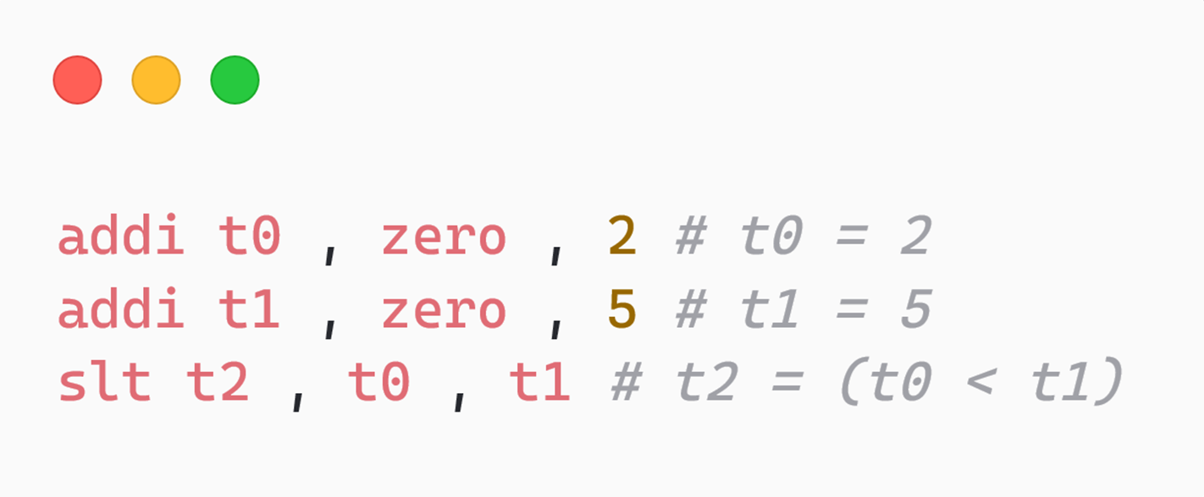
Control Transfer Instructions
RISC-V does not have a flags register.
Instead, the flags are stored in a register that the programmer specifies.
Compare 2 and 5 and store the comparison result in t2. [t2 = (2 < 5)]

Slide 30
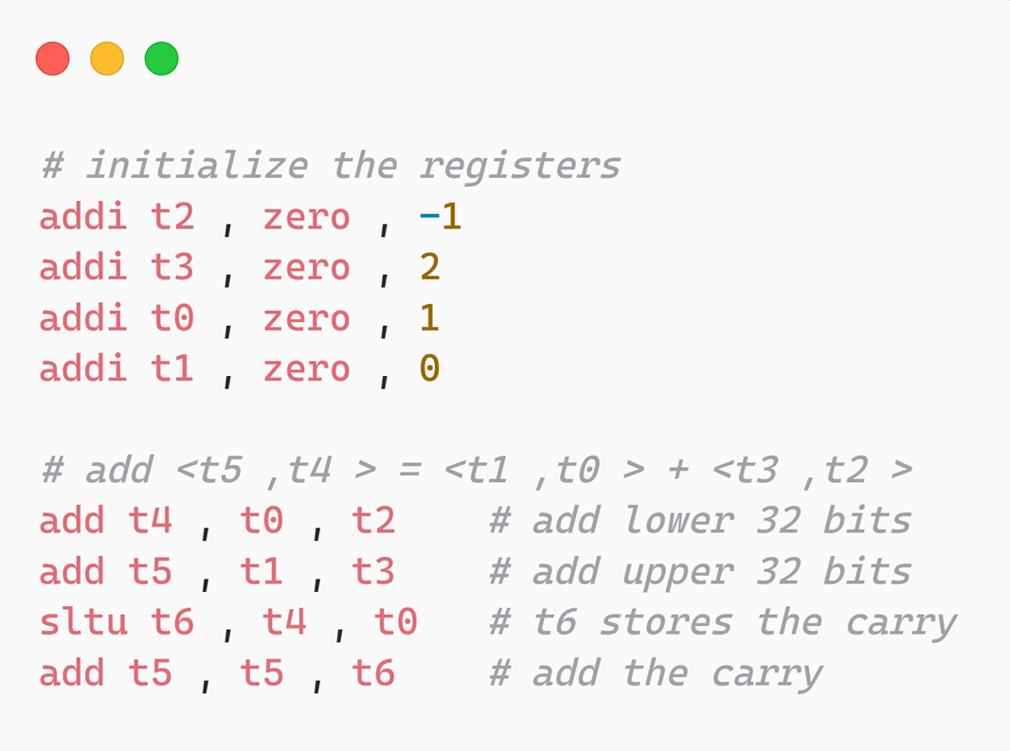
Add two 64-bit numbers (stored in two 32-bit registers) Note: sltu does an unsigned comparison.
t0 < t4 → there is a carry

Slide 31
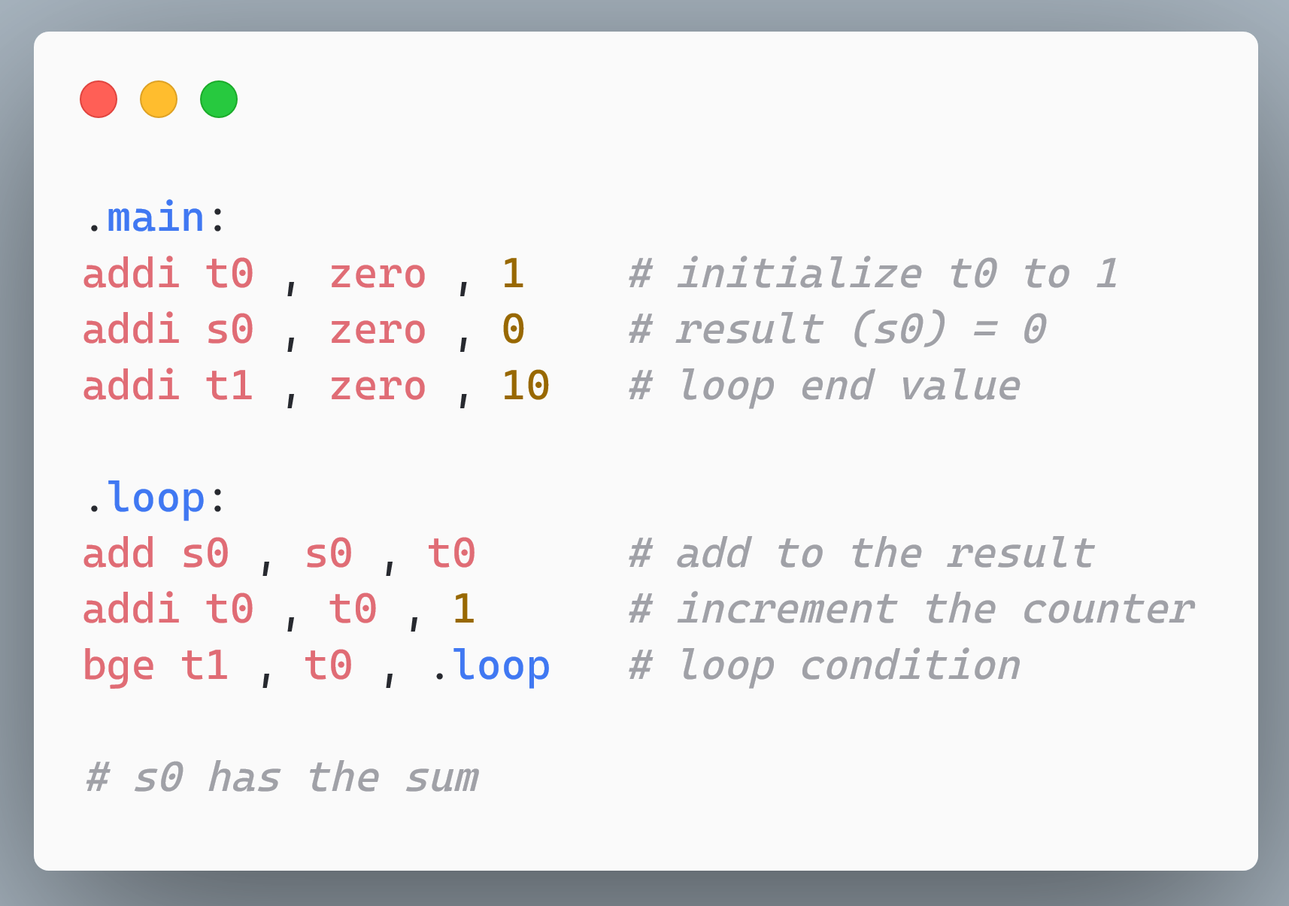
Add all the numbers from 1 to 10.

Slide 32
Unconditional Branches
Semantics | Example | Explanation
jal rd, label | jal x1, func | Jump to the func label and store the return address in x1
jalr rd, rs1, offset | jalr x1, x2, 20 | Jump to the address x2 + 20 and store the return address in x1
The jal instruction performs the role of an unconditional branch and a call instruction:
The return address is explicitly specified (there is no default)
If the return addr. register is zero, then this is a regular unconditional branch instruction
Otherwise, it is a call instruction
jalr is like a return instruction
In this case, the return address is stored in rd
If the return addr. register is zero, then nothing is stored. Functions like an indirect branch.

Slide 33
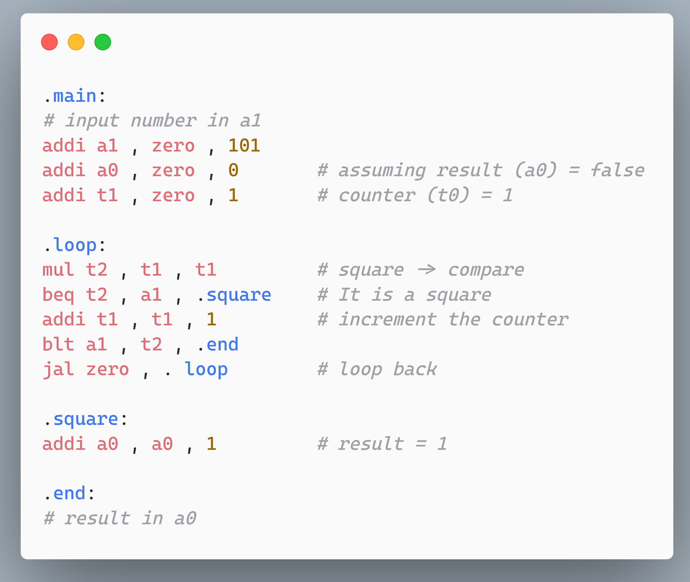
Check if the number stored in a1 is a square or not?

Slide 34
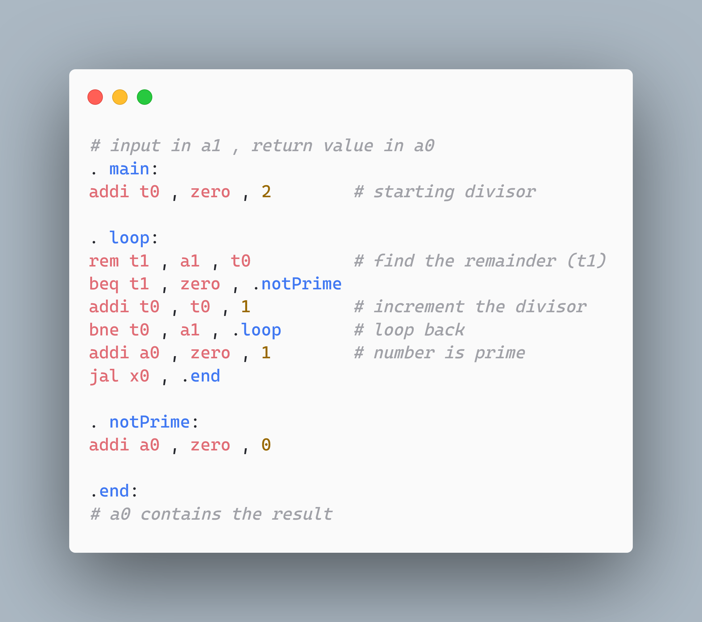
Check whether the number stored in a1 is a prime number.

Slide 35
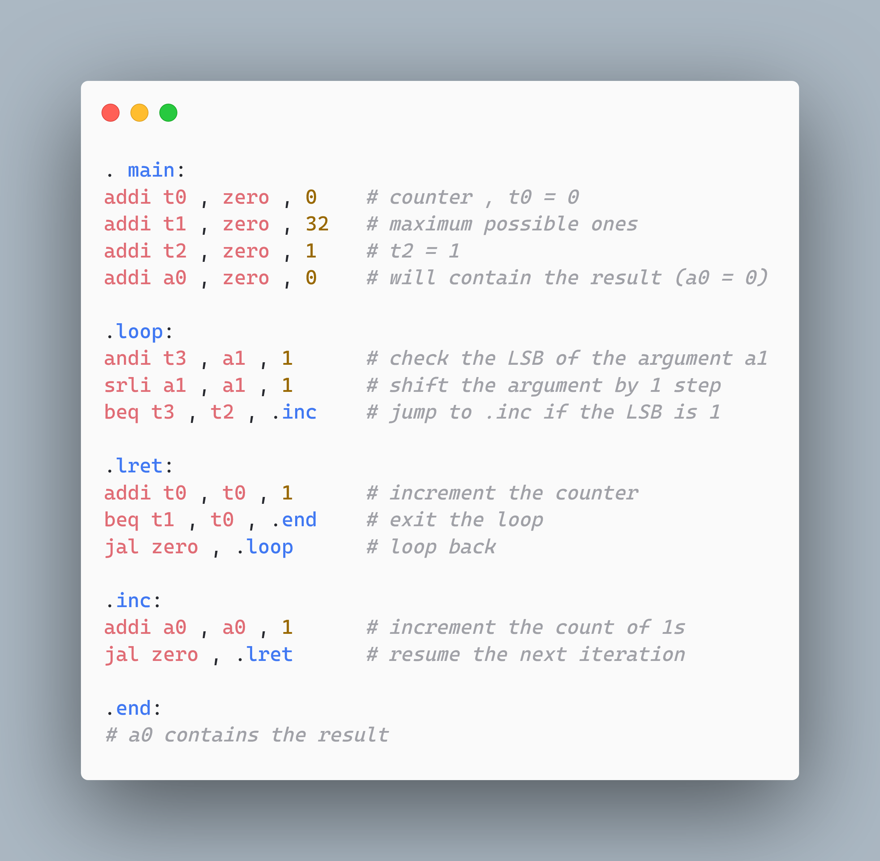
Find the number of ones in a 32-bit number stored in a1.

Slide 36
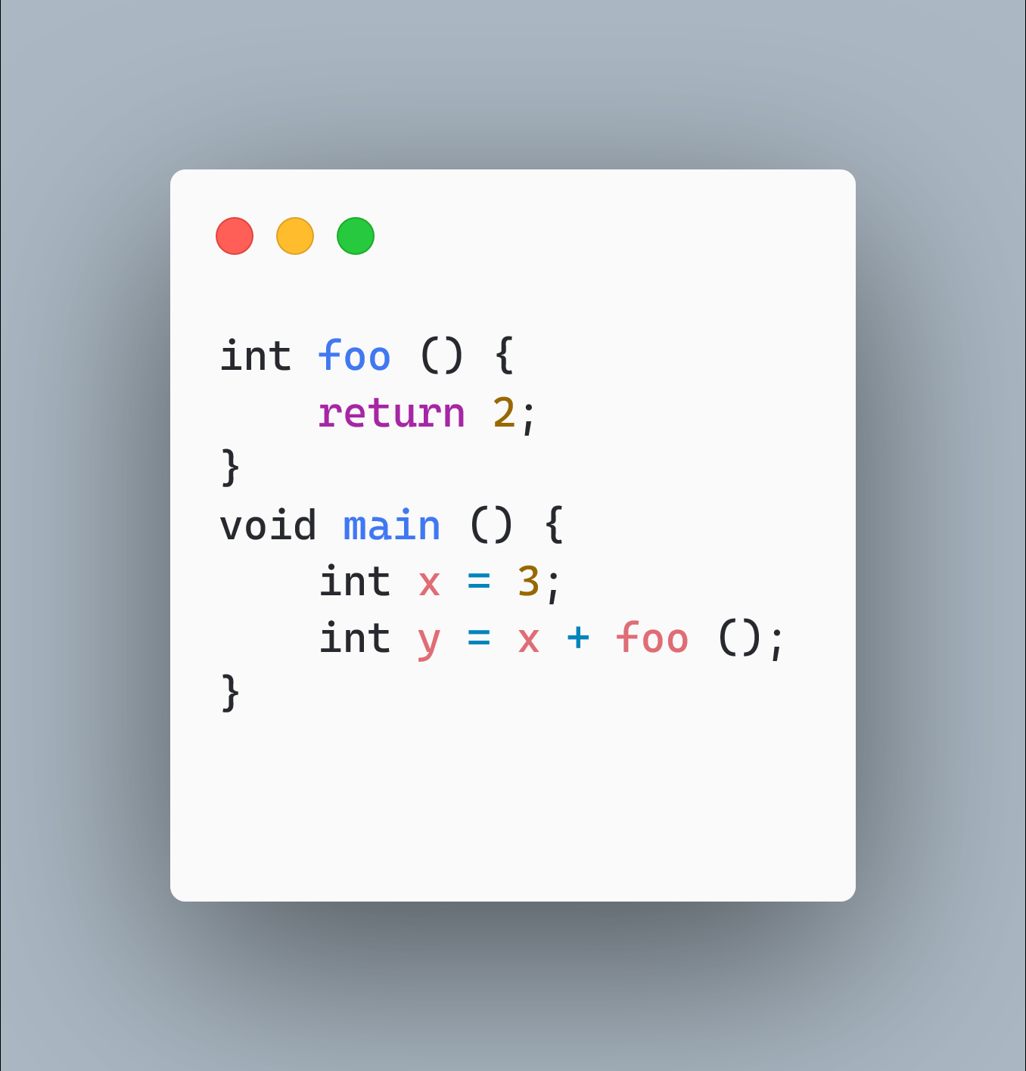
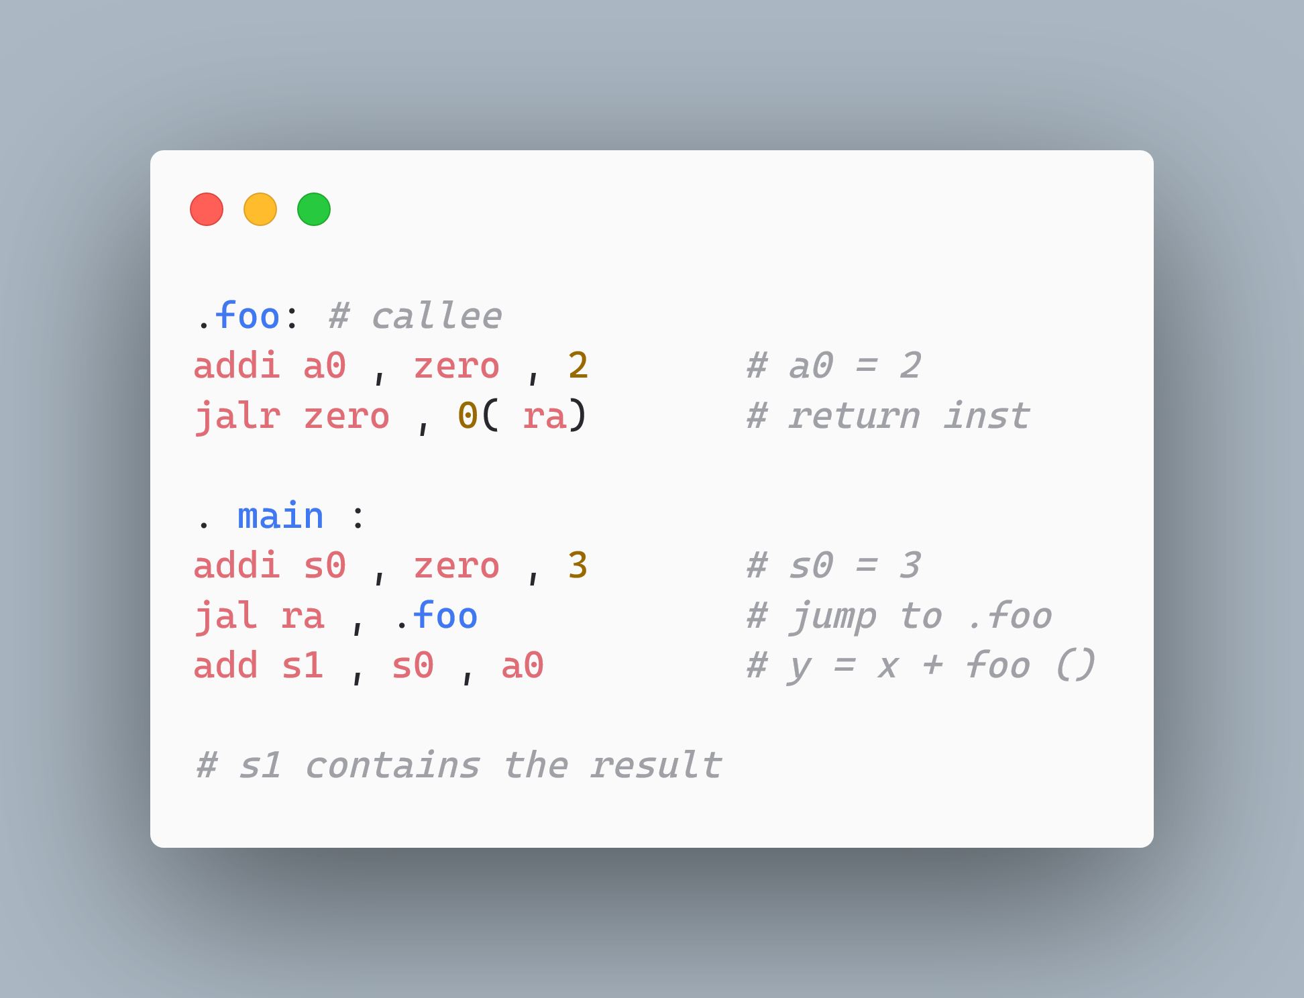
A Program with a Simple Function Call
Return value

Slide 37
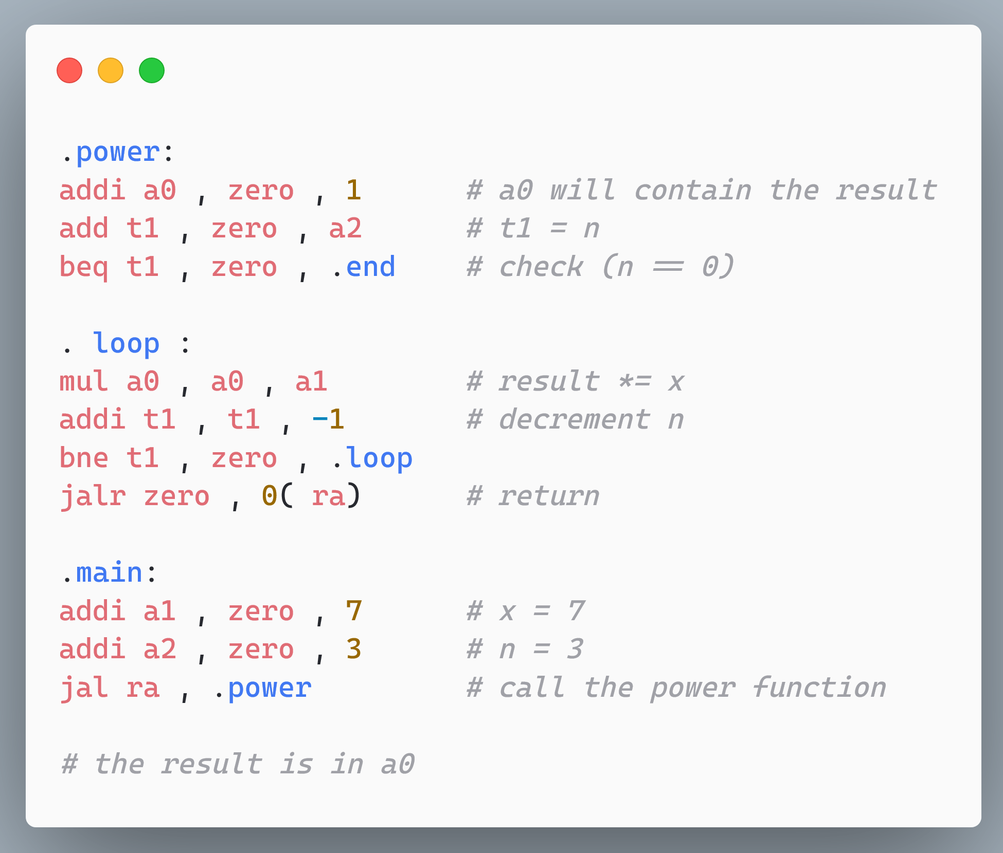
Compute x^{n} and store the result in a0.
Initialization
Computation

Slide 38
Load-Store Instructions
Semantics | Example | Explanation
lw rd, imm(rs1) | lw x1, 32(sp) | x1 ← mem[sp + 32]
sw rs2, imm(rs1) | sw x1, 32(sp) | mem[sp+32] ← x1
la rd, label | la x1, pi | x1 ← address(pi)
The lw and sw instructions load and store 32-bit values
There is a need for an assembler directive (la)
Assign a constant to a label
Load the label directly to a register
Generate assembly statements to load the constant to a register

Slide 39
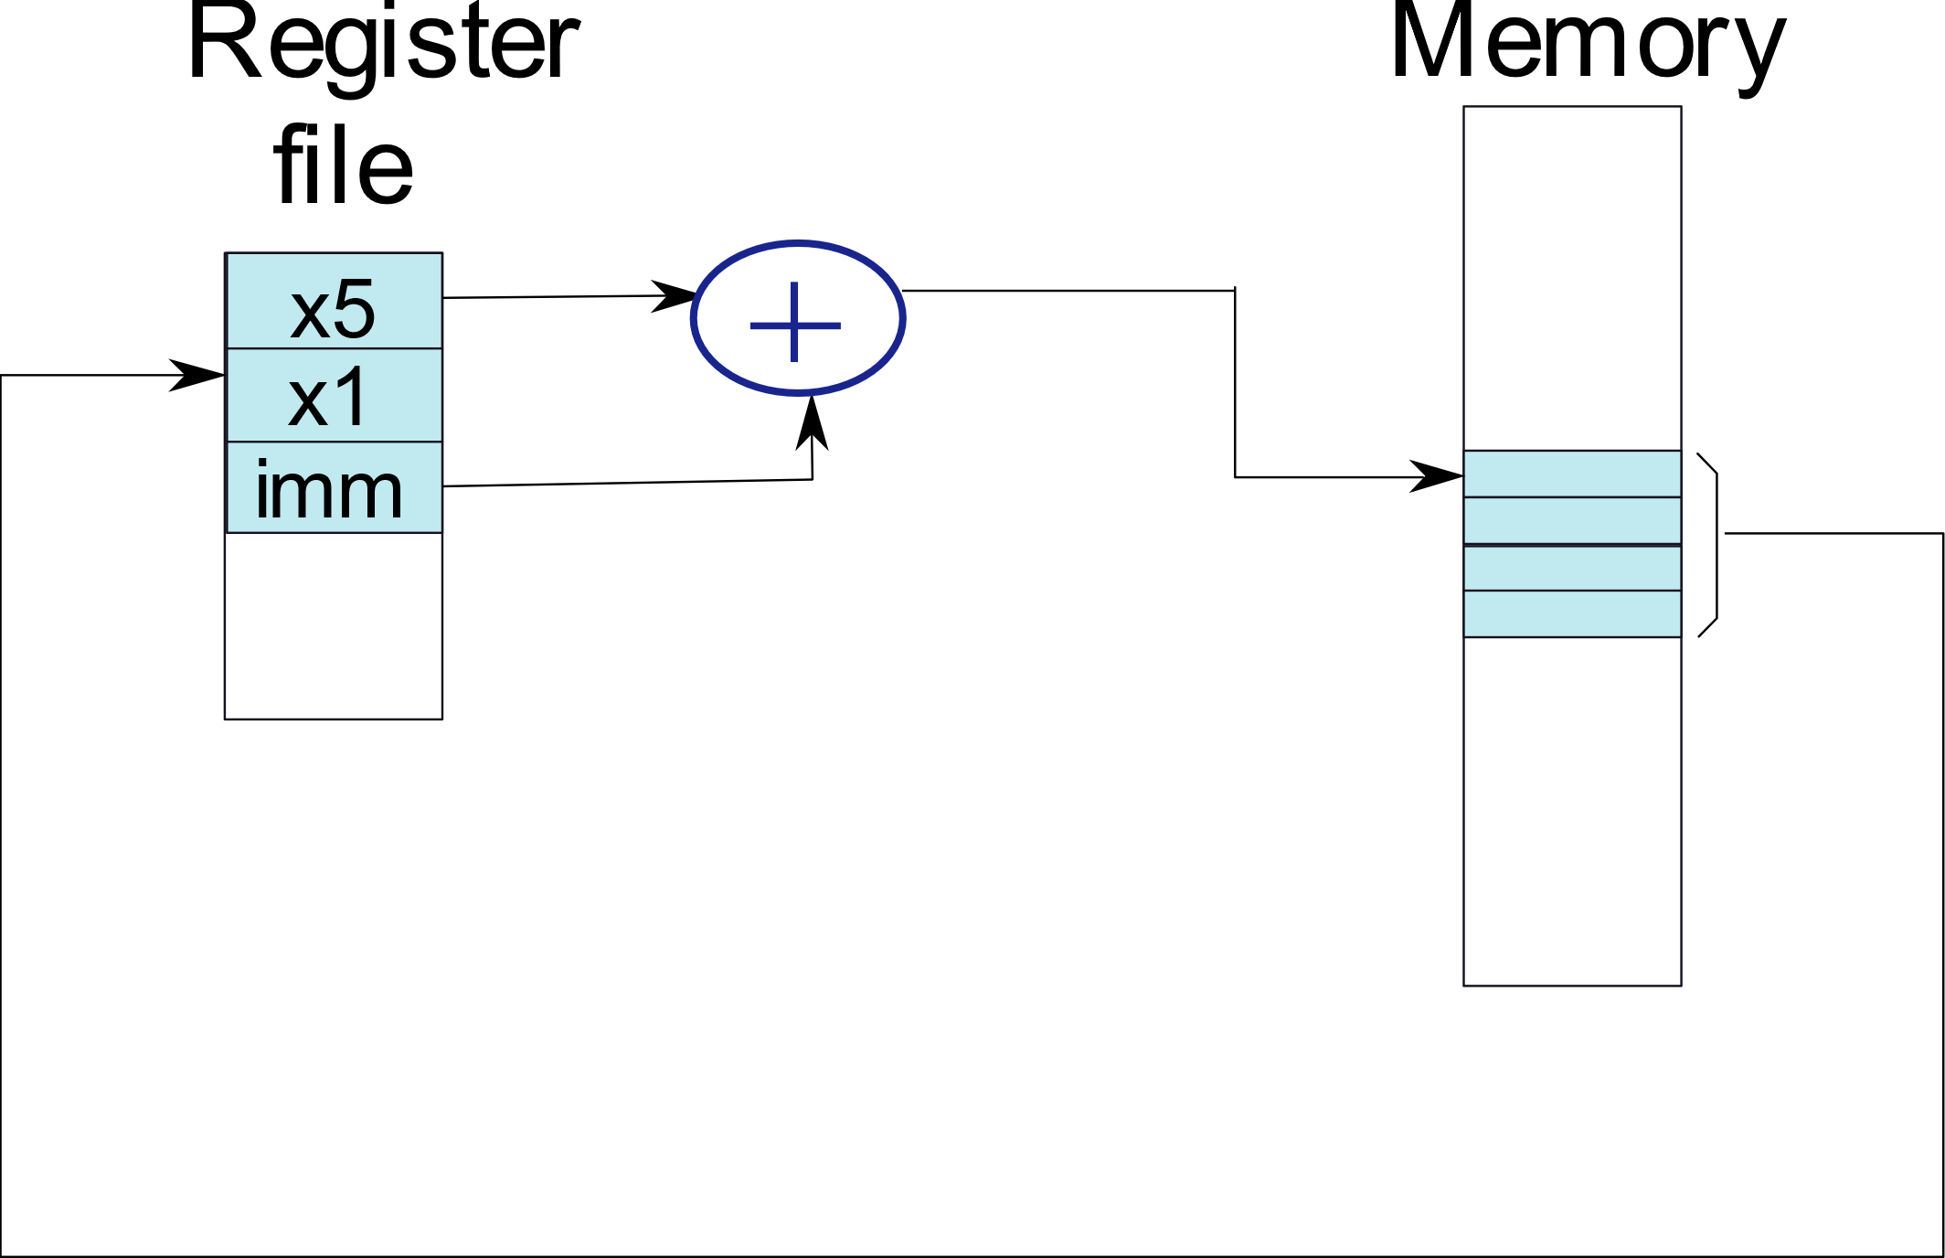
Load Instruction
lw x1, imm(x5)

Slide 40
Store Instruction
sw x1, imm(x5)
Register
Memory
file
x5
x1
imm

Slide 41
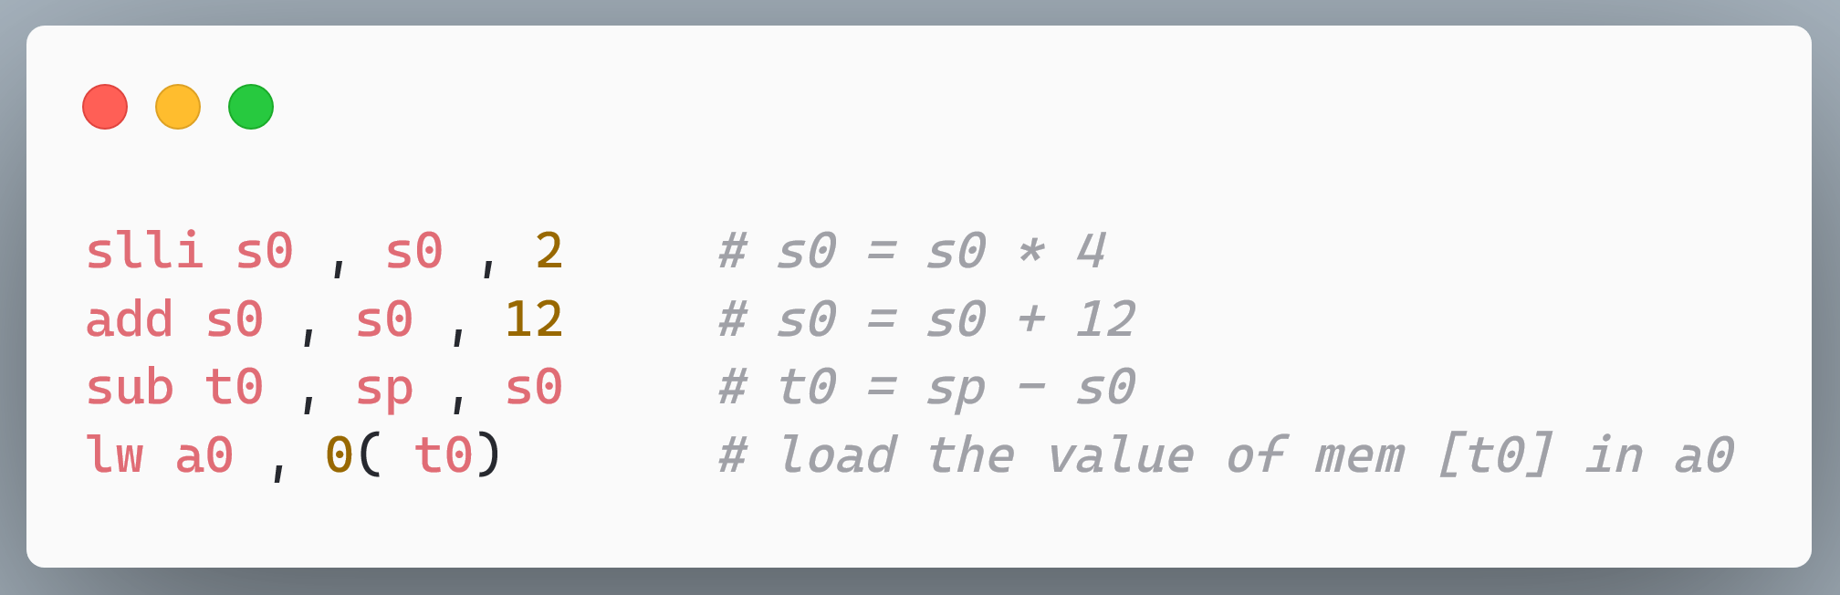
Load a0 with the contents of the memory address
sp − s0 × 4 − 12.
Load 17 into the register s0.

Slide 42
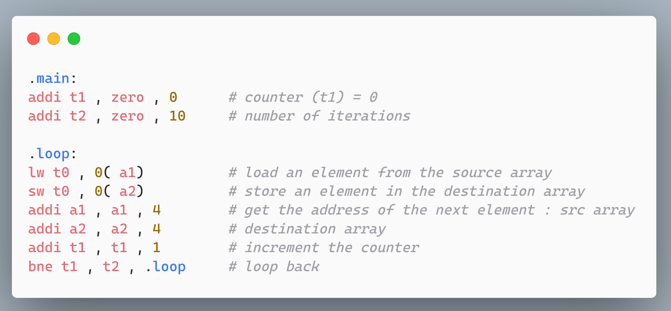
Create a copy of a 10-element array. Assume the starting address of the original array is stored in a1 and that of the destination array is stored in a2.

Slide 43
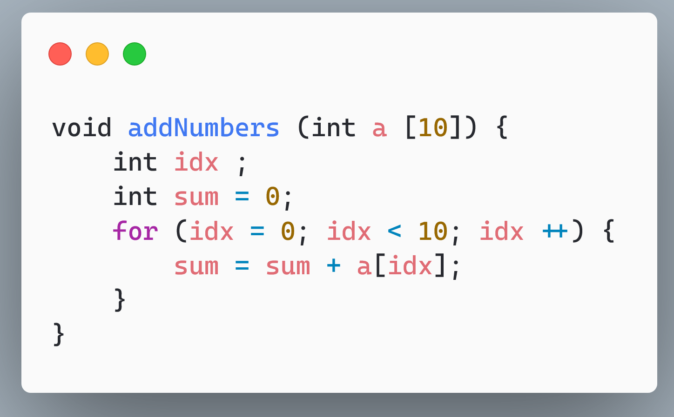
Compute the sum of the elements in a 10-element array. Assume that the base address of the array is stored in a1. Store the result in a0.

Slide 44
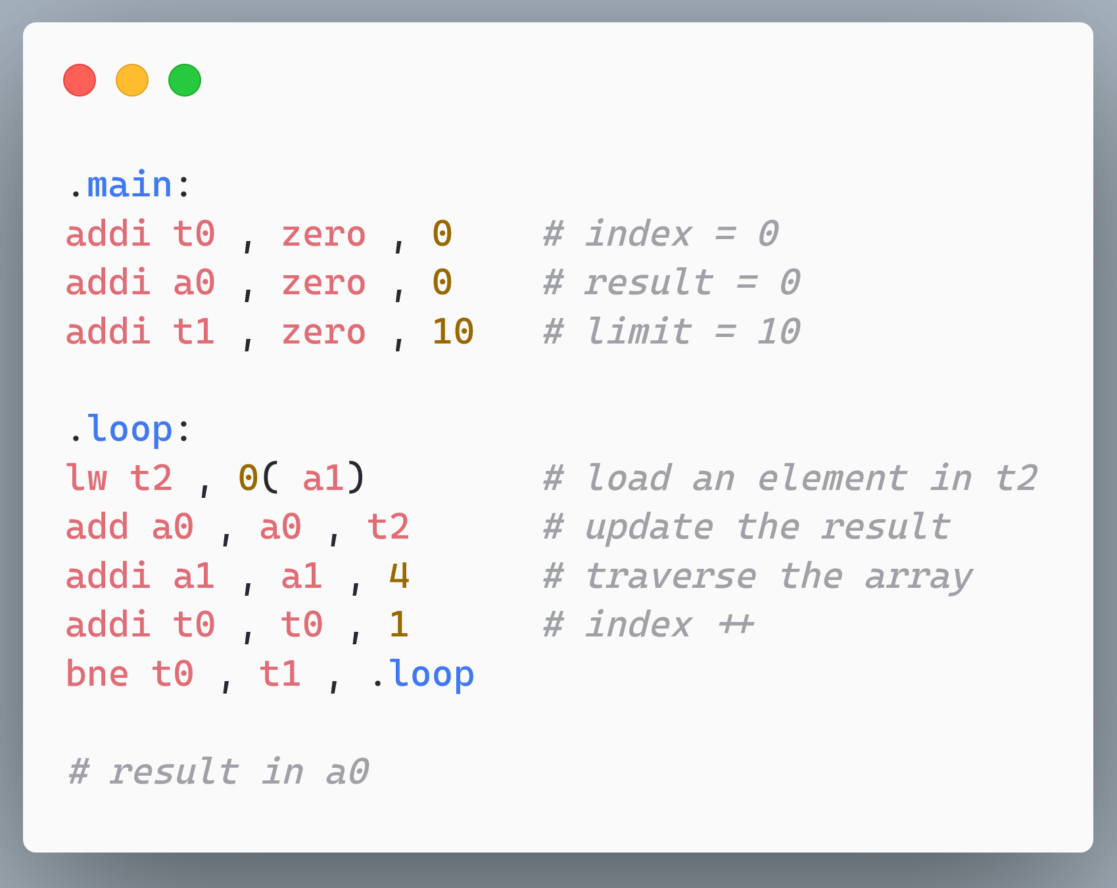
Contd…
Add the array element to a0

Slide 45
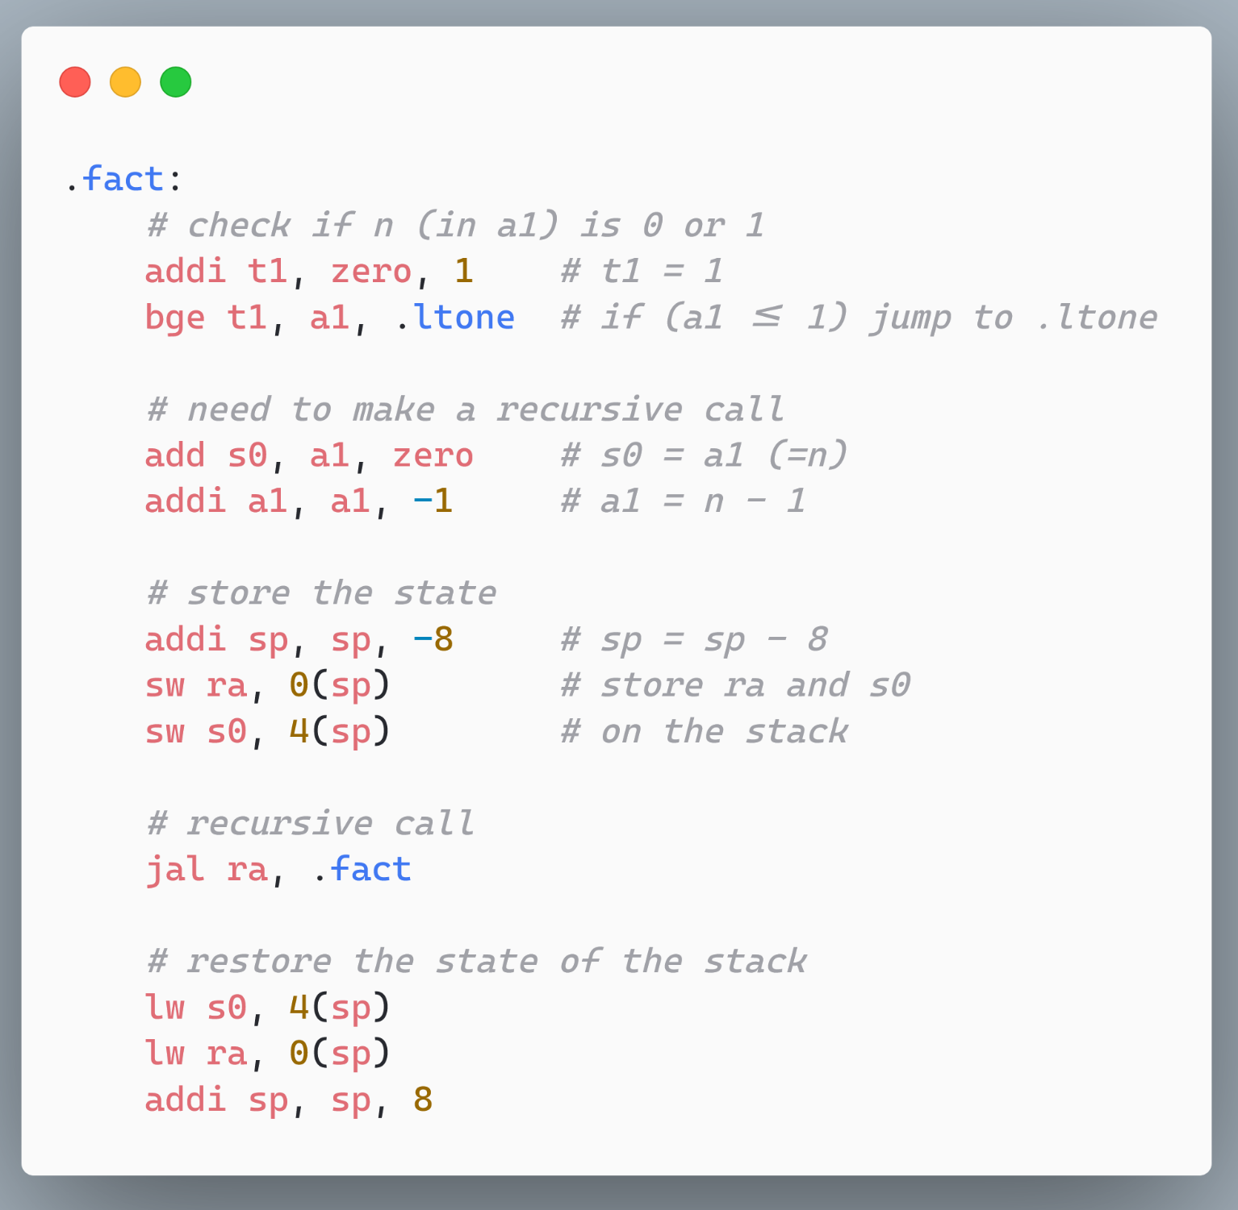
Compute the result of the factorial function using a recursive algorithm.

Slide 46
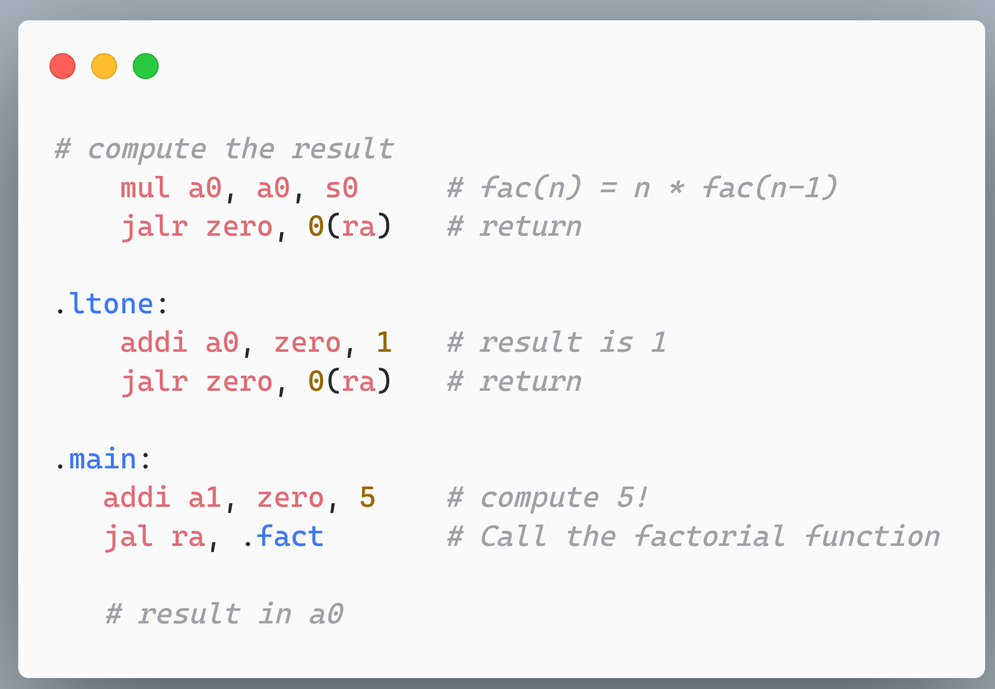
Contd …

Slide 47
Outline
RISC-V Machine Model
Integer Instructions
Control Transfer and Memory Instructions
Floating Point Instructions
Instruction Encoding

Slide 48
Floating Point Registers
Register | Mnemonic | Description
f0-7 | ft0-7 | Temporary registers
f8-9 | fs0-1 | Saved registers
f10-11 | fa0-1 | Arguments/return values
f12-17 | fa2-7 | Function arguments
f18-27 | fs2-11 | Saved registers
f28-31 | ft8-11 | Temporary registers
No register is hardwired to 0
It is not possible to load values into FP registers directly
They can only be initialized by loading values from memory (like x86)

Slide 49
Floating Point Control and Status Register
31
8
7
5
4
0
Reserved
Rounding mode (frm)
Accrued exceptions (fflags)
NV
DZ
OF
UF
NX
1
1
1
1
1
24
3
Mnemonic | Explanation
NV | Invalid operation
DZ | Divide by zero
OF | Overflow
UF | Underflow
NX | Inexact
Rounding Mode | Mnemonic | Meaning
000 | RNE | Round to nearest, prefer even LSBs
001 | RTZ | Round towards zero
010 | RDN | Round down (towards -∞)
011 | RUP | Round up (towards +∞)
100 | RMM | Round to nearest (prefer maximum abs. val.)
101,110 |  | Invalid. Reserved for future use
111 | DYN | Select a rounding mode dynamically (frm field)

Slide 50
Floating Point Load and Store Operations
Semantics | Example | Explanation
flw rd, imm(rs1) | flw f1, 32(sp) | f1 ← mem[sp + 32]
fsw rs2, imm(rs1) | fsw f1, 32(sp) | mem[sp+32] ← f1
We load the contents into memory first, and then transfer it to a FP register.

Slide 51
Load the value of a constant val into the floating point register fs1.
Define the constant.
Store its address in a1
Load into an FP register.

Slide 52
Arithmetic Instructions
Semantics | Example | Explanation
fadd.s rd, rs1, rs2 | fadd.s f1, f2, f3 | f1 ← f2 + f3
fsub.s rd, rs1, rs2 | fsub.s f1, f2, f3 | f1 ← f2 - f3
fmul.s rd, rs1, rs2 | fmul.s f1, f2, f3 | f1 ← f2 × f3
fdiv.s rd, rs1, rs2 | fdiv.s f1, f2, f3 | f1 ← f2 ÷ f3
fmin.s rd, rs1, rs2 | fmin.s f1, f2, f3 | f1 ← min(f2 , f3)
fmax.s rd, rs1, rs2 | fmax.s f1, f2, f3 | f1 ← max(f2 , f3)
fsqrt.s rd, rs1 | fsqrt.s f1, f2 | f1 ← $\sqrt{f2}$
.s is for single precision
.d is for double precision

Slide 53
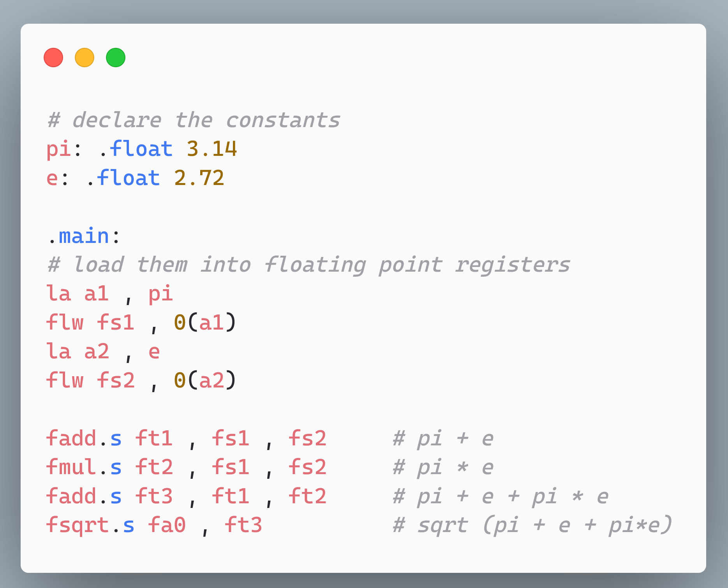
Compute $\sqrt{π+e+π∗e }$, and store the result in fa0.

Slide 54
Multiplication and Conversion Instructions
Semantics | Example | Explanation
fmadd.s rd, rs1, rs2, rs3 | fmadd.s f1, f2, f3, f4 | f1 ← f2 * f3 + f4
fmsub.s rd, rs1, rs2, rs3 | fmsub.s f1, f2, f3, f4 | f1 ← f2 * f3 - f4
fcvt.s.w rd, rs1 | fcvt.s.w f1, x5 | f1 ← (float) x5
fcvt.w.s rd, rs1 | fcvt.w.s x5, f1 | x5 ← (int) f1
fmadd.s and fmsub.s are compound instructions: multiply + add/subtract
The convert instruction (fcvt) is another way of loading and storing FP values

Slide 55
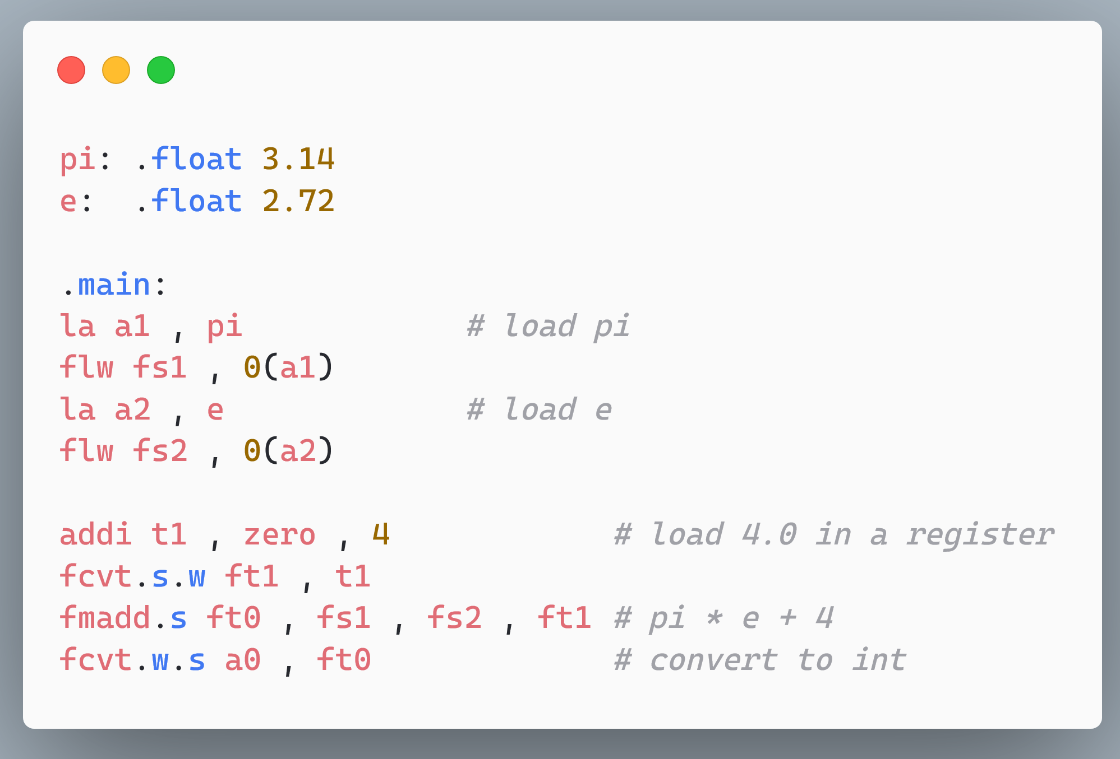
Compute π × e + 4, and store the result in ft0. Convert the result to an integer and store the result in a0.
Need to convert 4 to 4.0 first

Slide 56
Floating Point Comparison Instructions
Semantics | Example | Explanation
flt.s rd, rs1, rs2 | flt.s s1, f2, f3 | if (f2 < f3) set s1 to 1
fle.s rd, rs1, rs2 | fle.s s1, f2, f3 | if (f2 ≤ f3) set s1 to 1
feq.s rd, rs1, rs2 | feq.s s1, f2, f3 | if (f2 == f3) set s1 to 1
Same as integer comparison

Slide 57
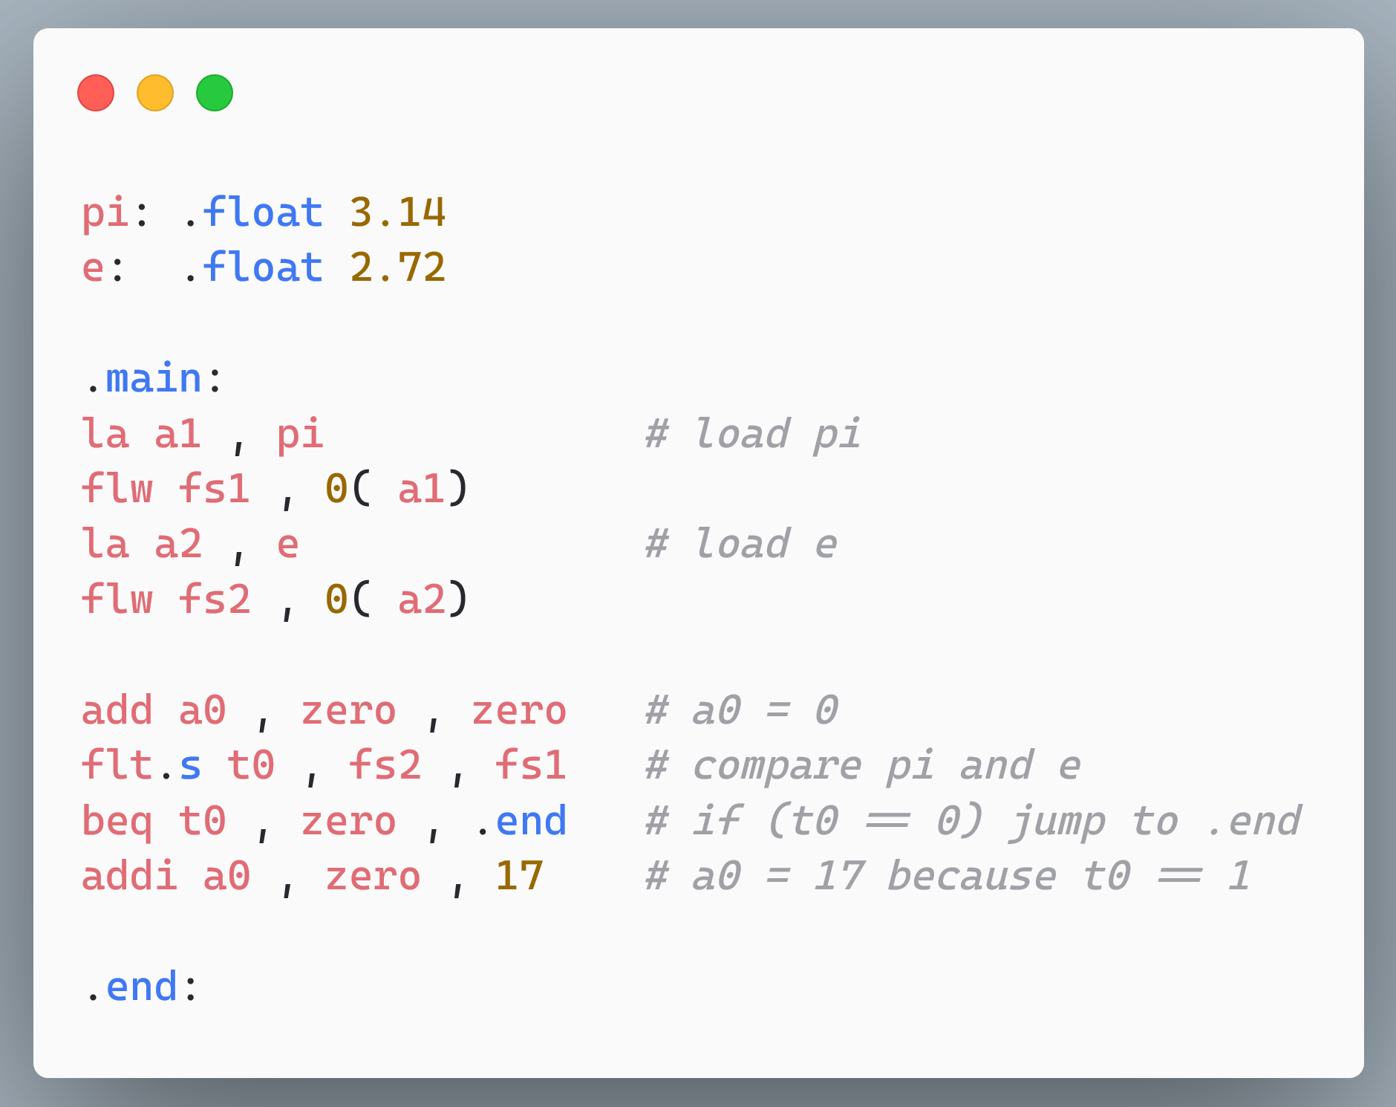
First, initialize a0 = 0, then set a0 = 17 if e < π.
Perform the comparison and store the result in t0
Check the result of the comparison.

Slide 58
Outline
RISC-V Machine Model
Integer Instructions
Control Transfer and Memory Instructions
Floating Point Instructions
Instruction Encoding

Slide 59
Instruction Formats in 32-bit RISC-V
Format/Type | Structure | Instructions
R | rd, rs1, rs2 | add, sub, mul, div, rem, and, or, xor, sll, srl, sra, slt, sltu
I | rd, rs1, imm rd, imm(rs1) | addi, andi, ori, xori, slli, srli, srai, slti, sltiu lw, jalr
S | rs2, imm(rs1) | sw
U | rd, imm | lui
Define a new instruction type for store instructions
The default immediate size is 12 bits
The U-type supports a 20-bit immediate

Slide 60
Further differentiation between opcodes (add, sub)
Differentiate between opcodes
funct7
rs2
rs1
funct3
rd
opcode
R-Type
7
5
5
3
5
7
add, slt and xor
12-bit immediate field
funct7
imm
rs1
funct3
rd
opcode
I-Type
12
5
3
5
7

Slide 61
Do not define a new format
Split the immediate
Split the immediate
imm[11..5]
rs2
rs1
funct3
imm[4..0]
opcode
S-Type
7
5
5
3
5
7
20-bit immediate
imm
rd
opcode
U-Type
20
5
7

Slide 62
Format | Structure | Instructions
B | rs1, rs2, imm | beq, bne, blt, bge, bltu, bgeu
J | rd, imm | jal
immediate bits: LSB is 0
→ Do not represent it
immediate bit
4..1
12
imm[10..5]
rs2
rs1
funct3
imm[..]
11
opcode
B-Type
7
5
5
3
5
7
$$≈ ± 4 KB$$
20
imm[10..1]
11
imm[19..12]
rd
opcode
J-Type
20
5
7
$$≈ ± 1 MB$$
immediate bits: LSB is 0

Slide 63
12-bit immediate field
#bytes loaded/stored
funct7
imm
rs1
width
rd
opcode
LOAD-FP
12
5
3
5
7
imm[11..5]
rs2
rs1
width
imm[4..0]
opcode
STORE-FP
7
5
5
3
5
7

Slide 64
FP Instructions
Used by all FP arithmetic, compare and conversion instructions.
precision
rounding mode
funct5
fmt
rs2
rs1
rm
rd
opcode
5
2
5
5
3
5
7
Fused multiply-add instruction
rs3
fmt
rs2
rs1
rm
rd
opcode
5
2
5
5
3
5
7

Slide 65
THE END

