Slide 1
Chapter 9:
Multicore Systems

Slide 2
Background Required to Understand this Chapter
Caches
On-Chip Network
Graph Algorithms
Chapters 7 and 8

Slide 3
Contents
1.
Parallel Programming
2.
Theoretical Foundations
3.
Cache Coherence
4.
Memory Models
5.
Data Races
6.
AGENDA ITEM 06
Transactional Memory
Green marketing is a practice whereby companies seek to go above and beyond.

Slide 4
Era of Sequential Computing is Over
35
30
25
20
Speclnt 2006 Score
15
40
10
5
0
29/10/99
12/03/01
25/07/02
07/12/03
20/04/05
02/09/06
15/01/08
29/05/09
11/10/10
23/02/12
Date
Single core performance from 2001 to 2010
It has clearly saturated after 2008.

Slide 5
Solution
Have multiple cores that collaboratively solve a task.
Big Problem
Map each sub-problem
to a core
Smaller problems

Slide 6
Problem
Take an array numbers with SIZE elements.
Compute the sum of all of its elements.
Distribute the work among N threads.
Approach
Divide the array into N parts.
Assign each part to a core.
Compute the partial sum (sum of each part)
Add the partial sums

Slide 7
Shared Memory based Programming
Core 1
Core 2
Core N
Shared memory
Each core runs a thread.
Different threads share parts of the virtual memory space
They communicate by reading and writing to shared variables

Slide 8
/* variable declaration */
int partialSums [N];
int numbers [SIZE];
int result = 0;
/* initialise arrays */
...
/* parallel section */ # pragma omp parallel {
/* get my processor id */
int myId = omp_ get_ thread_ num ();
/* add my portion of numbers */
int startIdx = myId * SIZE/ N;
int end Idx = startIdx + SIZE/ N;
for( int jdx = startIdx; jdx < end Idx; jdx++)
partialSums[ myId] += numbers[ jdx];
}
/* sequential section */
for( int idx=0; idx < N; idx++)
result += partialSums[ idx];
OpenMP
code

Slide 9
A Typical Shared Memory Program
Parent thread
Initialization
Spawn child threads
Child
threads
Time
Thread join operation
Sequential
section

Slide 10
Message Passing Code
Cores communicate by sending messages to each other
They do not share memory.
There are two basic functions.
Function | Semantics
send(pid, val) | Send the integer val to the process with id, pid
receive(pid) | Receive an integer from process pid This is a blocking call If the pid is equal to ANYSOURCE, then the receive function returns with the value sent by any process

Slide 11
/* start all the parallel processes */
Spawn AllParallelProcesses();
/* For each process execute the following code */
int myId = getMyProcessId ();
/* compute the partial sums */
int startIdx = myId * SIZE/ N;
int end Idx = startIdx + SIZE/ N;
int partialSum = 0;
for( int jdx = startIdx; jdx < end Idx; jdx++)
partialSum += numbers[ jdx];
/* All the non - root nodes send their partial sums to the root */
if( myId != 0) {
/* send the partial sum to the root */ send (0 , partialSum );
}
Message
passing
code

Slide 12
Continuation
else {
/* for the root */ int sum = partialSum ;
for ( int pid = 1; pid < N; pid ++) {
sum += receive( ANYSOURCE );
}
/* shut down all the processes */
shutDown AllProcesses();
/* return the sum */
return sum;
}

Slide 13
Shared Memory vs Message Passing
Shared memory
Easy to program.
Issues with scalability
The code is portable across machines.
Message passing
Hard to program.
Scalable
The code may not be portable across machines.

Slide 14
Amdahl’s Law
How much can we parallelize?
We are limited by the fraction of the sequential section: f_{seq}
For P processors
$$T_{par}=T_{seq} × \left(f_{seq}+ \frac{1 − f_{seq}}{P}\right)$$
As $P⟶∞$,
$$S →\frac{1}{f_{seq}}$$
Speedup
$$S=\frac{T_{seq}}{T_{par}}=\frac{1}{f_{seq}+ \frac{1 − f_{seq}}{P}}$$

Slide 15
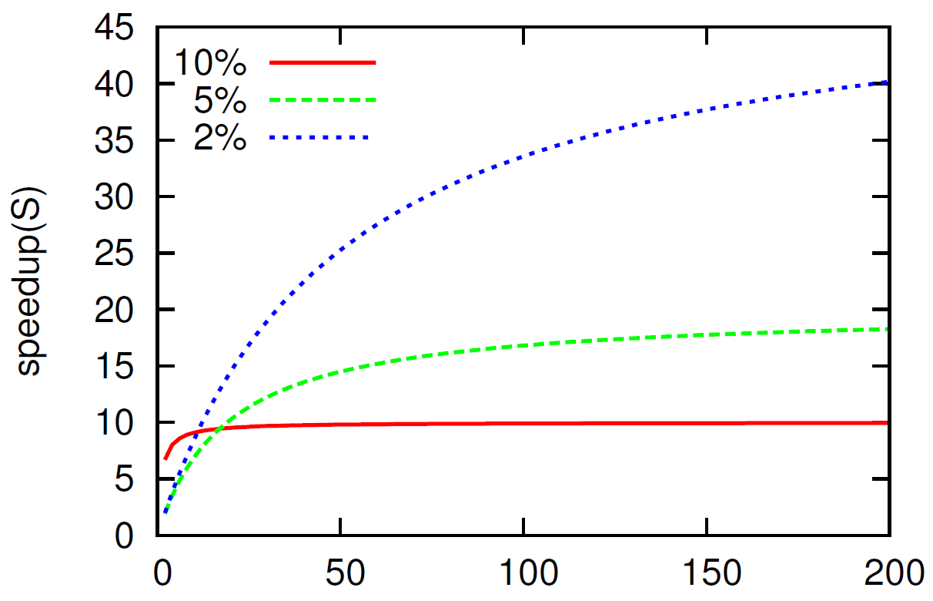
Speedup vs #Processors
Note the saturation of the speeudup
Number of processors (P)

Slide 16
Gustafson-Barsis’s Law
New workload: Scale the parallel part by #procs (P)
Old workload: W
Entity | Mathematical expression
New workload | $$W_{new}= f_{seq}W+\left(1 − f_{seq}\right)PW$$
Sequential Time ($T_{seq}$) $α$ is a constant of proportionality | $$αW_{new}=α \left(f_{seq}W+\left(1 − f_{seq}\right)PW\right)$$
Parallel Time ($T_{par}$) | $$α\left(f_{seq}W+\left(1 − f_{seq}\right)PW/P\right)= αW$$
$$S=\frac{T_{seq}}{T_{par}}$$ $= \frac{f_{seq}W+\left(1 − f_{seq}\right)PW}{W}$ $$= f_{seq}+\left(1−f_{seq}\right)P$$

Slide 17
Design Space of Multiprocessors: Flynn’s Classification
SISD
Single inst. single data
SIMD
Single inst. multiple data
MIMD
Multiple inst. multiple data
MISD
Multiple inst. single data

Slide 18
Explanation of the Flynn’s Classification
SISD Processors
A regular single core processor
SIMD Processors
Single instruction stream, multiple data streams
Vector instruction set. Example: add v1, v2, v3
v1, v2, and v3 are vector registers
They pack multiple integers (let’s say 4)
A pairwise addition is performed
Summary: We can do 4 additions using just a single instruction

Slide 19
Explanation II
MISD Processors
Used in airplanes: Run the same program on three separate processors that have different instruction sets. Compare the outputs and decide by voting.
MIMD Processors
SPMD Processors: Single program, multiple data. Run the same program on different cores with different data streams (most common)
MPMD Processors: Consider a processor with different accelerators. Each core or accelerator runs a different program.

Slide 20
Hardware Threads

Slide 21
Notion of Hardware Threads
We traditionally have processes that run on different cores.
Let’s say we have cores with large issue widths
If processes have low ILP, then we waste issue slots
Run multiple processes simultaneously on the same core
Definition
Such processes that share cores are known as hardware threads.
They are not the same as software threads that share the virtual address space.

Slide 22
Coarse-grained Multithreading
1
4
2
3
Run instructions from thread 1 for k cycles.
Then switch to thread 2, then to thread 3, thread 4, thread 1, ...
Separate program counters, ROBs and retirement register files per thread
Each instruction packet, rename table entry, LSQ entry, physical register is tagged with the thread id
If there is a high-latency event like an L2 miss, the core can switch to a new thread.

Slide 23
Fine-grained Multithreading
Coarse-grained multithreading does not let the processor idle, if there is a high-latency event.
Fine-grained multithreading reduces k to 1-5 cycles.
We can tolerate low-latency events like L1 misses.
There is an additional overhead of excessive thread switching.

Slide 24
Simultaneous Multithreading (SMT)
Run multiple hardware threads simultaneously
Dynamically split the issue slots between the threads
There are several heuristics for partitioning the issue slots
Fairness
Instruction criticality (higher priority to loads)
Thread criticality: real time, non-real time
Based on instruction type (expected ILP, etc.)
Hyperthreading → SMT with static partitioning (typically 50:50)

Slide 25
Comparison of Different Hardware Multithreading Schemes
Coarse-grained
Fine-grained
Simultaneous
multithreading
multithreading
multithreading
Thread 1
Thread 2
e
Thread 3
m
i
T
Thread 4
issue
slots

Slide 26
Contents
1.
Parallel Programming
2.
Theoretical Foundations
3.
Cache Coherence
4.
Memory Models
5.
Data Races
6.
AGENDA ITEM 06
Transactional Memory
Green marketing is a practice whereby companies seek to go above and beyond.

Slide 27
Issues with Large Caches
Large caches’ access times can be between 10-50 cycles
Requests need to traverse the NoC
If we have many cores, they will make parallel accesses.
We are dealing with large, slow, multi-ported caches.
This is not possible to build.
Create large distributed caches.

Slide 28
Notion on a Distributed Cache
Make a set of small caches act like one single, large cache.
Each sister cache is small and fast.
Many parallel accesses.

Slide 29
Shared vs Distributed Caches
We want a set of small L1 caches (sister caches) act like one, single, large L1 cache. How is this possible?
Consider accesses to a single memory address/variable, x
If we have a single physical location for x, then there is no advantage of a distributed design.
If we have multiple locations for storing the variable x, then the replicas have to contain the same value.
This is the problem of coherence.
Coherence → Make a set of locations behave like a single location.

Slide 30
Consider Multiple Locations
Assumptions
All global variables are initialized to 0. They start with u, v, x, y, or z.
All local variables are mapped to registers. They start with a ‘t’.
The delay between the execution of consecutive instructions can be indefinitely large. Instructions across threads can execute in any order.
Thread 1 | Thread 2
x = 1 | t1 = y
y = 1 | t2 = x
Is the outcome <t1, t2> = <1,0> possible?
It for some reason bothers us because no sequential ordering of instruction executions can produce this outcome.

Slide 31
This outcome is indeed valid on many machines
Thread 1 | Thread 2
x = 1 | t1 = y
y = 1 | t2 = x
Thread 1 sets x to 1
It sends an update message on the NoC. The message gets caught in congestion.
Thread 1 sets y to 1. The corresponding message on the NoC is swiftly delivered.
Thread 2 reads y to be 1.
Thread 2 reads x as 0 (initialized value)
This is indeed possible!

Slide 32
One More Example
Thread 1 | Thread 2
x = 1 | y = 1
t1 = y | t2 = x
Can we read <t1, t2> = <0,0> ?
The loads are issued early, and the writes happen at commit time.

Slide 33
Set of Valid Outcomes
Given a parallel program, what are the set of valid outcomes?
This depends on the system on which the program is running. It depends on ....
The pipeline
Memory system
NoC
Memory controller (for off-chip memory)
Every processor has a set of specifications that specify the allowed outcomes/behaviors. If the behavior is consistent with the specifications, the execution is said to be consistent.
This specification is known as the memory model or memory consistency model.

Slide 34
Difference between Memory Consistency and Memory Coherence
A memory consistency model or a memory model is a policy that specifies the behavior of a parallel, multithreaded program. In general, a multithreaded program can produce a large number of outcomes depending on the relative order of scheduling of the threads, and the behavior of memory operations. A memory consistency model restricts the set of allowed outcomes for a given multithreaded program. It is a set of rules that defines the interaction of memory instructions between each other.
Coherence is a subset of the overall memory model that specifies the behavior with respect to a single location.

Slide 35
Theoretical Foundations

Slide 36
Every Observer has a Point of View
t_{start} | Start time
t_{end} | End time
t_{comp} | Completion time
Cache
Queue
Observer
Timeline of memory requests seen by the observer:
Time
R1
R2
R3
t
start
t
end
t
start
t
end
t
start
t
end
t
comp
t
comp
t
comp

Slide 37
Definition of an Execution
Operation
tid
t_{start}
t_{end}
type
addr
value
read
write
Operation
Operation
Execution
Operation
Operation

Slide 38
More about Executions
Sequential Execution
All the operations are ordered.
Legal Sequential Execution
Every read operation returns the value of the latest write operation to the same address.
The observer sitting on a memory location needs to observe a legal sequential execution.

Slide 39
Observer sitting on a Core
In the case of a load, this relationship still holds → $t_{start}< t_{comp}< t_{end}$
However, things change for a store.
We don’t know when it will complete. The store will be put on the NoC. It may reach the cache bank a long time later.
The operation ends when the store leaves the ROB.
We can very well have → $t_{start}< t_{end}< t_{comp}$
Even in this case, the observer on the core expects to see a legal sequential execution
Otherwise, the execution will not make any sense ....

Slide 40
Parallel Executions
Consider a parallel execution.
Term | Meaning
Rx1 | Read the value of x as 1
Wy2 | Set y = 2
Multiple threads: one observer per thread. Each observer records the local execution history of a thread.

Slide 41
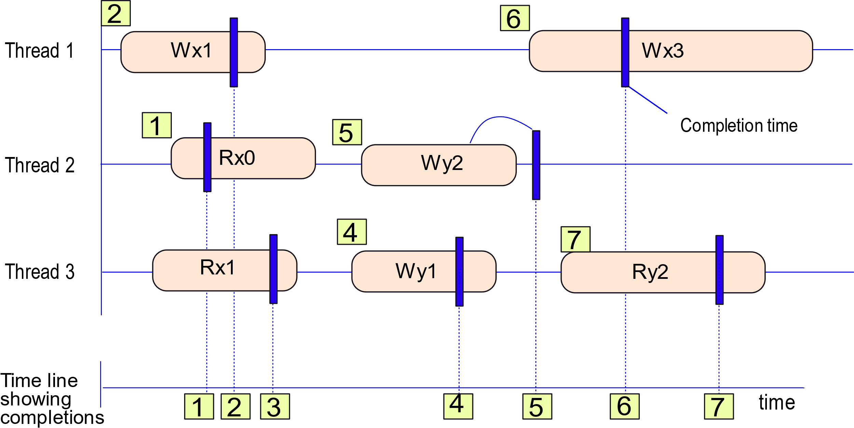
A Parallel Execution
We somehow know the completion times
3
Note the time line: ordered by the completion time.

Slide 42
Issues with Parallel Executions
Atomicity → Every operation has a single completion time. It appears to execute instantaneously at that point of time.
Have multiple observers (one per each thread) with their points of view does not help.
It is better if we can think of parallel executions in terms of sequential executions → It is very intuitive.
For this, we need to introduce the notion of the equivalence of executions: P and S.

Slide 43
Equivalence of Two Executions
Equivalence of two executions
Expression | Meaning
P | T | All the operations issued by thread T (in the same order). This is an ordered sequence.
$$P \left| T≡S \right|T$$ | There is a one-to-one mapping between the two sequences of operations.
$$P ≡S$$ | For all T, $P \left| T≡S \right|T$

Slide 44
Example of Execution Equivalence
Mapping
1 → 1’, 2 → 2’, ... , 7 → 7’

Slide 45
Now, assume we don’t know the completion times
Can we guess them?
Subject to certain rules
As long as the guessed completion times lead to a legal sequential execution that follows all the rules, we are done.
Rule 1:
The completion times follow program order
→ All the operations issued by the same thread have monotonically increasing completion times
It is never the case that the order of completion times is different from the order of operations issued by a thread

Slide 46
Contd ….
Guess completion times for all operations (subject to program order)
Arrange all the operations by their completion time
Does this lead to a legal sequential execution?
The parallel execution is equivalent to a legal sequential execution and program order is respected.
The parallel execution is said to be sequentially consistent
If it is not possible to find completion times subject to respecting program order, then the execution is not sequentially consistent.

Slide 47
Do we even need completion times?
By guessing completion times, what are we essentially doing?
We are reordering the operations issued by different threads
For a given thread, we cannot reorder its operations (program order).
Thread A
A1
A2
A3
A4
Thread B
B1
B2
B3
Valid interleaving (sequential order)
A1
B1
A2
A3
B2
B3
A4
If this sequence is legal, the parallel execution is sequentially consistent.

Slide 48
Sequential Consistency: Two Definitions
When is a parallel execution equivalent to some sequential execution?
Sequential Consistency (SC)
When a parallel execution is equivalent to a legal sequential execution and the order of operations in the sequential execution is as per program order, we say that the execution is sequentially consistent.
We can interleave the executions of different threads such that they are arranged sequentially, every read receives the value of the latest write, and for each thread, the operations are arranged in program order.

Slide 49
Key Properties of SC
Writes are atomic
Program order is preserved
SC = Atomicity + Program Order
Reordering accesses to different addresses might create havoc in multiprocessor systems.

Slide 50
Examples of Single-variable Programs
T1 | T2 | T3
Wx1 | Rx0 | Rx1
Wx2 | Rx2 | Rx2
T1 | T2 | T3
Wx1 | Rx1 | Rx2
Wx2 | Rx2 | Rx1
Execution in SC
Execution that is not in SC
Rx0 → Wx1 → Rx1 → Wx2 → Rx2 (T2) → Rx2 (T3)
This behavior is non-intuitive. For x there appear to be different storage locations.
PLSC
If we consider all the accesses to a single variable (memory location), let such an execution be always in SC. This is known as the PLSC (Per Location Sequential Consistency) constraint. It is needed to provide the illusion of a single memory location, even if we have a distributed cache.

Slide 51
SC for Multi-variable Programs
T1 | T2
Wx1 | Wy1
Ry0 | Rx0
Can <x,y> = <0,0>?
This execution is not in SC
PLSC does not guarantee SC?
Accesses w.r.t x
Accesses w.r.t y
Both are in PLSC
T1 | T2
Wx1
 | Rx0
T1 | T2
 | Wy1
Ry0

Slide 52
Why not make all machines guarantee SC?
T1 | T2
x = 1 | y = 1
t1 = y | t2 = x
Threads can reorder accesses to different addresses.
The outcome <x,y> = <0,0> is clearly not in SC.
This is because
The loads will be sent early to the cache
The stores will only be sent at commit time
This means that both the loads will read x and y to be 0
If we still need SC then
Loads will have to be issued at commit time
All the benefits of OOO execution and the LSQ will go away
For high performance we need to sacrifice SC
It prohibits many performance-enhancing optimizations

Slide 53
Non-atomic Writes
T1 | T2 | T3
Wx1 | while (x != 1) {} | while (y != 1) {}
 | Wy1 | Rx0
T1 | T2 | T3
Wx1 | Rx1
 |  | Rx0
T1 | T2 | T3
Wx1 | Rx1 | Ry1
 | Wy1 | Rx0
T1 | T2 | T3
 |  | Ry1
 | Wy1
This execution is clearly not in SC
It is however in PLSC. Verify
However, the write to x appears to have different completion times for different threads. The write is non-atomic.

Slide 54
Non-Atomic Writes - II
This is possible in many architectures such as IBM and ARM machines
Thread 2 is basically reading the write to x early → before it is visible to Thread 3
This is possible if multiple locations store the variable x, and Core 2 is closer to Core 1 and Core 3 is much farther away.
In a system with an NoC, this can easily happen.
Given that this execution is in PLSC, let us accept it.

Slide 55
Behaviors not in PLSC
T1 | T2 | T3
Wx1 | Rx1 | Rx2
Wx2 | Rx2 | Rx1
This behavior is not in PLSC
SC implies PLSC, PLSC does not necessarily imply SC
Writes atomic w.r.t. one location need not be atomic w.r.t. accesses for multiple locations.
Such behaviors break the notion of shared memory completely
Let us thus allow non-atomic writes as long as PLSC is preserved.

Slide 56
Summary Till Now
SC is intuitive yet impractical
SC = Atomicity + Program order
PLSC is definitely required
SC implies PLSC (not the other way round)
In OOO machines, it is impractical
PLSC holds in systems that have non-atomic writes.
It is needed to provide the illusion of a single memory location in a distributed cache

Slide 57
From PLSC to Coherence
Akin to the definition of SC, we can define PLSC as per-location program order + atomicity (viewed per location)
Program order basically means that processors or cache controllers are not allowed to reorder accesses to the same address.
Since caches have FIFO queues for requests, they already ensure program order.
Consider atomicity. Because of PLSC an observer at a memory address always sees atomic writes, but an observer on a core may see non-atomic writes because of intervening accesses to other addresses.
For a given address, let us look at the following orders of operations
Global order → All observers record this order between operations
Local order → A few observers do, and a few don’t

Slide 58
Ordering between Accesses to the Same Variable across Threads (Observer at the Core)
Order | Implication
Read → Read | Does not matter
Write → Read | Given that a core can read another core’s write early, while other cores may not even see the write, this order may not be global all the time. A core does not know when a write reaches the sister caches present in other cores. Hence, it may not agree about the values read by other cores; this order is local.
Write → Write | If this order is not global, then the same variable will end up with multiple final states. This is not allowed. Hence, in all systems this order is global.
Read → Write | Writes are globally ordered. Assume one core records W_{i} → R_{i} → W_{j} . All the cores will record R_{i} → W_{j} because the core that issued R_{i} could not have seen W_{j} else it would have read a different value.

Slide 59
Implications of PLSC (Observer at the Core)
Write → Write order is global
Read → Write order is global
Write → Read order is global only for machines with atomic writes.
Axioms of Coherence
Write Serialization
Writes to the same location are globally ordered.
Write Propagation
A write is eventually seen by all the threads.

Slide 60
SC Using Synchronisation Instructions

Slide 61
Communicating a Value between Threads
T1 | T2
value = 3 | while (status != 1) {}
status = 1 | temp = value
This code will work correctly on an SC machine. It will not work correctly on other machines with other memory models.
The ordering between the read and write in T2 may not hold.
A store instruction fully completes when all the threads can read the stored value
fence instruction → All the instructions fetched before the fence need to fully complete before the fence instruction executes. All the instructions after the fence instruction cannot execute until the fence instruction has completed.

Slide 62
Code with fence Instructions
T1 | T2
value = 3 | while (status != 1) {}
fence | fence
status = 1 | temp = value
Regardless of the underlying memory model this code will always work
Memory barriers
A fence is an example of a memory barrier
Specifies rules of completion for instructions before and after the barrier (in program order)
Store barrier → Ensures an ordering between store instructions before and after the barrier instruction.

Slide 63
Acquire and Release Instructions
Acquire instruction → No instruction after the acquire instruction in program order can execute before it has completed.
Release instruction → The release instruction can only complete if all the instructions before it have been fully completed. Note that the release instruction allows instructions after it to execute before it has completed.

Slide 64
Theory of Memory Models

Slide 65
Where do we stand ...
Processors reorder instructions that access different addresses
Very problematic in multithreaded systems → non-intuitive behaviors
Writes can be non-atomic
How do we reason about the correctness of these systems?
SC gave us a mechanism where we could map a parallel execution
to a legal sequential execution (LSE). We could then reason on the LSE.
What about non-SC executions?

Slide 66
Method of Execution Witnesses
Parallel Execution
Execution Witness
Sequential Execution
A given piece of parallel code can have many different executions.
The valid outcomes are dependent on the memory model of the machine.
For each execution (valid or invalid), we can create an execution witness (a graph containing nodes and edges).
If we can convert the execution witness to a sequential execution that obeys the memory model, the execution is valid, otherwise it is invalid.

Slide 67
Execution Witness
SC Execution
1 | x = 1
2 | t1 = y
3 | y = 1
4 | t2 = x
<t1,t2> = <0,1>
T1 | T2
x = 1 | y = 1
t1 = y | t2 = x
It is a graph
The nodes are the instructions
We can have edges between the instructions based on the orders that are guaranteed by the memory model.
We can have two edges: global and local
These are happens-before edges → If $A\underset{→}{hb}B$ means that event A happened first and then event B happened after that. It could be immediately later or after a very long time.
A global hb edge (ghb) is agreed to by all threads.

Slide 68
Program Order (po) Edge
All the edges are between memory operations issued
by the same thread regardless of their address.
Edge | Description
po_{RW} | Read → Write edge
po_{RR} | Read → Read edge
po_{WR} | Write → Read edge
po_{WW} | Write → Write edge
po_{IS} | read/write → synch operation
po_{SI} | synch → read/write operation
Not always global. Global only in SC.
Global

Slide 69
Example of a po edge
Execution witness
(a)
Wx1
T1
(a) | x = 1
(b) | y = 1
(c) | t1 = x
po
(b)
Wy1
po
(c)
Rx1
We create a node for each memory operation
We add edges between them (as per the memory model)

Slide 70
rf (read from) edge
rfe edge
Read and write ops in different threads
rf edge
rfi edge
Read and write ops in the same thread
If writes are atomic, the rfe edge is global. Not otherwise.
rfi is not global when we have optimizations like load-store forwarding where a core can read its own value before other cores can.
(a)
(b)
T1 | T2
(a) x = 1 | (b) t1 = x
Wx1
rfe
Rx1
t1 = 1

Slide 71
Write Serialization (ws) Edge
Execution witness
(a)
(c)
T1 | T2 | T3
(a) x = 1 | (b) x = 2 | (c) t1 = x (d) fence (e) t2 = x
rf
Wx1
Rx1
ws
po
(d)
Wx2
fence
t1 = 1, t2 = 2
(b)
rf
po
(e)
Rx2
This is always global. This is a direct consequence of PLSC and the requirements of coherence.

Slide 72
From-read (fr) Edge
Execution witness
T1 | T2
x = 1 x = 2 | (c) t1 = x
(a)
(c)
Wx1
rf
Rx1
ws
fr
t1 = 1
Wx2
(b)
This edge is global because of PLSC.

Slide 73
Synchronization Edge: so
(a)
(c)
T1 | T2
x = 1 y = 1 | (c) t1 = y (d) t2 = x
Wx1
Ry1
po
rf/so
po
t1 = 1, t2 = 1
rf
Wy1
Rx1
(b)
Assume y is a synchronization variable.
All updates to such synch variables are globally ordered.

Slide 74
Relationships between memory accesses
po
program order edge (same or different addresses)
rf
write → read, dependence (same address)
ws
write → write (same address)
fr
read → write (same address)
so
Synchronisation edge between synch operations.

Slide 75
Summary: Memory Models
ws, fr, and so are always global
Let $gpo ⊆po$ be global
Let 𝑔𝑝𝑜 ⊆𝑝𝑜 be global
Let $grf ⊆rf$ be global
Let grf ⊆𝑟𝑓 be global
grf=rf and gpo=po only for SC
$$ghb=gpo ∪ws ∪fr ∪grf$$

Slide 76
Cycles in an Execution Witness
If a graph does not have a cycle, we can arrange all the nodes in a linear sequence such that
If there is a path from operation A to B in the graph, then A appears before B in the linear sequence.
This is a topological sort.
An acyclic execution witness
Sequential execution that respect ghb

Slide 77
Implications of a Sequential Execution
For an arbitrary memory model
We can now establish an equivalence between a parallel execution and a sequential execution.
It may not be legal.
The sad part is that it may not be legal if writes are not atomic.
At least the fact that we established an equivalence means that
the execution is feasible according to the memory model.

Slide 78
Access to a Single Location Data and Control Dependences

Slide 79
Access Graphs: All accesses to the same location
(a)
Wx1
T1
(a) x = 1
(b) x = 2
(c) y = 3
(d) z = x + y
(e) x = 4
up
(b)
Wx2
up
(d)
Rx2
Instead of po edges, we have up edges → Edge between accesses to the same location in the same thread.
up
(e)
Wx4

Slide 80
$$PLSC=up ∪rf ∪fr ∪ws$$
PLSC is always respected regardless of the memory model.
Hence, the access graph never has cycles.

Slide 81
Example
(a)
(d)
T1 | T2 | T3
(a) x = 1 | (c) x = 2 | (d) t2 = x
(b) t1 = x |  | (e) t3 = x
Wx1
rf
Rx1
ws
(c)
fr
up
Wx2
up
<t1,t2,t3> = <2,1,0>?
(b)
rf
Rx2
Rx0
(e)
fr
Note the up edges and the presence of the cycle.

Slide 82
Data and Control Dependences
(a)
(d)
Rx1
Ry2
T1 | T2
(a) t1 = x | (d) t2 = y
(b) if (t1 == 1) { | (e) fence
(c) y = 2 } | (f) x = 1
po
(b)
(e)
if-stmt
fence
t1 = 1, t2 = 2
po
rfe
(c)
rfe
(f)
Wy2
Wx1
There is a clear breakdown of causality. Rx1 seems to be happening without a preceding write. This is a thin air read.

Slide 83
Causal Graph
(a)
(d)
Rx1
Ry2
dep
po
(b)
(e)
if-stmt
fence
dep
po
rfe
(c)
rfe
(f)
Wy2
Wx1
Three kinds of global edges: rf, gpo (all global program order edges), dep (dependences)
To stop thin air reads
$$acyclic(rf ∪gpo ∪dep)$$

Slide 84
Putting it all Together
Condition | Test
Satisfies the memory model | The execution witness is acyclic.
PLSC holds for all memory locations | All access graphs are acyclic.
No thin air reads | The causal graph is acyclic.

Slide 85
Contents
1.
Parallel Programming
2.
Theoretical Foundations
3.
Cache Coherence
4.
Memory Models
5.
Data Races
6.
AGENDA ITEM 06
Transactional Memory
Green marketing is a practice whereby companies seek to go above and beyond.

Slide 86
Write Update Protocol

Slide 87
Enforce PLSC in Hardware
All writes to the same location are seen in the same order
A write ultimately completes
Bus based Model
Cache 1
Cache 2
Cache 3
Cache 4
Shared bus

Slide 88
Write-Update Protocol
Every cache line has three states
State | Meaning
M | Modified
S | Shared with other sister caches
I | Invalid
Event | Message Notation
Event Type | Meaning
Rd | Read request
Wr | Write request
Evict | Evict the block
Wb | Write back data to the lower level
Update | Update the copy of the block

Slide 89
Message Types
Message Type | Meaning
RdX | Generate a read miss message. Send it on the bus/NoC if required.
WrX | Generate a write miss message. Send it on the bus/NoC if required.
WrX.u | Get permission to write to a block that is already present in the cache.
Broadcast | Broadcast a write on the bus.
Send | Send a copy of the block to the requesting cache.

Slide 90
Snoopy Protocols
Cache coherence protocols that use buses are known as Snoopy protocols.
All messages are essentially broadcast messages.
All the caches can read them (snoop on them).
These are easy to design
There are serious scalability issues. Such systems do not scale beyond 4 to 8 cores.

Slide 91
Reads
If the block is not present, send a read miss message on the bus.
S state → If it is already present, don’t do anything. Just read it.
The S state allows seamless evictions
Rd | -
Rd | RdX
I
S
Evict | -

Slide 92
Writes
If the block is not present, send a write miss message on the bus. Transition to the M state.
If it is already present, don’t do anything. Just read it.
M state → If we need to write, the write is broadcasted first to the rest of the sister caches.
The M state does not allow seamless evictions. We write back the data to the lower level, while evicting → Otherwise, the updates will be lost.
Rd | -
Wr | Broadcast
Wr | WrX
I
M
Evict | Wb
Broadcasting after every write is the issue.

Slide 93
All the transitions due to read, write, and evict events
Rd | -
Rd | RdX
I
S
Evict | -
Wr | Wrx
Wr | Broadcast
Evict | Wb
M
Rd | -
Wr | Broadcast
Power hungry step

Slide 94
Events Received from the Bus
Broadcast | Update
RdX | Send
WrX | Send
Broadcast | Update
M
RdX | Send
S
WrX | Send
Given that only one sister cache can use the bus at any time, a global order of writes is automatically enforced.
If the bus master disallows starvation, then all writes will ultimately
complete.

Slide 95
Write Invalidate Protocol

Slide 96
Single Writer Multiple Reader Model for each Cache Line
Single Writer
Multiple Readers
Ensures a global order of writes to the same memory location

Slide 97
Write Invalidate Protocol (MSI Protocol)
Rd | RdX
Rd | -
I
S
Evict | -
Upgrade the status of the line
Wr | WrX
Evict | Wb
Wr | WrX.u
Only one cache can contain
a block in the M state. At that point, no other cache has a valid copy.
Multiple caches can have the
block in the S state. They can all read from it.
Rd | -
M
Wr | -
Seamless reads and writes

Slide 98
Transitions because of Messages Received on the Bus
A writeback is necessary here. The S state has seamless evictions.
If any line is in the modified state and another cache requests for the block, then a state transition is necessary.

Slide 99
MESI Protocol
Insight: Consider a core that reads a block, and the block is never shared. It will be read first in the shared state, and then an additional message (WrX.u) is required to transition to the M state.
Can we avoid this?
Add an additional Exclusive (E) state → The block is only present in one cache. If we are reading a block from the lower level, it enters the E state.
The rest remains the same.
MSI protocol → MESI protocol

Slide 100
MESI (Read, Write, and Evict events)
Rd | RdX
(from sister cache)
Rd | -
I
S
Evict | -
Rd | RdX
Wr | WrX
Evict | Wb
Wr | WrX.u
(from lower
level)
Evict | -
Rd | -
Rd | -
E
Wr | -
M
Wr | -
New state
Seamless transition

Slide 101
MESI (messages received from the bus)
The moment another cache requests for the data (read-only), we need to transition to the S state.

Slide 102
Important Engineering Questions
Who supplies data if a sister cache sends a read miss or write miss message?
Answer:
The caches who have a copy of the block, arbitrate for the bus. The one who gets access to the bus first, sends the data. The rest snoop this value, and then cancel their request. This is an overhead in terms of time and power.
Do we have to write data back on an M → S transition?
Answer:
In the interest of performance and power, it will be the best if we can avoid it.

Slide 103
MOESI (messages received from the bus)
Whenever, another cache requests for data, from an E or M state, the line moves to the O state.
In the O state, it sends data to other requesting caches.
We will discuss the Probe message in the next slide.
From the S state, no data is sent.

Slide 104
MOESI
St
Reply | -
Rd | -
Timeout | Probe
Rd | RdX
I
S
Evict | -
Evict | Wb
Se
Reply | -
Wr | WrX.u
Wr | WrX
O
Evict | Wb
Wr | WrX.u
Timeout | Read from
Rd | -
Evict | -
lower level
Rd | -
Rd | -
E
M
Wr | -
Wr | -
Ignore the two temporary states – St and Se – for the time being.
Main problem: An eviction from the O state, leaves us with a state where there is no owner.
This makes the transitions from the I state tricky

Slide 105
MOESI
St
Reply | -
Rd | -
Timeout | Probe
Rd | RdX
I
S
Evict | -
Evict | Wb
Se
Reply | -
Wr | WrX.u
Wr | WrX
O
Evict | Wb
Wr | WrX.u
Timeout | Read from
Rd | -
Evict | -
lower level
Rd | -
Rd | -
E
M
Wr | -
Wr | -
We first transition to the St state upon encountering a read miss
If a Reply is received, then the state transitions to the shared(S) state.
Otherwise, there is a timeout. A Probe message is sent. We transition to the Se state.
Again, if we receive a Reply from a cache (line in the S state), we transition to the S state.

Slide 106
MOESI
St
Reply | -
Rd | -
Timeout | Probe
Rd | RdX
I
S
Evict | -
Evict | Wb
Se
Reply | -
Wr | WrX.u
Wr | WrX
O
Evict | Wb
Wr | WrX.u
Timeout | Read from
Rd | -
Evict | -
lower level
Rd | -
Rd | -
E
M
Wr | -
Wr | -
If there is a timeout in the Se state, we read from the lower level.
Transition to the E state.

Slide 107
Directory
Protocol

Slide 108
A Scalable Solution: Directory Protocol
Do not have a bus
Have a dedicated structure called a directory
The directory co-ordinates the actions of the coherence protocol
It sends and receives messages to/from all the caches and the lower level in the memory hierarchy
Scalable
Cache
Directory
Cache
Cache
Cache
Lower Level in the Memory Hierarchy

Slide 109
Structure of the Directory
Directory
Directory Entry
State
Block Address
List of Sharers
State of the entry
Block address
List of sharers
List of caches that contain a copy of the block.
Typically, stored as a bit vector. If the i^{th} bit is set, it means that the i^{th} cache has a copy of the block.

Slide 110
Design of the Directory
What are the messages that the directory receives?
RdX
WrX and WrX.u (regular and upgrade)
Evict
What should the directory do:
RdX → Locate a cache that contains the block (sharer) and fetch the block
WrX and WrX.u → Ask all sharers to invalidate their lines, give exclusive rights to the cache that wants to write
Evict → Delete the cache from the list of sharers
The basic protocol at the level of the caches remains the same. The state transitions of directory entries are as follows.

Slide 111
State Transitions of a Directory Entry (from the U and S states)
P sends a message
RdX | 1. Send RdX to one of the
sharers. Ask it to forward
a copy.
2. sharers += {P}
U
S
sharers={} | -
Evict | sharers -= {P}
RdX |
1. sharers = {P}
2. Read from LL
WrX.u | 1. Send WrX.u to all sharers
WrX |
(other than P)
1. sharers = {P}
2. sharers = {P}
2. Read from LL
WrX | 1. Send WrX to all sharers
E
2. Ask one of the sharers to
forward a copy.
3. sharers = {P}
LL → Lower level
U → Uncached

Slide 112
State Transitions of a Directory Entry (from the E state)
U
S
Evict |
1. sharers = {}
RdX | 1. Send RdX to the sharer. Ask it
to forward a copy of the block.
2. sharers += {P}
WrX | 1. Send WrX to the sharer
E
2. Ask the sharer to forward a copy
3. sharers = {P}

Slide 113
Enhancements to the Directory Protocol
Let us list some of the common problems associated with directories
We need an entry for each block in a program’s working set (lot of storage)
In each directory entry, we need an entry for each constituent cache (storage overheads)
The directory itself can become a point of contention
Let us look at →

Slide 114
Distributed Directories
Split the address space
Address
Space
Directory
Directory
Directory
Directory
Directory
Split the physical address space
A directory handles all the requests for the part of the address space it owns
Resolves the issue of the single point of contention.

Slide 115
List of Sharers
How to maintain the list of sharers?
Solution 1 [Fully mapped scheme]:
If there are N processors, have a bit vector of N processors.
Each block is associated with a bit vector of sharers
block address
1 1 0 0 0 0 0 0 1 0 0 0 1 0 1 1
Space-efficient Solutions
Maintain a bit for a set of caches. Run a snoopy protocol inside the set.
Store the ids of only k sharers. Have an overflow bit to indicate that there are more than k sharers. In this case, every message needs to be broadcasted. [Partially mapped scheme]

Slide 116
Size of the Directory
The directory should ideally be as large as the number of blocks in the programs’ working sets
Having an entry for every block in the physical address space is impractical
Practical Solution:
Design a directory as a cache
Keep the state of a limited number of blocks
If an entry is evicted from the directory, invalidate it in all the caches

Slide 117
A Few More Issues
False sharing → Consider a 64-byte block. It is possible that different threads access different memory words within the block.
The block will keep bouncing between caches.
These are false sharing misses.
Use a smart compiler to place data more intelligently.
Race conditions
In real hardware, there are a lot of interactions. It is possible that multiple messages of different types for the same block might arrive at the same time.
Such concurrent events (race conditions) need to be handled. Hence, a practical cache coherence protocol has close to a 100 states.

Slide 118
Critical
Sections and Atomic Operations

Slide 119
Consider this piece of code
t1 = account.balance;
t2 = t1 + 100;
account.balance = t2;
Can this code be executed in parallel by multiple threads?

Slide 120
What is the problem?
100
t1 = account.balance;
t2 = t1 + 100;
account.balance = t2;
100
t1 = account.balance;
t2 = t1 + 100;
account.balance = t2;
200
200
200
200
Each line corresponds to a line of assembly code
Assume corresponding lines execute in parallel.
The final answer is wrong. It should be 300, it is 200.

Slide 121
Solution: Use Locks
Only one thread can execute this piece of code at any single point in time.
lock();
t1 = account.balance;
t2 = t1 + 100;
account.balance = t2;
unlock();

Slide 122
Use Atomic Instructions to Implement Locks
For implementing lock and unlock functions.
We need atomic instructions
Either execute completely or not at all. Nobody observes a partial state.
Most atomic operations also act as a fence.
Atomic exchange operation
xchg reg, <mem>
Atomically exchanges their contents

Slide 123
Assembly Level Implementation of the Lock and Unlock Functions
.lock:
mov r1, 1
xchg r1, 0[r0]
cmp r1, 0
bne .lock
ret
r0 contains the lock address
The xchg instruction contains a fence
Contains 0 if the lock is not acquired
1 if acquired
.unlock:
mov r1, 0
xchg r1, 0[r0]
ret
We store 0 at the lock address

Slide 124
Implementation of Atomic Exchange
xchg r1, [r2]
temp = r1, r1 = [r2], [r2] = temp
It involves 3 steps
1 memory read + 1 memory write + register move
All the operations need to happen atomically
This is called a read-modify-write instruction (RMW)
Method
Get exclusive access (M state) with write permissions for the memory address in r2
Perform the read-modify-write operation
Do not respond to any other requests from the local cache, or other caches, or the directory when the operation is in progress
Respond to the directory or other caches only when the operation is over

Slide 125
Spin Locks
We need to repeatedly try to acquire the lock
This is a spin lock
There are a lot of overheads:
Every time we access the lock, it needs to be read in the M state.
Too many invalidation messages
Test and Exchange Lock

Slide 126
Test and Exchange Lock
.lock:
mov r1, 1
.test
/* test if the lock is free */
ld r2, 0[r0]
cmp r2, 0
bne .test
/* attempt an exchange only when the lock is free */
xchg r1, 0[r0]
cmp r1, 0
bne .test
ret
.unlock:
mov r1, 0
xchg r1, 0[r0]
ret

Slide 127
Atomic Operation | Example | Explanation
Test and Set | tas r1, 8[r0] | if (8[r0] == 0) { 8[r0] = 1; r1 = 1; } else r1 = 0;
Fetch and Increment | fai r1, 8[r0] | r1 = 8[r0]; 8[r0] = r1 + 1;
Fetch and Add | faa r1, r2, 8[r0] | r1 = 8[r0]; 8[r0] = r1 + r2;
Compare and Set | cas r1, r2, r3, 8[r0] | if (8[r0] == r3) { 8[r0] = r2; r1 = 1; } else r1 = 0;
Load linked (ll) Store conditional (sc) | ll r1, 8[r0] .... mov r2, 1 sc r3, r2, 8[r0] | r1 = 8[r0] /* Use the ll instruction */ ... /* sc */ if (8[r0] is not written to since the last ll){ 8[r0] = r2; r3 = 1; } else r3 = 0;

Slide 128
Lock-free Algorithms
Let us write the same code without locks.
If the thread goes to sleep after acquiring the lock, all the threads wait.
while (1) {
t1 = account.balance;
t2 = t1 + 100;
if (CAS (account.balance, t1, t2))
break;
}
It is possible for a thread to starve – never get the lock.

Slide 129
How do we eliminate starvation?
Answer:
Wait free algorithms
Basic Idea
A request, T, first finds another request, R, that is waiting for a long time
T decides to help R
This strategy ensures that no request is left behind
Also known as an altruistic algorithm

Slide 130
Summary of Consensus Numbers
Are all atomic operations equally powerful?
Consensus number
Consensus problem: each thread proposes a value – one among the proposed values is chosen. The consensus number is the maximum number of threads that can solve this problem using a wait-free algorithm.
Type of Operation | Consensus Number
Atomic exchange | 2
Test and Set | 2
Fetch and add | 2
CAS (Compare and Set) | $$∞$$
LL/SC | $$∞$$
The consensus problem forms the theoretical basis of most concurrent algorithms.

Slide 131
Contents
1.
Parallel Programming
2.
Theoretical Foundations
3.
Cache Coherence
4.
Memory Models
5.
Data Races
6.
AGENDA ITEM 06
Transactional Memory
Green marketing is a practice whereby companies seek to go above and beyond.

Slide 132
Memory Models
The memory model is dependent on the processor architecture. If there are very aggressive optimizations, then the memory model has to be very weak.
PLSC requires the ws and fr orders to be global. All popular architectures follow PLSC, and many disallow thin air reads.
The only orders that can be local are rf and po.

Slide 133
Write-to-Read Order
LSQ forwarding and write buffers
rfi
Execution witness
T1
T2
fr
(a)
Wx1
Rx0
(e)
(a) x = 1
(d) t2 = y
(b) t1 = x
(e) t3 = x
rfi
po
(c) y = 1
(b)
Rx1
Ry1
(d)
t1= 1, t2 = 1, t3 = 0 ?
po
rfe
(c)
Wy1

Slide 134
Non-atomic Writes
Create local tiles of caches.
rfe
Execution witness
T1
T2
T3
(a)
Wx1
fr
Rx0
(e)
(a) x = 1
(b) t1 = x
(d) t2 = y
(c) y = 1
(e) t3 = x
rfe
po
(b)
Rx1
Ry1
(d)
t1= 1, t2 = 1, t3 = 0 ?
po
Wy1
rfe
(c)
If writes are atomic, this behavior is not allowed, otherwise it is.
We are seeing writes to different locations in different orders.

Slide 135
Write-to-Write Order
Non-blocking Caches
Execution witness
T1
T2
(a)
Wx1
Ry1
(c)
(a) x = 1
(c) t1 = y
fr
(b) y = 1
(d) t2 = x
po
po
rfe
t1= 1, t2 = 0 ?
(b)
Wy1
Rx0
(d)
Even if writes are atomic, this behavior is not allowed.
If the W→ W ordering is relaxed, we will see writes to different locations in different orders.

Slide 136
Read-to-Read Order
Issues loads OOO in the LSQ
Execution witness
(a)
Rx1
(c)
Wy1
rf
Ry1
(d)
T1
T2
T3
(a) t1 = x
(c) y = 1
(d) t3 = y
po
po
(b) t2 = y
(e) x = 1
fr
rf
(b)
Ry0
Wx1
(e)
t1 = 1, t2 = 0, t3 = 1?
If the R→ R ordering is relaxed, we will observe this behavior.

Slide 137
Read-to-Write Order
Speculative writes
Execution witness
T1
T2
(a)
Rx1
Ry1
(c)
rf
(a) t1 = x
(c) t2 = y
po
po
(b) y = 1
(d) x = 1
rf
(b)
Wy1
Wx1
(d)
t1= 1, t2 = 1 ?
If the R → W ordering is relaxed, we will observe this behavior.

Slide 138
Special case of rfi in SC.
Can the rfi relation be relaxed in SC?
The proof is there in the book

Slide 139
Summary of Memory Models
Relaxation | W → R | W → W | R → R | R → W | rfe | rfi
SC
TSO (Intel)
Processor consistency
PSO
Weak Ordering/ RC
IBM PowerPC
ARM
Ordering is
relaxed

Slide 140
Contents
1.
Parallel Programming
2.
Theoretical Foundations
3.
Cache Coherence
4.
Memory Models
5.
Data Races
6.
AGENDA ITEM 06
Transactional Memory
Green marketing is a practice whereby companies seek to go above and beyond.

Slide 141
Increment a Counter
Let us say that all we want to do is
counter++
t1 = counter;
t2 = t1 + 1;
counter = t2;
fetch_and_increment (counter)
Uses an atomic instruction

Slide 142
Code with Locks
If we do not want to write code using atomic instructions, we need to encapsulate this code within a critical section.
lock()
t1 = counter;
t2 = t1 + 1;
counter = t2;
unlock()

Slide 143
Critical Sections
time
T
1
T
2
T
1
T
2
T
2
Successfully locked
Unlocked
Failed to acquire a lock

Slide 144
Why do we need to use locks?
If there are no shared variables, do we need to use locks?
Answer:
When do we need locks then?
Answer:
Two blocks of code need to be making conflicting and concurrent accesses to the same address.
Conflicting accesses
At least one access is a write

Slide 145
Concurrent Accesses
Common sense meaning → At the same time.
Code for T1 and T2
Code for T1
Code for T2
x = 1;
while (y != 1) {}
x++ ;
y = 1;
t1 = x;
T1
T2
T1
T2
(a)
Rx0
(c)
Rx0
(a)
Wx1
(c)
Ry1
y is a synch variable
(b)
Wx1
(d)
Wx1
(b)
Wy1
(d)
Rx1
(a)
(c)
(a)
(c)
(a)
(c)
Rx0
fr
fr
Rx0
Wx1
rf
Ry1
po
po
po
po
(b)
(d)
(b)
so/rf
(d)
Wx1
Wx1
Wy1
Rx1
ws
Execution witness
Execution witness
(b)
(d)
Note the so edge

Slide 146
Data Races
Two accesses are said to be concurrent when there is no path between them in the execution witness that contains an so edge.
Data Race
A pair of conflicting and concurrent accesses to the same regular variable constitute a data race.
If a piece of code does not have data races, what does it mean?

Slide 147
Does SC Imply Data-Race-Freedom?
Rx0
S2
po
po
T1
T2
T1
T2
S2
S1
Rx1
S2
Wx1
Rx0
Data
S1
Wx1
so
S1
Wx1
rf
race
S2
Rx1
po
po
(a)
(c)
Wx1
S1
Execution 1
Execution 2
(b)
(d)

Slide 148
Does Data-Race-Freedom imply SC?
Refer to the book for the detailed proof.
Salient Points
If there are two conflicting accesses, there will be an so edge on at least one path between them in the execution witness.
They will thus be ordered by the so edge.
Let us add all the SC edges to the execution witness.
A cycle implies that there is a cycle between synch operations.
This is not possible. Synch operations follow SC.
Proof by contradiction.

Slide 149
What does having data races imply?
Theorem
If we have a data race in a program, we can construct an SC execution that also has a data race.
Proof → refer to the book
What does it imply?
If an automated tool cannot construct an SC execution
that has a data race, then it means that the program
is data race free.
Method to detect data races

Slide 150
Summary of All the Results
Properties
SC does not imply data-race-freedom.
Data-race-freedom implies SC
Non-SC execution implies data races
If an automated tool cannot construct an SC execution that has a data race, then it means that the program is data race free.
Moral of the story
If there are no data races, the memory model doesn’t matter
Programming languages need to define data-race-free memory (DRF) memory models that provide synchronization primitives.
Programmers need to use them to write properly synchronized programs.
This means that all accesses to shared variables are protected with critical sections such that there are no concurrent, conflicting accesses.

Slide 151
Methods to Detect Data Races

Slide 152
Data Race Detection Algorithm
How do we detect data races?
We need an algorithm that tests a piece of code for data races
Exercise all possible control paths
Create as many interleavings as possible
A data race must show up in an SC execution
Try to find it …

Slide 153
Notion of Lock Sets
L(v)
Set of locks held by this memory location, v.
L(T)
Set of locks held by thread, T.
A lock is identified by the lock address.
After each access we modify the lock set.
$$L\left(v\right)=L\left(v\right)⋂ L(T)$$
Compute an intersection

Slide 154
Standard Approach
Add annotations to multithreaded code. These annotations modify the lock set.
The locksets of threads are initially empty.
For each variable, its lockset initially has all the locks.
When a thread acquires a lock, we add the lock to its lock set.
When it releases a lock, we remove the lock.
As the program executes, $L(v)$, keeps getting updated.
At the end, if there is a variable with an empty lock set, it is probably involved in a data race.
If the lock set is empty, it means that there is no
synchronization between accesses to the variable.

Slide 155
Notion of False Positives
Note that we will detect many scenarios that are actually not data races. For example, the basic algorithm will flag a data race when we consider read-only variables.
A few more examples
Example | Description
Initialization | We typically initialize variables without using locks
Read-only variables | Written once (during initialization) and read many times
Reader-writer pattern | Multiple threads read a variable concurrently.

Slide 156
Modified State Diagram for each Variable
The first access has to be a write. We then move to the Exclusive state.
If a different thread reads it, move to the Shared state.
The Shared state allows reads (irrespective of the thread).
After a write, move to the Modified state.
In the Modified state, run the regular lock set algorithm.

Slide 157
Notion of Vector Clocks
We can think of a multithreaded execution environment as a classical distributed system
Here, there is no notion of global time.
Every thread has a local clock.
The local clocks are updated any time there is an interaction between threads.
Assume there are n threads. Every thread maintains an n-element vector clock. Thread i’s vector clock is $V_{i}$.
$V_{i}[j]$ is the best estimate that i has for j’s local clock

Slide 158
Comparability of Clocks
Two vector clocks are equal when
$$V_{i}=V_{j} ⟺ ∀k, V_{i}\left[k\right]=V_{j}[k]$$
Two vector clocks are totally ordered when
$$V_{i} ≺ V_{j} ⟺\left(V_{i}≠V_{j}\right) ∧(∀k, V_{i}\left[k\right]≤V_{j}[k])$$
$$V_{i} ≼ V_{j} ⟺\left(V_{i}=V_{j}\right) ⋁ (V_{i} ≺ V_{j})$$
Two vector clocks may not always be comparable

Slide 159
Notion of a Message
A message represents an interaction between two threads.
Say if a thread i accesses a variable in memory, it updates its state, and then thread j accesses the variable (and its state) → This is an interaction that falls under the theoretical definition of a message.
Event 1
hb
Event 2
x = 1
t1 = x
Memory location

Slide 160
More about Events
Increment the local clock (e.g., $V_{i}[i]$ for thread i) before sending a message and after receiving a message.
Let’s say, thread i sends a message to thread j. When j receives the message, it updates its clock as follows.
$$∀k, V_{j}\left[k\right]=max⁡(V_{i}[k],V_{j}\left[k\right])$$
The receiver is as at least as up to date as the sender. It records an additional receive event.

Slide 161
Vector Clocks and Causality
Let’s say that there is a happens-before relationship between events e_{i} and e_{j}. We use vector clocks to track the interaction.
Event | Time
e_{i} | Event in thread i at time V_{i}
e_{j} | Event in thread j at time V_{j}
We have the following relationship
$$V_{i}≺V_{j} ⟺{e_{i} }_{⟶}^{hb} e_{j}$$
This happens because the receiver has all the sender’s updates
and without a chain of happens-before edges, two vector clocks
will not remain comparable.

Slide 162
Vector Clock based Algorithm
Symbol | Meaning
$$C_{T}$$ | Vector clock of the current thread
$$C_{L}$$ | Vector clock of the current lock
$$R_{v}$$ | Read clock of variable v
$$W_{v}$$ | Write clock of variable v
$$tid$$ | Thread id
$$C_{T}\left[tid\right] ← C_{T}\left[tid\right]+1$$
Increment the vector clock of C_{T} and C_{L}
$$C_{T} ← C_{T} ⋃{ C}_{L}$$
$$C_{L} ← C_{T}$$
$$C_{T}. inLock←True$$
$$C_{T}. inLock←False$$

Slide 163
Read Operation
$$if (∼C_{T}.inLock) then$$
Increment the local count of the thread clock
$$C_{T}\left[tid\right]←C_{T}\left[tid\right]+1$$
$$end$$
$$if (W_{v} ≼ C_{T}) then$$
If no thread has overwritten the value after the transaction started, then the read is successful. Update the read clock.
$$R_{v} ← R_{v}∪ C_{T}$$
$$end$$
$$else$$
$$DeclareDataRace$$
$$end$$

Slide 164
Write Operation
$$if (∼C_{T}.inLock) then$$
Increment the local count of the thread clock
$$C_{T}\left[tid\right]←C_{T}\left[tid\right]+1$$
$$end$$
$$if \left(W_{v} ≼ C_{T}\right) ∧ \left(R_{v} ≼ C_{T}\right) then$$
If no thread has overwritten or read the value after the transaction started, then the read is successful. Update the read and write clocks.
$$R_{v} ← R_{v}∪ C_{T}$$
$$W_{v} ← W_{v}∪ C_{T}$$
$$end$$
$$else$$
$$DeclareDataRace$$
$$end$$

Slide 165
Contents
1.
Parallel Programming
2.
Theoretical Foundations
3.
Cache Coherence
4.
Memory Models
5.
Data Races
6.
AGENDA ITEM 06
Transactional Memory
Green marketing is a practice whereby companies seek to go above and beyond.

Slide 166
Lock and Unlock functions have a problem
void updateBalance ( int amount , Account account ) {
lock ();
int temp = account.balance ;
temp = temp + amount ;
account.balance = temp ;
unlock ();
}
If we have one lock, then there is no parallelism in the system.
We can afford much more parallelism.
The only constraint is:
We should not have two parallel accesses to the same account.
Disjoint access parallelism

Slide 167
Code that Allows Disjoint Access Parallelism
void updateBalance ( int amount , Account account ) {
account.lock ();
int temp = account.balance ;
temp = temp + amount ;
account.balance = temp ;
account.unlock ();
}
Account specific locks
This is a scalable solution.
But, there is a problem. If we have code where we acquire multiple locks, we may have a deadlock.

Slide 168
Deadlock Situation
Thread B waits for lock A
Thread A acquires lock A
Thread B acquires lock B
Thread A waits for lock B
Deadlock

Slide 169
Create a Transaction
Provides disjoint access parallelism
Automatically manages all the locks and avoids deadlocks.
void updateBalance ( int amount , Account account ){
atomic { /* an atomic transaction */
int temp = account . balance ;
temp = temp + amount ;
account.balance = temp ;
}
}
The atomic block implements a transaction

Slide 170
Properties of a Transaction
Atomicity: Either the entire transaction completes or fails.
Consistency: A consistent state is a valid state that is as per a given set of specifications (consistency model). The property of consistency says that if the full system was consistent before a transaction started, it should be consistent after it ended.
Isolation: It appears that while the transaction was executing, regular instructions or other transactions were not executing.
Durability: Once a transaction has finished, its results are written to stable storage.

Slide 171
Transactional Memory
A memory system that provides support for transactions is known as a transactional memory (TM).
Two Types
Hardware TM
Software TM

Slide 172
Basics of Transactional Memory
read set
write set
set of variables that are
read by the transaction
set of variables that are
written by the transaction
Term | Meaning
R_{i} | Read set of transaction i
W_{i} | Write set of transaction i
R_{j} | Read set of transaction j
W_{j} | Write set of transaction j

Slide 173
When do transactions conflict?
There is a conflict if and only if
W_{i} ∩ W_{j} ≠ φ
W_{i} ∩ R_{j} ≠ φ
OR
R_{i} ∩ W_{j} ≠ φ

Slide 174
Abort and Commit
Commit
A transaction completed without any conflicts
Finished writing its data to main memory
Abort
A transaction could not complete
due to conflicts
Did not make any of its writes visible

Slide 175
What happens after an abort?
The transaction restarts and re-executes
Might wait for a random duration of time to minimize future conflicts
do {
…
…
} while (! Tx.commit());
This is automatically handled by the transactional memory system

Slide 176
Basics of Concurrency Control
A conflict occurs when the read-write sets overlap
A conflict is detected when the TM system
becomes aware of it
A conflict is resolved when the TM system either
delays a transaction
aborts it
occurrence
detection
resolution

Slide 177
Pessimistic vs Optimistic Concurrency Control
occurrence,
detection,
resolution
pessimistic
concurrency
control
detection
resolution
occurrence
optimistic
concurrency
control

Slide 178
Version Management
Eager version management
Write directly to memory
Maintain an undo log
Lazy version management
Write to a buffer (redo log)
Transfer the buffer to memory on a commit
commit
flush undo log
abort
writeback undo log
commit
writeback
redo log
abort
flush redo log

Slide 179
Conflict Detection
Eager
Check for conflicts as soon as a transaction accesses a memory location
Lazy
Check at the time of
committing a transaction

Slide 180
Semantics of Transactions
Serializable
Sequential consistency at the level of transactions
Strictly Serializable
The sequential ordering is consistent with the real time ordering
This means that if Transaction A starts after Transaction B ends, it should be ordered after it in the equivalent sequential ordering
For concurrent transactions, their ordering does not matter
Opacity
Even aborted transactions need to see a consistent state – one produced by only committed transactions
What about aborted transactions?

Slide 181
Opacity
Thread 1
Thread 2
atomic {
t1 = x;
t2 = y;
while (t1 != t2) {}
}
atomic {
x = 5;
y = 5;
}
If one transaction executes after the other, x will always be equal to y
Assume optimistic concurrency control: resolution at the end
Assume Thread 1 reads x=0
Then the transaction on thread 2 finishes
The transaction on thread 1 needs to be aborted (will read y=5)
However, it will be stuck in the while loop, it will never reach the end
Opacity will not y to be read as 5

Slide 182
Mixed Mode Accesses: Transactional and Non-Transactional
Single Lock Atomicity (SLA)
Assume all the transactions are protected by a single lock
Transactions first acquire a hypothetical (global) lock
Same definition of data races
Reduces concurrency
Disjoint Lock Atomicity (DLA)
Uses more locks than SLA: (let’s say one per variable)
We a priori need to know the locks that a transaction is going to use
Transactional Sequential Consistency (TSC)
We can order all transactions (committed or aborted) and regular instructions in a sequential order
All the instructions are in program order (incl. within transactions)

Slide 183
Software Transactional Memory
choices
Concurrency Control
Optimistic or Pessimistic
Version Management
Lazy or Eager
Conflict Detection
Lazy or Eager

Slide 184
Support Required
Augment every transactional object/ variable with meta data
object
Transaction that has locked the object
Read or write
object
metadata

Slide 185
Maintaining Read–Write Sets
Each transaction maintains a list of locations that it has
read in the read-set
written in the write-set
Every memory read or write operation is augmented
readTX (read, and enter in the read set)
writeTX (write, and enter in the write set, make changes to the undo/redo log)

Slide 186
Bartok STM
Eager version management, lazy conflict detection
Every variable has the following fields
version
value
lock
value
version
Transactional Variable

Slide 187
Read Operation
Read Operation
Record the version of the variable
Add the variable to the read set
Read the value

Slide 188
Write Operation
Lock the variable
Abort if it is already locked
Add the old value to the
undo log
Write the new value

Slide 189
Commit Operation
For each entry in the read set
Check if the version of the variable is still the same
Yes
No
Abort
For each entry in the write set
Increment the version
Release the lock

Slide 190
Pros and Cons
simple
does not
provide opacity
reads are simple
uses locks
provide a strong
semantics for
transactions
writes are slow

Slide 191
Subtle Points
With an undo log, aborts are more expensive than commits
A transaction can read intermediate values written by transactions
Opacity is thus not guaranteed
Locks are kept for a long time: lock → commit

Slide 192
TL2 STM
Uses lazy version management → redo log
Uses a global timestamp (globalClock)
Locks variables only at commit time
Every transaction does the following (atomically) when it starts:
globalClock++ ;
Tx.rv = globalClock ;
Set the value of the transaction’s Tx.rv timestamp (read version)

Slide 193
Read Operation
Read Operation: read (tX, obj)
obj in the redo log?
No
Yes
Return value in the redo log
Check if the value and timestamp are collected atomically
v1 = obj.timestamp
result = obj.value
v2 = obj.timestamp
if( (v1 != v2) || (v1 > Tx.rv) || obj.lock) abort();
addToReadSet(obj);
return result;
Collect a snapshot

Slide 194
Write Operation
Add entry to the redo log if required
Perform the write
Writes are

Slide 195
Commit Operation
For each entry in the write set
failure
Lock object
abort
Tx.wv = ++globalClock (atomic)
For each entry e in the read set
failure
if (e.timestamp > Tx.rv)
abort
writeback redo log
For each entry e in the write set
e.timestamp = Tx.wv
Release the lock

Slide 196
Pros and Cons
simple
A redo log is slower
provides opacity
Commits are more expensive than aborts
holds locks for a
lesser amount of time
uses locks

Slide 197
Subtle Points
We use two timestamps per transaction: Tx.rv and Tx.wv
We have, $Tx.wv ≥Tx.rv+1$
We first write the variables to permanent state
Then, we update their timestamps
If another transaction sees an updated timestamp, it is sure that the variable has been written to
Finally, we release the locks. This allows later reads.
Provides opacity

Slide 198
Hardware Transactional Memory

Slide 199
Case for Hardware
STM systems do not handle non-transactional accesses
Acquiring and releasing locks is expensive
Maintaining undo and redo logs is difficult
Hardware is much faster …

Slide 200
Hardware Support (mostly based on LogTM)
ISA Support
Add three new instructions: begin, abort, and commit
Version Management
HW schemes mostly use eager version management – undo log
The log has its dedicated set of addresses in virtual memory
Cache line
R
W
If (R=1) some word has been read
If (W=1) some word has been written

Slide 201
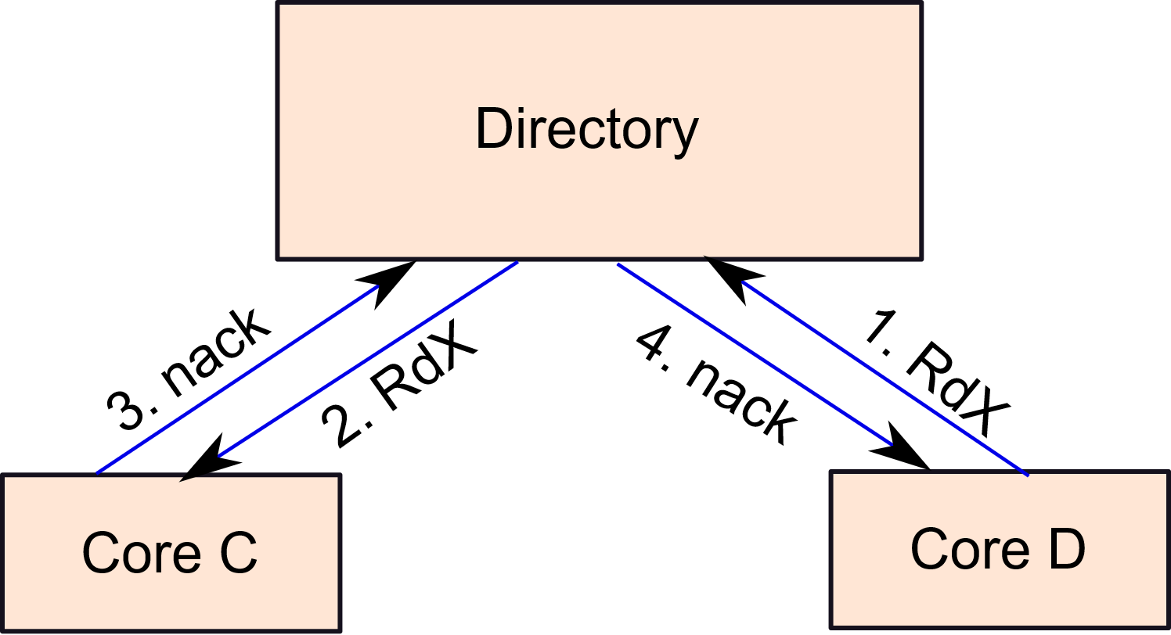
Conflict Detection
Use the coherence protocol to detect conflicts
Let us say core D has a miss. It sends a read-miss to the directory.
The directory forwards it to core C.
C detects a conflict.
It sends a nack message to D (via the directory).
The transaction at D aborts.

Slide 202
Eviction
What if there is an eviction?
If there is an eviction in the M state, the state at the directory is set to M@C. C is the number of the core that evicted the block.
Sets the overflow bit to 1.
Let us assume silent evictions from the S state.
Whenever the directory gets a request for a block in the M@C state, it forwards it to core C.
Core C may not have the block in the cache.
It will however infer a conflict because of the state of the block in the directory (the block is in its write set).
If it gets a normal request (not @C), it will assume that the line was in the S state.

Slide 203
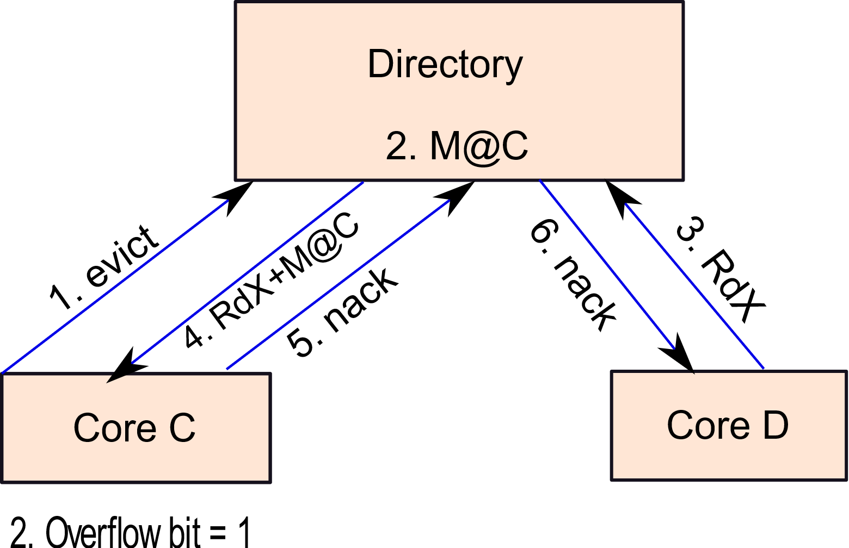
Example
Core D sends a read-miss message to the directory.
The directory forwards it to core C with the (M@C) directive
Core C infers a conflict
Sends a nack back to D (via the directory)

Slide 204
Subtle Issues
Assume a block has been evicted.
If there is a conflicting request by a non-transactional access, the current transaction has to abort
If a transaction aborts, then we need to clean the read/write sets. Some blocks might have gone to lower levels of the memory hierarchy.
Since we restore the entire undo log, the correct state of the blocks is restored (in the L1 cache). Wrong values at lower levels do not matter.
After a transaction finishes, all the R, W, M@C, and overflow bits need to be cleared.

Slide 205
Conclusion
There are two paradigms in parallel programming:
shared memory and message passing
Per-location sequential consistency (PLSC) is followed by
all systems today. It translates to the axioms of coherence.
A memory model is determined by two factors: write atomicity and program order. It is specified by the po, rf, fr, and ws relations.
Cache coherence protocols enforce the axioms of coherence.
If a program is data-race-free its execution is in SC.
Transactional memory is a very easy-to-use paradigm for writing data-race-free code (wrapped in atomic blocks).

Slide 206
The End

