Slide 1
Chapter 7:
Caches

Slide 2
Background Required to Understand this Chapter
RC and CMOS Circuits
Memory cells, latches and digital logic
Branch Prediction
Chapter 3
CMOS Logic

Slide 3
Contents
1.
Overview of Memory Systems
2.
Modelling Caches
3.
Advanced Cache Design
Simpler Version of an OOO Processor
4.
Trace Caches
Compiler based Techniques
5.
Instruction Prefetching
EPIC based Techniques: Intel Itanium
6.
Data Prefetching

Slide 4
How do we read books?
Read the books on the desk more frequently.
Keep books on similar topics on the desk.

Slide 5
Patterns in Real Life
Temporal Locality
Tend to read the same book over and over again.
The person will rarely fetch a book from the cabinet
Spatial Locality
High probability of fetching and reading books on similar topics
Generalize to the memory hierarchy
Temporal locality
Access the same address over and over again.
Spatial locality
Access similar (proximate) addresses in the same window of time.

Slide 6
Laptop → desk → shelf Principle
Laptop
Fastest
Most frequently read books and documents are in the laptop.
Desk
Slightly slower
Slightly less frequent documents are on the desk
Shelves
Slowest
Rarely accessed books are in the shelf
Increasing
storage
space

Slide 7
Apply a similar idea and create a memory hierarchy (use temporal locality)
Inclusive cache hierarchy: each cache contains a subset of addresses that are stored in the lower level.
Processor
2-4 cycles
I-cache
D-cache
L2 Cache
10-50 cycles
200-400 cycles
Main Memory

Slide 8
Use Spatial Locality
Store data at the granularity of blocks: 32 to 128 bytes A block is also called a cache line
We treat the block as an indivisible, atomic unit
Even if we read or write one byte, we fetch the entire block
A cache simply
contains a
set of blocks
along with some
metadata per block
block
We don’t want to maintain separate per-byte state in a block
Hence, we never fetch a subset of a block
While writing we wait for the block to be fist loaded into the cache.

Slide 9
Storing Blocks in a Cache
Problem
In a 32-bit memory system, design a cache with a 64-byte block size. Total size: 64 KB
26 bits
6 bits
Block address
Byte
offset
Break the address into two parts: block address and byte offset

Slide 10
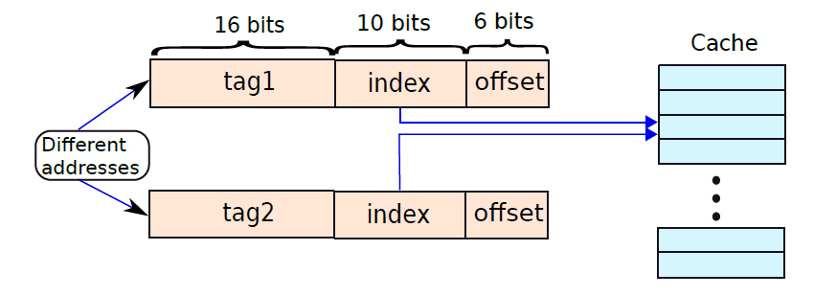
A Simple Mapping
Number of cache lines = 64 KB/ 64 B = 1024
16 bits
10 bits
6 bits
Rest of the bits (tag)
Index
Byte
offset
Aliasing is possible

Slide 11
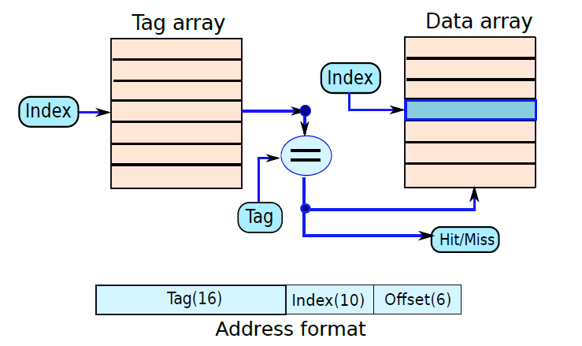
Direct Mapped (DM) Cache: Solves the problem of aliasing
There will be a lot of destructive interference.
Have a separate tag and data array
Access the tag and data array in parallel
If the tag matches, read or update the corresponding data block

Slide 12
Fully Associative (FA) Cache
Array of CAM (content addressable memory) cells in each row
Input bits
CAM
CAM
CAM
cell
cell
cell
match
line
The match line is set to 1 only if all the CAM cells (contain 1 bit) match the corresponding input bit
Problem with a DM cache → bind a block to a single cache line
We can use a CAM array to implement a fully associative (FA) cache where a block can be stored in any cache line

Slide 13
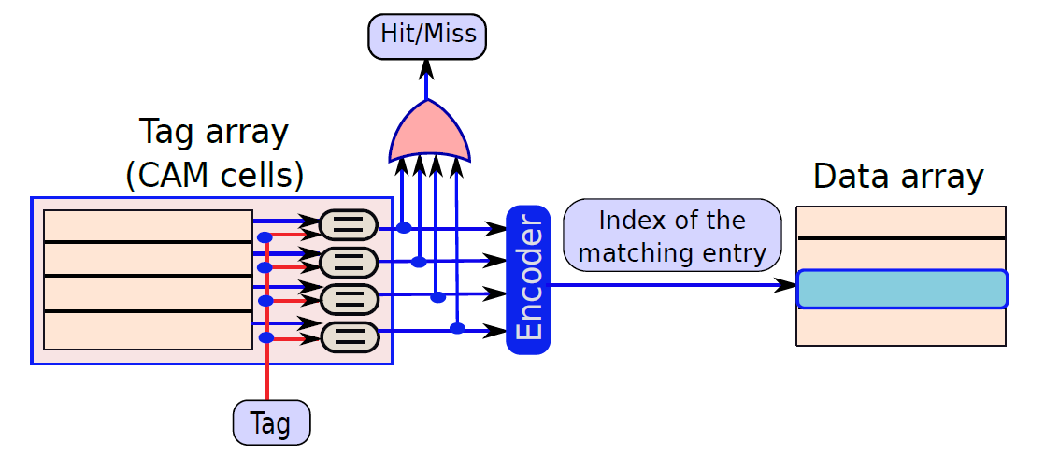
Fully Associative Cache - II
A block can be stored in any cache line
Disadvantage: Such caches are slow and power hungry

Slide 14
Compromise Solution: Set Associative Cache
Divide the 1024 cache lines into 256 sets
Each set contains 4 cache lines
Map a block to a set
Within the set it can be stored in any cache line
A flexible design that is fast and reduces the probability of aliasing
We access the tag array
Read all the tags in the set
If one of them matches the tag part of the address: declare a hit
Else it is a miss

Slide 15
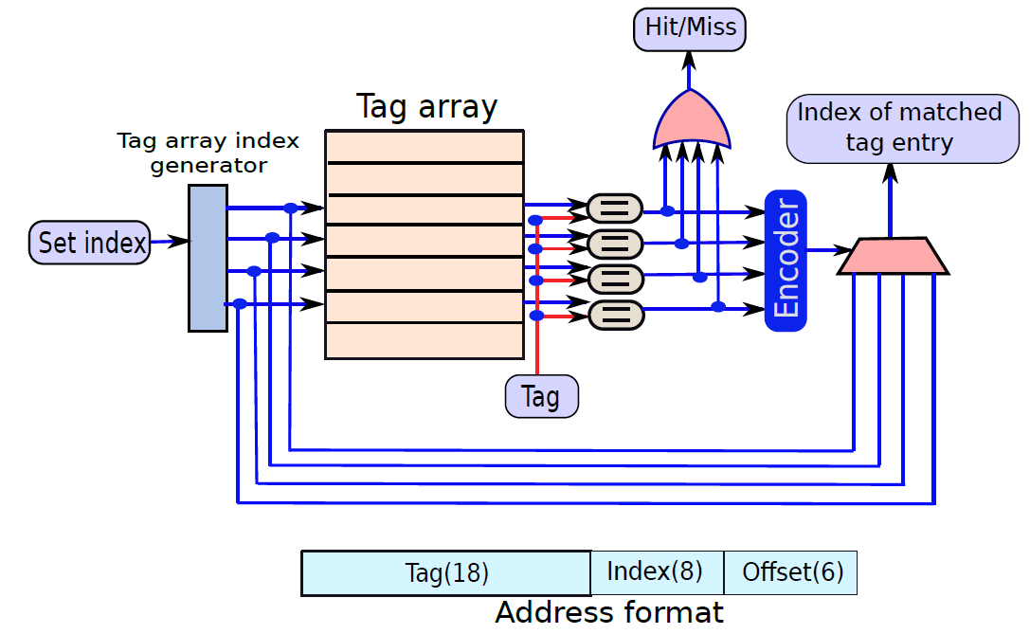
Diagram of a Set Associative Cache

Slide 16
Basic Operations in a Cache

Slide 17
The read Operation
Time
insert
replace
evict
insert
lookup
lookup
read block
if write
hit
data read
miss
back cache
Lower level
Lower level
cache
cache
Along with looking up the tag, read all the blocks of the set in parallel
If there is a hit, choose one of the read blocks (performance optimization)
If there is a miss, read the block from the lower level and find an empty line in the set
If there is no empty line, evict a block in the set to create space for the new block

Slide 18
The Valid bit and Modified bit
Enhance the tag array to contain two important bits
Valid bit → Does this line contain valid data?
Modified bit → Has any byte in the block been modified?
Write-through scheme
Propagate every write to the lower level
We can seamlessly evict the block
Write-back scheme
Set the modified bit, if there is a write access.
At the time of eviction → If the line is modified, write it back to the lower level.
Consumes a lot of power

Slide 19
Write Operation (write-back cache)
Time
write
lookup
lookup
block
insert
replace
evict
insert
hit
data write
miss
Lower level
Lower level
cache
cache
If there is a hit, the access is straight-forward. Set the modified bit.
If there is a miss, write to the block, and try to insert it.
If there is no space, find a replacement candidate, and evict it

Slide 20
Write Operation (write-through cache)
Time
lookup
write
lookup
block
insert
replace
evict
insert
hit
data write
miss
Lower level
Lower level
cache
cache
In a write-through cache, we can seamlessly evict a line
However, at the time of writing, the write needs to be propagated to the lower level.
Because the hierarchy is inclusive, there will be a hit at the lower level.

Slide 21
Cache Replacement Policies
Random replacement
FIFO (first in, first out) replacement
LRU → Least recently used
Impractical because we need to maintain timestamps
Use Psuedo LRU
Have a 3-bit saturating counter with each tag
Increment on every access
Periodically decrement all counters
Choose the entry in the set with the least counter

Slide 22
Mathematical Analysis

Slide 23
Average Memory Access Time
$$AMAT= {L1}_{hit time}+L1_{miss rate }∗L1_{miss penalty}$$
$$L1_{miss penalty }=L2_{access time}$$
$={L2}_{hit time}+L2_{miss rate }∗L2_{miss penalty}$
$$L2_{miss penalty }=L3_{access time}$$
$={L3}_{hit time}+L3_{miss rate }∗L3_{miss penalty}$
$$L3_{miss penalty}=main memory_{access time}$$

Slide 24
Simple Optimizations

Slide 25
Basic Strategy
Reduce hit time
Reduce miss rate
Reduce miss penalty
Three kinds of misses
Cold or compulsory misses
Misses incurred the first time we read or write a block
Capacity misses
Misses incurred because of the limited size of the cache
Misses incurred because of destructive interference
Conflict misses

Slide 26
Simple Optimizations
Reduce hit time
Reduce compulsory misses
Reduce capacity misses
Small and simple caches
Increases the miss rate
Increase the block size, prefetching
A large block size reduces the number of blocks
Prefetching, better compiler algorithms

Slide 27
Simple Optimizations – II
Conflict misses
Increase the associativity
Increases the latency and power consumption
CPU
Victim cache
The small victim cache
stores frequently evicted
blocks. If a block is not found
in the L1 cache, it is searched
in the victim cache before
searching the L2 cache.
L1
Victim
L2

Slide 28
Static Optimizations – III
Reduce the miss penalty
We typically request for 4 bytes in a 64-byte block
Transfer those 4 bytes first and then transfer the remaining 60 bytes subsequently (critical word first)
Let the processor resume when the 4 bytes arrive (early restart)

Slide 29
Virtual Memory

Slide 30
What does a process assume about the memory system?
Memory Map
0xFFFF FFFF
Kernel
Process → Running instance of a
program.
0xC000 0000
Stack
It owns a large contiguous chunk of the memory space. Within
this chunk it can access and modify any location at will.
Heap
BSS
Data
Text

Slide 31
Two Important Questions
Overlap Problem
How do we support multiple processes concurrently? A typical machine runs 100s of processes concurrently. Wouldn’t they be able to access each other’s data?
Size Problem
Can we access memory that is larger than the size of the physical memory?

Slide 32
Solution to the Size and Overwrite Problems
Virtual Memory
The processor generates virtual addresses
Convert virtual to actual (physical) addresses
This solves both the problems

Slide 33
Address Translation
Address
Translation
Physical address (32 bits)
Virtual address (32 bits)
What do we need to ensure?
Unless intended, two processes never access the same physical address
The physical address might point to a location outside main memory (solution to the size problem)

Slide 34
Basic Idea
Divide the virtual memory space (addresses that programmers and compilers see)
Into 4 KB pages
Divide the physical memory into 4 KB frames
Map pages to frames
Ensure that the mapping solves the size and overwrite problems

Slide 35
Overlap Problem: Map in such a way that there are no overlaps
Process 1
Physical
address
space
Process 2
Page
Frame
Map pages to frames such that there are no overlaps.

Slide 36
Size Problem: Create an array of frames in the hard disk called swap space
Process 1
Page
Main
Swap
Frame
memory
space
Create an array in the hard disk or other form of stable storage. This is the swap space.
If a page points to a frame in the swap space, we need to bring the frame to main memory.

Slide 37
Page Tables and TLBs
The mappings are stored in a dedicated data structure called the page table.
The page table takes several cycles to access. This is a slow process.
Have a fast hardware structure called the TLB to cache the most frequent mappings
The processor accesses the TLB first, uses the mapping if it is there. Otherwise, it accesses the page table.

Slide 38
Flowchart for a memory access
Memory
access
Yes
Send mapping
TLB hit?
to processor
No
Frame in
Yes
Populate
Send mapping
memory?
TLB
to processor
No
Free frame
No
(1) Evict a frame
available?
to swap space
(2) Update its page
Yes
table
Read in the new frame
from swap space (if possible),
or create a new empty frame
Create/update mapping
in the page table
Populate
Send mapping
TLB
to processor

Slide 39
Contents
1.
Overview of Memory Systems
2.
Modelling Caches
3.
Advanced Cache Design
Simpler Version of an OOO Processor
4.
Trace Caches
Compiler based Techniques
5.
Instruction Prefetching
EPIC based Techniques: Intel Itanium
6.
Data Prefetching

Slide 40
SRAM Array

Slide 41
Cross-Coupled Inverters
Q
Q
Q
Q
Cross-coupled inverters
Cross-coupled inverters
implemented using CMOS logic

Slide 42
Basic SRAM Cell
Word line
transistor
Word line (WL)
Q
Q
W
W
1
2
BL
BL
Each cell is connected to a bit line pair. They have complementary values.
(Bit line)

Slide 43
SRAM Array
BL
BL
WL
SRAM
SRAM
SRAM
SRAM
cell
cell
cell
cell
Row
WL
address
Decoder
SRAM
SRAM
SRAM
SRAM
cell
cell
cell
cell
WL
SRAM
SRAM
SRAM
SRAM
cell
cell
cell
cell
Column
Column mux/demux
address
Write
Write
driver
driver
Data in
Data in
Sense amplifier
Sense amplifier
Data out

Slide 44
Structure of a Cache
SRAM cell
Address
Tag Array
Data Array
wordlines
Decoder
column muxes
sense amps
Output driver
Comparators
mux drivers
hit/miss
data output

Slide 45
Precharging Trick
Assume ground is 0 V and the supply is 1 V
SRAM cell
BL
BL
Do we wait for one bit line
to go to 0 V and the other to
reach 1 V?
This will take too much time.
Sense
Amplifier

Slide 46
Precharging trick – II
To figure out which side is heavier, do we have to wait for one of the stones to hit the ground?
Keep measuring the slope of the rod. Once it is more than a threshold (noise value), declare the result.

Slide 47
Precharging Trick – III
We don’t have to wait for the voltage values to reach the final values.
$$value= \left\{\begin{aligned}1 V\left(BL\right)−V\left(\overline{BL}\right)> Δ \\ 0 V\left(\overline{BL}\right)−V\left(BL\right)> Δ\end{aligned}\right.$$
Here $Δ$ is the noise margin
Precharging step: Set the voltage of the bit line pair to 0.5 V using powerful precharge drivers
A dedicated sense amplifier senses the difference in the voltage
It sets the output, once the difference crosses the threshold $Δ$

Slide 48
The Sense Amplifier
Bit Line (BL)
Bit Line (BL)
AMP₁
AMP₂
T₁
T₂
AMP₃
Output

Slide 49
CAM Array

Slide 50
A CAM Cell
A
A
BL
BL
Word line (WL)
Q
Q
W1
W2
match line
T1
T3
Checks whether Q = A
T2
T4

Slide 51
Truth Tables
Q | $$\overline{A}$$ | T₁ | T₂
0 | 0 | off | off
0 | 1 | off | on
1 | 0 | on | off
1 | 1 | on | on
$$\overline{Q}$$ | $$A$$ | T₃ | T₄
0 | 0 | off | off
0 | 1 | off | on
1 | 0 | on | off
1 | 1 | on | on

Slide 52
CAM Array
A
1
A
1
A
2
A
2
A
n
A
n
CAM mode
BL
BL
BL
BL
BL
BL
WL
CAM
cell
match
Row
WL
address
Decoder
Priority encoder
Matching
index
WL
Column
Column mux/demux
address
Write
Write
driver
driver
Data in
Data in
Sense amplifier
Sense amplifier
match
Data out

Slide 53
The Cacti Tool

Slide 54
Modeling and Simulating Caches
Should I use a 4 KB, 2-way assoc. cache or an 8 KB, 1-way assoc. cache? Should I allow concurrent accesses?
First, we need to find the access times of both caches
Convert access time into clock cycles
Simulate both the configurations: find the faster one
To find the time it takes to access a cache
We need to use a simulation tool
Most popular simulation tool → Cacti (designed by HP labs)
Along with that
We need power and area data as well
Cacti 6.0 provides all of these

Slide 55
Idea that will not work: Multi-ported structures
BL1
BL1
WL1
WL2
BL2
BL2
Re-design the SRAM cell → slower and larger

Slide 56
Usage
cacti C B A
C → cache size in bytes
B → block size in bytes
A → associativity
Number of banks (a bank is a sub-cache) (more later ..., assume 1 for now)
Hidden inputs
b_{o} → output width (32 or 64 bits)
b_{width} → input address width (32 or 64 bits)
inputs
area,time,power
Cacti

Slide 57
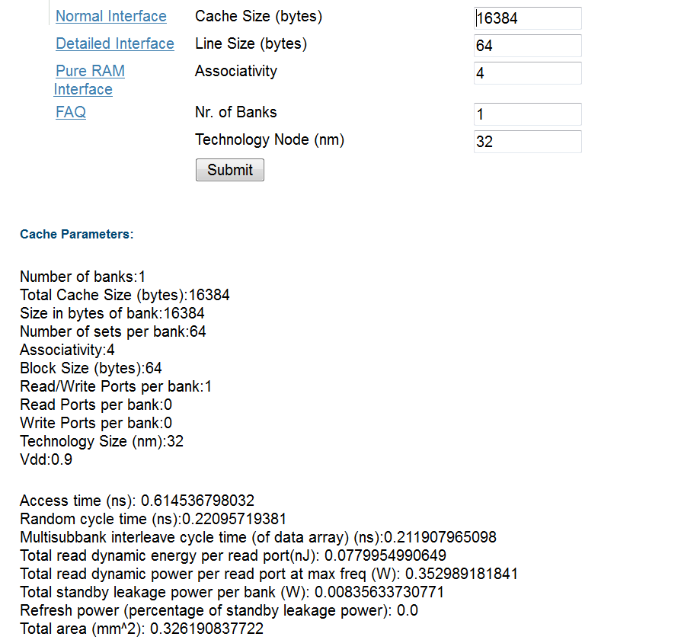
Sample input and output

Slide 58
How does Cacti work?
Given the inputs, it tries to create the most optimal (often fastest) cache
What can happen?
Caches can get very asymmetric. rows >> columns, or columns >> rows (>> means significantly more than)
Slow design
Fast design

Slide 59
How to make it fast?
Set the aspect ratio first:
Number of sets mapped to a wordline → N_{spd}
A higher N_{spd} will increase the number of column multiplexers → slowdown
However, it will decrease the number of rows, and thus the size of the address decoder → speedup
Then create subarrays of SRAM cells
N_{dwl} → Number of vertical cut lines
N_{dbl} → Number of horizontal cut lines
Total number of subarrays created → N_{dwl} * N_{dbl}
The optimal values of N_{dwl} , N_{dbl,} and N_{spd} are found out by Cacti

Slide 60
Partitioning an SRAM array
Large SRAM array
A * B * N_{spd} bytes
N_{dbl}
N_{dwl}

Slide 61
Banks and Subarrays
A large array can be split into multiple banks
A bank is an independent array.
Different banks can be accessed simultaneously
Given an address, we first need to map it to a bank, and then access that specific bank
Advantage of banking → faster banks and more parallel access
Disadvantage of banking → More area, and additional delay in deciding the bank. Higher wire routing overhead.
We split each bank into multiple subarrays
Compute the three parameters: N_{dwl}, N_{dbl}, N_{spd}

Slide 62
Arrange the Subarrays in a Hierarchy
Each bank can then be split into subbanks
Subbanks do not allow parallel (concurrent) access
A subbank stores a full block (Advantage: read the block in one go)
Each subbank is further divided into mats and subarrays
Each mat supplies a portion of a block (enhanced parallelism)
Subarrays in a mat share a decoder or predecoder
Array
Bank
Subbank
Mat
Subarray

Slide 63
Summary
First set the aspect ratio: N_{spd}
Then compute N_{dwl} and N_{dbl} → Total N_{dwl} * N_{dbl} subarrays
Divide the cache into equal-sized banks
Keep in mind the probability of bank conflicts
A bank is a fully independent array with its separate address and data lines
Hierarchy: bank → subbank → mat → subarray
subbanks do not allow independent or concurrent accesses
Enhanced intra-block parallelism
A mat stores a part of a block. It contains multiple subarrays.
subarrays share their decoding logic in a mat.

Slide 64
Examples: (2-way assoc, 64B line size, 1 bank, 32 nm) Access Time vs Cache Size
Little variation. Because of Cacti’s optimizations.

Slide 65
Area vs Cache Size
Roughly linear scaling

Slide 66
Cache Size vs Power
Little variation. Because of Cacti’s optimizations.

Slide 67
Elmore Delay Model

Slide 68
Time and Power Modelling
How to compute the delay of a cache?
Replace it by its equivalent RC model.
RC model of a wire

Slide 69
Assumptions
Let us only consider RC trees
We only consider voltage sources that provide step inputs. 0 → 1 or 1 → 0
Elmore Delay Model

Slide 70
Example: RC Tree
1 → 0 transition
R
4
R
5
4
5
ground
C
C
4
5
R
1
R
2
R
3
0
1
2
3
C
C
C
V
1
2
3

Slide 71
Replace Capacitors with Current Sources
R
4
4
R
5
5
C
4
C
5
R
1
R
2
2
R
3
0
1
3
-C₃ dV₃(t)/dt
C
C
C
V
1
2
3

Slide 72
Principle of Superposition
AIM: Compute the voltage at node V_{x} at time t.
Methodology:
The aim is to find $V_{i}^{j}$ → voltage at terminal i because of the current source placed at terminal j
While considering one current source, disconnect the rest of the current sources (replace by an open circuit)
$$V_{3}^{4}=−R_{1}C_{4} \frac{dV_{4}^{4}}{dt}$$

Slide 73
Generalize the Result
j
RC circuit
i
0
Let P_{ij} denote the RC circuit in the shared path from from 0→i and 0→ j
$$R_{ij}=\sum_{R ∈ P_{ij}}{R}$$
Definition

Slide 74
Elmore’s Assumption
$$V_{i}^{j}=− R_{ij}C_{j}\frac{dV_{j}^{j}}{dt}$$
Superposition
$$V_{i}=\sum_{j}{V_{i}^{j}}=− \sum_{j}{R_{ij}C_{j}\frac{dV_{j}^{j}}{dt}}$$
Elmore’s Assumption
$$\frac{dV_{j}^{j}}{dt}=\frac{dV_{i}}{dt}$$

Slide 75
Using Elmore’s Approximation
$V_{i}= \sum_{j}{−R_{ij}C_{j}\frac{dV_{i}}{dt}}=−τ_{i} \frac{dV_{i}}{dt}$
$$τ_{i}=\sum_{j}{R_{ij}C_{j}}$$
$V_{i}=V_{0}e^{−\frac{t}{τ_{i}}}$
Solution

Slide 76
Results Derived by using the Elmore Delay Model
The latency of a wire is proportional to the square of its length.
The bit line and word line can be modelled very easily.
Full SRAM banks can be modeled as a sequence of simple elements.

Slide 77
Contents
1.
Overview of Memory Systems
2.
Modelling Caches
3.
Simpler Version of an OOO Processor
Advanced Cache Design
4.
Trace Caches
Compiler based Techniques
5.
Instruction Prefetching
EPIC based Techniques: Intel Itanium
6.
Data Prefetching

Slide 78
Pipelined Caches
Let us say that a cache takes 5 cycles to access.
Do we wait for 5 cycles for the next access?
Pipeline the cache.
Even if the latency is high, we can achieve a high throughput.

Slide 79
Tasks Involved in a Read Operation
Tag array
access
Tag
Data block
comparison
selection
Data array
access
Pipelined Implementation
Stage 1
Stage 2
Stage 3
Tag array
access
Tag
Data block
comparison
selection
Data array
access
Pipeline
latches

Slide 80
More on Pipelining
We simply add new pipeline buffers
The SRAM access can be pipelined by adding latches after the decoder
This is very expensive in terms of area and power.
The write access can be pipelined
Access tag array → Compare the tags → Effect the write in the data array

Slide 81
Non-Blocking Caches
Let us say that there is a cache miss.
Do later cache access stall?
Cache accesses need not be blocked. We simply need to record all accesses to the missed block.
MSHR
Miss Status Holding Register

Slide 82
Design of an MSHR
MSHR
Miss queue entry
Address
Read/
Word
Tag
Store
write
address
value
Miss queue
For every address we have an associated miss queue → Ordered in FIFO order

Slide 83
Operation of an MSHR
When there is a miss in a cache, an entry is created in its MSHR. If there are no free entries, the request blocks.
We also create an entry in the miss queue.
This is a primary miss.
If at the same time, another miss arrives, it will be called a secondary miss.
If it is a write, we just append it to the tail of the miss queue.
If it is a read, we search for earlier writes in the miss queue to the same set of bytes. If we find an entry, the value is forwarded. Else, we enqueue the entry.

Slide 84
Skewed Associative Caches
Conflict misses are the main problem
Solution:
Have multiple subcaches
Use different indexing functions for each subcache
Subcache 1
f
1
f
Subcache 2
2
Subcache 3
f
f
Subcache 4
3
4
Address

Slide 85
Basic Insight
Consider two addresses
If $f_{1}\left(A_{1}\right)=f_{1}(A_{2})$ most likely $f_{2}\left(A_{1}\right)≠f_{2}(A_{2})$
If they conflict in one subcache most likely they will not conflict in another subcache
Reduce conflict misses
Overheads
These functions need to be computed
Replacements are tricky

Slide 86
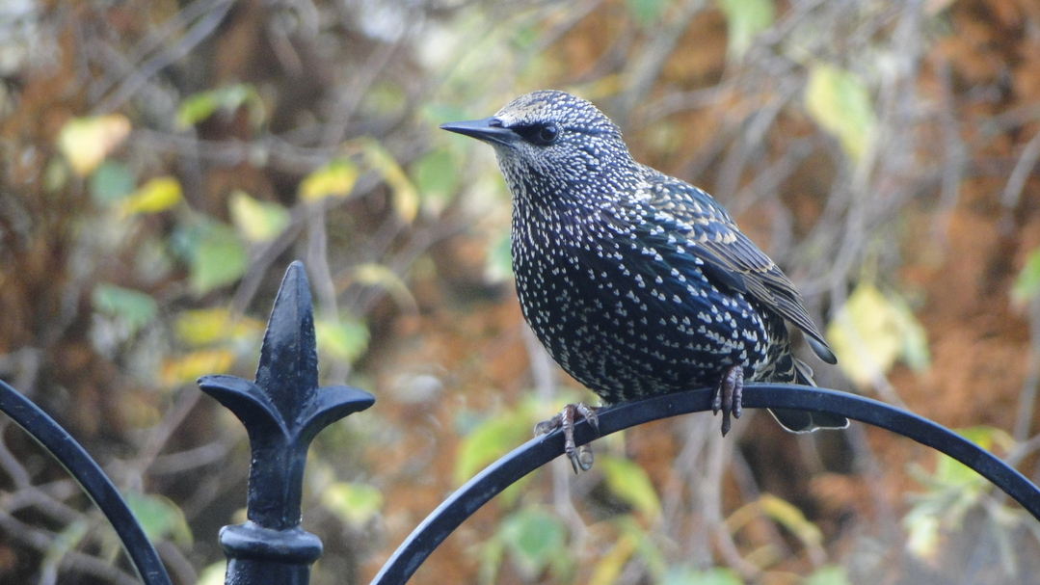
Replacements
Cuckoo search
Assume that we want to add the block B at address A
We will first check if $f_{1}\left(A\right)$ ... $f_{4}\left(A\right)$ are free
If not, we evict the block B’ with address A’ stored at $f_{1}\left(A\right)$. We insert block B in the first subcache at $f_{1}\left(A\right).$
We try to accommodate B’ at $f_{2}\left(A′\right)$ or $f_{3}\left(A′\right)$or $f_{4}\left(A′\right)$
If none of these locations are free, we choose one of the locations randomly. Let’s say, it is $f_{2}\left(A′\right).$We insert B’ there by evicting block B’’. Again we try to accommodate B’’.
We repeat this process a few times before finally giving up and evicting a block.

Slide 87
Way Prediction
Default mechanism in set-associative caches
Read all the tags and blocks in a set (simultaneously)
Compare the tag part of the address with each of the tags
We do more work that what is required.
Predict the way in which the tag will be found
Access that way first
If the tags don’t match, access the rest of the ways
Fast and power-efficient

Slide 88
Way Prediction Techniques
If the address is available use it, else use some other piece of information.
Approach 1
Predict based on the program counter
Use a branch predictor-like mechanism
Problems: Memory addresses for an instruction might keep changing
Approach 2
Use an estimate of the memory address to predict the way

Slide 89
Way Prediction Techniques – II
Load instruction
ld r2, 12[r1]
Read registers
Compute the address
Check for LSQ forwarding
Access the d-cache
r1 XOR 12
Way prediction
Combine the value of the base address with the offset (like GShare). We may use additional PC bits
Then use a branch predictor-like mechanism to predict the way

Slide 90
Loop Tiling
How do we run large loops that access large arrays on a system with caches?
How is a 2D array stored?
Row-major order: Store the first row, then the second, then the third and so on.
Column-major order: first column, second column, and so on

Slide 91
Basic Matrix Multiplication
Matrix Multiplication
for (i=0; i<N; i++) {
for (j=0; j<N; j++) {
sum = 0;
for (k=0; k<N; k++)
sum += A[i][k] * B[k][j];
C[i][j] = sum;
}
}
Not suitable when arrays are large, and caches are comparatively much smaller.

Slide 92
Tile the Multiplication
Operate on blocks of data
j
j
i
i
(a)
ii,kk
kk,jj
ii, jj
(b)

Slide 93
Tiled loops
/* Iterate through the tiles */
for (ii =0; ii <N; ii +=b) {
for (jj =0; jj <N; jj +=b) {
for (kk =0; kk <N; kk +=b) {
/* iterate within a tile */
for (i=ii; i < ( ii+b) ; i++) {
for (j=jj; j < ( jj+b) ; j++) {
for (k=kk; k < ( kk+b) ; k++) {
C[i][j] += A[i][k] * B[k][j];
b
b
Fits within the cache
...

Slide 94
Prove that the algorithm is correct.

Slide 95
VIPT (Virtually Indexed Physically Tagged) Caches
Compute address
Translate address
Access the d-cache
We need to spend an additional cycle translating the address after we have computed it.
What if we don’t need any translation to access the correct set in the L1 cache?
Possible

Slide 96
VIPT Caches
Virtual address
Page id
Offset
Physical
address
Frame id
Offset
Offset
Tag
Index
Byte offset
Access all the ways in the set while the address translation mechanism is working. It will compute the tag.

Slide 97
The Design of the VIPT Cache
Tag array
Data array
Tag
Index
Offset
Address
translation
Multiplexer
Output
Overlap
(a) VIPT cache
Access tag array
Read data array
Address
translation
Tag comparison
Select data block
Time
(b) Timeline

Slide 98
Contents
1.
Overview of Memory Systems
2.
Modelling Caches
3.
Simpler Version of an OOO Processor
Advanced Cache Design
4.
Trace Caches
Compiler based Techniques
5.
Instruction Prefetching
EPIC based Techniques: Intel Itanium
6.
Data Prefetching

Slide 99
Trace Cache
Execution of a typical program
Basic Block 1
Basic Block 2
Basic Block 3
Basic Block 4
Basic block → A set of instructions with a single point of entry and a single point of exit
We fetch a sequence of basic blocks from the i-cache
Such a sequence is called a trace
Let us have a cache that stores such traces. We have the option of sequentially reading out a full trace
This is called a trace cache (first major use: Pentium 4, circa 2000)
If the trace is accurate, we need not predict branches or decode instructions

Slide 100
Early Approaches
Traditional approach
A cache line contains contiguous cache blocks
Peleg and Weiser
Store successive basic blocks per cache line
Trace segments cannot span multiple cache lines
Melvin et al.
CISC instruction sets decode instructions into micro-ops
The idea is to store decoded micro-ops for each instruction in a cache line
Saves some decoding effort
Can we combine and augment these solutions?

Slide 101
Structure of a Solution
A trace consists of multiple cache lines
It is a linked list of cache lines (each line is a trace segment)
We need a method to place a marker to terminate a trace and start a new trace.
Trace Head
Trace Body
Trace Body
Trace Tail

Slide 102
Design of the Trace Cache
Fill buffers
Controller
Tag array
Data array
NLIP
μ
IP
μ
OPs

Slide 103
Storage of Traces
Way 0
Way 1
Way 2
Way 3
Set 1
Head
Head
Set 2
Body
Body
Set 3
Body
Body
Set 4
Body
Body
Set 5
Tail
Tail
Store trace segments in consecutive sets
Each trace segment stores the number of the way in the next set
Each data line can store up till 6 decoded micro-instructions

Slide 104
Basic Rules
Rules for storing trace segments in a data line
Never distribute micro-ops of a macro instruction across cache lines
Terminate a data line if you encounter more branch micro-ops than a threshold
Termination of the trace creation process
Encounter an indirect branch
Interrupt or branch misprediction notification
Maximum length of trace (64 sets) reached

Slide 105
The Tag Array
Tag
Type
Next way
Prev way
NLIP
μIP
valid
bit
Field | Meaning
Type | Trace head, body, or tail
Next way | Index of the way for the next trace segment (next set)
Prev way | Index of the way of the previous trace segment (prev. set)
NLIP | Address of the next CISC instruction
μIP | Index into the table of micro-instructions

Slide 106
State Diagram (reading a trace)
Search for head
Head lookup
Start a new trace
Search for head
Miss
Body lookup
Body miss
Complex instruction
Tail
Return
encountered
Read micro-
instructions

Slide 107
State Diagram (creating a trace)
Read micro
instructions
Fetch from i-cache
Trace not
Trace end
ended
Complex
condition
instruction
detected
Bypass
μ
OPs
Trace segment
Wait for
μ
OPs
OPs reach
end condition
Head lookup
the fill buffer
μ
Trace not
Trace end
ended
Transfer
condition
detected

Slide 108
Contents
1.
Overview of Memory Systems
2.
Modelling Caches
3.
Simpler Version of an OOO Processor
Advanced Cache Design
4.
Trace Caches
Compiler based Techniques
5.
Instruction Prefetching
EPIC based Techniques: Intel Itanium
6.
Data Prefetching

Slide 109
Misses in the Caches
We can incur a large performance penalty if there is a miss in the i-cache
For the next 10-50 cycles, there will be no instructions to fetch, if there is an L2 hit
If there is a miss in the L2, we have nothing to do for hundreds of cycles
IPC will suffer
What is the solution?
Prefetch memory addresses
Meaning: Predict memory addresses that will be accessed in the future. Fetch them from the lower levels of the memory hierarchy before they are actually required.

Slide 110
Instruction Prefetching
1
Find patterns in the i-cache access sequence
Leverage this pattern for prefetching
2

Slide 111
Precautions
Do not prefetch too soon.
Do not prefetch too late.

Slide 112
Next Line Prefetching
Pattern: Spatial locality
If cache line X is accessed, there is a high probability of accessing lines: X+1 and X+2
Reason: The code of most functions spans multiple i-cache lines and we have spatial locality
Leverage this pattern: If a cache line X incurs an i-cache miss, read X and the next k lines from the L2 cache
If k is too high, we might fill the cache with useless data.
Almost all prefetching algorithms operate on the miss sequence, not on the access sequence.

Slide 113
Markov prefetching
Pattern: i-cache miss sequences have high repeatability
The miss sequence of a core typically looks like this:
High correlation between consecutive misses
Leverage this pattern for prefetching
Miss sequence:
X | Y | …. | X | Y | … | X | Y | … | X | Y | …

Slide 114
Markov prefetching
Record the i-cache miss sequences in a table
Given that cache line X incurs a miss, predict the line which will incur a miss next
Miss sequence:
X | Y | …. | X | Y | … | X | Z | … | X | Y | …
Cache line | Option 1 |  | Option 2
 | Address | Frequency | Address | Frequency
X | Y | 3 | Z | 1
Markov table:
Higher probability

Slide 115
Markov Predictors - II
We can instead have an n-history predictor that takes the last n misses into account
Whenever there is a miss, access a prefetch table. Find the next few addresses to prefetch. Issue prefetch instructions.
Also, update the frequencies of the entries for the last n-1 misses.
All prefetch requests go to a prefetch queue. These requests are subsequently sent to the L2 cache (lower priority).

Slide 116
Call Graph Prefetching
Pattern: The function call sequence is predictable
Leverage this pattern: predict and prefetch the function that may be called next

Slide 117
Call Graphs
prepare_window
show_screen
set_buttons()
....
set_buttons()
....
set_textboxes()
......
......
......
......
prepare_window( )
......
......
update_window( )
......
......
clear_window( )
......
......
......
set_textboxes()
......
......
update_window( )
......
......
clear_window
......
......

Slide 118
Call Graphs - II
1
set_buttons
prepare_window
2
1
set_textboxes
show_screen
2
update_window
3
clear_window

Slide 119
Call Graph based Prefetching (in software)
show_screen
show_screen
......
prepare_window( )
......
......
update_window( )
......
......
clear_window( )
......
......
prefetch prepare_window
......
……
prepare_window()
prefetch_update_window
......
......
update_window( )
prefetch clear_window
......
......
clear_window( )
......
becomes
The compiler analyzes the code and inserts instructions to prefetch the code of functions.

Slide 120
Hardware Approach Call Graph History Cache (CGHC)
Tag Array
Data Array
Function id
Index
func 1
func 2
func 3
func 4
func 5
Each entry in the data array contains a list of functions to be subsequently executed.
The index maintains a pointer to a function in the data array entry.
The index is initially 1. We prefetch the code of func1. After returning from func1, we set the index to 2, and prefetch the code for func2.

Slide 121
Operation (Function Call)
Function Call.
X calls Y
Access the entry of Y in the CGHC
Does it exist?
NO
Create entry
YES
Prefetch the first function in Y’s call sequence
Put Y in X’s call sequence at the appropriate index (if required)

Slide 122
Operation (Function return)
Y returns to X
Reset the index of Y to 1
Access X’s call sequence
Prefetch the next function in the call sequence
Increment the index

Slide 123
Patterns
Technique | Pattern/Insight
Next line prefetching | Spatial locality
Markov prefetching | i-cache miss sequence has high repeatability
Call graph prefetching | Function access sequence has high repeatability

Slide 124
Contents
1.
Overview of Memory Systems
2.
Modelling Caches
3.
Simpler Version of an OOO Processor
Advanced Cache Design
4.
Trace Caches
Compiler based Techniques
5.
Instruction Prefetching
EPIC based Techniques: Intel Itanium
6.
Data Prefetching

Slide 125
Data Prefetching
Instead of instructions, let us now prefetch data
Important distinction
Instructions are fetched into the in-order part of the OOO pipeline
Data is fetched into the OOO pipeline
As a result, the final IPC is slightly more resilient to data cache misses
Nevertheless, prefetching is very useful
i-cache hit rates are typically very high, whereas d-cache hit rates are much lower
Hence, the margin for improvement is significant.

Slide 126
Stride based Prefetching
for (i = 0; i < N; i++ ) {
...
A [i] = B[i] + C[2*i];
}
Consider the following piece of code
For the arrays A and B, the addresses in each iteration differ by 4 bytes (assumed to be the size of an integer)
For the array, C, consecutive accesses differ by 8 bytes
This instruction will translate into multiple load/store RISC instructions
There will be only one memory access per instruction
The hardware will observe that for the same PC
The memory address keeps getting incremented by a certain value (4 or 8 bytes in this case)
This fixed increment is called a stride

Slide 127
Reference Prediction Table (RPT)
Memory address
Instruction Tag
Previous Address
Stride
State
PC
Prefetched address
Adder
For each instruction
Keep track of the address and the stride
We can decide to prefetch N iterations in advance
State: initial → transient (not sure about the stride) → steady

Slide 128
Extensions
How many iterations do we prefetch in advance?
This depends upon the rest of the instructions in the for loop
This ideally should be dynamically adjusted
For a subset of prefetches
Monitor the number of cycles between when a line is prefetched and it is actually used
Should not be negative
It is being prefetched too late. We will not get the desired benefits.
Should be a small positive number
The data arrives just before it is needed.

Slide 129
Pointer Chasing
...
/* traverse the linked list */
node * temp = start_node ;
while ( temp != NULL ) {
prefetch (temp -> next ); /* prefetch the next node */
process ( temp );
temp = temp -> next ;
}
Linked list accesses cannot be characterized by strides.
We can insert code to prefetch subsequent linked list nodes.

Slide 130
Runahead Mode
What happens when we do incorrect prefetching?
We have misses because we do not prefetch the correct data and we displace useful data. L1 misses can more or less be taken care of by an OOO pipeline
L2 misses are bigger problems
What happens on an L2 miss
We go to main memory (200-400) cycles
What does the OOO pipeline do?
The IW and ROB fill up
It pretty much stalls
Idea: Do some work during the stalled period

Slide 131
What can we do?
Enter runahead mode
Return a junk value for the request that misses in the L2 cache
Restart execution with the junk value
We will produce junk values (in the forward slice)
That is still okay. Why?
We will have a lot of instructions in the pipeline that can be executed correctly because they are not in the forward slice of the mispredicted load.
We will prefetch data into the caches, and train the predictors
Once when the L2 miss returns
Flush the instructions in the forward slice of the L2 miss
Re-execute them
Very effective prefetching technique

Slide 132
Operation
Before entering the runahead mode
Take a checkpoint of the architectural register file + the branch history register + return address stack
Start the runahead mode
Add an invalid (INV) bit to each register
The L2 miss generates an INV value
All the instructions in its foward slice have an INV value
The INV value is same as the poison bit (learnt earlier)
Question:
Do we restrict invalid values to the pipeline or let them propagate?

Slide 133
Value Propagation
Pipeline
L1
L2
If till the pipeline → nullify all stores
If till the L1 → do not evict INV data from the L1. Invalidate it later.
Preferably not till the L2 (massive amount of state management)

Slide 134
Let us take INV values till the L1
If we use the traditional L1 cache, there will be some problems
We need to maintain both INV and non-INV data together
What if they are on the same line (additional state required)
Solution: have an additional runahead cache that contains only INV data.
Runahead L1
Pipeline
L1

Slide 135
Runahead L1 Cache
A store might have the INV flag set for two reasons
Its address is INV. Ignore.
A stores data is INV. Access the runahead cache, and also prefetch.
Perform the store
Let us keep some additional state per line. Let us mark those words written by an INV store as INV.
Cache Line
INV Stores

Slide 136
Loading a Value
First try forwarding in the LSQ
If not possible:
Access the runahead cache and L1 cache in parallel
The runahead cache gets preference
Load the data. If the data is marked as INV, marked the load data as INV
Otherwise, load data from the L1 cache
If there is a miss, load data from the L2 (acts as prefetching)

Slide 137
Operation (Contd...)
Keep fetching and retiring (in runahead mode) instructions
All the instructions before the speculated load (in program order) will retire
After that, all instructions are in runahead mode (will not retire)
As we fetch and execute more and more instructions, we in effect do more prefetching
What about updating branch predictors?
Best option: Treat runahead instructions as normal instructions
Return from runahead mode
Similar to a branch misprediction, restore the checkpoint

Slide 138
Helper Threads
In a multicore processor, we can spawn threads (lightweight processes) on other cores
For some of the memory addresses, the threads can execute the backward slice of the load – instructions that determine the address of the load.
The computed address can be prefetched.
Requires some compiler support to identify the critical loads.

Slide 139
Conclusion
Caches are divided into a tag array and data array.
We can have three kinds of caches: FA, SA, and DM.
We typically use the Elmore delay model to estimate the
latency and power consumption of data and tag arrays.
Caches use a variety of optimization techniques: pipelining,
non-blocking execution using MSHRs, way prediction, tiling, etc.
Trace caches can be used to increase the IPC of the core by
storing frequently executed traces. We can save on decoding.
Both instruction and data prefetching techniques are
heavily used in modern processors to improve the IPC.

Slide 140
The End

