Slide 1
Chapter 5:
Alternative Approaches to
Issue and Commit

Slide 2
Background Required to Understand this Chapter
OOO Pipelines
Wakup/select Mechanism
Instruction commit
Chapter 4

Slide 3
Contents
1.
Load Speculation
2.
Replay Mechanisms
3.
Simpler Version of an OOO Processor
4.
Compiler based Techniques
5.
EPIC based Techniques: Intel Itanium
AGENDA ITEM 06
Green marketing is a practice whereby companies seek to go above and beyond.

Slide 4
Aggressive Speculation
Branch prediction is one form of speculation
If we detect that a branch has been mispredicted
Solution: flush the pipeline
This is not the only form of speculation
Another very common type: load latency speculation or value speculation
Assume that a load will hit in the cache
Speculatively wakeup instructions
Later on if this is not the case: DO SOMETHING

Slide 5
Types of Aggressive Speculation
Address Speculation
Load-Store Dependence Speculation
Latency Speculation
Value Prediction

Slide 6
Address Speculation: Predict the memory address of a load or store
2^{n} entries
Load address
PC
n LSB bits
Predict last address scheme
Use a simple predictor

Slide 7
Stride based Address Pattern

Slide 8
Predicting the Stride
Last address (A)
Stride (S)
Pattern (P)
Last address (A): The memory address computed the last time the instruction with this PC was executed.
A stride-based access pattern is followed if: current address – last address = S
Then we set the pattern bit, P
Alternatively, if P is set, we predict the next address to be
A + S

Slide 9
Load-Store Dependence Speculation
Predict a collision (same memory address) between a load and a store
If there are no collisions, send the load directly to the cache.
Forward values across unresolved stores.

Slide 10
Collision History Table
Loads show consistent behavior
They are either colliding or non-colliding
n-bit PC
colliding or non-colliding
Collision History Table (CHT)

Slide 11
Using the CHT
When we compute the address of a load
We access the CHT
If it is predicted to be colliding
Wait for all prior stores to be resolved
Else
Send the load to the d-cache
Once the address is resolved
Update the CHT, recover the state (if necessary)
We can augment it with the store→load distance (D). A load waits till there are less than D entries before it in the LSQ.

Slide 12
Store Sets
PC → Store set identifier
Last fetched store in the store set
SSIT
LFST
Last fetched store
in this store set
2
n
entries
(instruction number)
store set id
Ld/St
PC
n LSB
bits
Explicitly remember load-store dependences

Slide 13
Basic Idea
For every load, we have an associated store set
Stores that have forwarded values to it in the past
A store may be a part of a single store set
Load
Store
Read the store set id
Get the instruction number of the latest store (S) from the LFST
The load waits for store S to get resolved and then receives the forwarded data.
Read the store set id
Set the instruction number of the current store in the corresponding entry of the LFST.
Can be used to speculatively forward data to loads in its store set.
Whenever we detect a load-store dependence, we update the SSIT and LFST

Slide 14
Load Latency Speculation
A load might hit in the L1 cache (2 cycles) or might go to the lower levels of the memory system.
We don’t know for sure
Pipeline
L1 d-cache
1-2 cycles: hit rate: 90%
L2 cache
10-50 cycles: hit rate: 50%
Main memory
300 cycles: hit rate: 100%

Slide 15
Make a guess
For load instructions, predict if it will hit in the data cache or not. If it will, do an early broadcast.
Design a hit-miss predictor. Same idea as branch predictors.

Slide 16
Value prediction: Why are values predictable?
Bit Masking
Data redund-ancy
Error checking code
Register spill code
Virtual function code
Constants

Slide 17
Value Predictor
Last value
Stride based
Based on profiling results

Slide 18
Using an additional predictor for confidence
Confidence
Table
(uses sat. counters)
Predictor
Table
PC
Confidence
PC
Prediction
First, use the confidence table to find out if it makes sense to predict
Simultaneously, make a prediction using a predictor table (value, memory dependence, ALU result)
Predictor table can contain 1 value, or the last k values
Make a prediction, and use it if it has high confidence
Update both the tables when the results are available
If needed recover with a replay/flush mechanism

Slide 19
Contents
1.
Load Speculation
2.
Replay Mechanisms
3.
Simpler Version of an OOO Processor
4.
Compiler based Techniques
5.
EPIC based Techniques: Intel Itanium
AGENDA ITEM 06
Green marketing is a practice whereby companies seek to go above and beyond.

Slide 20
Replay
Flushing the pipeline for every misspeculation is not a wise thing
Instead, flush a part of the pipeline (or only those instructions that have gotten a wrong value)
Replay those instructions once again (after let’s say the load completes its execution)
When the instructions are being replayed, they are guaranteed to use the correct value of the load
Identify and replay the forward slice →

Slide 21
Forward Slice of Instruction I₀
Forward slice
I
0
I
1
I
2
I
3
I
4
I
5
I
6
A forward slice contains an instruction’s consumers, its
consumers and so on.

Slide 22
Non-Selective Replay
Trivial Solution: Flush the pipeline between the dispatch and execute stages
Smarter Solution
It is not necessary to flush all the instructions between the schedule and execute stages
Try to reduce the set of instructions
Define a window of vulnerability (WV) for n cycles after a load is selected. A load should complete within n cycles if it hits in the d-cache and does not wait in the LSQ
However, if the load takes more than n cycles, we need to do a replay

Slide 23
Example
Predict the value
1: ld r1, [r2]
2: add r4, r1, r3
3: add r5, r6, r7
4: add r8, r9, r10
squash them
Let us say that instructions 2, 3, and 4 had one operand waking up in the WV of instruction 1
If there is a misspeculation, all three instructions get squashed
Instruction 1 gets reissued with the correct value later

Slide 24
Instruction Window Entry
Set after a misspeculation
Kill wire
Tag
bus
Tag
Ready bit
Timer
1 if the timer
Set to N if the
tag matches
is non-zero, else 0
When an operand becomes ready, we set its timer to n
Every cycle it decrements (count down timer)
Once it becomes 0, we can conclude that this instruction will not be squashed

Slide 25
More about Non-Selective Replay
We attach the expected latency with each instruction packet as it flows down the pipeline
Wherever there is an additional delay (such as a cache miss)
Time for a replay
Set the kill wire
Each instruction window entry that has a non-zero timer, resets its ready flag
We now have a set of instructions that will be replayed
Methods of replaying instructions

Slide 26
Two methods of replaying
Method 1: Keep instructions that have been issued in the issue queue (see reference)
verification status
IW
Pipeline Stages
Verify
remove from the IW if verified

Slide 27
Two methods of replaying - II
Method 2:
Move the instructions to a dedicated replay queue after issue
Once an instruction is verified, remove it from the replay queue
verification status
Pipeline Stages
Verify
IW
Replay queue
remove from replay
queue if verified
remove from the IW

Slide 28
Orphan Instructions
ld r1, 8[r4]
add r2, r1, r1
sub r4, r3, r2
xor r5, r6, r7
Assume that the load instruction misses in the L1 cache
The add, sub, and xor instructions will need to be squashed, and replayed
For the add and sub instructions, tag will be broadcast
What about the xor instruction?
Say that r6’s ready bit was forcefully set to 0

Slide 29
Orphan Instructions - II
Impractical Method
Keep track of squashed instructions.
Re-broadcast tags of orphan instructions.
→ We need to dynamically detect which instructions are orphans.
Better Approach
Let the orphan instruction reach the head of the ROB
Execute and commit it.

Slide 30
Delayed Selective Replay
Let us now propose an idea to replay only those instructions that are in the forward slice of the misspeculated load
Let us extend the non-selective replay scheme
At the time of asserting the kill signal, plant a poison bit in the destination register of the load
Propagate the bit along the bypass paths and through the register file
If an instruction reads any operand whose poison bit is set, then the instruction’s poison bit and its destination register are also set.
When an instruction finishes execution →
Automatically tracks the forward slice

Slide 31
Delayed Selective Replay - II
When an instruction finishes execution →
Check if its poison bit is set.
If yes, squash it
If no, remove the instruction from the IW (it is verified to be correct)
Issues with this scheme
It is effective, but assumes that we know the value: n
This might not be possible all the time
Instructions in the WV (window of vulnerability) that have not been issued might become orphans

Slide 32
Pros and Cons of this Approach
Why have a poison bit?
It is a method of propagating the forward slice. All the “poisoned” instructions can be
identified and removed from the pipeline. Otherwise, they will continue to occupy
resources and consume power. We can also identify issued instructions in the WV that are safe.They can be executed and removed from the replay queue.
Will we still use features of non-selective replay and have orphan instructions?
Yes (sadly). Assume a safe instruction is in the WV and has not been issued. Its ready operands may get invalidated, and it will become an orphan.
The poison bits may propagate forever.
No. This will not happen. The instructions that will use “poisoned” operands cannot be issued after the WV (they will get replayed values). If they are issued
in the WV, they will get squashed.

Slide 33
Orphan Instructions
We can always wait for the instruction to reach the head of the ROB.
Another scheme: Let’s say instruction J was orphaned because one of its operands (woken up by inst. K) was reset back to a non-ready state.
Instruction K will later come back to rescue J, via broadcasting on the completion bus.
Inst. K
broadcasts its tag
Misspeculation for Inst. I
Inst. I
broadcasts its tag
Assert the kill wire
N
Inst. K broadcasts its tag again
on the completion bus

Slide 34
Token Based Selective Replay
Let us use a pattern found in most programs:
Most of the misses in the data cache are accounted for by a relatively small number of instructions
90/10 thumb rule → 90% of the misses are accounted for by 10% of instructions
Predictor → Given a PC, predict if it will lead to a d-cache miss
Use a predictor similar to a branch predictor at the fetch stage
PC
Prediction
Table
Hit/miss prediction

Slide 35
After Predicting a d-cache Miss
Instructions that are predicted to miss, will have a non-deterministic execution time (most likely) and lead to replays (set S1)
Other instructions will not lead to replays (most likely) (set S2)
Let us consider an instruction in set S1
At decode time, let the instruction collect a free token
Save the id of the token in the instruction packet
Example: assume the instruction: ld r1, 4[r4] is predicted to miss
Save the id of the token in the instruction packet of this instruction
Say that the instruction gets token #5
This instruction is the token head for token #5
Let us propagate this information to all the instructions dependent on the load
If this load fails, all the dependent instructions fail as well

Slide 36
Structure of the Rename Table
r1
rename
table
phy. reg
tokenVec
If an instruction is a token head, we save the id of the token that it owns in the instruction packet
Assume we have a maximum of N tokens.
tokenVec is an N-bit vector
For the token head instruction, if it owns the i^{th} token, set the i^{th} bit to true in tokenVec
Tokens are propagated the same way as poison bits

Slide 37
While reading the rename table ...
add r1, r2, r3
Read the tokenVecs of the source operands
Merge the tokenVecs of the source operands
Save the merged tokenVec for the destination register (in the rename table)

Slide 38
After execution
After the token head instruction completes execution, see if it took additional cycles (verification of latency speculation)
If YES, broadcast the token id to signal a replay (Case 1)
If NO, broadcast the token id to all the instructions. They can turn the corresponding bit off. (Case 2)
Case 1
Case 2
Replay

Slide 39
Instructions in S2
Assume an instruction that was not predicted to miss actually misses
No token is attached to it
Wait till it reaches the head of the ROB; flush the pipeline.

Slide 40
Contents
1.
Load Speculation
2.
Replay Mechanisms
3.
Simpler Version of an OOO Processor
4.
Compiler based Techniques
5.
EPIC based Techniques: Intel Itanium
AGENDA ITEM 06
Green marketing is a practice whereby companies seek to go above and beyond.

Slide 41
A Simpler Design
Physical Register File (PRF) based design
Fast and efficient
Physical register management is onerous
State recovery is complex
Architectural Register File (ARF) based design
Have a dedicated architectural register file that stores the committed state
Enhance the ROB to store uncommitted values

Slide 42
Let us now look at a different kind of OOO processor
Instead of having a physical register file, let us have an architectural register file(ARF)
A 16-entry architectural register file that contains the committed architectural state.
Commit Time
Rest remains the same
Committed State
ARF
IW
Decode
Renaming
Register
Write
ROB
Temporary State
Write back uncommitted results

Slide 43
Changes to renaming
Entry in the RAT table
Entry in the RAT table
ROB id
ROB/RF bit
ROB/RF bit → 1 (value in the ROB), 0 (value in the ARF)
Use the ROB if the ROB/RF bit indicates that the value might be there in the ROB
Entry in the ROB: (ready bit indicates if the value is in the ROB (1) or being generated in the pipeline (0))
Entry in the ROB
Instruction
ready dest
value dest

Slide 44
Changes to Dispatch and Wakeup
Each entry in the IW now stores the values of the operands
Reason: We will not be accessing the RF again
What is the tag in this case?
It is not the id of the physical register.
It is the id of the ROB entry.
What else?
Along with the tag, we need to broadcast the value of the operand, if we will not get the value from the bypass network
This will make the circuit slower

Slide 45
Changes to Wakeup, Bypass, Reg. Write and Commit
We can follow the same speculative wakeup strategy and broadcast a tag (in this case, id of ROB entry) immediately after an instruction is selected. Tags+values are broadcast when the instruction is in the write-back stage.
Instructions directly proceed from the select unit to the execution units
All tags are ROB ids.
After execution, we write the result to the ROB entry
Commit is simple. We always have the architectural state in the ARF.
We just need to flush the ROB.

Slide 46
PRF based design vs ARF based design
points in the PRF based design
A value resides in only a single location (PRF). Multiple copies of values are never maintained. In a 64-bit machine, a value is 64 bits wide.
Each entry in the IW is smaller (values are not saved).
The broadcast also uses 7-bit tags
Restoring state is complicated
points in the ARF based design
Recovery from misspeculation is easy
We do not need a free list
Values are stored at multiple places (ARF, ROB, IW)

Slide 47
Contents
1.
Load Speculation
2.
Replay Mechanisms
3.
Simpler Version of an OOO Processor
4.
Compiler based Techniques
5.
EPIC based Techniques: Intel Itanium
AGENDA ITEM 06
Green marketing is a practice whereby companies seek to go above and beyond.

Slide 48
Compiler based Optimizations
Can the compiler optimize the code?
Reduce code size
Increase ILP
Reduce slow instructions with fast ones

Slide 49
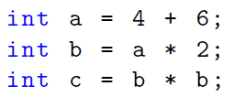
Constant Folding
We can directly replace a with 10, b with 20, and c with 400

Slide 50
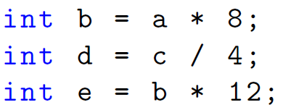
Strength Reduction
slow
fast

Slide 51
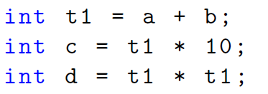
Common Subexpression Elimination
Each line in the second example corresponds to one line of assembly code.
We do not compute (a+b) many times.

Slide 52
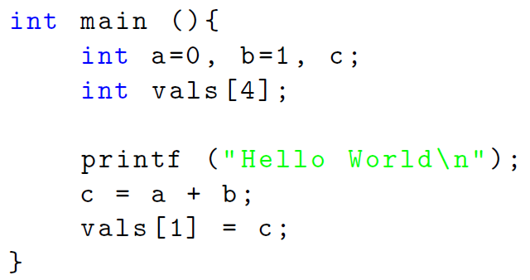
Dead Code Elimination
Dead code

Slide 53
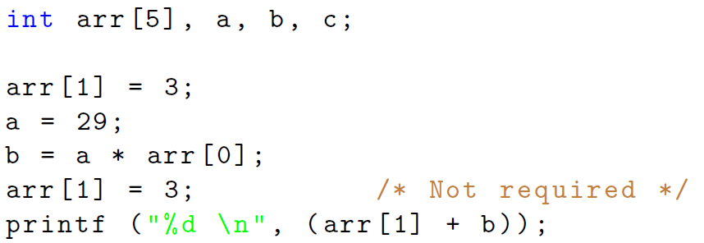
Silent Stores
Silent
store
Silent stores write the same value that is already present

Slide 54
Loop Based Optimizations

Slide 55
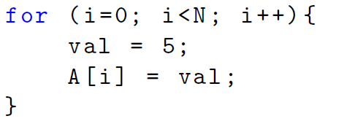
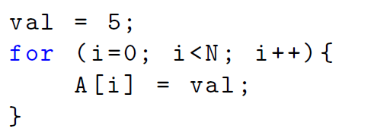
Loop Invariant based Code Motion
Original
Loop Invariants Moved
There is no point setting (val = 5) repeatedly.

Slide 56
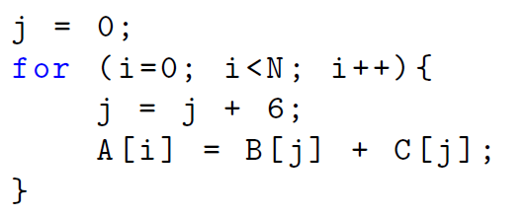
Induction Variable based Optimization
Original
Induction
variable
-6
Replace
a multiply
with an add
Optimized
An add operation is faster than a multiply operation. Hence, it makes sense to replace multiplies with adds.

Slide 57
Loop Fusion
Original
Fuse the loops
Optimized
Loop fusion reduces the instruction count and the number of branches
significantly

Slide 58
Loop Unrolling - I
Original loop
Assembly code

Slide 59
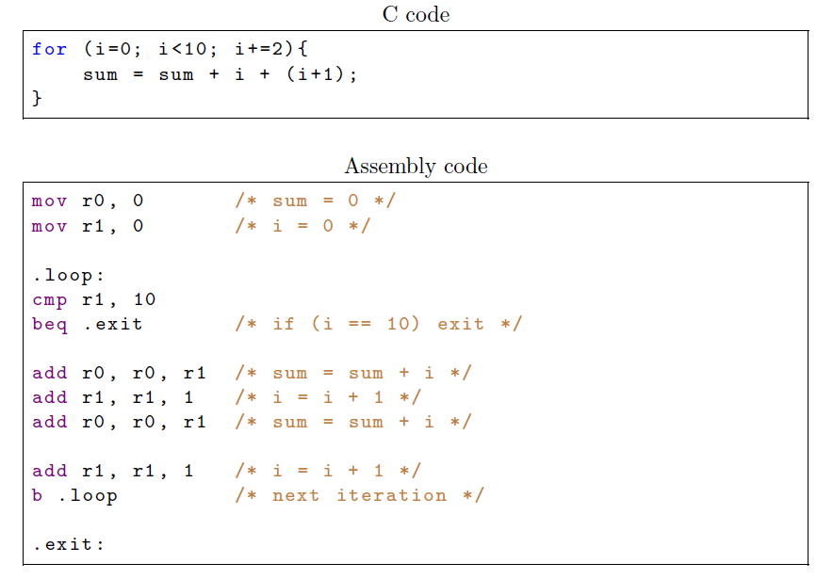
Loop Unrolling - II
Advantage: fewer total instructions and specifically fewer branch instructions

Slide 60
Software Pipelining

Slide 61
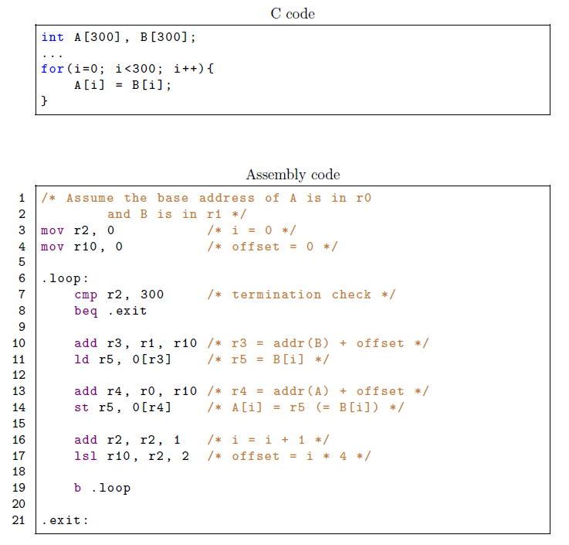
L
S
I

Slide 62
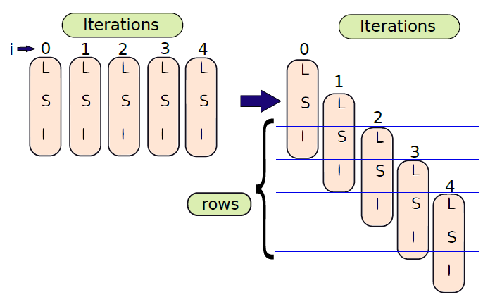
Visualization of the Execution Process
We can create our loops differently. Execute instructions from different iterations.

Slide 63
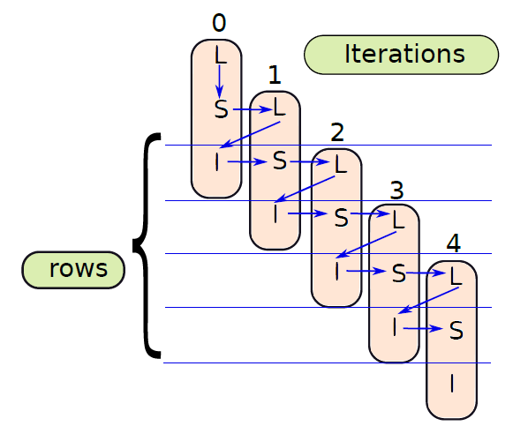
Can we execute instructions in this order?
Treat each row as a pipeline stage. Execute
instructions from different
iterations roughly at the same time.
Order of
operations
in a row
I⁰ → S¹ → L²
I¹ → S² → L³
I² → S³ → L⁴

Slide 64
Advantages of Software Pipelining
Consider this order:
I⁰ → S¹ → L² → I¹ → S² → L³ → I² → S³ → L⁴
The gap between the L, S, and I blocks is one block
This means that we can absorb delays
We can accommodate multi-cycle loads without stalls
The blocks I, S, and L can possibly be executed concurrently
There is a problem
How do we execute three blocks (belonging to different iterations) possibly concurrently?
Solution: Use different loop iterators

Slide 65
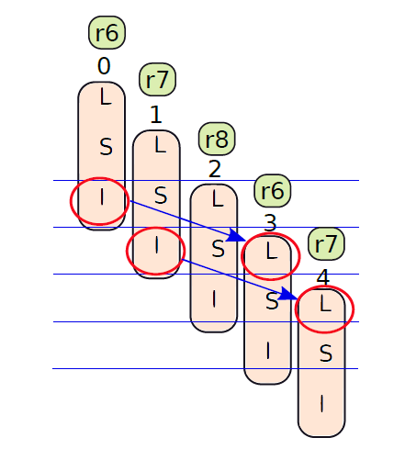
Different Loop Iterators: Group of 3 iterations

Slide 66
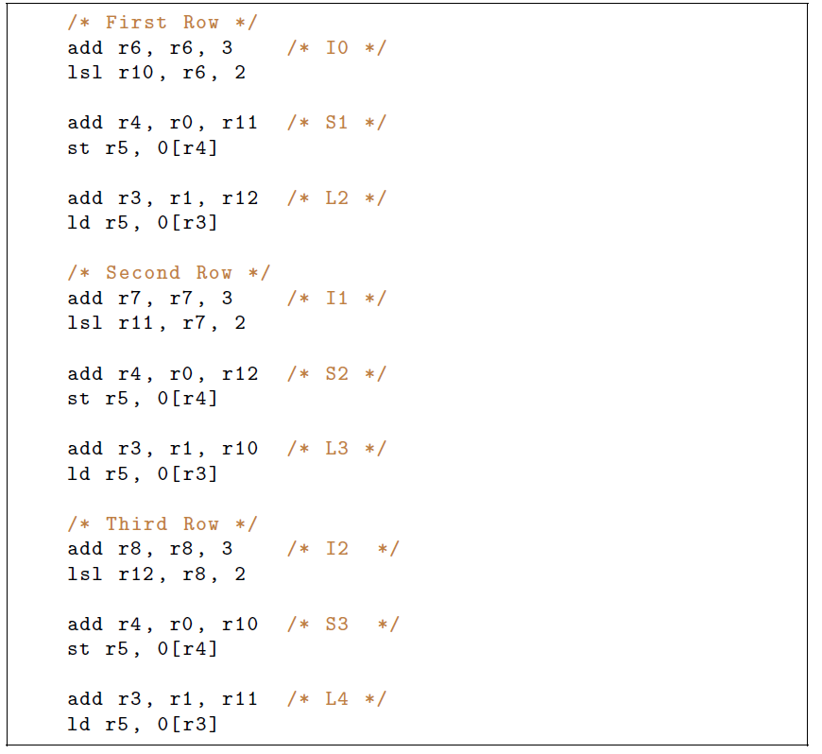
Code with Different Loop Iterators
We cannot execute S1
and L2 in parallel because
of the dependence on r5
Unroll the loop 3 times

Slide 67
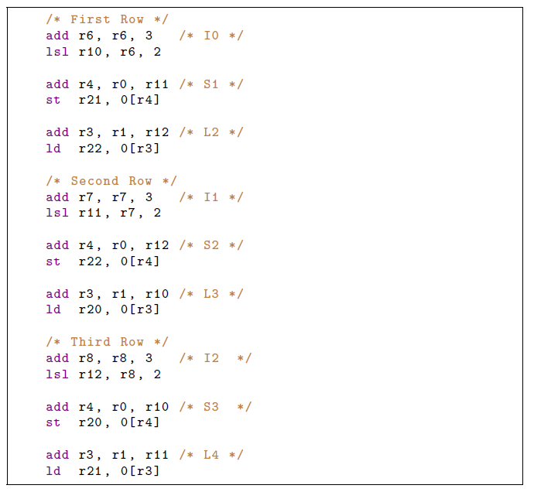
If we had 32 registers, we could do this very easily
and elegantly

Slide 68
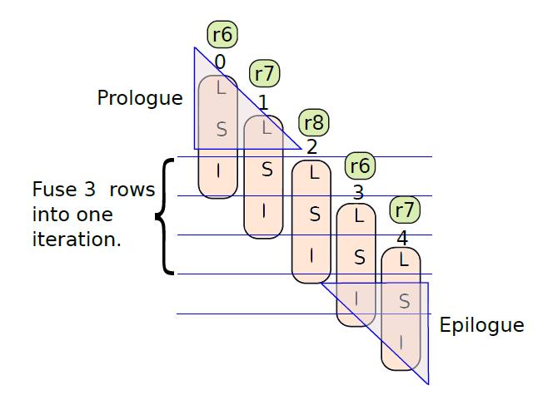
Epilogue and Prologue

Slide 69
Solution without Unrolling
i = -1; t = B[0];
.loop if (i < 298) {
i++;
A[i] = t;
t = B[i+1];
}
A[299] = t;

Slide 70
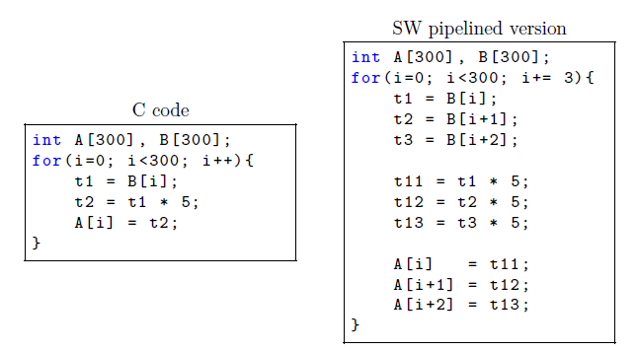
Unrolling and Mixing

Slide 71
Contents
1.
Load Speculation
2.
Replay Mechanisms
3.
Simpler Version of an OOO Processor
4.
Compiler based Techniques
5.
EPIC based Techniques: Intel Itanium
AGENDA ITEM 06
Green marketing is a practice whereby companies seek to go above and beyond.

Slide 72
.
Can we outsource the work of renaming and scheduling
to the compiler?
Sounds like a promising idea …
Less hardware → less power, less complexity
Modern software is quite fast and quite intelligent
Basic idea:
Create bundles of several instructions (using the compiler)
Schedule a bundle in one go
Assume that all dependences are handled.

Slide 73
VLIW Processors
VLIW (Very Long Instruction Word) processors were the first designs in this space.
Bundle instructions into long words
If an instruction is 4 bytes, bundle 4 into a 16-byte word
Schedule and execute all instructions together
Problems caused by
Conditional if statements – control flow not predictable
Memory instructions – addresses are computed at runtime
Basic philosophy of many VLIW processors
It is the compiler’s job to ensure correctness

Slide 74
If Statements: Predicated Execution
If Statements
Use predicated execution (remember GPUs).
There maybe a branch in the bundle
If it is taken, the rest of the instructions are invalid
Mark them with an invalid bit
Let these instructions pass through the pipeline (just don’t process them)
Remember predicated execution in GPUs

Slide 75
Curious Case of Memory Instructions
st r1, 8[r2]
ld r3, 8[r4]
We can have multiple memory instructions in a bundle
The addresses are computed at runtime
In this case, we have a hazard
Same is the case for two store instructions, and a load → store dependence
Avoid such situations in software or
hardware

Slide 76
VLIW vs EPIC
EPIC
VLIW
Given that VLIW processors do not necessarily guarantee correctness, their usability is limited
Mostly used in digital signal processors
VLIW processors have been replaced by EPIC processors
EPIC → Explicitly Parallel Instruction Computing
They guarantee correctness
Irrespective of the compiler

Slide 77
Intel Itanium Processor
Unique collaboration between Intel and HP
Aim:
EPIC processor
Designed to leverage the best of software and hardware
Targeted the server market
Primarily gets rid of the scheduler: instruction window, wakeup, select, and broadcast
The branch predictor, decode unit, execute units, and advanced load-store handling are still required

Slide 78
Fetch Stage
Read 32 bytes from the i-cache
We can fit six instructions
Bundle 1
Bundle 2
Decoupling Buffer
Each bundle contains 3 instructions
The decoupling buffer can hold 8 such bundles

Slide 79
Branch Predictors
Itanium has four types of branch predictors
Compiler directed
Four special registers: Target Address Registers (TARs)
The compiler populates them.
Contain a PC and a target
Whenever the current PC matches the PC in a TAR → predict taken and jump to the target
Traditional Predictor
Large PAp predictor

Slide 80
Branch Predictors – II
Multi-way Branches
Compilers ensure that (typically) the last instruction in a bundle is a branch
If there are multiway branches: there are many possible targets for a given bundle
Predict the first instruction that is most likely a taken branch and then predict its target
Loop Exit Predictor
The compiler marks the loop instruction
It also populates the register with the loop iteration count
The predictor keeps decrementing the loop count till it reaches 0. Then it predicts a loop exit.

Slide 81
This part of the pipeline
Instruction
Fetch
Instruction
Dispersal
Register Remapping
Itanium has 9 issue ports: 2 for memory, 2 for integer, 2 for floating point, 3 for branch instructions
Disperse the instructions → map instructions to issue ports
Data hazards:
Option 1: Avoid data hazards in a bundle or put nop instructions or forward results.
Option 2: Use stop bits. Instructions between two instructions with their stop bits set to 1 are independent of each other.
Structural hazards: Each bundle indicates the resources that it requires. This information is used to avoid structural hazards.

Slide 82
Register Remapping Stage
Large 128-entry register file.
Visible to all functions
32 static registers
96 stacked registers
Limited visibility across functions
Allocate different sets of virtual registers to each function.
This avoids spilling.

Slide 83
Example: Function foo calls function bar
We deliberately create an overlap in the virtual register set to pass
parameters.

Slide 84
Register Stack Frame
The in and local registers are preserved across function calls.
The out registers are used to send parameters to callee functions.
An alloc instruction automatically creates such a register stack frame.
Communicating return values.

Slide 85
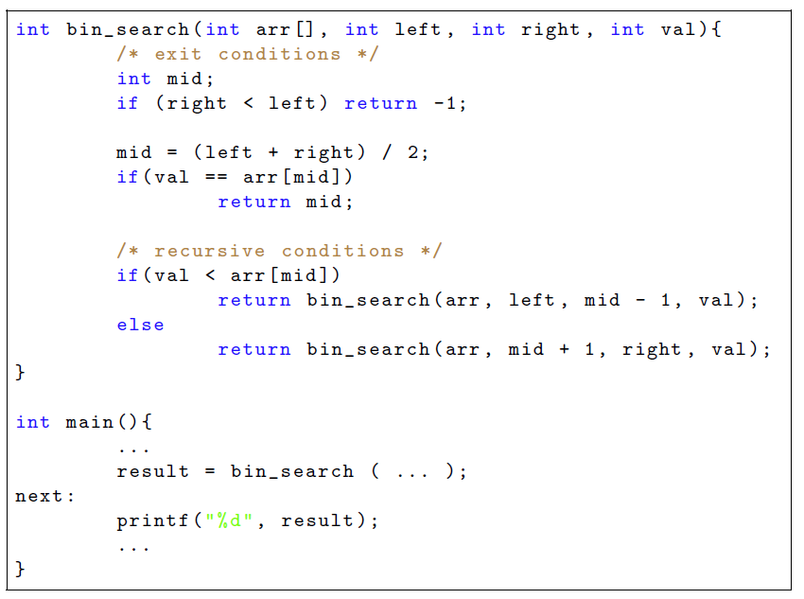
Binary Search
No processing done after receiving the return value. Just pass it on.
This is known as tail recursion

Slide 86
Register Stack Frame
The in and local registers are preserved across function calls.
The out registers are used to send parameters to callee functions.
An alloc instruction automatically creates such a register stack frame.
Communicating return values.
Store the return values in a static register
In this case, directly jump to the return address in the main function.
We don’t need to process return values.

Slide 87
Support for Software Pipelining and Overflows
Main Problem: We run out of registers
Itanium has a Register Stack Engine (RSE)
Automatically handles the spilling of registers to memory and restoring them
Software Pipelining
We use separate registers for the same variable across different iterations.
This issue is taken care of automatically
Notion of a rotating register set
Assign registers based on the loop iteration number
Easier to write the code of SW-pipelined loops

Slide 88
High Performance Execution Engine
Scoreboard
Simple mechanism for OOO execution
Makes instructions wait till it is safe to execute them
finished field → 1 if it has finished its execution, 0 otherwise.
fu → Name of the functional unit

Slide 89
Conditions: Instruction I
WAW Hazards
Check all the earlier entries
For each earlier entry E the following expression should be false
$$\left(E.finished=0\right) ∧(E.rd=I.rd)$$
Check all the earlier entries
For each earlier entry E the following expression should be false
WAR Hazards
$$\left(E.finished=0\right) ∧(\left(E.rs1=I.rd\right)∨ \\ (E.rs2=I.rd))$$

Slide 90
Conditions: II
Check all the earlier entries
For each earlier entry E the following expression should be false
RAW Hazards
$$\left(E.finished=0\right) ∧(\left(E.rd=I.rs1\right)∨ \\ (E.rd=I.rs2))$$
Structural Hazards
1. For each earlier entry E
$$\left(E.finished=0\right) ∧(E.fu=I.fu)$$
Instructions wait in the scoreboard until they are safe
No hazards

Slide 91
Predication
Consider the following piece of code
if( rand () %2 == 0)
x = y;
else
x = z;
If we flush the pipeline upon a branch misprediction
It would be quite unfair
Let the if statement just be used to mark an instruction with the result of the comparison
Store the result in a flags register
The rest of the instructions are processed regardless of the branch outcome
Some results modify the architectural state, many do not

Slide 92
Code without Predication
/* mappings : x <-> r1 , y <-> r2 , z <-> r3 */
mod r0 , r0 , 2 /* assume r0 contains the output of rand () ,
compute the remainder when dividing it by 2 */
cmp r0 , 0 /* compare */
beq . even
mov r1 , r3 /* odd case */
b. exit
.even :
mov r1 , r2 /* even case */
. exit :
Count the number of branch instructions.

Slide 93
Predicated Instructions
/* mappings : x <-> r1 , y <-> r2 , z <-> r3 */
mod r0 , r0 , 2 /* assume r0 contains the output of rand ()
compute the remainder when dividing it by */
po ,pe = cmp r0 , 0 /* compare and set the predicates */
[po] mov r1 , r3 /* odd case */
[pe] mov r1 , r2 /* even case */
The comparison generates predicates (flags)
po → number is odd, pe → number is even
If the predicate is correct, the instruction gets executed, otherwise not
Itanium sets and maintains the predicate registers
An instruction is executed if all the predicate registers are set to 1 for the instruction.

Slide 94
Pipeline

Slide 95
Load Boosting
Boost a load and some instructions that use its value to a point before “where it appears in the code”.
Loads are almost always on the critical path → hence, boosting them is beneficial because they can get their data early
Put the load address in the ALAT
Advanced Load Address Table
Subsequently, each store checks the ALAT for a match, and marks it (upon an address match)
Put a load-check (ld.c) instruction at the original point
Check the ALAT
If there have been no intervening stores to the same address, the speculation is successful.
Else, re-execute the load and its boosted forward slice

Slide 96
Conclusion
There are four kinds of aggressive speculation: load address, dependence, latency, and value speculation.
There are three methods of replaying instructions: non-selective, delayed selective and token-based replay
We can use the ROB as the physical register file and use it to buffer temporary values. The ARF can contain the committed state.
A host of compiler optimizations can be used to speed up
programs and improve their memory access behavior.
EPIC processors guarantee correctness as well as follow the VLIW model that gives primacy to the compiler.

Slide 97
The End

