Slide 1
Chapter 10:
Main Memory

Slide 2
Background Required to Understand this Chapter
Caches
Basic Digital Electronics
Basic Device Physics
Chapter 7
http://www.cse.iitd.ac.in/~srsarangi/archbooksoft.html

Slide 3
Outline
1.
Dynamic RAMs
2.
Design Space of DRAMs
3.
DRAM Timing
4.
Memory Controller
5.
Emerging Memory Technologies
6.
Roofline Model

Slide 4
DRAM – Dynamic RAM
Circuit to store a single bit. It is stored in the capacitor.
The transistor controls the access.
Word line (WL)
Stores a single bit
W
1
Bit line (BL)

Slide 5
Destructive Reads and Refresh
Writing is easy. Turn on the access transistor → Write
Reading is harder. After turning the access transistor on, the bit line gets charged/discharged.
The cell loses its value (destructive read)
A read has to be followed by a write
The capacitor will also periodically lose its stored voltage due to leakage
Refresh
We need to periodically read the value stored in a cell and write it back (restore voltage levels).

Slide 6
Capacitors Used in DRAM Cells
Trench capacitor
W
The capacitor has to be accommodated in very little area.
Access transistor
Word line
Bit
n+ region
line
Polysilicon
electrode
Dielectric
Buried n+
region
To minimize area make the capacitor
as deep as possible

Slide 7
Stacked Capacitors
Electrode 2
Metal or
Polysilicon
Dielectric
Electrode 1
Metal or
Polysilicon
Substrate
A trench capacitor is hard to fabricate
This alternative design does not have deep structures
This is a 3D structure that is easier to reliably fabricate

Slide 8
DRAM Array
BL
WL
DRAM
DRAM
DRAM
DRAM
cell
cell
cell
cell
Row
WL
Row decoder
address
DRAM
DRAM
DRAM
DRAM
cell
cell
cell
cell
Enable a given row of cells
WL
DRAM
DRAM
DRAM
DRAM
cell
cell
cell
cell
Sense
Sense
Sense
Sense
Choose a subset of columns
amplifier
amplifier
amplifier
amplifier
Column mux/demux
Column decoder
Column
Read
Data out
buffer
address
Write
Note the position of the sense amps
driver
Data in

Slide 9
Open Bit Line Array Architecture
Problem: Unlike SRAM arrays, we cannot precharge lines and monitor the difference. We just have a single bit line.
Bit lines
Divide a column into groups of cells. Connect the bit lines of adjacent groups to a single sense amplifier
DRAM
DRAM
DRAM
DRAM
cell
cell
cell
cell
DRAM
DRAM
DRAM
DRAM
cell
cell
cell
cell
Word
DRAM
DRAM
DRAM
DRAM
Sense Amplifier
lines
cell
cell
cell
cell
Compact design: 6F²
area. F → feature size
DRAM
DRAM
DRAM
DRAM
cell
cell
cell
cell
DRAM
DRAM
DRAM
DRAM
Higher susceptibility to noise
cell
cell
cell
cell
DRAM
DRAM
DRAM
DRAM
cell
cell
cell
cell

Slide 10
Folded Bit Line Array Architecture
DRAM cell
DRAM cell
At the cost of higher area, place the two bit lines close to each other.
More noise resilient.
Area: 8F²
DRAM cell
DRAM cell
DRAM cell
DRAM cell
DRAM cell
DRAM cell
DRAM cell
DRAM cell
DRAM cell
DRAM cell

Slide 11
Design of a Sense Amplifier
Bit line 1
Bit line 2
T1
Precharge circuit:
Voltage equalizer
EQ
T2
T3
V_{dd}
2
Set the EQ line to 1. Enable all the transistors
The voltages of both the bit lines gets set to V_{dd}/2
After precharging, we set EQ to 0 V (disable the transistors)

Slide 12
Sense Amplifier
Additional function: Also, temporarily buffer the data
Bit line 1
Bit line 2
SAN
V₁
T1
T2
V₂
Quickly senses data and temporarily buffers data
T3
T4
SAP
Assume that the voltage on Bit line 1 (V₁) is slightly higher than V₂
Let the voltage on the SAN line be 0 V and the voltage on the SAP line be a logical 1
Gradually T2 becomes more conductive → V₂ dips → T3 become more conductive → V1 rises
Ultimately: V1 reaches V_{dd} and V2 reaches 0 V
To disable, set all voltages to V_{dd}/2

Slide 13
The Full Circuit
Bit line 1
Bit line 2
DRAM cells
The sense amplifiers serve a dual purpose.
They buffer data and can be used to set the state of the DRAM cell.
Note the chip select (CS) lines that enable/disable the entire array.
The column mux/demux logic chooses a set of set of columns for reading and writing, respectively
They are driven by the column decoder
EQ
Precharge
circuit
SAN
$$\frac{V_{dd}}{2}$$
Sense
amplifier
SAP
Chip
select (CS)
Write
driver
Write
driver
Read
Write
enable
enable
Column mux/demux

Slide 14
Process of Reading
Precharge the bit lines. Set the voltages on the SAN and SAP lines to V_{dd}/2
Enable the corresponding word line (via the row decoder)
Set the values of the SAN and SAP lines
Enable CS and “Read Enable”
Send the column address to the mux/demux unit.
Read the data out.
Note that this is a destructive read. The value is buffered in the sense amps. After reading, we need to keep the cell on, such that we can write the old value back (happens automatically).

Slide 15
Process of Writing and Refreshing
The first part is the same: enable the row, precharge, set the values of the sense amps, and allow them to restore all the values in the cells.
In the second stage, we use strong write drivers to write values to the sense amps and subsequently to the DRAM cells.
The writing process thus requires some more time to finish – write recovery time.
Refresh
A DRAM cell periodically loses its value. Charge leaks through the capacitor.
Hence, we need to periodically refresh it: read a row and write it back
Do it all together (burst) or intersperse with regular operations (distributed)

Slide 16
Memory Hierarchy
CPU
CPU
DRAM
channel 32-128 bit
i-cache
d-cache
L2 cache bank
Dual inline memory
modules (DIMMs)
Memory
controller
The CPU has multiple DRAM channels, each one is connected to different DIMM chips
Main memory

Slide 17
DIMM Modules

Slide 18
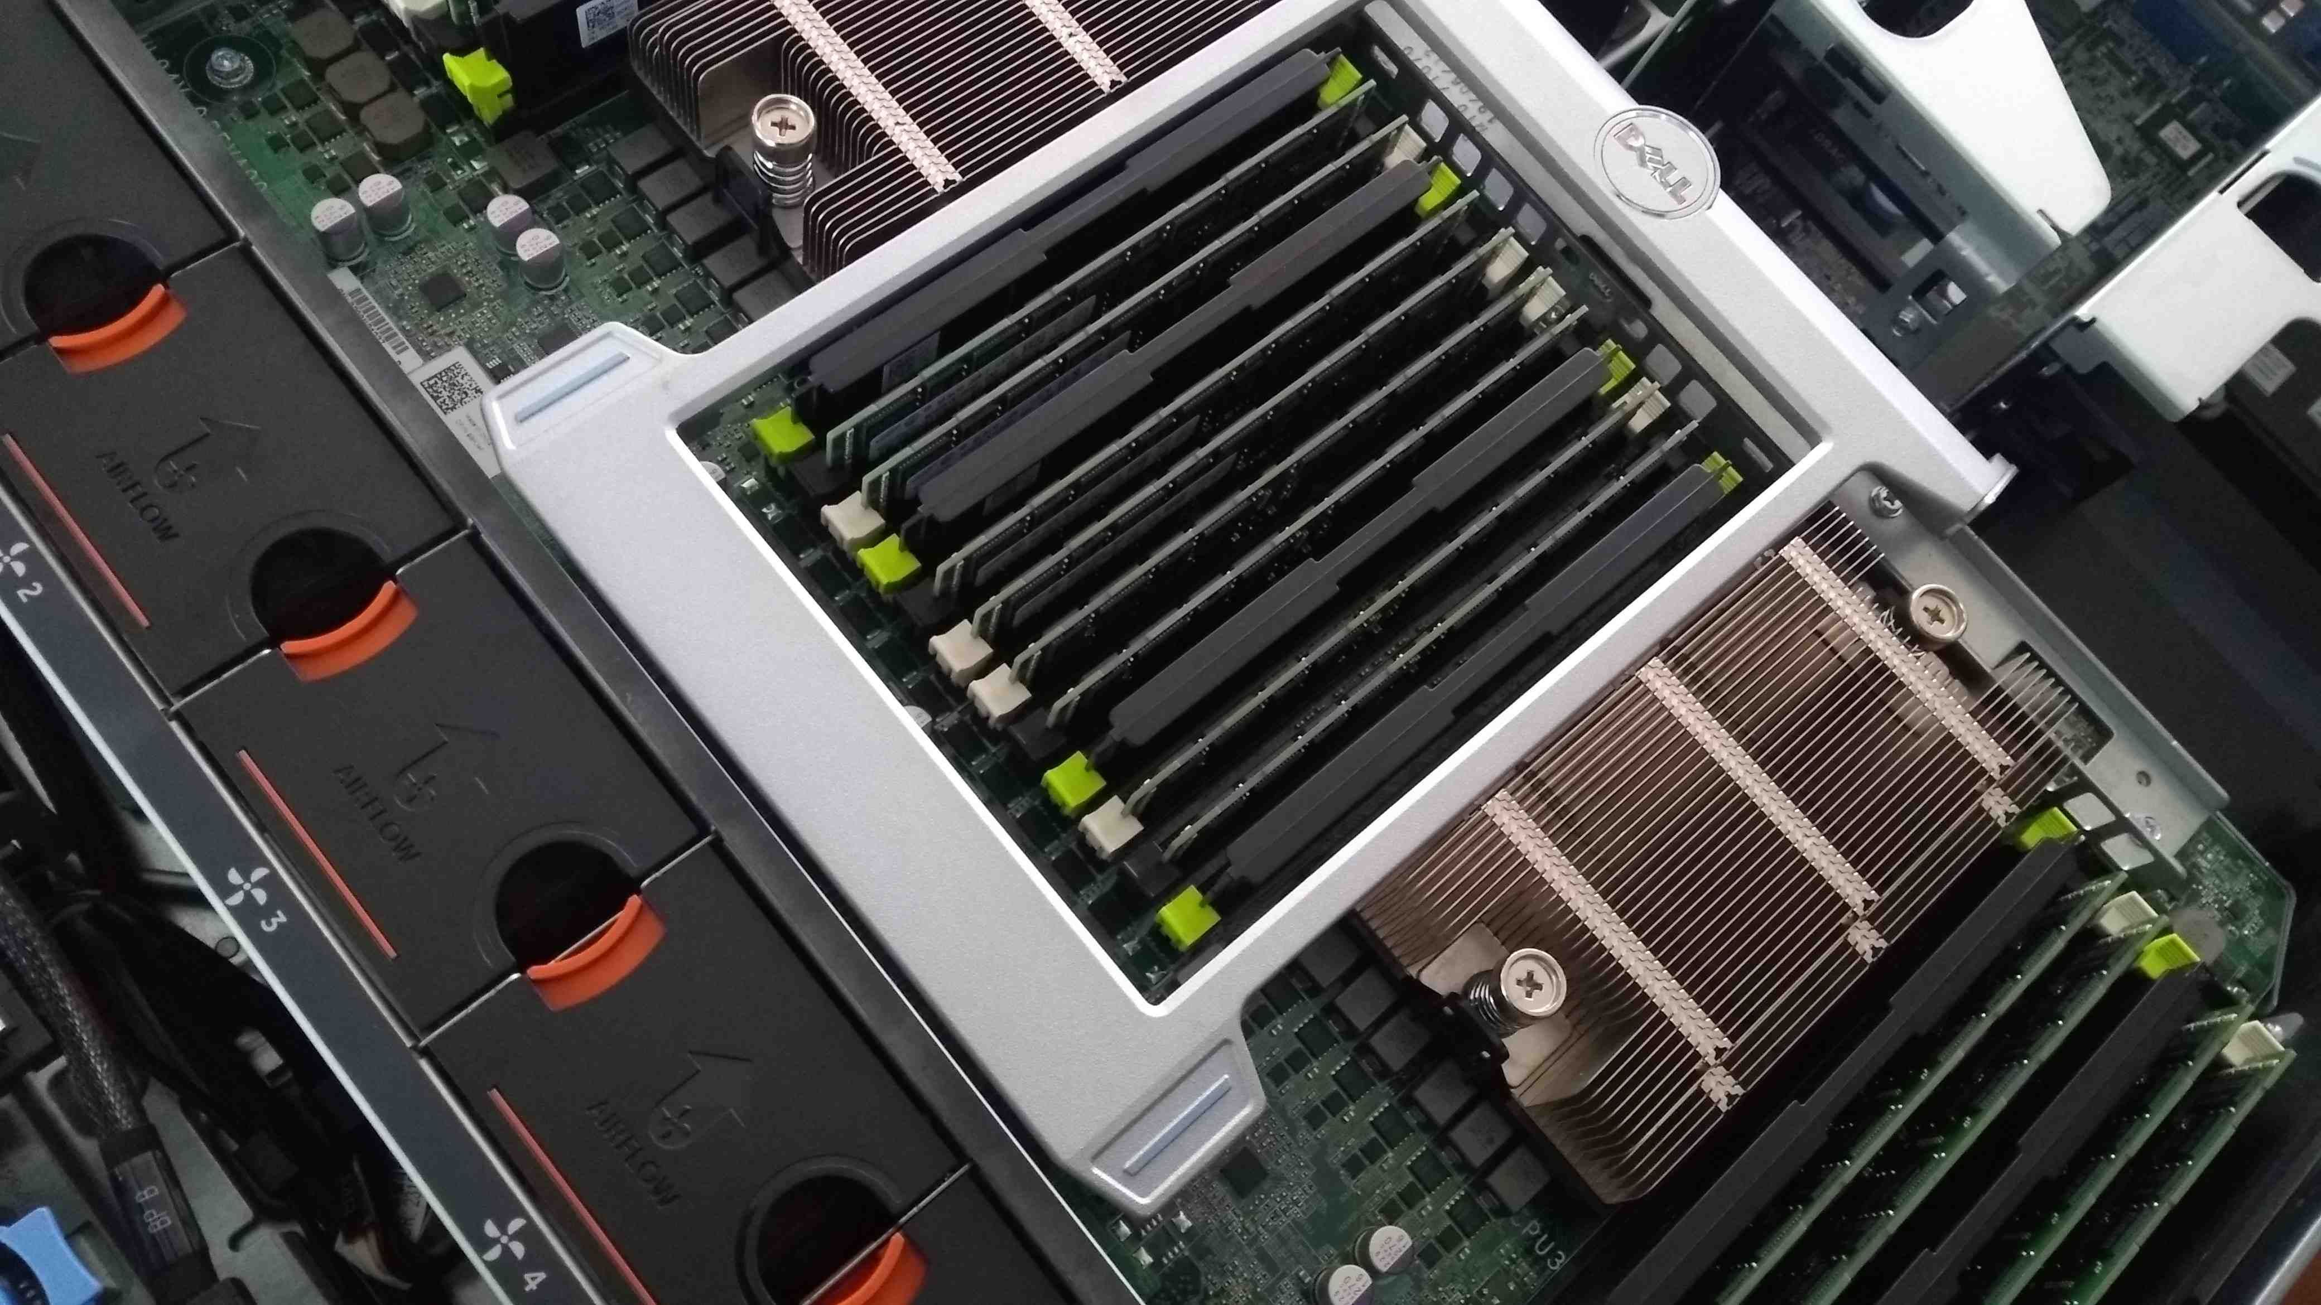
Adding DIMM Modules to the Motherboard

Slide 19
Structure of a DIMM
DIMM
Memory
Rank
controller
Bank
Bank
CPU
MC
Channel
Rank
Chip
Bank
Bank
Row
Column
We divide a DIMM into ranks.
A rank is a set of DRAM chips that execute in lockstep. Signals take roughly the same time to reach them from the MC.
The memory controller typically issues a command to a given rank.

Slide 20
Structure of a DIMM
DIMM
Memory
Rank
controller
Bank
Bank
CPU
MC
Channel
Rank
Chip
Bank
Bank
Row
Column
Each DRAM device (chip) is then divided into banks.
A bank is a set of DRAM arrays. In principle, it can operate independently of other banks. It seldom does so.
The arrays within a bank operate in synchrony.

Slide 21
Some more information about DRAMs
A DRAM array contributes a single bit to an access.
If a bank has 4 arrays, then it contributes 4 bits to the rank.
If a single access reads/writes 64 bits, then we need 16 such banks.
Terminology
x16 DRAM → 16 arrays in a bank
x64 and x128 configurations are as of 2021 only available in 3D configurations.
CPU → channel → DIMM → rank → chip/device → bank → array → row → column

Slide 22
Information Sent on a Channel
Address
Command
Data
Chip Select
Address and command buses are unidirectional
The data bus is bidirectional
The Chip Select (CS) signal selects the rank
There is a need to multiplex the same channel across DIMMs
Spatial → Divide a 128-bit channel to make two 64-bit channels
Temporal → Time sharing

Slide 23
Data Bus and Address Bus
Ranks
Address/
command
bus
Bank
Memory
Data bus
controller
Chip select lines

Slide 24
Double Data Rate DRAM Devices
Note the following.
The address and command buses reach every bank. We can use the same bus and multiplex it for addresses and commands.
The data bus is split into four lanes. Each lane is connected to four banks.
Lower the number of connections → Lesser the capacitive loading → Lower the RC value → Faster is the bus
Since the data bus is faster, run it at twice the speed.
Use 2x the frequency of the address/command bus.
Double Data Rate

Slide 25
Outline
1.
Dynamic RAMs
2.
Design Space of DRAMs
3.
DRAM Timing
4.
Memory Controller
5.
Emerging Memory Technologies
6.
Roofline Model

Slide 26
DRAM Access Protocols
How do the memory controller and the DRAM device communicate?
Asynchronous transfer: This is the simplest idea in this space. Just send data, the sender and receiver do not need to share a clock.
Some basic concepts
Bus
Receiver
The receiver needs to read the bit into a flip-flop (also referred to as a latch in this context)
The receiver has its own clock
It cannot latch in a signal in the setup+hold window.
t_{setup}
t_{hold}

Slide 27
The Strobe Signal
DQS
Receiver’s
Latch
DQ
The strobe signal (DQS) is sent by the sender.
The receiver knows that it is time to latch the data (sent on DQ) once the strobe becomes 1.
This implicitly conveys the timing.
Two kinds of strobe signals
Active high: $DQS$
Active low: $\overline{DQS}$ (when DQS=0, it is time to latch)
Note that most memory buses are half-duplex buses. At a time, data is transferred in only one direction.

Slide 28
Timing Diagram of Asynchronous Memory
RAS
CAS
Address
row
col
DQ
data
There are two strobes: RAS (row address) and CAS (column address). Both are active low.
When $\overline{RAS}$ is asserted (set to 0), the sender sends the row address
The device activates the row
After a delay, the sender asserts $\overline{CAS}$, and sends the column address
After some more time, the data is sent.
Finally, both $\overline{RAS}$ and $\overline{CAS}$ are deasserted (set to 1)

Slide 29
Extended Data Out (EDO)
Do not activate a row again and again for accesses to different columns. Note: each column supplies 1 bit.
Keep the row open
Keep sending new column addresses and reading the corresp. data
Use a separate data strobe signal to regulate the process of reading the data.

Slide 30
Burst Extended Data Out (BEDO)
Prefetch length = 2
We typically read at least 64 bytes of data in one go.
Most DRAM devices thus read multiple bits at a time.
Subsequent addresses are generated internally.
In this case, the prefetch length = 2
The $\overline{CAS}$ signal synchronizes the column address and the data
Nevertheless, asynchronous transmission is less expressive, cumbersome and synchronization is difficult.

Slide 31
Synchronous Memory
Advantages
Easy to design and verify
Opportunities to add additional programmable logic
Create a hierarchical architecture where different banks can be controlled differently.
Since the data bus is faster, run it at twice the speed.
Use 2x the frequency of the address/command bus.
Double Data Rate

Slide 32
DDR (Double Data Rate) Transfer
Double data rate
All the signals synchronize to a clock (upward edge)
We mostly rely on the command and address buses
DQ is the data bus
We still need a data strobe signal (DQS) to indicate the arrival of data.

Slide 33
DDR Commands
ACT → Activate the row
NOP → 1 idle cycle. Gives enough time for the previous command to act.
CAS → Activate column
COL → Column address
Prefetch length = 4

Slide 34
Subtle Aspects of the Communication between the Memory Controller (MC) and DRAMs
We typically transfer 64 bytes at a time. 64 bytes = 512 bits
Different devices in a rank store a subset of these 64 bytes
They provide the data in parallel.
The data is synchronized with the strobe
This is known as source synchronous data transmission
While writing the data the strobe signals at the middle of sending a data bit. It is easier to recover the clock this way.
While reading, the data transitions are synchronized with the strobe signal’s transitions
We send data in half-duplex mode.
Memories with full duplex buses are known as QDR (Quad Date Rate) memories.

Slide 35
DDR Generations and Timing
Tech. | Bus clock speed | Prefetch length | Transfer rate (MT/s) | Voltage | Maximum DIMM size
DDR | 100-200 MHz | 2 | 200-400 | 2.5-2.6 V | 1 GB
DDR2 | 200-400 MHz | 4 | 400-800 | 1.8 V | 4 GB
DDR3 | 400-1066 MHz | 8 | 800-2133 | 1.35/ 1.5 V | 16 GB
DDR4 | 800-2133 MHz | 8 | 1600-4266 | 1.2 V | 64 GB
Memories are gradually getting faster and larger
Feature size ↓ Clock speed ↑ Transfer rate ↑ Voltage ↓ Size ↑
DDR memories’ internal clock speeds can be much lower than the bus speeds
Compensate by increasing the bandwidth

Slide 36
Some DDR Math
Example 1
Bus frequency = 800 MHz
Internal clock frequency = 200 MHz
$$\frac{Internal data rate}{Bus data rate}= \frac{800}{200} ∗2=8$$
Multiply by 2 because of DDR
Prefetch length or burst size = 8
Example 2
Width of the proc-memory bus = 64 bits
Prefetch length = 8
Minimum transfer size = 64 * 8 bits = 64 bytes

Slide 37
The Equation for the Transfer Rate
Tech. | Bus clock speed | Prefetch length | Transfer rate (MT/s) | Voltage | Maximum DIMM size
DDR-4 | 800-2133 MHz | 8 | 1600-4266 | 1.2 V | 64 GB
Derive the equation for the transfer rate
800 MHz * 2 = 1600 MT/s
2133 MHz * 2 = 4266 MT/s
Definition
DDR3-1600 means
DDR3 technology
1600 MT/s

Slide 38
Fully Buffered DIMMs: Problems with DDR Memory
DDR Memories don’t scale
The bus frequency does not scale
Example
Number of devices per generation is decreasing.
There is a limit on the number of devices → capacitive loading
Constraint
DDR is a well accepted standard. It is not possible to change the hardware or command interface.
An attempt at re-architecting memory: FB-DIMMs (Fully Buffered DIMMs)

Slide 39
FB-DIMMs: Advanced Memory Buffer (AMB)
Crux of the idea:
Create a decoupling buffer (AMB) between the MC and the DRAM devices
Reduces the capacitive loading
Southbound traffic → towards DIMMs
Northbound traffic → towards the MC

Slide 40
Architecture of the System
AMB
AMB
The AMBs are connected to each other using lanes
Each lane is a high-speed serial bus
Not fully synchronized with other lanes
If a given lane fails, other lanes can be used (some failure immunity)
Role of an AMB
Communicate with all the devices in a DIMM
Communicate with other AMBs

Slide 41
Role of an AMB
Receive data from Southbound lanes
If it is meant for the DIMMs, reconstitute the packet
Collect data from all the serial lanes
Create a packet and send it to the devices in the DIMM
Relay northbound and southbound packets

Slide 42
Features of FB-DIMMs
1
3
2
4
Scalability
Reduced
pin count
Large number of DIMMs can be connected
High-speed
No need to have
many channels
Reliability
It is fine if a few lanes develop faults
Lanes have reduced RC delays

Slide 43
High Speed Transmission
10 bit lanes in the southbound channel and 14 bit lanes in the northbound channel
On each lane
Transmit 12 bits per DRAM cycle
Addresses, commands, status bits, error correction bits
Capacity of the southbound channel
120 bits
Capacity of the northbound channel
168 bits
Per DRAM clock cycle

Slide 44
Resample, Resync, and Reliability
Clock skews between lanes will accumulate over several hops
Resample
Just allow signals to pass through the AMBs
Maybe quite slow (wait for the slowest signal)
Delays may cancel out over the transmission
Resync
Synchronize the lanes in every AMB
Bit Lane Steering
If any lane develops a fault, the traffic is diverted to other lanes

Slide 45
Registered DIMMs
FB-DIMMs never took off. The industry was not ready to accept a new protocol.
Registered Memory
Associate a register with a DIMM
Place buffers for the address and command buses
Support regular DDRX protocols
Adds 1 extra cycle to the latency
Increases the DRAM capacity significantly

Slide 46
Outline
1.
Dynamic RAMs
2.
Design Space of DRAMs
3.
DRAM Timing
4.
Memory Controller
5.
Emerging Memory Technologies
6.
Roofline Model

Slide 47
Lifecycle of a DRAM Operation
Transporting and decoding
Performing the read or write
Move the data within the DRAM and chip
Transporting data back to the pipeline
Let us explain the DDR4 protocol.
Running Example
Single DRAM device with 16 banks.
Banks are divided into groups (4 or 8 per group)
All the delays are in terms of bus cycles.

Slide 48
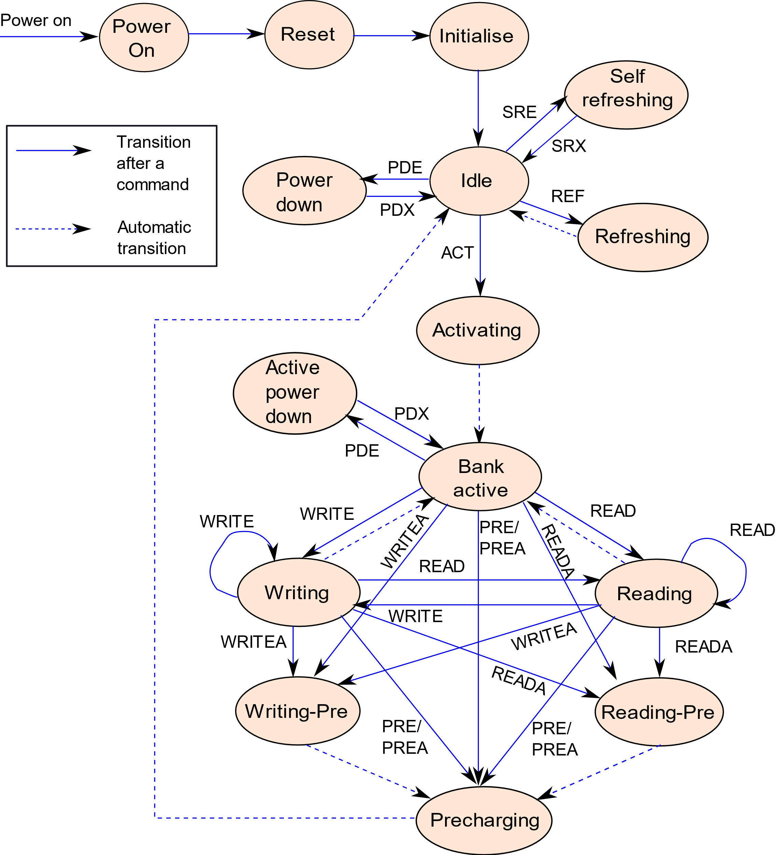
Simplified State Diagram
Point of view of a DRAM device
There are two kinds of refresh modes: automatic and command driven
Before accessing a row, activate it first.
Two versions of commands: ones with auto-precharge and ones without.

Slide 49
Discussion of the State Diagram
A DRAM device is by no means dumb. It maintains its own state as well as the state of its banks.
Banks can be accessed independently (states not shown in the diagram)
The key idea is that there is a need to activate a row first → before doing anything
We can then keep the row open
For further reads and writes
Closing a row means ensuring that the cells contain the values that were written and precharging the bit lines

Slide 50
DRAM Timing
Memory Controller
DRAM device
The memory controller sends commands to the DRAM device.
The device presents itself as an FSM. It mostly does not generate commands on its own.
The memory controller maintains a parallel state machine.
It initiates all the actions in the DRAM device.
It thus needs accurate knowledge of the timing of different actions

Slide 51
DDR4: DRAM Commands Activate Command
Consecutive pair of commands | Time interval
ACT → PRE | tRAS
ACT → <IntREAD/IntWRITE> | tRCD
ACT → ACT | tRC
ACT → REF
Relationships: tRC > tRAS > tRCD
Most common DRAM commands for reading and writing
We need to activate the row first
Then we send commands
IntREAD/IntWRITE are internally generated
These timing relationships need to hold in the state machine
Recall the MC maintains a copy of the state machine.

Slide 52
Breakup of the Timeline of a Read Access
Activate
t_{RCD}
row
ACT
Data sensing
Data restore
t_{RAS}
Row activation command → Decoding and precharging
Sense the data → Allow the sense amplifiers to get set. Enable the column multiplexers such that the data can be read.
Data restore → DRAMs have destructive reads. Restore the data.

Slide 53
Precharge Command
Consecutive pair of commands | Time interval
PRE → ACT | tRP
Relationships: tRC = tRAS + tRP tRC: ACT → ACT tRAS: ACT → PRE
Precharging takes some time
We can only activate after some more time (tRP time units later)
tRC is the activation (row 1) → activation (row 2) delay
ACT → PRE → ACT

Slide 54
Constraints w.r.t. Power Consumption
Consecutive pair of commands | Time interval
Different bank group: ACT → ACT | tRRD_{S}
Same bank group: ACT → ACT | tRRD_{L}
Four-bank Activation Window | tFAW
Relationships: tFAW $≥4 ∗tRRD_{S}$ and ${tRRD}_{L} ≥ {tRRD}_{S}$
We need to limit the power consumption of DRAM devices
We need to limit the activity
We wish to limit activity in the same bank: ${tRRD}_{L} ≥ {tRRD}_{S}$
Even within the same bank group (within a DIMM), we need to limit the activity.
Concept of the four-bank activation window (activity within a rank)
We can have at most 4 row activations in this window.

Slide 55
Read Operation
Operation | Duration
Read preamble | tRPRE
Read postamble | tRPST
Preamble → Time needed by the receiver to synchronize its clock
Also known as read levelling
Similar is the idea for a postamble → Give some time before the next transmission (let the receiver read the data)

Slide 56
Read Commands
Consecutive pair of commands | Time interval
READ → <First data bit on the bus> | RL
READ → IntREAD | AL
IntREAD → <First data bit on the bus without parity checking> | CL
Time to verify the parity | PL
IntREAD → PRE | tRTP
Relationships: RL = AL + CL + PL
It takes time to issue the internal read command
After that the process of reading takes time (till we have bits on the bus)
The parity needs to be checked after the entire block has been read
The total read latency is the sum of all the three components
The data has to stabilize for some time before we can precharge (tRTP)

Slide 57
Burst of Read Commands
Consecutive pair of commands | Time interval
Column to column delay (same bank group) | tCCD_{L}
Column to column delay (different bank group) | tCCD_{S}
Relationships: $tCCD_{L}≥tCCD_{S}$
DRAM devices support a burst of read commands
We encourage requests to go to a different bank group (tCCD_{L} ≥ tCCD_{S})
Power constraints and more resources available at the other bank group

Slide 58
Write Command (Timing)
Consecutive pair of commands | Duration
WRITE → <First data bit on the bus> | WL
WRITE → IntWRITE | AL
Time to compute the parity | PL
IntWRITE → <First data bit on the bus> | CWL
Relationships: WL = AL + PL + CWL
Similar to the formula for reads
WL = AL + PL + CWL

Slide 59
Read-to-Write Delay
Operation | Duration
Write preamble | tWPRE
Write postamble | tWPST
It shows the read-to-write delay (tRTW) = Read Latency + Burst length / 2 (because of DDR) + 1 (needed to change the direction of transmission) + tWPRE (Write preamble) – WL (write latency)

Slide 60
Interaction between Read, Write, and Precharge Operations
Consecutive pair of commands | Time interval
READ → WRITE | tRTW
WRITE → READ | tWTR
Burst length | tBL
WRITE → PRE | tWR
tRTW (seen in the previous slide)
Writes need to do some additional work (set the sense amplifier states). Hence, tWTR is a few cycles. Here, again tWTR_{L} ≥ tWTR_{S}
tWR is similarly defined. Need time to recover, before we can precharge.

Slide 61
Refresh Commands
Interval | Duration
Maximum refresh interval | tREFI
Refresh cycle time | tRFC
The memory controller issues a REF command (when a refresh is required)
We need one refresh cycle, every tREFI cycles.
Refreshes can be triggered by the internal refresh controller as well
The entire process takes tRFC cycles (refresh cycle time)
For refreshing all the rows

Slide 62
Parameters of the DDR-1600 Protocol
Parameter | Mnemonic | Value (cycles)
Row cycle time | tRC | 38
ACT to PRE command period | tRAS | 28
PRE to ACT command period | tRP | 10
ACT to internal read or write | tRCD | 10
CAS latency | CL | 10
CAS write latency | CWL | 9
Column-to-column delay (same bank group) | tCCD_{L} | 5
Column-to-column delay (different bank group) | tCCD_{S} | 4

Slide 63
Parameters of the DDR-1600 Protocol – II
Parameter | Mnemonic | Value (cycles)
Row to row delay (same bank group, 1 Kb page size) | tRRD_{L} | 5
Row to row delay (different bank group, 1 Kb page size) | tRRD_{S} | 4
Four-bank activation window (1 Kb page size) | tFAW | 20
Write to read latency (same bank group) | tWTR_{L} | 6
Write to read latency (different bank group) | tWTR_{S} | 2
IntREAD to PRE command period | tRTP | 6
Write Recovery Time | tWR | 12

Slide 64
Outline
1.
Dynamic RAMs
2.
Design Space of DRAMs
3.
DRAM Timing
4.
Memory Controller
5.
Emerging Memory Technologies
6.
Roofline Model

Slide 65
Schematic of the Memory Controller
A high-level read/write scheduler (schedules transactions)
It has a local cache that can absorb writes
Maps the memory address with the address on the DRAM (channel, rank, bank group, etc.)
Command generator → Generate commands (follow the timing rules)
Bank specific queues → Send requests to banks

Slide 66
DRAM Transaction Scheduling
Observations
Recognize the relative priority of operations
Cluster reads: have back-to-back reads
Writes are typically not on the critical path. Schedule them when the DRAM is relatively free.
Reordering reads and writes introduces consistency issues.
Transaction
Scheduler
Use a write cache
Write cache

Slide 67
Access Policies
Open-page access policy
An entire row (page) can store 512-2048 bits
Close-page access policy
Issue READA and WRITEA commands
Keep the row open
We will keep on accessing the sense amps (row/page buffer)
Once, a new phase of requests start, we close the row
Close the row after an access
Hybrid access policy
Based on the address and other information decide whether to keep the row open or close it.

Slide 68
Address Mapping
Basic Terminology
Symbol | Description
$$c$$ | Channel id
$$k$$ | Rank id
$$g$$ | Bank group id
$$b$$ | Bank id
$$r$$ | Row id
$$l$$ | 64-byte block id in a row
1 beat = half cycle
$$N=c+k+g+b+ \\ r+l$$
Bits transferred per beat
Block size
64 bytes
64 bits

Slide 69
Addressing for the Open-Page Policy
Insight
The least significant bits tend to vary more as compared to the more significant bits.
Map the least significant bits to that variable that has the least switching cost.
Insight | Sequence
Switching between channels is the fastest | $$x:x:x:x:x:c$$
Given it is open page access, we can choose another set of words on the same row | $$x:x:x:x:l:c$$
New bank group | $$x:x:x:g:l:c$$
New set of banks within a bank group | $$x:x:b:g:l:c$$
New rank (rescyhronization) | $$x:k:b:g:l:c$$
New row (long precharge + activation delays) | $$r:k:b:g:l:c$$

Slide 70
Addressing for the Close-Page Policy
Insight | Sequence
Switching between channels is the fastest | $$x:x:x:x:x:c$$
We are not reusing the row; use bank-level parallelism | $$x:x:x:b:g:c$$
Switch the rank | $$x:x:k:b:g:c$$
Reuse caching at the memory controller | $$x:l:k:b:g:c$$
Finally choose a new row. | $$r:l:k:b:g:c$$
We always choose a new row at the end. That is because of the overheads of activating and precharging.
If the memory address supports more than N blocks, then we need support from the virtual memory system (should not map two aliased addresses) at the same point of time.

Slide 71
Command Scheduling
Bank Round Robin (BRR)
For each rank, visit each bank queue, and service it
Rank Round Robin (RRR)
Access the same bank id in each rank
We can batch ACT and READ commands
Then move to the next rank
Then move to the next bank id (across ranks)
Greedy
Greedily choose commands (choose the one that can be issued immediately)
Works well on a lightly loaded system

Slide 72
Outline
1.
Dynamic RAMs
2.
Design Space of DRAMs
3.
DRAM Timing
4.
Memory Controller
5.
Emerging Memory Technologies
6.
Roofline Model

Slide 73
Memories as Storage Devices
The main problem with DRAM memory is that when the power is turned off, the data disappears. Can this be solved?
Answer:
Use some kind of nonvolatile memory (NVM) whose data
is not lost upon a loss of power. Can also act as a storage
device.
Slower than DRAM memory
Nonvolatile Memory
Faster than hard disks

Slide 74
Basic Idea of NVMs
Construct a device that has two physical states
Designate one state a logical 1 and the other a logical 0
Create an array of such devices
Manage reliability using a HW-SW approach
Generic approach
High Resistance State (HRS)
Low Resistance State (LRS)

Slide 75
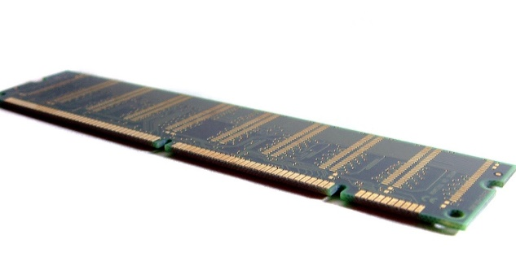
Types of NVMs
Type of NVM | Basic Principle
Flash memory | A floating gate transistor that has an additional gate that can be made to store electrons (based on the magnitude of the voltage)
Ferroelectric RAM (FeRAM) | The degree of polarization of the ferroelectric material is a function of the voltage applied to it in the past.
Magnetoresistive RAM (MRAM) | The direction of magnetization of a ferromagnetic material is a function of the direction of current flow through it (in the past)
Phase change memory (PCM) | We use a small heater to change the state from amorphous to crystalline.
ReRAM | Based on the history of the voltage applied, a filament forms based between the anode and cathode. The resistance is determined by the width of this filament.
This Photo by Unknown Author is licensed under CC BY-SA-NC

Slide 76
Flash Memory

Slide 77
Floating Gate Transistors
Introduce an additional gate → floating gate
We can trap electrons in it
Given that it is separated by SiO₂ layers, the trapped charge can remain there for a long time.
Two states: (0) Charge trapped (1) No charge trapped

Slide 78
Impact on the Threshold Voltage
Threshold voltage when no charge is trapped
$$V_{T}$$
Threshold voltage when charge is trapped
$$V_{T}^{+}$$
Given that electrons are negatively charged, for creating a conducting channel, we need to have:
$$V_{T}<{ V}_{T}^{+}$$
Just set the threshold voltage to a value between $V_{T}$ and ${ V}_{T}^{+}$
See if the transistor is conducting or not.

Slide 79
Writing to a Floating Gate Transistor
Writing a 0 (programming)
Apply a strong positive potential at the gate
The resulting electric field pulls electrons into the floating gate region
Writing a 1 (erasing)
Apply a strong negative potential at the gate
Pushes the electrons back into the channel (back to the default state)

Slide 80
Two Configurations of Flash Cells
NAND Flash
Bit line
Ground
WL8
WL7
WL6
WL5
WL4
WL3
WL2
WL1
Bit line
select
select
Bit
line
WL1
NOR Flash
WL2

Slide 81
NOR Flash
Bit
line
WL1
NOR Flash
WL2
It saves only 2 bits
Only one of the transistors is enabled (voltage set between $V_{T}$ and ${ V}_{T}^{+}$)
The voltage on the bit line is the reverse of the voltage stored in the cell
Very similar to a DRAM cell

Slide 82
NAND Flash Cell
NAND Flash
Bit line
Ground
WL8
WL7
WL6
WL5
WL4
WL3
WL2
WL1
Bit line
select
select
A bunch of transistors connected in series
Set the voltage on the bit line select and ground select line to 1 (enable them)
Assume we want to read the value stored in the transistor WL5
Set the gate voltage of the rest of the transistors to ${ V}_{T}^{+}$ (conducting)
40-60% higher density as compared to NOR Flash

Slide 83
Multi-Level Flash
We can store multiple bits per cell.
We can store 1-4 bits per cell. For storing n bits, we need to realize 2^{n} distinct charge levels.
Charge
Threshold voltage
Accurately sense based on the current flow
Higher storage density
Lower endurance and higher bit error rate (need more ECC).

Slide 84
Blocks and Pages
These are storage devices
Flash devices provide page-level access. Page size = 512-4096 bytes
There is a need to accumulate writes, and then sync to the flash device
Pages are grouped into blocks
Blocks contain 32-128 pages
Read or write data at the level of pages
A page once written, cannot be written again (unless erased)
There is a need to erase a block first and then write

Slide 85
Program/Erase Cycle
Program phase
Consider a fresh page (never written after being erased)
Programming → write a 0
By default, a cell contains a 1
Cannot convert from 0 → 1 without erasing
Erase phase
Set all the bits in the block of pages to 1 (not programmed)
How do we write to a page after writing to it once?
Answer:
Copy the full block to a fresh block (non-programmed) other than
the page that needs to be modified. Replace its contents with the
new contents.

Slide 86
Reliability Issues: Wear Levelling
A flash device can endure a finite number of P/E cycles (50-150k). Then, the oxide layer breaks down.
There is a need to ensure that all blocks wear out equally.
Maintain a P/E counter for each block
Assume that flash addresses are virtual addresses, which are mapped to physical addresses
Maintain a mapping table
This decouples the actual flash address from the address that is visible to software. Allows the hardware to remap obliviously.
mapping
Virtual flash address
Physical flash address

Slide 87
What can we achieve with remapping?
1. Copy the contents of a frequently accessed block to a temporary (free) block
Free block
High P/E count
2. Erase
Low P/E count
4. Erase and copy
3. Copy
Swap blocks

Slide 88
Read Disturbance
Definition
If we read a given cell continuously, the neighboring cells start getting programmed.
Reason: In NAND flash, the rest of the cells have to be enabled (voltage at the gate $> V_{T}^{+})$
A few electrons accumulate in the floating gate.
Over time, the cell gets programmed.
Solution
Maintain a read counter for each block
The moment it exceeds a threshold, copy the block to a new location. It starts from a fresh state.

Slide 89
Ferroelectric RAM (FeRAM)

Slide 90
Ferroelectric Effect
The polarization is defined as the density of dipole moment vectors in a material.
The polarization is a function of the applied electric field.
Several materials exhibit a ferroelectric effect → They have a memory (remember the polarization), even when the applied electric field is zero.
What makes a memory cell?
When the applied electric field is zero, there are two values for the polarization (two logical states)
The polarization is dependent on the history of the applied electric field.
PbZrO₃ + PbTiO₃
PZT
Popular Ferroelectric materials
BaTiO₃
Barium Titanate
SrBi₂Ta₂O₉
SBT

Slide 91
Hysteresis Curve
Polarisation
D
E
0
-V_{dd}
F
Voltage
C
+V_{dd}
1
B
A
Note the fact that the system has memory. The path from B → D is 1-way. While reducing the voltage, the path is D → E.

Slide 92
Diagram of a Ferroelectric Memory Cell
BL (Bit line)
WL (Word line)
Ferroelectric
capacitor
PL (Plate line)
Needed to create +ve and –ve voltages
Sense amp.

Slide 93
Writing to a Cell
Writing
Just set the voltage to –V_{dd} for a logical 1 and + V_{dd} for a logical 0 (plate line voltage w.r.t. to the bit line voltage.
When the cell is disabled (word line set to 0), the cell reverts to a stable point: Point B or E
The read operation is tricky.

Slide 94
Reading from a Cell
Set PL=V_{dd} and the bit line to 0 Volts
There are two possible movements: E → D or B → D
The magnitude of the current flow into the bit line will be different for both the cases. Its potential will also increase differently.
$$ΔV_{1}> ΔV_{0}$$
Expected result
Can be sensed using sense amplifiers
Note if the cell was storing a logical 1, it will revert to E (destructive read)

Slide 95
FeRAM vs DRAM
FeRAM
No refreshes
Nonvolatile
DRAM
Silicon based
Easy to manufacture
Small size

Slide 96
Magnetoresistive RAM (MRAM)

Slide 97
MRAM Memories
Free
layer
Insulating layer
Pinned layer
Ferromagnet → Iron-based material that has a natural magnetic dipole moment
One of the layers (pinned layer) has a fixed direction of magnetization
The direction for the other layer (free layer) can be reversed.
They are separated by a thin (1-2 nm) insulating layer made of MgO
There are thus two states for the cell in terms of the magnetizations: parallel and anti-parallel

Slide 98
Basic Insights behind Spin-Transfer Torque (STT) MRAM
Parallel state (P)
Low resistance (LRS)
Logical 1
Anti-parallel state (AP)
High resistance (HRS)
Logical 0
How do we reverse the magnetization?
STT-MRAM
Pass current through the pinned layer
Produces spin-polarized current (most of the electrons have the same spin)
Now, if this current passes through the free layer, it can transfer its momentum (spin) to the electrons and flip the direction of magnetization.

Slide 99
The Read and Write Operations
Bit line
Reading is trivial: For a given voltage measure the current. Effectively, we are measuring the resistance.
Writing: AP → P
Electrons flow from the pinned layer to the free layer
The spin gets polarized in a single direction
The free layer is magnetized in the same direction as the pinned layer
Writing: P → AP
Electrons flow from the free → pinned layer
Some electrons with the wrong spin bounce back and accumulate
They ultimately reverse the magnetization
Free layer
Pinned layer
Word
line
Select
line

Slide 100
Phase Change Memory (PCM)

Slide 101
Basic Idea
Chalcogenide glass has two states
Crystalline (low resistance, logical 1)
Amorphous (high resistance, logical 0)
Popular material in this class GeSbTe (GST)
How to switch between the two states?
Short high amplitude current pulse
Amorphous state
Long low amplitude current pulse
Crystalline state

Slide 102
Phase Chage Memory (PCM)
Top electrode
Crystalline GST
Programmable
region
Heater
(resistance)
Bottom
electrode
Nonvolatile memory
Reads are fast, writes are very slow
Multilevel PCM cells have been proposed (4 states)

Slide 103
Structure of a PCM Cell
Word
line
Bit
line
PCM
cell
The PCM cell presents itself as a resistor
Measuring the resistance is easy (determines the current on the bit line)
Writing is also easy → apply pulses of different kinds

Slide 104
Dealing with Slow Writes and Reliability
Implement a DRAM-based write cache to absorb writes.
Assume a write operation is midway, and a read arrives. Immediately service the read, come back and finish the write. The technology allows this.
Over time, the cell ages. It is necessary to apply a current for some time and verify if the write is done or not (1 iteration). We can switch to a high-priority read between iterations.
Wear leveling is required (like flash).
Start-gap wear leveling: Periodically move each block at location L to L + 1.

Slide 105
Resistive RAM (ReRAM)

Slide 106
Basic Physics
HRS state
Logical 0
LRS state
Logical 1
The resistance is a function of the history of the voltage
applied across the material.
Two kinds of ReRAMs
Redox ReRAMs
CBRAMs

Slide 107
Redox ReRAMs
Top electrode
Metal oxide
Bottom electrode
Let the metal oxide be of the form VO₂. V is a transition metal, typically Nickel and Titanium.
Two kinds of charge carriers: $O^{2−}$ and $V_{o}$ (oxygen vacancy)
Applying a high potential causes a breakdown in the oxide layer

Slide 108
Formation of a Conductive Filament
Anode
O²⁻ ion
Oxygen
Filament
vacancy
Cathode
LRS
The oxygen ions move towards the anode and accumulate there
The vacancies stay back
The oxygen ions may react with the material of the anode and form an oxide layer on it.
The oxygen vacancies align themselves along the electric field and create a conductive filament.

Slide 109
Reset Process
Unipolar switching
Send a high reset current through the filament
Causes localized heating
The oxygen ions trapped in the anode get released
They combine with the oxygen vacancies and break the filament
Bipolar switching
Apply a negative voltage at the anode
Pushes the $O^{2−}$ ions towards the filament.
Combine with the oxygen vacancies and rupture the filament

Slide 110
CBRAMs: Conductive Bridging RAM
One of the electrodes is an electrochemically active electrode; it is made of Ag (silver), Cu (copper), or Ni (nickel)
The other electrode is inert: platinum (Pt) or iridium (Ir)
In between, we have a thin electrolyte layer: Ge_{x}S_{y}, SiO₂, TiO₂, Ta₂O₅, ZrO₂

Slide 111
Programming the Cell
Apply a highly positive voltage to the active electrode (Ag)
Breaks down the material: Ag⁺ and 1 electron
The positively charged Ag⁺ ions move towards the inert electrode
A filament of Ag⁺ ions forms. This can carry current.
To reset the cell, apply a negative voltage to the active electrode. Ag⁺ ions move towards the active electrode and thus rupture the filament.

Slide 112
3D and Embedded Memory

Slide 113
Hybrid Memory Cubes (HMC) and High Bandwidth Memory (HBM)
DRAM array
3D stack of DRAM memory arrays.
Connected via trans-silicon vias or microbumps
Divide each layer into a set of blocks. A column of blocks (across layers) is known as a vault.
This memory stack is connected to the CPU with a high-bandwidth connection known as an interposer (128 bits)
eDRAM (embedded DRAM) → Integrate a DRAM module into the same die as the chip: a high-bandwidth connection

Slide 114
Outline
1.
Dynamic RAMs
2.
Design Space of DRAMs
3.
DRAM Timing
4.
Memory Controller
5.
Emerging Memory Technologies
6.
Roofline Model

Slide 115
A Basic Question
How do we compare two different computer systems using a simple graphical tool?
Performance (Ops per second)
Memory bandwidth
Operational intensity (Ops per byte)
How effectively is data read from memory used

Slide 116
Relation between these Three Quantities
$$\underset{Performance}{\underbrace{\frac{FLOPs}{second}}}= \underset{Memory bandwidth}{\underbrace{\frac{bytes}{second}}}∗ \underset{Operational intensity}{\underbrace{\frac{FLOPs}{byte}}}$$
FLOPs → Number of floating point operations
Different
B₃
bandwidths
Performance (FLOPs/sec)
B₂
y = Bx
B₁
Operational intensity
(FLOPs/byte)

Slide 117
Some Basic Math leading to the Roofline Diagram
$$y=Bx \\ ⟹\log\left(y\right)=\log\left(x\right)+\log{(B)}$$
Roofline diagram
Peak performance
Plotted in the log scale
45-degree line
Performance
Feasible region
of operation
Operational intensity

Slide 118
Bandwidth Ceilings
log-log plot
B₃
Different
S
B₂
bandwidths
R
B₁
B₃ > B₂ > B₁
Q
Performance
P
Operational intensity

Slide 119
Different Bandwidth and Computational Ceilings
P₃
B₁
Without prefetching
P₂
P₁
B₂
With prefetching
B₃
B₃
Theoretical maximum
Performance
B₂
B₁
P₁
Default
P₂
With SIMD
Operational intensity
P₃
Peak performance
Different architectural techniques lead to different performance and bandwidth ceilings.

Slide 120
Use Case
Roofline diagram
Peak performance
Q
Performance
Bandwidth ceiling
P
R
Operational intensity
P is close to the memory bandwidth ceiling.
Q is close to the performance ceiling.
R is an under-optimized design

Slide 121
Conclusion
A DRAM cell contains a single transistor and
capacitor. It can be a stacked or trench capacitor.
The hierarchy of structures in a DRAM: channel → rank → bank group → bank → array → row → col
The DDR memory protocols use detailed state diagrams and an
elaborate set of commands to access DRAM arrays.
The memory controller maintains the state of the protocol,
schedules commands and implements write caching.
Nonvolatile memories have at least two stable physical states (without an external stimulus).

Slide 122
The End

