Slide 1

Chapter 7:
I/O System, Device Drivers and Virtualization
Smruti R Sarangi
IIT Delhi

Slide 2
Outline of this Chapter
Basics of the I/O System
Storage Devices
Character and Block Device Drivers
File System
Virtual Machines

Slide 3
System Diagram
Processor
Frontside
PCI express
bus
bus
North Bridge
Memory
Graphics
modules
processor
chip
PCI express
SATA
Network
bus
South Bridge
bus
card
chip
Hard
disk
PCI express
Intel high
bus
def. audio on
a PCI bus
USB
USB
USB
USB
Audio/ Mic
USB ports
ports

Slide 4
Software Flow
Application
Request
Response
Operating
Device
system
Kernel
driver
Software
Hardware
I/O
I/O
Processor
device
system

Slide 5
Layers in the I/O Protocol Stack
Device-driver level transmission protocol
Protocol layer
Routing messages to the right I/O device
Network layer
Error correction, framing
Data link layer
Transmission
Synchronization
Voltage levels, timing of bits, synchronization
Physical layer

Slide 6
Explanation of the Layers
Physical Layer
  Transmission Sublayer → Defines the electrical specifications of the bus, and the methods of encoding data
  Synchronization Sublayer → The timing of signals
Data link layer
  Framing, buffering, error correction, transactions
Network Layer
  I/O device addressing, location, routing
Protocol Layer
  End-to-end request processing
  Interrupts, and polling (continue to read an I/O register until its value changes)
  DMA (Direct Memory Access)

Slide 7
I/O Ports
Every device on the motherboard exposes a set of I/O ports.
  An I/O port in this case, is a
  HW/SW entity → a set of registers
  Each software I/O port is a
  wrapper on the actual hardware
  I/O port
  A hardware I/O port is a set of
  connectors used to connect to an
  external device.
Software interface
Registers
Input
Output
Port controller
Port connector

Slide 8
Software Interface
Each I/O port exposes a set of 8-32 bit registers to software
Software writes to the registers. The port controller automatically sends the information to the I/O device.
Similarly, to read data, the processor reads the registers associated with the port controller.
Example : Intel processors define 64K, 8-bit I/O ports. Each port has a 16-bit port number.
Reading and writing to the actual device ↔ read and write to the associated software ports (special registers associated with I/O devices)

Slide 9
I/O Address Space
Set of all I/O ports that are accessible to software
x86 processors have two instructions to access I/O ports → in and out
These are special (privileged) instructions
Instruction | Semantics
in r1,<i/o port> | r1 ← contents of <i/o port>
out r1, <i/o port> | contents of <i/o port> ← r1

Slide 10

I/O Mapped I/O
A request contains an I/O port address
The processor sends it to the Northbridge chip.
The Northbridge chip forwards it to the Southbridge chip (if necessary)
The Southbridge chip forwards it to the destination. (there might be several more hops)
Each chip maintains a small routing table.
The response follows the reverse path.

Slide 11

Memory Mapped I/O
Problems with I/O mapped I/O
  The programmer needs to be aware of the addresses of the I/O ports.
  The same device might have different port addresses across different motherboards
  Programs will cease to work on other machines.
  It is hard to transfer a block of data (need to send it instruction by instruction)
  Solution : memory mapped I/O

Slide 12

Memory Mapped I/O – II
Define a virtual layer between I/O ports, and the application.
The operating system can use the paging mechanism to map I/O ports to memory addresses.
Whenever, we write to a memory address that is mapped to an I/O port, the TLB directs the request to the I/O system.
Similarly, for reading data, the response comes from the I/O System
The physical address in this case comprises a diversity of devices

Slide 13

Advantages
The operating system creates the mapping between the I/O ports and the memory addresses
The same I/O program runs on multiple machines
Reading and writing to I/O devices requires normal load/store instructions
Easy to read and write a large block of data using block load/store operations available in some architectures (e.g, x86)

Slide 14
Outline of this Chapter
Basics of the I/O System
Storage Devices
Character and Block Device Drivers
File System
Virtual Machines

Slide 15

Flash Drives

Slide 16
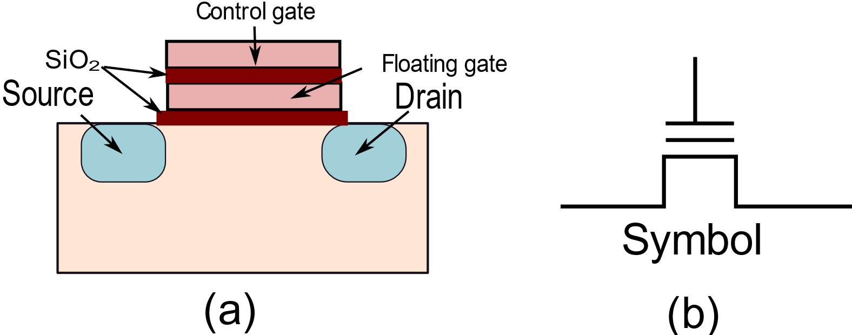


Floating Gate Transistors
Introduce an additional gate → floating gate
We can trap electrons in it
Given that it is separated by SiO₂ layers, the trapped
charge can remain there for a long time.
Two states: (0) Charge trapped (1) No charge trapped

Slide 17




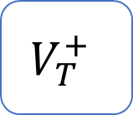
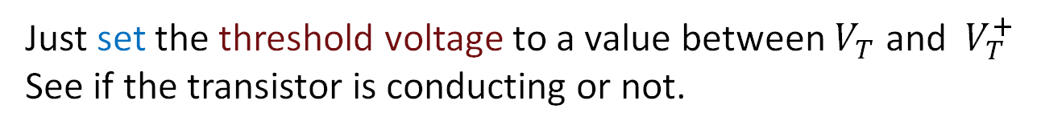
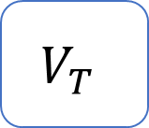

Impact on the Threshold Voltage
Threshold voltage when no charge is trapped
$$V_{T}$$
Threshold voltage when charge is trapped
$$V_{T}^{+}$$
Given that electrons are negatively charged, for creating a
conducting channel, we need to have:
$$V_{T}<{ V}_{T}^{+}$$
Just set the threshold voltage to a value between $V_{T}$ and ${ V}_{T}^{+}$
See if the transistor is conducting or not.

Slide 18
Writing to a Floating Gate Transistor
Writing a 0 (programming)
Apply a strong positive potential at the gate
The resulting electric field pulls electrons into the floating gate region
Writing a 1 (erasing)
Apply a strong negative potential at the gate
Pushes the electrons back into the channel (back to the default state)

Slide 19
Two Configurations of Flash Cells
NAND Flash
Bit line
Ground
WL8
WL7
WL6
WL5
WL4
WL3
WL2
WL1
Bit line
select
select
Higher density
Bit
line
WL1
NOR Flash
WL2

Slide 20
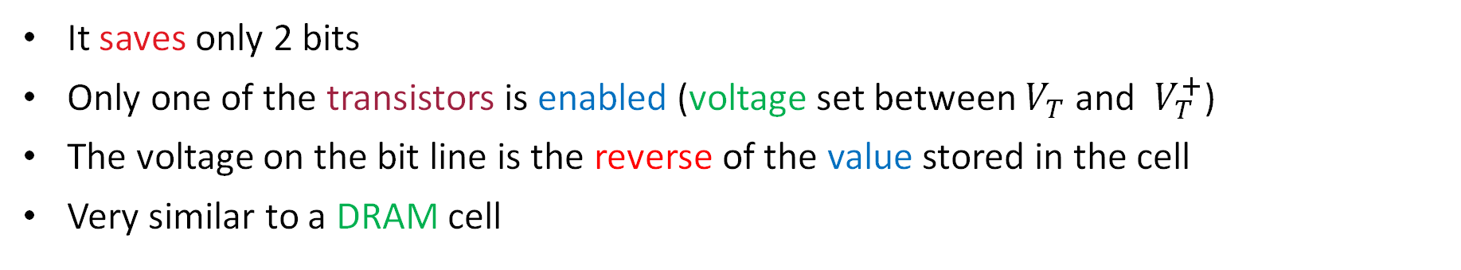
NOR Flash
Bit
line
WL1
NOR Flash
WL2
It saves only 2 bits
Only one of the transistors is enabled (voltage set between $V_{T}$ and ${ V}_{T}^{+}$)
The voltage on the bit line is the reverse of the value stored in the cell
Very similar to a DRAM cell

Slide 21
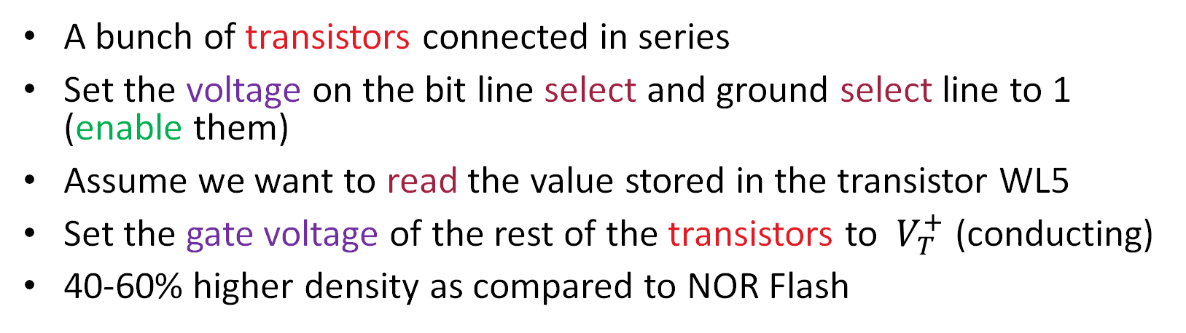
NAND Flash Cell
NAND Flash
Bit line
Ground
WL8
WL7
WL6
WL5
WL4
WL3
WL2
WL1
Bit line
select
select
A bunch of transistors connected in series
Set the voltage on the bit line select and ground select line to 1 (enable them)
Assume we want to read the value stored in the transistor WL5
Set the gate voltage of the rest of the transistors to ${ V}_{T}^{+}$ (conducting)
40-60% higher density as compared to NOR Flash

Slide 22



Multi-Level Flash
We can store multiple bits per cell.
We can store 1-4 bits per cell. For storing n bits, we need to realize
2^{n} distinct charge levels.
Charge
Threshold voltage
Accurately sense based on the current flow
Higher storage density
Lower endurance and higher bit
error rate (need more ECC).

Slide 23


Blocks and Pages
These are storage devices
Flash devices provide page-level access. Page size = 512-4096 bytes
There is a need to accumulate writes, and then sync to the flash device
Pages are grouped into blocks
Blocks contain 32-128 pages
Read or write data at the level of pages
A page once written, cannot be written again (unless erased)
There is a need to erase a block first, and then write

Slide 24

Program/Erase Cycle
Consider a fresh page
(never written after being erased)
Programming → write a 0
By default, a cell contains a 1
Cannot convert from 0 → 1 without
erasing
Program phase
Erase phase
Set all the bits in the block of
pages to 1 (not programmed)
How do we write to a page after writing to it once?
Answer:
Copy the full block to a fresh block (non-programmed) other than
the page that needs to be modified. Replace its contents with the
new contents.

Slide 25

Reliability Issues: Wear Levelling
A flash device can endure a finite number of P/E cycles (50-150k). Then, the oxide layer breaks down.
There is a need to ensure that all blocks wear out equally.
Maintain a P/E counter for each block
Assume that flash addresses are virtual addresses, which
are mapped to physical addresses
Maintain a mapping table
This decouples the actual flash address from the address that is
visible to software. Allows the hardware to remap obliviously.
Virtual flash address
mapping
Physical flash address

Slide 26
What can we achieve with remapping?
1. Copy the contents of a frequently
accessed block to a temporary (free) block
Free block
High P/E count
2. Erase
Low P/E count
4. Erase and copy
3. Copy
Swap blocks

Slide 27
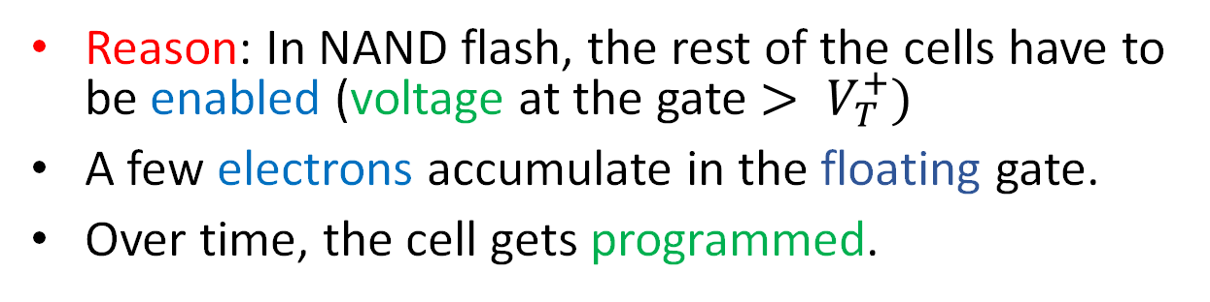
Read Disturbance
Definition
If we read a given cell continuously, the neighboring
cells start getting programmed.
Reason: In NAND flash, the rest of the cells have to be enabled (voltage at the gate $> V_{T}^{+})$
A few electrons accumulate in the floating gate.
Over time, the cell gets programmed.
Solution
Maintain a read counter for each block
The moment it exceeds a threshold, copy the block to a new
location. It starts from a fresh state.

Slide 28
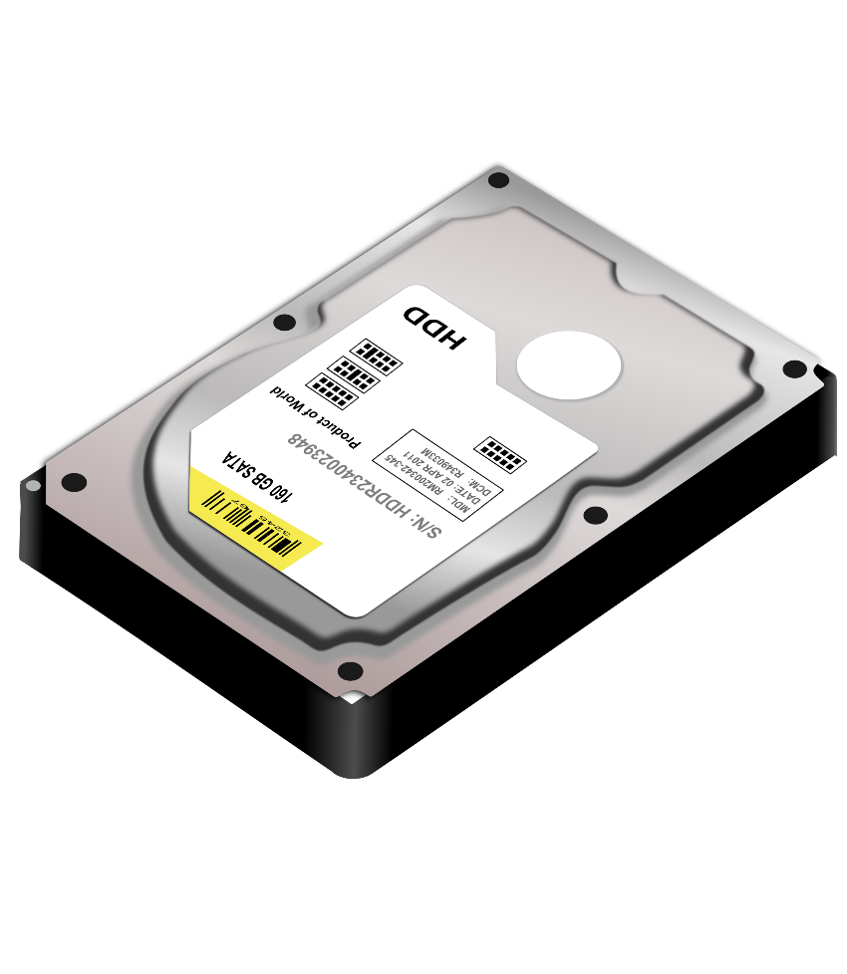
Hard Disks

Slide 29
NRZI (non-return to zero inverted)
Clock
0
1
1
1
0
1
0
1
0
0
0
Data

Slide 30
Data Storage in Hard Disks
Magnetic storage (sequence of tiny magnets)
NRZI Encoding
  with dummy bits (added to synchronize signals)
N
S
N
S
S
N
S
N
N
S
0
1
0
1

Slide 31
Structure of a Platter
Sector
Track
A platter is divided into concentric rings (track)
Each track is divided into fixed size sectors

Slide 32
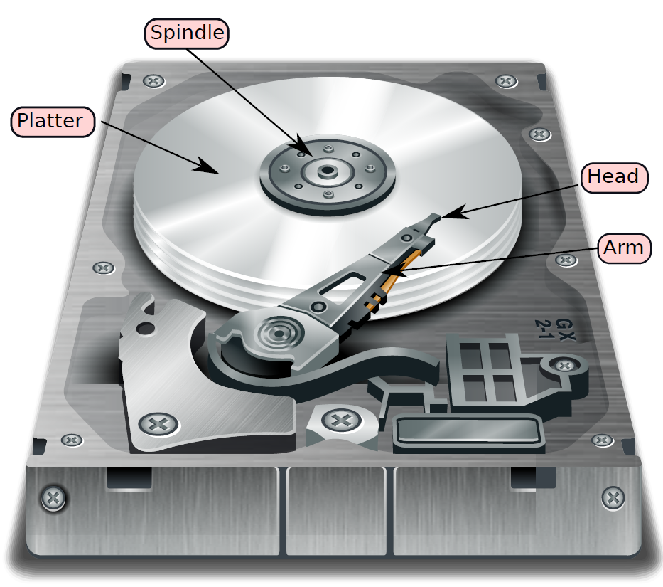
Structure of a hard disk

Slide 33
Spindle
Read/Write
head
Platter
Arm
Bus
Bus
Actuator
interface
Spindle motor
Drive
electronics

Slide 34
Accessing a Given Sector
Position the head on the correct track
  seek time
Wait for the desired sector to come under the head
  Rotational Latency
  Assume that the hard disk rotates at a constant angular velocity
Read or Write data
  Perform error checking, correction, framing
  Transfer data to the CPU → (Transfer Time)
  The transfer starts when the head is on the first bit of the sector
$$T_{disk access}= T_{seek}+ T_{rot. latency}+ T_{transfer}$$

Slide 35

Logical vs Physical Block Address
Software programs use the logical block address to address a hard disk block (sector)
  The hard disk internally converts the logical address to a physical address (recording surface, track, sector)
  It dedicates a recording surface for storing this mapping information.
  It also has a small cache (DRAM) to store the most recently used mappings
  The hard disk can also use this mechanism to mark bad sectors and remap logical sectors to healthy physical sectors.
A file maybe split into many chunks and stored all over the disk. A defragmenter rearranges the blocks such that most of the blocks in a file are contiguous.

Slide 36
RAID – (Redundant Array of Inexpensive Disks)
Hard Disks tend to have high failure rates
  Too many mechanical components
  High temperature sensitivity
What do we do?
  Do we lose all our data ....
  NO
Use RAID
  Redundant disks
  To tolerate faults, and recover from failures

Slide 37

RAID – II
What about bandwidth?
  Assume we want to read two different blocks from the same disk?
  We need to read them serially.
  Low Bandwidth
How can we increase bandwidth
  Read from multiple disks in parallel.
  Solution: RAID
Additional resources increase performance and improve reliability

Slide 38
RAID 0
Block 1
(512 bytes)
B1
B2
B3
B4
Data striping
Distributing data across disks defined as data striping
B5
B6
B7
B8
B9
B10
Disk 1
Disk 2
No Reliability
Allows us to read even and odd blocks in parallel

Slide 39
RAID 1
B1
B1
B2
B2
B3
B3
B4
B4
B5
B5
Disk 1
Disk 2
Immune to one disk failure
Can read blocks B1 and B2 in parallel
100% overhead in storage

Slide 40
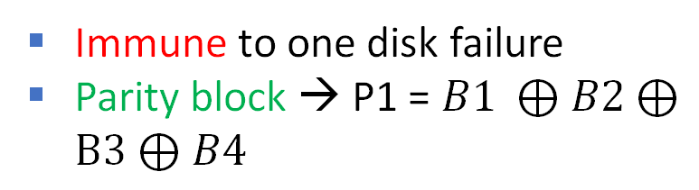
RAID 2, 3, 4
B1
B2
B3
B4
P1
B5
B6
B7
B8
P2
B9
B10
B11
B12
P3
B13
B14
B15
B16
P4
B17
B18
B19
B20
P5
Disk 1
Disk 2
Disk 3
Disk 4
Parity Disk
Immune to one disk failure
Parity block → P1 = $B1 ⊕B2⊕B3⊕B4$
25% storage overhead
If a disk fails, add a new disk and reconstruct it from the parity bits

Slide 41
RAID 2, 3 and 4
Single point of contention
B1
B2
B3
B4
P1
B5
B6
B7
B8
P2
B9
B10
B11
B12
P3
B13
B14
B15
B16
P4
B17
B18
B19
B20
P5
Disk 1
Disk 2
Disk 3
Disk 4
Parity Disk
RAID | Block Size
2 | 1 bit
3 | 1 byte
4 | 1 block (512 bytes)
For reading a single block → access all the disks

Slide 42
RAID 5
B1
B2
B3
B4
P1
P2
B5
B6
B7
B8
B9
P3
B10
B11
B12
B13
B14
P4
B15
B16
B17
B18
B19
P5
B20
Disk 1
Disk 2
Disk 3
Disk 4
Disk 5
To avoid this problem: Distribute the parity blocks across the disks
Reliable + high bandwidth

Slide 43
RAID 6
B1
B2
B3
B4
P1A
P1B
P2B
B5
B6
B7
B8
P2A
P3A
P3B
B9
B10
B11
B12
B13
P4A
P4B
B14
B15
B16
B17
B18
P5A
P5B
B19
B20
Disk 1
Disk 2
Disk 3
Disk 4
Disk 5
Disk 6
Immune to two disk failures
Have two parity blocks (parity is computed differently)
High reliability at the cost of increased storage overhead

Slide 44

Memories as Storage Devices
The main problem with DRAM memory is that when the power is turned off, the data disappears. Can this be solved?
Answer:
Use some kind of nonvolatile memory (NVM) whose data
is not lost upon a loss of power. Can also act as a storage
device.
Slower than DRAM memory
Nonvolatile Memory
Faster than hard disks

Slide 45
Basic Idea of NVMs (Nonvolatile memories)
Construct a device that has two physical states
Designate one state a logical 1 and the other a logical 0
Create an array of such devices
Manage reliability using a HW-SW approach
Generic approach
High Resistance State (HRS)
Low Resistance State (LRS)

Slide 46
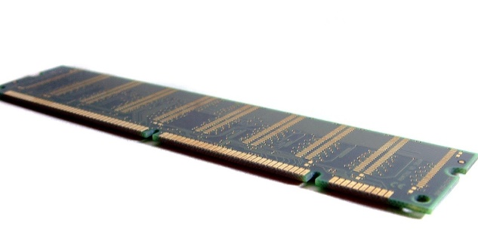
Types of NVMs
Type of NVM | Basic Principle
Flash memory | A floating gate transistor that has an additional gate that can be made to store electrons (based on the magnitude of the voltage)
Ferroelectric RAM (FeRAM) | The degree of polarization of the ferroelectric material is a function of the voltage applied to it in the past.
Magnetoresistive RAM (MRAM) | The direction of magnetization of a ferromagnetic material is a function of the direction of current flow through it (in the past)
Phase change memory (PCM) | We use a small heater to change the state from amorphous to crystalline.
ReRAM | Based on the history of the voltage applied, a filament forms based between the anode and cathode. The resistance is determined by the width of this filament.
This Photo by Unknown Author is licensed under CC BY-SA-NC

Slide 47
Outline of this Chapter
Basics of the I/O System
Storage Devices
Character and Block Device Drivers
File System
Virtual Machines

Slide 48

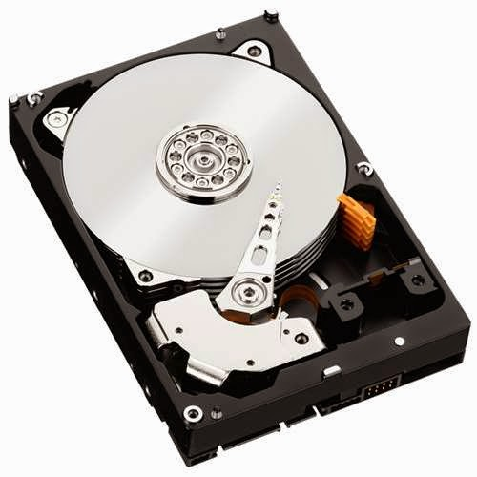
Basic Concepts
Represent each device as a file (devfs is in /dev). Use standard file-access primitives.
Character device
Block device
The device has a set of addressable locations
The minimum transfer size is 1 block (tens of bytes at least)
Read and write groups of characters
at a time. Typically, does not have
addressable locations. May have the
notion of a position in a stream of
characters.
A device driver provides a convenient interface to HW

Slide 49
Linux’s File Interface: Used by Character Device Drivers, Regular Files, etc.
Standard interface
Represent everything including block and character devices as files.
From the current position. Increment it
file
open
close
seek
read
write
current position
start
end
Contiguous set of bytes

Slide 50
open
close
seek – go to an address
read
write
Block Devices

Slide 51

Registering a Block Device
/block/genhd.c
major number
device
device driver
First register the device
minor number
register_blkdev (unsigned int major, const char *name, void (*probe) (dev_t devt))
  Register the device with the kernel (listed in /proc/devices)
  The kernel will subsequently use the major number to identify the device
  devt is a u32 that identifies the device: 12 bits for the major number and 20 bits for the minor number
  The minor number is used only by the device driver
Details

Slide 52

Overall Structure of the Block I/O System
File system
gendisk
device_driver
device
Block device
bus_type
request_queue
struct request
I/O scheduler
bio
bio
bio
Array of requests
List of memory regions

Slide 53

Notion of a Module and Device Driver
The Linux kernel is a large monolithic piece of code
  We should not be forced to recompile the kernel for every single driver that we add → Regular users should never do this
  We should also not be forced to statically link all possible drivers
  A module is like a dll or shared object in a kernel
  Load the device drivers as a module: make the module a part of the kernel code (not necessarily the binary) or load at runtime
Advantage: size and memory footprint arguments (as dlls and shared objs)
Load a module:
  insmod command (invoked by the superuser)
  The kernel does it automatically based on the action (such as mounting a filesystem)

Slide 54
Loading and Unloading a Module
The role of insmod or the function called by the daemon kerneld is to do the following:
  Locate the code of the module
  Map it to the kernel space
  Increase the kernel’s runtime code size and memory footprint
  Like a linker, change the addresses of all the symbols that the module plans to use from the global symbol table (kernel and other modules)
  Add the symbols it exports to the global symbol table
Unloading a module
  Maintain a reference count with each module
  Once it reaches zero and the user wishes to unload the module, follow the reverse sequence of steps.

Slide 55
Modules – II
Address of a function/ global variable
kernel symbol table
module 1 symbol table
module 2 symbol table
The modules can see (and use) the kernel’s symbol table
A module can also see (and use) the symbol tables of other modules
  We can make one module load after another to enforce a relationship

Slide 56

struct device_driver
/include/linux/device/driver.h
struct device_driver {
const char *name;
struct bus_type *bus;
struct module *owner;
struct of_device_id …;
}
Name of this device, type of the bus, name of the module that corresponds to the driver.
Name and type of the driver (used to match a device)
function pointers: probe, sync_state, remove, shutdown, suspend, resume
Called to bind the driver with a device
Device specific information

Slide 57
Add the Disk to the System
device_add_disk(…)
Define a few data structures
/include/linux/device.h
struct device
dev_t devt;
u32 id;
struct device *parent;
struct bus_type *bus;
struct device_driver *driver;
struct bus_dma_region *dma_range_map;
struct list_head dma_pools;
struct device_physical_location *physical_location;
Device identifier
High-level information
DMA regions
Location of the device: dock, lid, position on the motherboard

Slide 58


A Note about bus_type
Devices are connected to the processor via a bus (represented by bus_type). struct bus_type contains a list of function pointers and generic attributes like the name of the bus.
Every bus has a single device that is considered the parent (this could be virtual also). Along with the parent, it contains multiple devices and device drivers.
Common function pointers:
  probe → Check if a device matches a driver.
  sync_state → Sync the device’s state with its software state
  remove/shutdown/suspend/resume/online/offline → Self-explanatory
  dma_configure → Manage the DMA space associated with the bus

Slide 59
Generic Disk (struct gendisk)
/include/linux/blkdev.h
int major;
char disk_name[];
struct xarray part_tbl; /* partition table */
struct block_device *part0;
struct block_device_operations *fops;
struct request_queue *queue;
major number and disk name
Pointer to the partition table and block device (for the first partition)
List of pending requests
This is a wrapper on a block device
It also contains a pointer to a struct of type block_device_operations → contains a list of function pointers for opening, releasing and operating a block device

Slide 60


struct block_device
/include/linux/blk_types.h
A disk-like device that supports a file system and a request queue
sector_t bd_start_sect;
sector_t bd_nr_sectors;
dev_t bd_dev;
struct device bd_device;
struct super_block *bd_super;
struct inode *bd_inode;
struct gendisk *bd_disk;
struct request_queue* bd_queue;
size in sectors
pointer to the device
Details of the file system on this device
Pointer to a generic disk device
Queue of requests

Slide 61
struct request_queue
/include/linux/blkdev.h
one per device
struct request_queue {
struct request *last_merge;
struct elevator_queue *elevator;
}
pointer to the last request
I/O request queue that interfaces with the I/O scheduler
per CPU software request queue
per CPU queues that store requests
Hardware request queues
Software front-end of HW request queues
A request queue for a certain device contains both software request queues and hardware queues (with a software counterpart that periodically syncs with it)

Slide 62
Software and Hardware Queues
The per-CPU software queues are lockless queues used to hold requests from a single CPU
They can be merged and reordered.
They are then sent to the hardware dispatch queues (part of the device driver)
Here, there are requests from all CPUs: more merging and reordering
The driver sends the requests to the device at the right points of time (after appropriately delaying)
Every request and its response (from the device) is identified with a tag
  Needed for concurrent requests

Slide 63
struct request
/include/linux/blk-mq.h
struct request {
struct request_queue *q;
struct blk_mq_ctx *mq_ctx;
struct blk_mq_hw_ctx *mq_hctx;
struct block_device *part;
unsigned int __data_len;
sector_t sector;
unsigned int deadline, timeout;
struct bio *bio;
rq_end_io_fn *end_io;
}
request_queue
Back pointers
HW queues
SW queues
Params
phy. address ranges
struct
request
Function called to complete the request

Slide 64
struct bio (block operations currently active)
https://www.kernel.org/doc/Documentation/block/biodoc.txt
/include/linux/blk_types.h
struct bio {
struct block_device *bi_bdev;
struct bio_vec *bi_io_vec;
}
Back pointer to the block device
Array of I/O ranges
phy page, length, offset
It is possible to merge multiple bio structs or bio-vectors (<page,len,offset> tuples) to create a larger I/O request
Storage devices like disks, SSDs and NVMs prefer sequential read/writes from large contiguous regions.

Slide 65

I/O Scheduling Algorithms (Elevators)
Classic elevator scheduling algorithm
  An elevator keeps going up until there are requests and then keeps going down until there are requests (regardless of the FIFO order and priority)
  Early elevator-based disk scheduling algorithms did the same: move from the innermost track to the outermost track and then back (allowed us to leverage spatial locality). This minimizes back and forth movement of the disk head.
Linux uses three kinds of I/O scheduling algorithms
Flr 10
Flr 7
Flr 3
Flr 1
Deadline
BFQ
Kyber

Slide 66
I/O Scheduling Algorithms
Deadline scheduler
Store requests in queues (in sector order) and serve them in that order (prefer reads). Also, store requests as per their deadline. When a deadline expires, schedule all the requests that have timed out (from the deadline queues). After finishing this, start serving from the default queues.
BFQ (Budget Fair Queueing)
Similar to CFS Scheduling, BFQ gives processes a certain number of sectors in a large “sector slice”.
KYBER
Introduced by Facebook
A soft real-time scheduler that creates latency buckets for read/write requests and tries to schedule them within their target latency duration.

Slide 67
More about I/O Schedulers
They do three things
Delay
Delay requests such that there is a large set of requests
Merge
Coalesce reads and writes to the same address
Reorder
Reads, async. writes, and sync. writes have different priorities
We have more avenues for optimization in a large set of requests.
Merge adjacent memory regions or sectors
Also, we need to consider the current position of the disk head
Consider deadlines and user-assigned priorities.

Slide 68
Basic Device Driver (Sony’s Memory Stick Driver)
/drivers/memstick/core/mspro_block.c
The module starts by calling mspro_block_init
  Registers the driver name and block device “mspro_block”
  The driver is represented by a structure (mspro_block_driver) that contains multiple function pointers to probe/initialize, remove, suspend and resume
The initialization function (mspro_block_probe)
  Initialize the card
  Create a sysfs entry: special file system to expose specific attributes of kernel objects like devices.
  Initialize the disk structures: gendisk, block_device, request_queue, tags
  Add the disk to the device

Slide 69
Transferring Data to/from the Memory Card
/drivers/memstick/host/rtsx_usb_ms.c
Generic memstick
Specific device
Realtek USB
memstick card interface
rtsx_usb_ms_handle_req
  Keep a queue of requests – get the next request (part of memstick’s interface)
  Based on the type: read, write, or do a bulk transfer
  For reading and writing: create a set of USB read/write commands and pass them on to the low-level USB driver
  For a bulk transfer →
    Setup a one-way pipe: a virtual file in which one process can write and another can read
    Initiate the transfer by writing USB commands to the corresponding registers

Slide 70
open
close
read
write
Character Devices

Slide 71

USB Keyboard
/drivers/hid/usbhid/usbkbd.c
usb_kbd_probe is the entry point for adding a module
Allocate a generic input device. Associate it with the keyboard device.
Initialize all the function pointers that will be called when the module will be opened, closed, and a key press event will be processed
Two crucial functions for registering and deregistering character devices
  register_chrdev: Register the major and minor numbers of the device. Register the driver structure (list of function pointers).
  unregister_chrdev: Do the reverse

Slide 72

Register interrupt handler: usb_kbd_irq
void usb_kbd_irq(struct urb *urb)
struct urb
  USB request block: generic data structure to hold information pertaining to USB device requests and responses
Check the status of all special keys: Ctrl, Alt, Scroll Lock, …
Check if the same key has been pressed twice (continued to be pressed down)
Access a table to read the Ascii code from a table that is indexed with the code sent by the USB keyboard
  Report the key pressed
  Take special action for keys such as Num Lock, Caps Lock, etc.

Slide 73
Outline of this Chapter
Basics of the I/O System
Storage Devices
Character and Block Device Drivers
File System
Virtual Machines

Slide 74
File System
Logical address in a file
Physical address on the storage device
inode
Path of the file
Every disk can be divided into partitions: logical disks
Each partition may have a boot block (used to boot the OS) (typically starts from the 0th storage location of the storage device)
Every file system then has a superblock
Location of the root inode (“/” in Linux)
Metadata: max. file size, max. length of a filename, …

Slide 75






File, Directory and File System
Contiguous array of bytes.
File System
File
Directory
Path of the file
Symbolic
link
Mounted file system.
Map the root directory of
the mounted file system to
a directory in the parent file
system. mount command
Points to the same inode
Hard
link

Slide 76
Linux VFS (Virtual File System)
Application
Run df -a
Virtual File System (VFS)
ext3
FAT
procfs
sysfs
devfs

Slide 77
struct inode
VFS inode
/include/linux/fs.h
struct inode {
struct super_block *i_sb;
unsigned long i_ino;
struct address_space *i_mapping;
dev_t i_rdev;
blkcnt_t i_blocks;
loff_t i_size;
umode_t i_mode; kuid_t i_uid; kgid_t i_gid;
}
unique inode number
pointer to the page cache
device hosting the file system
size of the file
regular file, dir, character device, block device, FIFO pipe, sym link, socket
user id and group id

Slide 78
ext4 (/fs/ext4)
Linux and Android’s default filesystem
Backward compatibility mode
Filesystems typically declare their own inode structures. Most important structure:
struct ext4_inode
uint32 i_block [EXT4_N_BLOCKS] (list of logical block pointers)
Optimized for small files
Ptrs
Pointers to 12 directly mapped blocks
Pointers to data blocks
Indirect
Ptrs
Double indirect
Triple indirect

Slide 79

ext4 inode based on extents (scalable mode)
/fs/ext4/extents.c
Use the idea of folios
Regions in the disk
ext4_extent_header
ext4_inode
index node
ext4_extent
ext4_extent_header
ext4_extent_idx
ext4_extent
i_block[] (first 12 bytes)
ext4_extent_header
ext4_extent_idx
An extent is a contiguous region in the disk
size: 128 MB (max), 4 KB block size
If a file has more than 4 extents, use a tree
Maximum depth of the tree: 5
ext4_extent
ext4_extent

Slide 80

exFAT (Extended File Allocation Table)
/fs/fat/fat.h
File “abc”
FAT
table
Each entry points to the next entry in the FAT table and the corresponding location in the storage device
Directory
Name
attr
FAT table entry
abc
…
…
It can contain sub-directories also. Each sub-directory is represented as a sequence of data blocks. Each block contains a linear list of rows.
exFAT: Support for much larger file and filesystem sizes. Hash-based file name lookup, pre-allocation.
exfat_dentry

Slide 81

dentry
/include/linux/dcache.h
VFS structure
struct dentry {
struct hlist_bl_node d_hash;
struct dentry *d_parent;
struct qstr d_name;
struct inode *d_inode;
struct list_head d_child;
struct list_head d_subdirs;
}
hash collision chain
Embed a B-tree in an array: create dummy internal nodes and also keep some unoccupied space
map a filename to an inode
list of siblings and children
struct dx_root and struct dx_node: 3-level hashtable
ext_4_direntry: arrange as a linear list in each dir. block
Put dummy entries in the data blocks (corresp. to directory entries). Use them to realize a 3-level B-tree that is indexed by the hash of the file name. The last level is organized as a linear list.
inode num.
length of the file name
file type
file name

Slide 82
Two Basic Security Concepts
Access list for a file
All the users and groups that can access the file and the particular rights that they will have: read, write, execute, etc.
Capability list of a user or a group of users
The rights on files enjoyed by all users and groups. Very basic support in Linux. Read the documentation: man 7 capabilities

Slide 83
Page Cache
/include/linux/fs.h
struct address_space {
struct inode *host;
struct xarray i_pages;
struct rb_root_cached i_mmap;
unsigned long nrpages;
const struct address_space_operations *a_ops;
struct list_head private_list;
void *private_data;
}
host inode
Pointers to cached pages arranged as a radix tree
red-black tree that stores all mapped vmas
#pages
functions to bring in and evict folios
private data to be
used by the owner
Most file operations happen on the page that is stored in-memory
i_mmap stores vmas of all the processes that share the address_space (rmap pages of the file)

Slide 84

Named Pipes (special file system)
DELL@Desktop-home2 ~
$ mkfifo mypipe
DELL@Desktop-home2 ~
$ file mypipe
mypipe: fifo (named pipe)
DELL@Desktop-home2 ~
$ ls -al mypipe
prw-rw-rw- 1 DELL None 0 Apr 23 09:38 mypipe
DELL@Desktop-home2 ~
$ tail -f mypipe
I love my OS course
DELL@Desktop-home2 ~
$ echo "I love my OS course" > mypipe
Create a named pipe
Write to the pipe
Note the ‘p’
Unnamed pipes
int pipe (int fd[2]);
Write to fd[1], read from fd[0]: they are int file descriptors
Wait till the pipe is written to

Slide 85
Outline of this Chapter
Basics of the I/O System
Storage Devices
Character and Block Device Drivers
File System
Virtual Machines

Slide 86
Run an OS as an Application
processes
processes
processes
kernel
kernel
kernel
VM1
VM2
VM3
Virtual machine manager (VMM)
also known as Hypervisors
Hardware

Slide 87
Types of Hypervisors
Type | Explanation | Examples
Type 0 | Hardware or Firmware-based VMM. Minimal software support | IBM LPAR, Oracle LDOM
Type 1 | An OS that allows us to run other guest OSes. Provides native support and maps guest addresses to physical memory directly. | Linux KVM, VMWare ESX, Citrix XenServer
Type 2 | Run a guest OS as a regular application | VMPlayer, VirtualBox
Para-virtualization | The code of the guest OS is changed (unlike the previous cases) and made VM aware | Xen

Slide 88
Advantages of VMs in Cloud Environments
Create custom environments
Create custom environments (OS + libraries + software) and run them on any machine on a cloud.
Virtualize the CPU, network, file system, memory, and hardware
Transparently migrate the VM across different types of machines
Server consolidation
Live migration of VMs, efficiently heterogeneous server resources

Slide 89





Virtualization
CPU
Memory
i/o
storage
The guest OS has no idea that it is running on a hypervisor.
The OS needs to think that it exclusively owns these devices

Slide 90


Virtualize the CPU
Ring 3
Application
Ring 0
Ring 2
Ring 0
Ring 1
Ring 0
Ring 0
kernel
guest OS
Regular instructions
Privileged instructions
Trap and emulate: The guest OS runs with user privileges. Invoking a privileged inst. leads to a trap. The hypervisor catches it and successfully emulates the instruction.
Instructions that execute
differently based on the
privilege level
Binary translation

Slide 91

Binary Translation
The hypervisor follows a read-ahead scheme.
  Whenever a new code page is accessed, a fault is generated (either the TLB entry is missing or the page is marked non-accessible)
  The hypervisor reads the page and a few more subsequent pages
  It scans all the instructions.
  If there is a sensitive instruction (changes its behavior based on the privilege level), replace it with an alternative sequence
  Make it generate a trap or make the behavior the same (guest & kernel)

Slide 92

What about memory?
Type 1 Hypervisors
Guest Application
Type | Explanation
GVA | Guest virtual addr.
GPA | Guest physical addr.
HVA | Host virtual addr.
HPA | Host physical addr.
TLB entry
Guest OS
GVA → HPA
Host OS
Nested paging
Shadow paging
TLB miss → walk the guest and host page tables. (slow)
No need to track guest page table modifications.
VMM maintains only 1 page table.
1. The VMM builds a GVA → HPA page table (one per guest process).
2. Keeps the shadow page table consistent with both page tables. TLB Miss: Access just the shadow page table (fast)
3. Track every guest page table update

Slide 93
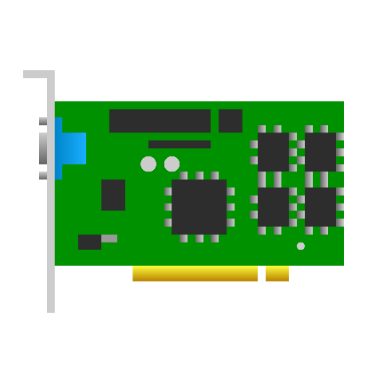
I/O Virtualization
One network card appears as several virtual network cards (one for each VM)
Emulation: The hypervisor traps every I/O instruction and memory-mapped ld/st instruction (make pages non-accessible). Follows the trap-and-emulate method. Every guest OS uses emulated devices. [slow]
With H/W support (PCI-X devices): Use the SR-IOV and MR-IOV protocols. A single device exposes separate buffers (request queues), interrupts and DMA streams to each VM. MR-IOV allows sharing the resources with multiple computers.

Slide 94

Paravirtualization
Why not modify the guest operating system to make it VM aware?
Xen [1] was the first popular para-virtualized hypervisor. Guest OSes communicate via system calls (also known as hypercalls).
Avoid instructions that change their behavior based on the privilege level
Ensure that either all privileged instructions either trap in VM mode or are replaced with non-privileged variants that do the same job (may invoke VMM routines)
Use “fast exception handlers” that are directly registered in the CPU’s exception and system call table. Page fault handlers need to be there with Xen (HW reasons 🤔)
Guest OSes can directly write into the CR3 register and change the current page table address (mapping: GVA → HPA). Updates to the page table need to go through the hypervisor. Xen maintains a shadow page table for each process and it updates it when the guest OS lets it know.
Interrupts are sent as lightweight events to the guest OS (similar to signals)
I/O: Create a bounded queue (request buffer) between the guest OS and Xen (aka I/O ring because it is a circular queue).

Slide 95
HW-Assisted Virtualization
Intel VT-x
AMD-V
Event | Action
Privileged instruction execution | Most of the time it is allowed like syscall enter and exit because in this case, VMs run in Ring 0 (albeit in non-root mode or VM mode). Some I/O instructions necessitate a VM exit. The device needs to be emulated.
Memory accesses | Use shadow page tables that are directly stored in HW (fast path). The CPU walks both the guest and host page tables on a TLB miss and updates the shadow page table (if there has been an update to either page table, slow path).
I/O | Use the SR-IOV and MR-IOV protocols
Storage | The hypervisor maintains a guest-to-host block table.

Slide 96
Bibliography
Paul Barham, Boris Dragovic, Keir Fraser, Steven Hand, Tim Harris, Alex Ho, Rolf Neugebauer, Ian Pratt, and Andrew Warfield. 2003. Xen and the art of virtualization. In Proceedings of the nineteenth ACM symposium on Operating systems principles (SOSP '03). Association for Computing Machinery, New York, NY, USA, 164–177. https://doi.org/10.1145/945445.945462

Slide 97



srsarangi@cse.iitd.ac.in

