Slide 1

Chapter 6:
Memory Systems
Smruti R Sarangi
IIT Delhi

Slide 2
Outline of this Chapter
Traditional Heuristics
Virtual and Physical Address Spaces
Page
Management
Kernel Memory Allocation

Slide 3
Heuristics for memory allocation: no virtual memory

Slide 4
Simple Memory Allocation
Consider the era that did not have virtual memory
OR systems that don’t have virtual memory
OR the parts of the kernel that need to use physical memory
Memory
Hole
Limit
Allocated region
Base

Slide 5

Fragmentation
Space wastage
Internal Fragmentation
Space wasted within an allocated region. Let us say that we waste the last 4 KB in a region.
External Fragmentation
Holes between regions.

Slide 6

Algorithms to Allocate Space
Let’s say that there is a request for a memory region R
Memory
Which hole do we fill?
Several Solutions

Slide 7
Algorithms to Allocate Space – II
Best Fit
Choose the smallest hole that is just about larger than R.
Worst Fit
Choose the largest hole.
Next Fit
First Fit
Start searching from the last allocation that was made towards higher addresses (with wraparounds).
Choose the first available hole

Slide 8
Heuristics for memory allocation: with virtual memory

Slide 9

What about allocating free frames?
We can only have internal fragmentation with virtual memory
Use a bitmap or an Emde Boas tree to manage the list of free frames
The main issue here is page replacement
If the main memory is full, which frame in memory should be sent to the swap space?

Slide 10
General Stack-based Algorithms
The notion of the stack distance
Hypothetically
Maintain a stack of all page accesses
Whenever there is a page access, locate the
entry in the stack.
Record the distance from the top of the stack → the stack distance.
Bring it to the top.

Slide 11
Typical Stack Distance Plot
A heavy tailed curve. Matches a log-normal distribution (most of the time)
Example
Representative plot

Slide 12
Significance of the Stack Distance
It is a measure of temporal locality
Higher is the stack distance, lower is the temporal locality and vice versa
The log-normal curve implies the following:
  There are very few accesses with ultra-small stack distances
  There is a distinct peak and a long tail
Easy to interpret theoretical tool
Practical algorithms are hard to realize

Slide 13

Optimal Algorithm
Cost of a page replacement algorithm = Number of page faults
Hypothetical Optimal Algorithm
Order all the pages in increasing order of “next use” time. Assume you can predict the future.
Replace the page that will be accessed the last.
Use the same contradiction-based technique to prove optimality.
This is a stack-based algorithm. The replacement is done based on the stack distance.

Slide 14

The LRU (Least Recently Used) Algorithm
Impractical !!!
Tag each page (in the memory) with the last time that it was accessed.
Augment each entry in the page table with a timestamp.
Choose the page whose last access time is the earliest
Let us assume that the past is a good predictor of the future.
These algorithms come with many theoretical guarantees
Every memory access cannot increment a counter. The overheads are prohibitive.

Slide 15
Such Stack-based Algorithms can be made Practical
Order all the physical pages (frames) in memory in some order (maybe FIFO order)
Leverage their protection bits. Mark them “no access”. Access bit = 0
When we access a page with its access bit set to 0, there is a fault
  Set it to 1
Periodically, set all access bits to 0
OR, alternatively record the time that it was set from 0 → 1. Reset it to 0 only if a certain duration has been exceeded.

Slide 16
WS_Clock Page Replacement Algorithm
Access bit = 1
Access bit = 0
A pointer (like the minute hand of a clock) points to a physical page
If its (access bit = 1) set it to 0
Otherwise, replace it
Next time, start the pointer from the same point and wraparound at the end

Slide 17
WS_Clock based Second Chance Algorithm
Access bit = 1
Access bit = 0
<Access bit, Modified bit> | New state | Action
<0, 0> | <0, 0> | Go ahead and replace
<0, 1> | <0, 0> | Schedule a write-back
<1, 0> | <0, 0> | Move forward
<1, 1> | <1, 0> | Frequently used frame; move forward. Schedule a write-back.

Slide 18


FIFO and the Belady’s Anomaly
[1]
10 faults
Consider the FIFO page replacement algorithm
Access sequence
1
2
3
4
1
2
5
1
2
3
4
5
1
2
1
3
2
1
4
3
2
1
4
3
2
1
4
3
2
1
5
4
3
2
1
5
4
3
2
1
5
4
3
2
1
5
4
3
2
1
5
4
3
2
4 frames

Slide 19
FIFO and the Belady’s Anomaly
9 faults
Consider the FIFO page replacement algorithm
Access sequence
1
2
3
4
1
2
5
1
2
3
4
5
1
2
1
3
2
1
4
3
2
1
4
3
2
1
4
5
2
1
5
2
1
5
2
1
3
5
2
4
3
5
4
3
5
3 frames

Slide 20
Final Word on Page Replacement
Stack-based algorithms are by and large impractical
We need to create approximations.
FIFO and Random replacement algorithms may exhibit the Belady’s anomaly
  The ratio between the faults in a large memory and small memory is unbounded → can be as large as we want it to be [2].
The clock-based algorithms approximate LRU and are known to work well.

Slide 21


Working Sets
Assume you have a recency-based replacement algorithm
A working set is a set of pages that a program access over a short duration.
How short is short?
Working set size
page fault rate
Keep track of the working set and ensure that it is in memory
#pages in memory

Slide 22
Thrashing
Consider a system with a lot of processes and a paucity of memory
If the space allocated to a process is less than its working set
  The process will spend most of its time fetching its working set
  The performance counters will indicate low CPU utilization
  The kernel will see the low load average and add more processes to the CPU’s run queue
  This will make the problem even worse
Ultimately the system will crash
This is called thrashing.

Slide 23
Outline of this Chapter
Traditional Heuristics
Virtual and Physical Address Spaces
Page
Management
Kernel Memory Allocation

Slide 24

Let us start from mm_struct
struct mm_struct {
….
pgd_t *pgd;
…
};
Pointer to the page table. The CR3 register is set to this value. Type: u64
PGD
57-49
P4D
40-48
PUD
31-39
PMD
22-30
PTE
13-21
Page
1-12
CR3 register points to the PGD of the current process

Slide 25

Explanation
/arch/x86/include/asm/pgtable_types.h
Acronym | Full Form
PGD | Page Global Directory
P4D | Fourth level page table
PUD | Page Upper Directory
PMD | Page Middle Directory
PTE | Page Table Entry
57-bit virtual address
5-Level Page Tables
128 PB VA space
Acronym | Full Form
PROT_READ | Read permission
PROT_WRITE | Write permission
PROT_EXEC | Execute permission
PROT_SEM | Can be used for atomic ops
PROT_NONE | Page cannot be accessed
/include/uapi/asm-
generic/mman-common.h
The variable pgprot_t contains the protection bits

Slide 26

Virtual Memory Map
Documentation/x86/x86_64/mm.rst
Kernel code + modules
512 MB + 1520 MB
The memory map is not drawn to scale and many regions have not been shown.
There are holes between regions. If any of the holes are written to, it is a fault.
The direct-mapped zone can be used to access the physical memory directly (albeit by subtracting an offset)
The kernel text (code) starts at physical address 0
Per-CPU area
0.5 TB
Memory-mapped I/O
12.5 PB
Direct mapped region
32 PB
Holes
User space
64 PB

Slide 27
The follow_pte function
/mm/memory.c
Key function used to traverse the page table
int follow_pte(struct mm_struct *mm, unsigned long address,
pte_t **ptepp, spinlock_t **ptlp) {
pgd_t *pgd;
p4d_t *p4d;
pud_t *pud;
pmd_t *pmd;
pte_t *ptep;
pgd = pgd_offset(mm, address);
p4d = p4d_offset(pgd, address);
pud = pud_offset(p4d, address);
pmd = pmd_offset(pud, address);
ptep = pte_offset_map_lock(mm, pmd, address, ptlp);
*ptepp = ptep;
return 0;
}
This code does not show the cases where an entry does not exist.
Walk the page table
Set the return value. Keep the page locked.

Slide 28
Accessing any given level (let’s say PMD)
// /include/linux/pgtable.h
pmd_t *pmd_offset(pud_t *pud, unsigned long address) {
return pud_pgtable(*pud) + pmd_index(address);
}
unsigned long pmd_index(unsigned long address) {
return (address >> PMD_SHIFT) & (PTRS_PER_PMD - 1);
}
// /arch/um/include/asm/pgtable-3level.h
#define pud_pgtable(val) ((pmd_t *) __va(pud_val(val) & PAGE_MASK))
// /arch/x86/include/asm/page.h
#define __va(x) ((void *)((unsigned long)(x)+PAGE_OFFSET))
Extract the index from the address.
~(2¹² – 1)
Starting virtual address of the kernel

Slide 29
Structure of a PTE entry
/include/linux/mm_types.h
Protection bits
Frame number (52 bits, maximum)
Some other important data structures that are a part of the memory subsystem
  page → Data structure for every physical page (frame) in main memory. The aim is to record (to some extent) who is using the page and what for.
  folio → Represents a contiguous set of bytes (physically and virtually). Its size is a power of two and is ≥ the page size.

Slide 30

struct page
/include/linux/mm_types.h
flags
One large union (20/40 bytes): it can store a bunch of things. Choices:
  Pointer to the address space (I/O device whose pages are mapped)
  Pointer to a pool of pages
  Page map (mapped from a dedicated device or DMA pages)
Reference count
This is a classic example of a data structure that has a very flexible structure: it can store anything (depending upon the end user).

Slide 31
struct folio
https://lwn.net/Articles/893512/
https://lwn.net/Articles/849538/
Definition: A compound page is an aggregate of two or more contiguous pages
A folio primarily points to a compound page.
  It is primarily needed to manage millions of pages in large memories
It points to the first page in a compound page
It is very useful for memory mapped I/O (I/O devices and files)
It is naturally aligned towards read prefetching and sequential writes
Writes and modification bits can be maintained at the folio level
  Easier to maintain LRU-based replacement lists

Slide 32
Folio of pages
A folio acts like a single page
It has its permission bits and copy-on-write state
Whenever a page needs to be migrated, swapped out, or replicated (because COW)
  If a page is a part of a folio, then the entire operation happens on the folio
There used to be a concept called huge pages (still is)
  We can have pages with size 2 MB and 1 GB
  Some server processors support huge pages. This requires changes to addressing or multiple entries are created in the TLB (one for each page). The latter solution is very expensive.

Slide 33
pte → pfn → page
#define pte_pfn(x) phys_to_pfn(x.pte)
#define phys_to_pfn(p) ((p) >> PAGE_SHIFT)
#define __pfn_to_page(pfn) \
({ unsigned long __pfn = (pfn); \
struct mem_section *__sec = __pfn_to_section(__pfn); \
__section_mem_map_addr(__sec) + __pfn; \
})
The contents of the pte (page table entry) contain the physical frame number and other protection information
pfn is just the physical page number that is obtained by shifting the pte by PAGE_SHIFT (=12)
struct page corresponds to a physical frame. Physical pages are organized into different sections. Each section points to a memory map (an array of page structures).

Slide 34
TLB

Slide 35
TLB
/arch/x86/mm/tlb.c
It is important to manage the TLB well.
More than 99% of the requests are satisfied by the TLB.
A TLB miss is quite expensive. It involves a costly page table walk.
In x86 machines
  By default, it is a 4 to 16-way set associative cache
  Some processors allow the user to configure the associativity
  Some processors can also have a 2-level TLB or a separate data TLB and i-TLB
  Each entry of the TLB (corresponding to a virtual page number) contains a pointer to a physical page number, and has other protection bits (+ other data)
Flushing the TLB
  Just modifying the CR3 register flushes the TLB
  Some entries can still be retained (not flushed) if the G (global) bit is set
  The invlpg instruction can flush the entire TLB, or a specific page, or the pages belong to a process. How ???

Slide 36
Notion of the ASID (PCID)
A context switch is heavy on the TLB
The new process suffers from plenty of TLB misses
The same is true when the old process runs on the core again
If we can store the pid along with every TLB entry, our job is done
Then two processes can run on the same core (one after the other) without flushing the TLB.
Let us call this additional annotate the ASID (address space ID), Intel calls it PCID → Processor-Context ID
Problem:
A pid is an OS-specific concept, whereas the ASIC/PCID is a hardware concept. How to reconcile both?

Slide 37
Let the Hardware Win
Maintain a small per-CPU array of PCIDs
Cache the last few mm (memory maps) for tasks that executed on the CPU
The PCID bits are set to [1, TLB_NR_DYN_ASIDS]
TLB_NR_DYN_ASIDS = 6 [default value] (/include/asm/tlbflush.h)
The PCID is the first 12 bits of the CR3 register
Each TLB entry also contains the associated PCID
  It is matched with the current PCID
  The INVPCID instruction can be used to invalidate all the TLB entries that corresponds to a single PCID

Slide 38
Lazy TLB Mode
https://notes.shichao.io/utlk/ch2/
Assume several CPUs share a page table
  One of them runs a call that invalidates an entry
  This is invalidated for the full process
  All the TLBs need to be flushed
Let’s say that one of the CPUs is running a kernel thread
  It need not invalidate the entry immediately
  It can set the CPU to “lazy TLB mode”
  The kernel threads don’t have separate page tables. It is a common one that is appended with user mode page tables (one large user + kernel page table)

Slide 39



Lazy TLB Mode
Three cases
The kernel tries to access the invalidated page. This will happen only via fixed entry points. This cannot happen in an uncoordinated fashion. Appropriate checks can be carried out and exceptions can be thrown.
The kernel switches to another user process. In this case, all the TLB entries of the original process are flushed out.
The kernel switches back to the same user process. Just finish the work of invalidating all the entries that were deferred.

Slide 40
Partitioning Physical Memory

Slide 41
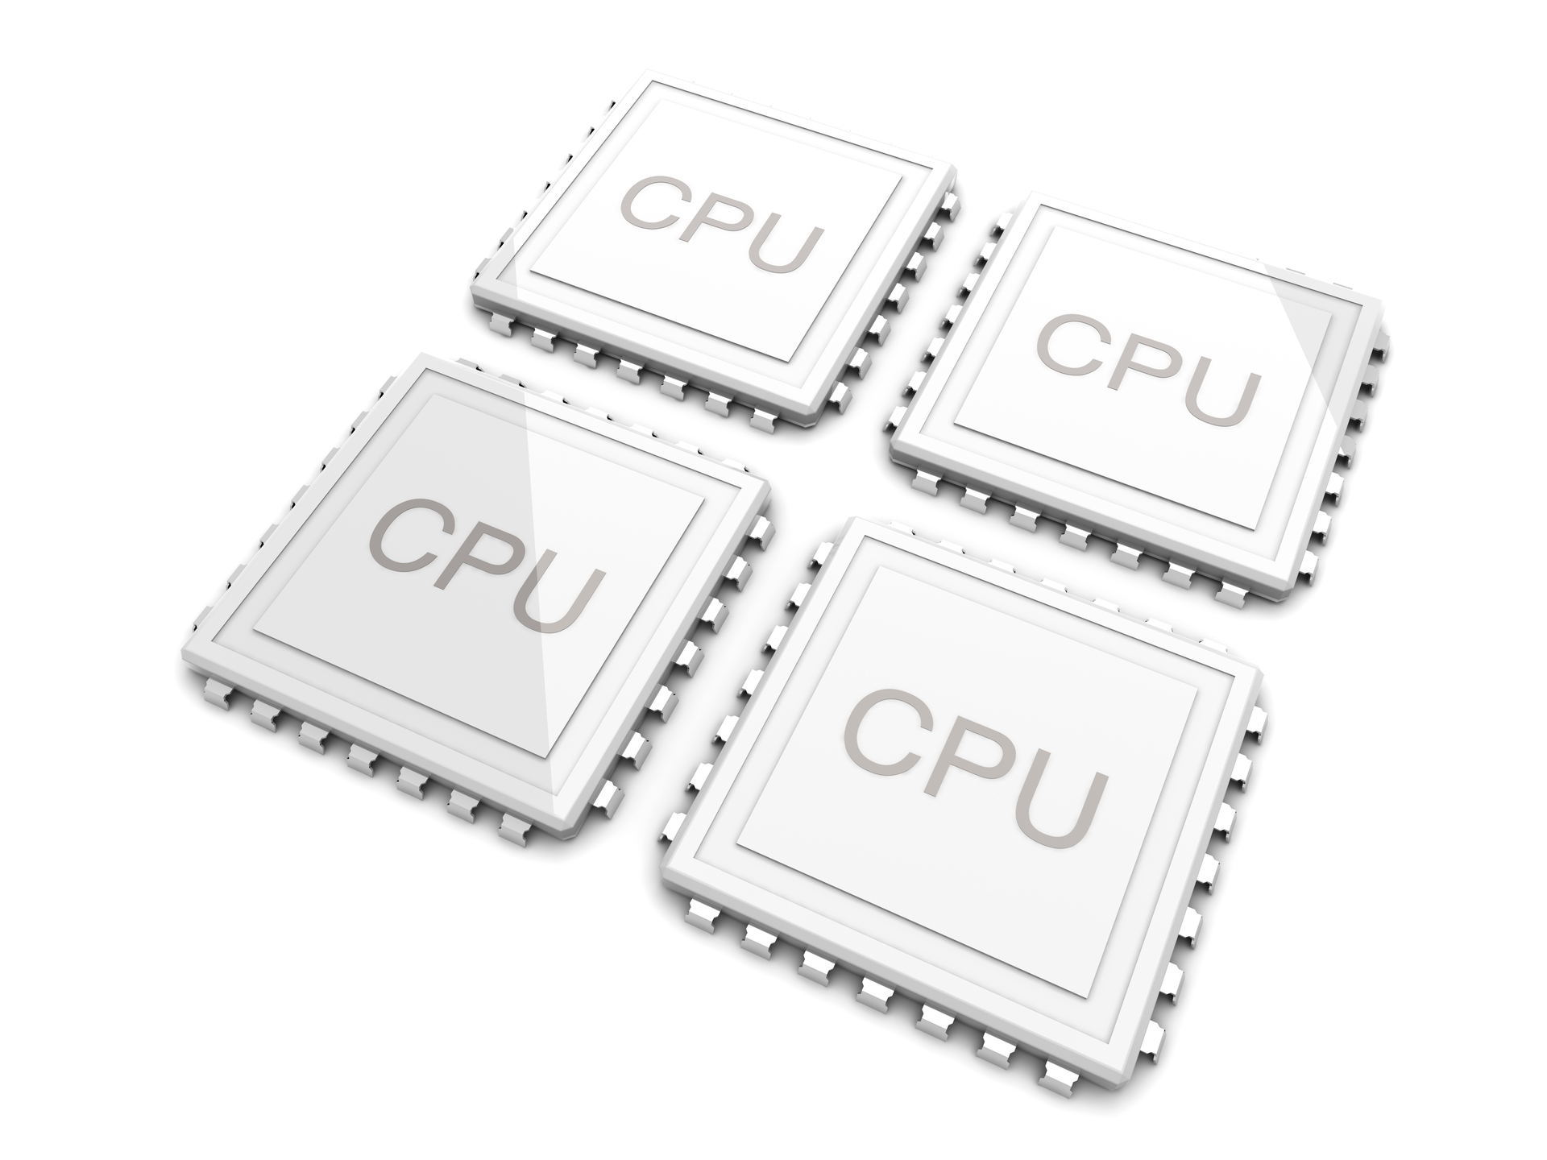
NUMA Machine
Node
Shared interconnect
CPUs have some amount of local memory, which is much faster
They are also organized into clusters.
A CPU can access all memory: intra-cluster and inter-cluster
Accesses to intra-cluster memory is much faster.
This is a non-uniform memory access machine (NUMA machine)
Each cluster is known as a node

Slide 42

Is all physical memory in a node the same?
https://lwn.net/Articles/789304/
Partition the physical memory space (in a node) into zones
Treat the frames (physical pages) in each zone differently.
The zones may themselves be stored on different devices.
I/O Devices may need a dedicated region (assign a zone)
Zone
one-to-one
PFN
struct page
There is a mem_map for each section that stores this mapping
mem_section
sections

Slide 43
Physical Memory Zones in Linux
/include/linux/mmzone.h
enum zone_type {
ZONE_DMA,
ZONE_NORMAL,
#ifdef CONFIG_HIGHMEM
ZONE_HIGHMEM,
#endif
ZONE_MOVABLE,
#ifdef CONFIG_ZONE_DEVICE
ZONE_DEVICE,
#endif
__MAX_NR_ZONES
};
Physical pages that are accessible only by the DMA controller
Normal frames
Useful in systems where the physical memory exceeds the size of max virtual memory.
It is assumed that the corresponding memory device may be removed at any point of time and possibly re-inserted later.
These frames are stored in novel memory devices like NVM devices.

Slide 44
struct zone
/include/linux/mmzone.h
struct zone {
int node;
struct pglist_data *zone_pgdat;
unsigned long zone_start_pfn;
atomic_long_t managed_pages;
unsigned long spanned_pages;
unsigned long present_pages;
const char *name;
struct free_area free_area[MAX_ORDER];
}
Pointer to the pglist_data structure
zone_end_pfn = zone_start_pfn + spanned_pages- 1
Name of the zone
Free areas in a zone (physical memory)

Slide 45
Data Structure to Manage the Memory in a Zone
/include/linux/mmzone.h
Ordering of zones
typedef struct pglist_data {
struct zone node_zones[MAX_NR_ZONES];
struct zonelist node_zonelists[MAX_ZONELISTS];
int nr_zones;
unsigned long node_present_pages;
unsigned long node_spanned_pages;
int node_id;
struct task_struct *kswapd;
struct lruvec __lruvec;
} pg_data_t;
Zones organized hierarchically
Number of pages owned by NUMA node_id
Page swapping daemon
Maintains LRU state information

Slide 46
Outline of this Chapter
Traditional Heuristics
Virtual and Physical Address Spaces
Page
Management
Kernel Memory Allocation

Slide 47

Required Background
Bloom Filters
PI Controller
Reverse Maps

Slide 48

Inserting a Key in a Bloom Filter
Background
A data structure that answers if an element is a member of a set (probabilistically)
Map a key to k different bit positions using k hash functions
Key
Hash function
Set to 1
H2
H1
H3
H4
1
1
1
1
Array of m bits
Initially all the bits are 0

Slide 49


Checking for Set Membership in a Bloom Filter
Background
Given a key compute the k different hash values (bit positions)
Check that each bit position stores a 1. If at least one bit position stores a 0, then the key is not present.
Elements cannot be deleted unless we store a count at each bit position
We need to periodically reset the Bloom Filter
False positives are allowed
No false negatives

Slide 50
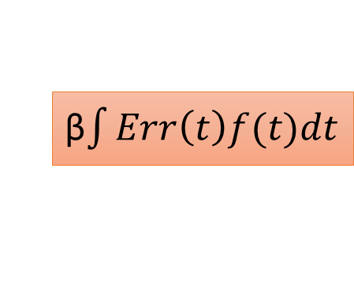
The PI Controller
Background
A refault is a page fault for a page that was evicted (replaced) in the past.
P
αErr(t)
SP
Err(t)
I
Σ
β$\int{Err\left(t\right)f(t)dt}$
Σ
System
PV(t)
Term | Meaning | Explanation in this context
P term | Proportional part | refaulted/ (evicted + pinned)
I term | Integral part | Exponential moving average of P (factor = ½)
SP | Set point | Refault rate of the first tier of ANON
PV | Process variable | Refault rate of the first tier of FILE
Both should be the same (target)

Slide 51
Error Term
Background
err = (pv->refaulted < 64 )||
pv->refaulted /pv->total * swappiness <=
(sp->refaulted + 1) / (sp->total + 64)* (200 – swappiness)
err = 1 if
Too few pages have refaulted (< 64)
The refault rate (refaulted/total) is lower than the set point (subject to the swappiness)
The swappiness is close to 0 (low)

Slide 52
Reverse Mapping (called from shrink_folio_list)
Background
Reverse map (rmap)
struct page
List of PTEs
While freeing a page (or folio), we need to consider the possibility of it being mapped to multiple address spaces (across processes)
We would thus need to create a reverse map (rmap)
  Map a struct page (or folio) to PTEs across processes
  Swapping out a folio requires a rmap walk
  Each PTE entry needs to be processed
The idea is to efficiently associate a list of vma regions with each PTE

Slide 53
Reverse Mapping – II
Background
A stub that pages point to
struct page
mapping field
anon_vma
mapping field
Per-process VM region
struct page
anon_vma_chain
vma
pages in the same vma
Key data structure that links the vmas of multiple processes that all point to the same set of physical pages

Slide 54
Multi-process View
Background
Parent process
Child process 1
page
anon_vma
page
anon_vma
page
vma
page
vma
anon_vma_chain
anon_vma_chain
anon_vma_chain
COW pages
Child process 2
anon_vma_chain
page
anon_vma
page
vma
anon_vma_chain
non-COW pages

Slide 55
anon_vma_fork in mm/rmap.c
Background
Justification of the complex structure →
The rest of the code relies on this structure
vma
anon_vma_chain
anon_vma
What is the need for the extra anon_vma_chain associated with a child process?
An anon_vma_chain is associated with a single anon_vma
We need one to point to the parent process’s pages (via the corresponding anon_vma) that are also mapped to the child (COW pages). This is the job of the extra anon_vma_chain.
The other one is needed for child pages in a vma to point to. These pages exclusively belong to the child.

Slide 56

Go forward

Slide 57
Page Replacement
https://elixir.bootlin.com/linux/latest/source/Documentation/mm/multigen_lru.rst
New MG-LRU page replacement algorithm
Objectives of a page replacement algorithm.
Leverage temporal locality
Take advantage of spatial locality
Use the slow path-fast path approach
Simple heuristics that are well-suited to all kinds of workloads

Slide 58
/include/linux/mmzone.h
struct lruvec {
struct pglist_data *pgdat;
unsigned long refaults [ANON_AND_FILE];
struct lru_gen_struct lrugen;
struct lru_gen_mm_state mm_state;
};
Number of refaults
age at least min_ttl ms after min_seq is created
struct lru_gen_struct {
unsigned long max_seq;
unsigned long min_seq[ANON_AND_FILE];
unsigned long timestamps[MAX_NR_GENS];
struct list_head
lists[MAX_NR_GENS][ANON_AND_FILE][MAX_NR_ZONES];
};
Latest
Oldest: separate for anon and file types

Slide 59
lru_gen_mm_state
/include/linux/mmzone.h
struct lru_gen_mm_state {
unsigned long seq;
struct list_head *head;
struct list_head *tail;
unsigned long *filters[NR_BLOOM_FILTERS];
int nr_walkers;
};
Current sequence number
tail has finished. continue at head
list of Bloom filters
#page walkers
mm
mm
mm
mm
Array of mm_struct
objects

Slide 60

/mm/vmscan.c
The basic idea of compressing the memory footprint
Iterate through the list of zones
Shrink each zone
https://lwn.net/Articles/419713/
Multi-Gen LRU Algorithm
A group of pages is associated with a generation.
The generation indicates recency of access.
Take the priority of pages into account. Prefer unmapped and clean pages.
Evict pages in the oldest generation (min gen) and also take the priority into account

Slide 61
Tracking Accesses
/arch/x86/include/asm/pgtable.h
Needed to maintain generations
pte_t pte_mkold(pte_t pte)
{
return pte_clear_flags(pte, _PAGE_ACCESSED);
}
This function is called by a bunch of functions that walk the page table
The key idea is to clear the _PAGE_ACCESSED bit in the PTE entry
The next time that the HW accesses this page
  It can either raise a page fault
  OR set the bit itself (directly)
A second scan of this memory region will indicate, which pages have been accessed.
Indicator of recency

Slide 62
When do we age and subsequently evict?
kswapd
This is a daemon that runs periodically: ages and reclaims pages
Call to page allocation routines
If there are not enough free pages, then attempt is made at compaction.
All the zones are shrunk by aging and reclaiming pages
A call is made to the function evict_folios
Reclaim pages after file-based memory operations finish
Transfer the contents of buffers
Read/write files
vmscan.c

Slide 63
Should we run the Aging Algorithm?
should_run_aging(...)
Youngest generation number: lrugen->maxseq
Oldest generation number: lrugen->minseq[ANON] and lrugen->minseq[FILE]
When max_seq – min_seq + 1 <= MIN_NR_GENS, increment max_seq
Given that max_seq and min_seq increase monotonically, not incrementing the sequence of a folio automatically ages it
A sliding window of generations is maintained. It tracks [MIN_NR_GENS, MAX_NR_GENS] generations
Triggered by a call to age the lruvec and reclaim pages

Slide 64
The Aging Process of Pages
/mm/vmscan.c
Corner case
Too many young pages.
if (young * MIN_NR_GENS > total)
return true;
if (old * (MIN_NR_GENS + 2) < total)
return true;
return false;
max_seq – min_seq == MIN_NR_GENS
Too few old pages.
Sliding window
minseq
maxseq
Note the definition
In this function, young page’s gen == max_seq
old page’s gen == min_seq

Slide 65
The Aging Process Triggers walk_mm
Walk through all the mm_structs
Walk through the individual page tables
Skip a PMD’s pages if
Its pages are predominantly unaccessed
Use a Bloom filter for this purpose
walk_pte_range (walking the PTEs)
Skip unaccessed pages
For the rest, clear the accessed bit and set the generation of the folio to max_seq

Slide 66
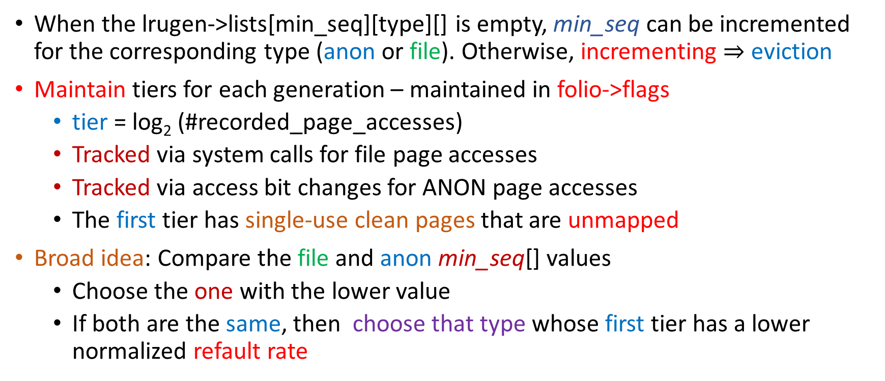
Eviction Algorithm
Overview
When the lrugen->lists[min_seq][type][] is empty, min_seq can be incremented for the corresponding type (anon or file). Otherwise, incrementing $⇒$ eviction
Maintain tiers for each generation – maintained in folio->flags
  tier = log₂ (#recorded_page_accesses)
  Tracked via system calls for file page accesses
  Tracked via access bit changes for ANON page accesses
  The first tier has single-use clean pages that are unmapped
Broad idea: Compare the file and anon min_seq[] values
  Choose the one with the lower value
  If both are the same, then choose that type whose first tier has a lower normalized refault rate
Typically in the page cache: SW cache for pages read from the disk
Evict the oldest generation

Slide 67
evict_folios (lruvec, int swappiness, ....)
Main function called from shrink_zones
Hyperparameter, typical value: 60
scanned = isolate_folios (lruvec, swappiness, ... )
Identify the folios that can possibly be evicted.
Reclaim pages by calling shrink_folio_list
Try to remove the folios that have been identified. It is possible that a folio is mapped to multiple processes.
Do additional bookkeeping and account for all corner cases.

Slide 68

evict_folios → isolate_folios
/mm/vmscan.c
Find the type that should be evicted
type
ANON = 0, FILE = 1, ANON_AND_FILE = 2
if (!swappiness)
type = LRU_GEN_FILE;
else if (min_seq[LRU_GEN_ANON] < min_seq[LRU_GEN_FILE])
type = LRU_GEN_ANON;
else if (swappiness == 1)
type = LRU_GEN_FILE;
else if (swappiness == 200)
type = LRU_GEN_ANON;
else
type = get_type_to_scan(lruvec, swappiness, &tier);
Default if swappiness = 0
ANON is older
Choose FILE if swappiness = 1
Choose ANON if swappiness = 200

Slide 69
get_type_to_scan (lruvec, swappiness, int *tier_idx)
Collect the number of total and refault accesses
Choose the type that has the lower normalized refault rate
Set point is ANON, tier = 0
int gain[ANON_AND_FILE] = {swappiness, 200 - swappiness};
read_ctrl_pos(lruvec, LRU_GEN_ANON, 0, gain[LRU_GEN_ANON], &sp);
read_ctrl_pos(lruvec, LRU_GEN_FILE, 0, gain[LRU_GEN_FILE], &pv);
type = positive_ctrl_err(&sp, &pv);
return type; /* If (Error = 1) return FILE else ANON */
PI cntrl
The process variable: refault rate of tier=0 for FILE
logic for comparing the normalized refault rate

Slide 70
The rest of the isolate_folios function
for (i = !swappiness; i < ANON_AND_FILE; i++) {
if(scanned = scan_folios(lruvec, type, list, …) break;
/* reset the type*/
return scanned;
}
Check if there are evictable folios and return the number of such folios
more about scan_folios

Slide 71

evict_folios → isolate_folios → scan_folios
scanned
scanned
list
list
Iterate through the zones that need to be shrunk (order: descending)
  Iterate through all the folios pointed to by
  lrugen->lists[min_seq][type][zone]
    Check that the folio can be evicted
    If the folio is pinned, is being written back, was recently accessed, or there is a race condition, skip it
Return the number of pages that can possibly be evicted, and a list of folios
  This is the variable scanned
  list variable → list of possibly evictable folios

Slide 72

More about scan_folios
Does some additional computation
tier at which the tier’s refault rate is higher
Increment the generations of folios in these tiers when they are scanned
lower normalized refault rate
Type chosen for
eviction (FILE/
ANON)
tier 0
tier 1
tier 2
tier 3
tier 4
>
>
>
<
Other type
tier 0
tier 1
tier 2
tier 3
tier 4
Even if the generation is min_seq, if the folio is in a higher tier, give it another chance by incrementing its generation

Slide 73

evict_folios → shrink_folio_list
We have a list of folios that can possibly be evicted
Perform basic bookkeeping. Take the number of reclaimed pages into account.
Folios that are in the process of being written back may stall this process. Wait.
Given a folio that needs to be evicted
  Look around nearby addresses: lru_gen_look_around
  Mark a few old (clear the access bit)
  Note down PMD entries that point to primarily young (recently accessed) pages (in the Bloom filter)
Split large folios into smaller folios (for performance reasons)
Free buffers, flush the corresponding entries from the TLB, write back

Slide 74

lru_gen_look_around: main input vm_area
Consider the memory space that is mapped by one entry in the PMD
Further limit the size of the considered region to 64 pages
Iterate through all the pages
  If it is an old page (not recently accessed) continue.
  Get the folio associated with the page
  Mark the page old (clear its access bit)
  If the folio’s generation ≠ max_seq, record the page number in a bitmap
If the number of young pages is more than a certain threshold record the PMD number in the Bloom filter (makes page walking more efficient)
Set the folios of the pages (recorded in the bitmap) to the latest generation (max_seq) and do the rest of the bookkeeping.

Slide 75
How do we use the Bloom filter (subsequently)?
kswapd, sequential write commands, and page allocation modules try to age and evict pages.
They call the function walk_mm() that walks the page table and marks young (accessed) entries as old (unaccessed), as well as updates the generation of young entries.
Entries that are already old are skipped.
While walking the PMD tables, test if the PMD address is in the Bloom filter. If it is not there, then the PMD range is most likely old and should be skipped. Improves performance.

Slide 76
Miscellaneous Topics: Thrashing
There is a need to keep the working set in memory
Don’t evict a page that is less than N ms old in memory
N = 1000 is practically a good value for GUI-based applications
If the working set cannot be maintained in memory
  The OOM killer (out-of-memory) comes into action and terminates applications
The behavior is configurable (hyperparameters)
MIN_NR_GENS
MAX_NR_GENS
swappiness

Slide 77
Outline of this Chapter
Traditional Heuristics
Virtual and Physical Address Spaces
Page
Management
Kernel Memory Allocation

Slide 78
Buddy Allocation
To manage the physical memory, the buddy allocation technique is used in the kernel
It can provide physical memory chunks of arbitrary sizes to processes
It now has more relevance given the prevalence of folios
128 KB
Total memory size
How do we allocate a 20 KB chunk?

Slide 79
Allocation using the Buddy Allocator
After some time
128 KB
128 KB
64 KB
64 KB
64 KB
64 KB
32 KB
32 KB
32 KB
32 KB
Full
Allocate 20 KB
Allocated 20 KB
Now delete the 20 KB chunk

Slide 80
Contd ….
128 KB
page
buddy
64 KB
64 KB
The size of each buddy chunk is a power of two
Adjacent free chunks (holes) can be merged
Tries to minimize internal and external fragmentation
Can handle requests for both small and large regions
Create a data structure to effectively manage the buddy list

Slide 81
Implementation of the Buddy System
struct zone {
...
struct free_area free_area[MAX_ORDER];
...
}
struct free_area {
struct list_head free_list[MIGRATE_TYPES]; /* unmovable, movable, reclaimable, ...*/
unsigned long nr_free;
};
list of order 0
zone
free_area
list of order 1
List of buddy pages
list of order 2

Slide 82
Traverse the free_area with an increasing order
/mm/page_alloc.c
__rmqueue_smallest (…)
for (current_order = order; current_order < MAX_ORDER; ++current_order) {
area = &(zone->free_area[current_order]);
page = get_page_from_free_area(area, migratetype);
if (!page)
continue;
del_page_from_free_list(page, zone, current_order);
return page;
}
Traverse the list of free pages: order=0 to order = MAX_ORDER – 1
Pick the first free compound page (from the first list that is non-empty)
Delete the selected page from the corresponding free list

Slide 83
Merging free Pages
/mm/page_alloc.c
void __free_one_page(struct page *page, unsigned long pfn,
struct zone *zone, unsigned int order, ...)
{
while (order < MAX_ORDER - 1) {
buddy = find_buddy_page_pfn(page, pfn, order, &buddy_pfn);
del_page_from_free_list(buddy, zone, order);
....
combined_pfn = buddy_pfn & pfn;
page = page + (combined_pfn - pfn);
pfn = combined_pfn;
order++;
}
set_buddy_order(page, order);
add_to_free_list(page, zone, order, migratetype);
}
buddy_pfn = pfn ^ (1 << order)
Not free any more
pfn of the parent
Details of combined_pfn
Set the order of the large combined_page and free it

Slide 84
Slab Allocator
Dedicated object cache
The buddy system is for generic memory allocation
Most of the time objects of specific types are used. They have a fixed structure.
  No reason to allocate and deallocate them.
  Take up a large memory region and use it for dedicated object storage (of only one type)
  For fast access, keep a cache of pre-initialized objects
  Use and return → Similar to a pool of objects
Terms:
slab
cache
chunk

Slide 85
The Kernel has Three Object Allocators
SLOB Allocator
Old Solaris-based allocator that uses the first-fit method.
SLAB Allocator
Most popular allocator.
Better performance, scalability and simpler
SLUB Allocator

Slide 86
Slab Allocator
per cpu
One cache for an object type
per cpu
slab
array_cache
kmem_cache
slab_cache
array_cache
free_list: array of free object indexes
ctor: object constructor function
entry[] → recently freed objects
s_mem
kmem_cache_node* node [NUMA_NODES]
slab
slab
slab
slab
slab
slab
object
slab
slab
full
slab
full
object
partial
free
slab
slab
object
slab
kmem_cache_node
memory_region

Slide 87
Quick Explanation of the SLAB scheme
A dedicated region of the physical memory and the kernel’s virtual memory stores slabs
Every slab corresponds to a region of physical memory (set of contiguous physical pages)
The kmem_cache is the key data structure that maintains all the slabs for a given object type. The external world only interacts with the kmem_cache
  It maintains a list of slabs in three different states: full, free, and partial
  This list is specific to each NUMA node
  It also holds a per-cpu cache of free objects that can quickly be allocated
  There are few kmem_cache structures in the system for storing very frequently used objects that are not allocated and deallocated every time they are used

Slide 88
Slub Allocator
per cpu
kmem_cache
kmem_cache_cpu
void ** freelist: pointer to free objects
kmem_cache_cpu *cpu_slab
slab
slab_cache
uint object_size
struct slab *slab
inuse:objects:frozen
ctor: object constructor function
freelist: first free object
slab
kmem_cache_node * node [NUMA_NODES]
object usage counters
Return empty slabs to the memory system.
Forget about full slabs.
slab
slab
slab
partial
kmem_cache_node

Slide 89
Quick Explanation of the SLUB Allocator
Much simpler than the SLAB allocator (still uses the notion of slabs)
Here also, the kmem_cache is the key data structure that is visible to the external world
In a slab → Maintain a freelist (object pointers)
In the kmem_cache → Maintain an array of per-cpu slabs
  One slab per CPU
  Just maintain the list of partial slabs in a kmem_cache (a single list)
  Basically means: forget about full and totally free slabs
  free slabs are returned to the regular memory allocation system
  When an object is freed in a full slab, add the full slab to the partial slab list

Slide 90
Bibliography
Belady, Laszlo A., Robert A. Nelson, and Gerald S. Shedler. "An anomaly in space-time characteristics of certain programs running in a paging machine." Communications of the ACM 12.6 (1969): 349-353.
FIFO anomaly is unbounded, arXiv:1003.1336

Slide 91


srsarangi@cse.iitd.ac.in

